Slide 1
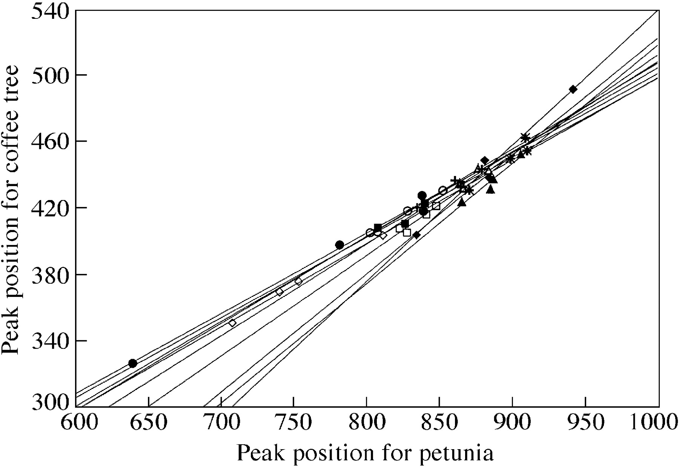
Fig. 1. Within‐tree relationships comparing the standard peak location (P‐PI) and the coffee peak location ...
Notes:
Fig. 1. Within‐tree relationships comparing the standard peak location (P‐PI) and the coffee peak location (C‐PI). Each symbol represents one tree.
Unless provided in the caption above, the following copyright applies to the content of this slide:

Slide 2
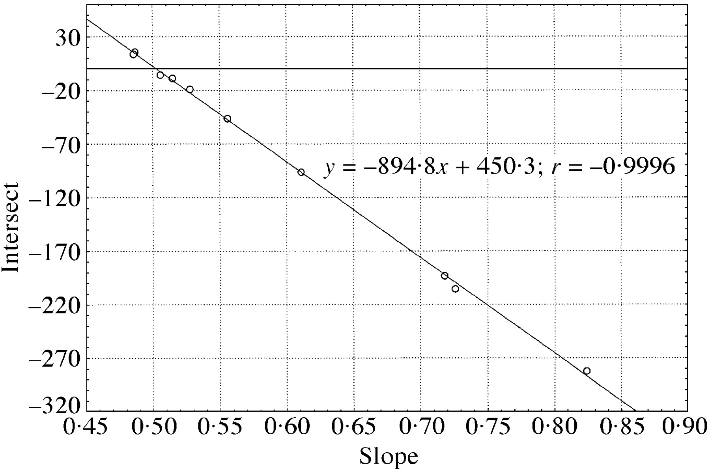
Fig. 2. Relationship between slopes and intersects for within‐tree linear regressions intersecting at one ...
Notes:
Fig. 2. Relationship between slopes and intersects for within‐tree linear regressions intersecting at one point (450·3; 894·8).
Unless provided in the caption above, the following copyright applies to the content of this slide:

