Slide 1
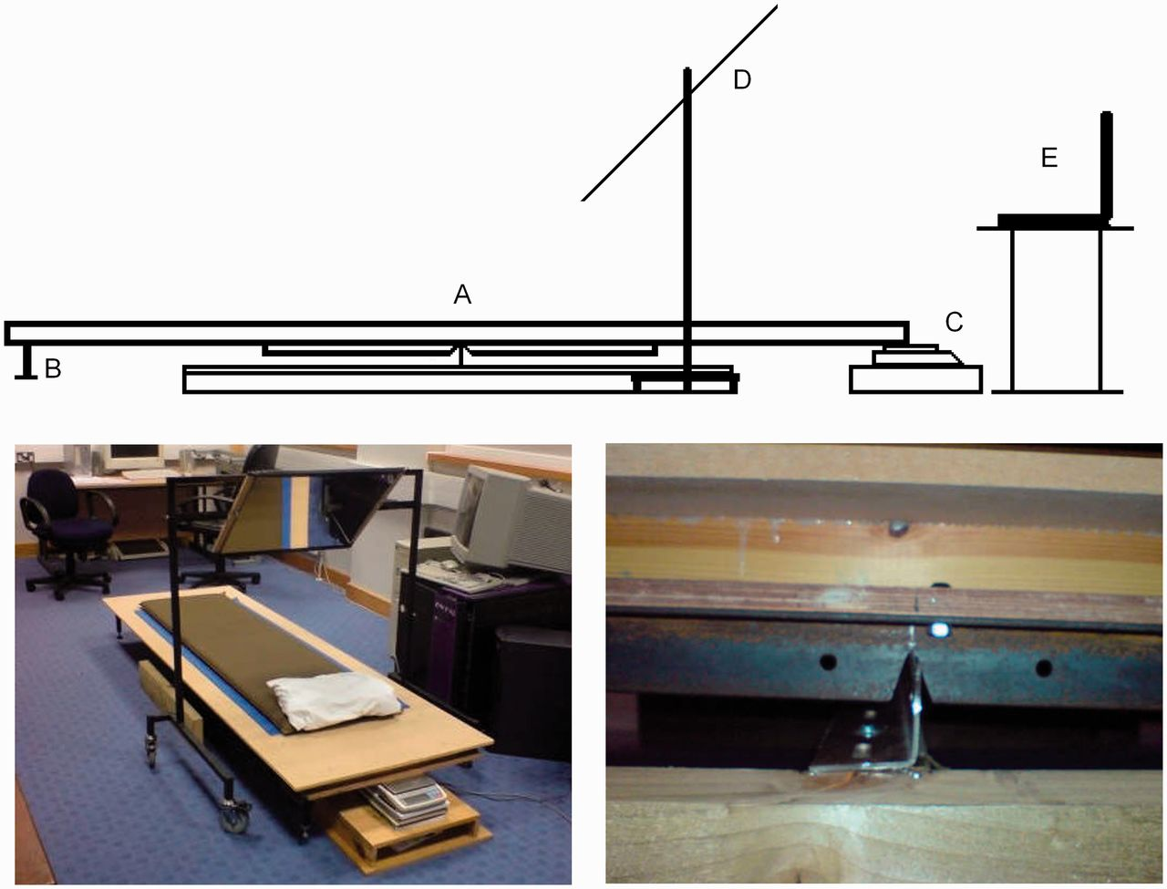
Figure 1 The balance consisted of a wooden board, reinforced longitudinally with two lengths of angle iron. A low ...
Notes:
Figure 1 The balance consisted of a wooden board, reinforced longitudinally with two lengths of angle iron. A low friction pivot point (A) was created in the middle of the board by cutting an inverted ‘V’ into the two lengths of angle iron. This allowed the board to be mounted on a third perpendicular piece of angle iron with a ground upper edge, the whole system comprising a ‘knife edge’ bearing. To stop the board from tipping excessively, a stop (B) was positioned at one end of the board, which was always the end where the participants’ legs and feet were located. When a participant was first placed on the balance it was ensured by the use of weights that the barycentre was to the foot-end of the fulcrum so that the balance rested on the stop. Electronic scales (C) with 0.001 N (newtons) resolution, and a sample rate of 10 Hz were then positioned underneath the head. The head was positioned at the far end of the balance regardless of the height of the participant. Weight was then removed from above (B) until the scales registered ∼2 N, indicating that the barycentre was now towards the head-end of the fulcrum. To allow presentation of visual stimuli, a mirror (D) was positioned above the participant that allowed the participant to view a computer screen (E). Participant comfort was enhanced by provision of a pillow and two layers of foam mats. The left-hand photo shows the whole apparatus. Note that during data collection the pillow was positioned at the end of the balance, so that the head was above the scales. The right-hand image shows the fulcrum mechanism (A).
Unless provided in the caption above, the following copyright applies to the content of this slide: © The Author (2014). Published by Oxford University Press on behalf of the Guarantors of Brain. All rights reserved. For Permissions, please email: journals.permissions@oup.com

Slide 2
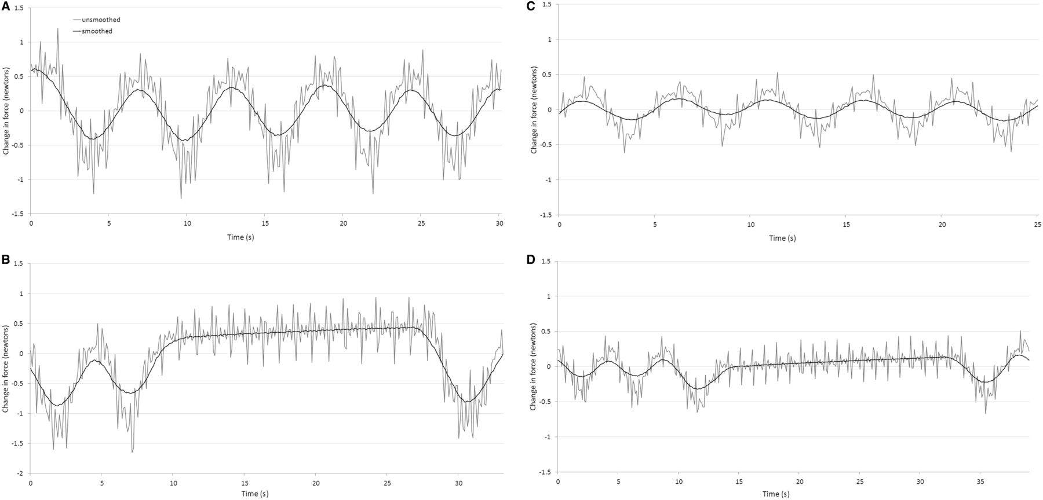
Figure 2 The force exerted on the scales positioned beneath the head as a function of time while a participant was at ...
Notes:
Figure 2 The force exerted on the scales positioned beneath the head as a function of time while a participant was at rest (A). A large oscillation produced by motion of the diaphragm relative to the fulcrum is clearly visible. Smoothing the data with a 3 s Hanning window reduces high frequency oscillations that we attribute to components of the cardiac cycle. During a 20 s breath hold after exhalation (B) the diaphragm oscillation ceases and a steady increase in force exerted is observable as blood was redistributed away from the fulcrum towards the head. In (C) and (D), comparable observations are presented for a second participant. Change in newtons is relative to the mean of the data series.
Unless provided in the caption above, the following copyright applies to the content of this slide: © The Author (2014). Published by Oxford University Press on behalf of the Guarantors of Brain. All rights reserved. For Permissions, please email: journals.permissions@oup.com

Slide 3
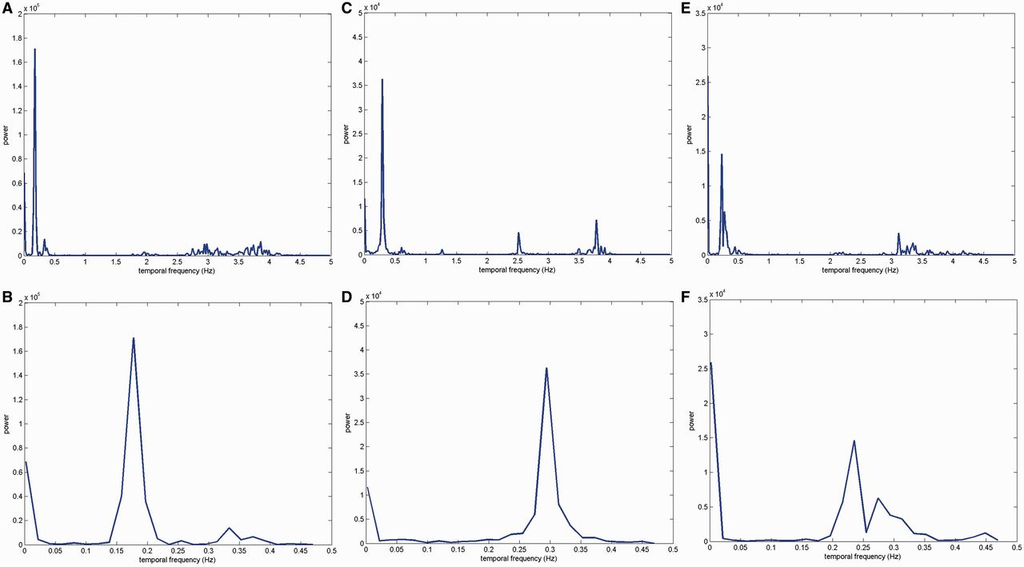
Figure 3 Representative power spectrums from fast Fourier transform of three participants’ data who took part in the ...
Notes:
Figure 3 Representative power spectrums from fast Fourier transform of three participants’ data who took part in the resting state experiment. (A, C and E) Frequencies up to 5 Hz. Spikes in the power spectrum at ∼2–4 Hz are probably caused by components of the cardiac cycle. A large peak at ∼0.15–0.30 Hz is caused by the periodic motion of the diaphragm during respiration. (B, D and F) These zoom in on the lower temporal frequencies revealing a concentration of power at ∼0.01–0.02 Hz. Based on analysis of six participants we concluded that the balance would be suitable to detect an uncontaminated experimental signal with a frequency of 0.04 Hz (Fig. 4).
Unless provided in the caption above, the following copyright applies to the content of this slide: © The Author (2014). Published by Oxford University Press on behalf of the Guarantors of Brain. All rights reserved. For Permissions, please email: journals.permissions@oup.com

Slide 4
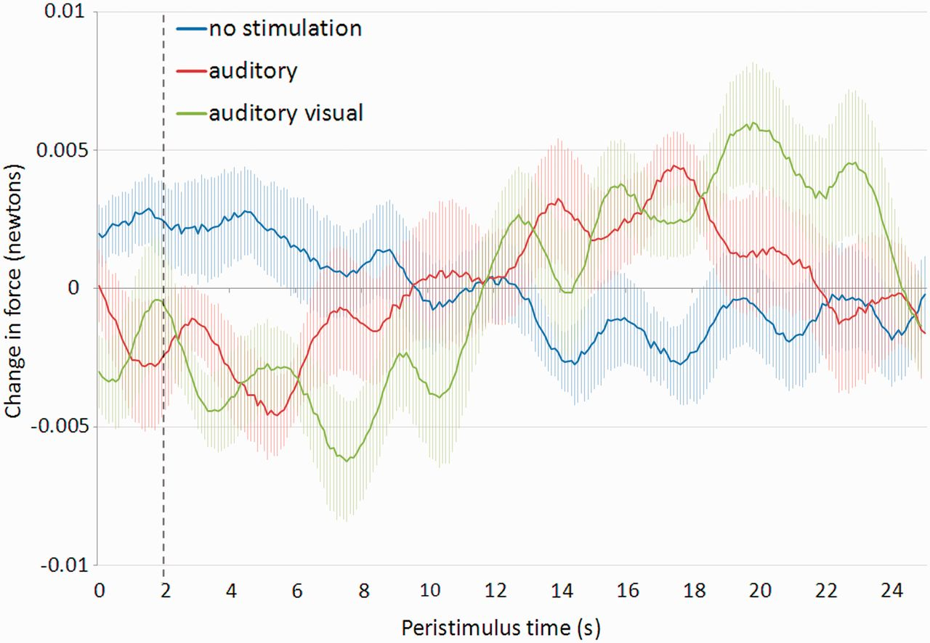
Figure 4 Peri-stimulus time plots averaged across 14 participants from the functional experiment. Stimulation occurred ...
Notes:
Figure 4 Peri-stimulus time plots averaged across 14 participants from the functional experiment. Stimulation occurred between 0 and 2 s for the auditory (red) and combined visual and auditory (green) conditions. In the baseline condition (blue) there was no stimulation. The end of the stimulation period is indicated by the dashed line. Raw data for each participant was preprocessed by removing the linear drift and demeaning, followed by smoothing out the respiration and cardiac signals using a 12 s Hanning window. Event-related averages were created for each condition for each individual to feed forward to the group average. For each data series change in force exerted is relative to the mean of that data series. Error bars represent ± 1 standard error based on between-participant variation.
Unless provided in the caption above, the following copyright applies to the content of this slide: © The Author (2014). Published by Oxford University Press on behalf of the Guarantors of Brain. All rights reserved. For Permissions, please email: journals.permissions@oup.com

