Slide 1
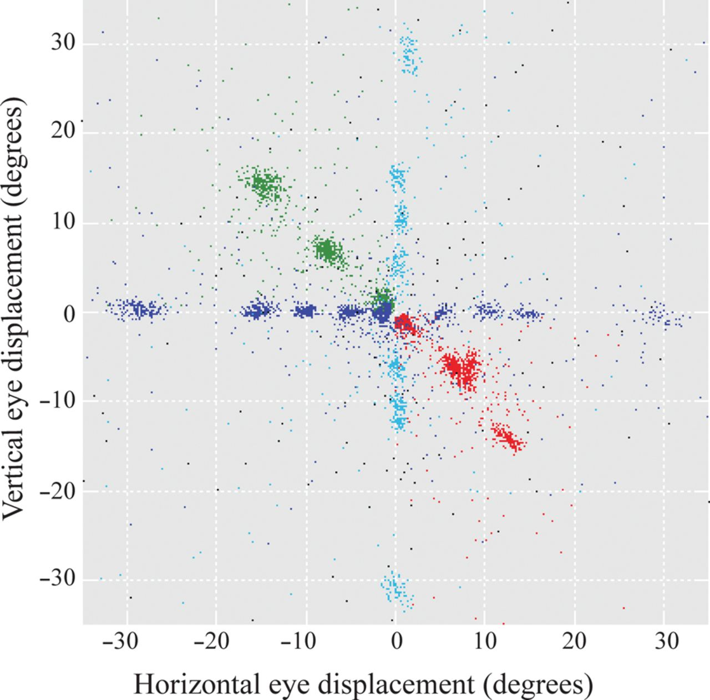
Figure 1. Scatterplots of the horizontal (abscissa) and vertical (ordinate) eye displacements (in degrees) of all ...
Notes:
Figure 1. Scatterplots of the horizontal (abscissa) and vertical (ordinate) eye displacements (in degrees) of all saccades executed by the seven experimental monkeys we studied during the critical first 10 min of the 14C-DG experiment. Dark blue dots represent horizontal, light blue dots vertical, green dots oblique upward, and red dots oblique downward saccades to visual targets. Moreover, black dots represent the saccades executed by the control in the dark (Cd) monkey.
Unless provided in the caption above, the following copyright applies to the content of this slide: © The Author 2014. Published by Oxford University Press. All rights reserved. For Permissions, please e-mail: journals.permissions@oup.com

Slide 2
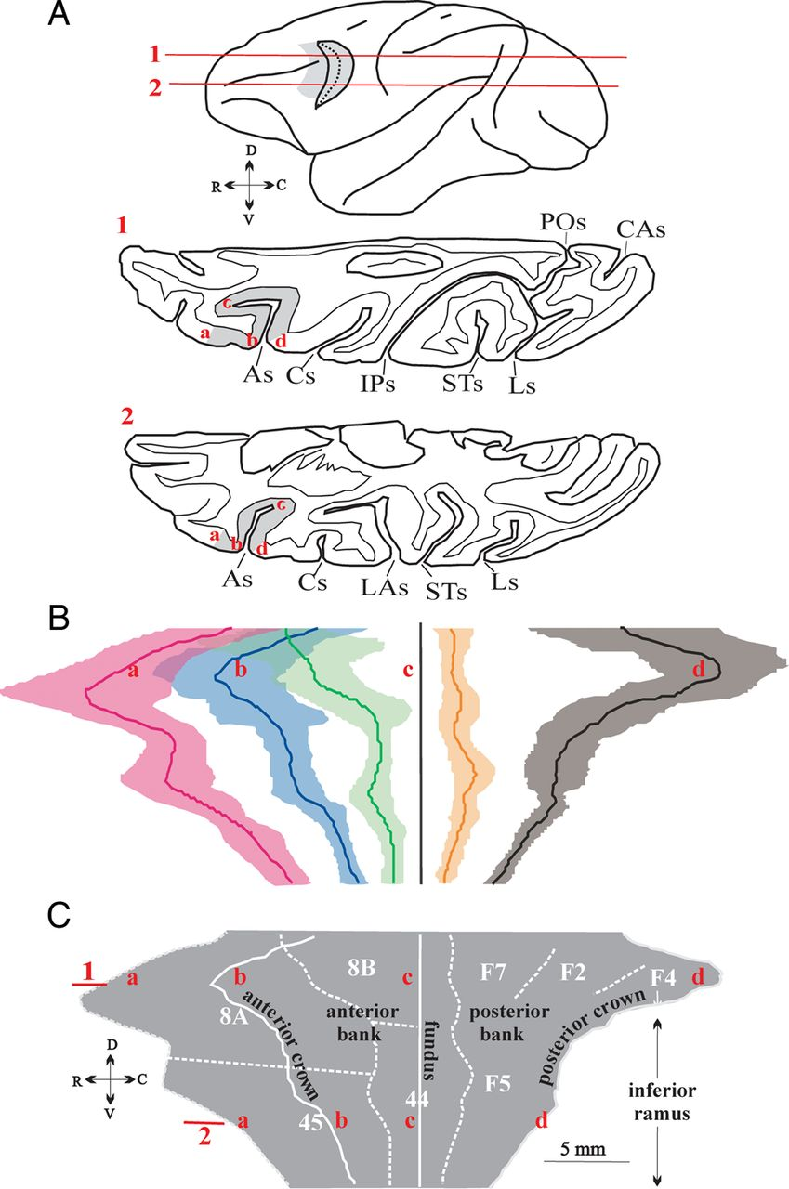
Figure 2. Two-dimensional reconstruction of the cortex lying in the As and the prearcuate convexity. (A) Schematic ...
Notes:
Figure 2. Two-dimensional reconstruction of the cortex lying in the As and the prearcuate convexity. (A) Schematic representation of two horizontal sections (1 and 2) passing through the left hemisphere at the dorsoventral level indicated on this lateral view of the brain. The gray area (marked with the red letters a through d in A1, 2) indicates the portion of the As and prearcuate convexity that was flattened. Red letters indicate: the anterior border of area 8A (in Section 1) and area 45 (in Section 2) in the frontal convexity (a), the crown of the anterior bank of the As (b), the fundus of the As (c), and the crown of the posterior bank of the As (d). As, arcuate sulcus; Cs, central sulcus, CAs, calcarine sulcus; IPs, intraparietal sulcus; Ls, lunate sulcus, Las, lateral sulcus, POs, parieto-occipital sulcus, Ps, principal sulcus, STs, superior temporal sulcus. (B) Average map of the unfolded As and the prearcuate convexity. Shading represents mean position for each border ± 1 SD calculated from all hemispheres we studied (n = 17) aligned on the fundus of As. Top corresponds to dorsal sections, bottom to ventral sections, left to anterior, and right to posterior sites. Magenta depicts the anterior border of area 8A dorsally and 45 ventrally. Blue: anterior crown of As. Green: posterior border of 8A dorsally and 45 ventrally. Orange: anterior border of F7 dorsally and F5 ventrally. Black: posterior crown of As. Letters a–d (in red) indicate the same landmarks as in A and C. (C) Geometrically normalized 2D map of the unfolded As and the prearcute convexity. Numbers 1, 2 (in red) indicate the dorsoventral location of the sections drawn in A. Solid vertical line indicates the fundus of the As, which was used as the point of alignment of adjacent sections. The part of the reconstruction to the right of the fundus corresponds to the posterior bank of the sulcus harboring premotor areas F2, F7 dorsally, and F5 ventrally. Cytoarchitectonically identified areas 8A and 8B dorsally and area 45 ventrally in the anterior bank of the As and the prearcuate convexity are also shown. Dotted white lines indicate the cytoarchitectonically identified borders of the anatomical areas indicated. Solid white lines indicate surface landmarks, that is, the crowns and fundus of the As. C, caudal; D, dorsal; R, rostral; V, ventral.
Unless provided in the caption above, the following copyright applies to the content of this slide: © The Author 2014. Published by Oxford University Press. All rights reserved. For Permissions, please e-mail: journals.permissions@oup.com

Slide 3
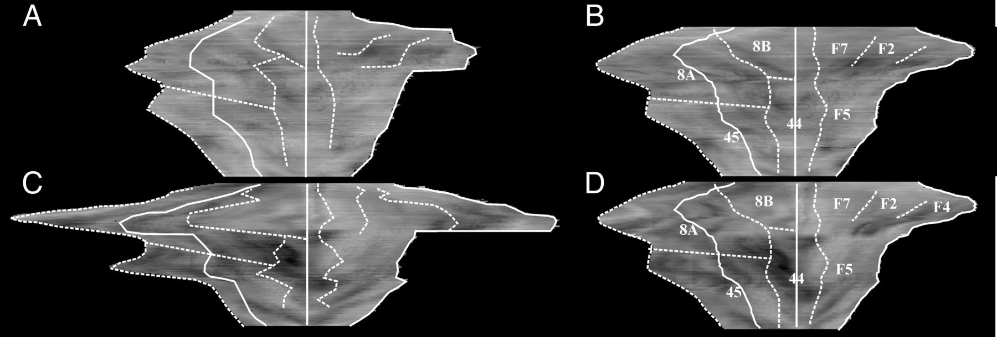
Figure 3. Examples of geometrically normalized 2D maps of the unfolded As and the prearcuate convexity. Maps ...
Notes:
Figure 3. Examples of geometrically normalized 2D maps of the unfolded As and the prearcuate convexity. Maps reconstructed from one hemisphere with small (A,B) and one hemisphere with large (C,D) spur, before (A,C) and after (B,D) geometrical normalization. Map A corresponds to one of the Cd hemispheres and map C to a hemisphere representing the vertical meridian.
Unless provided in the caption above, the following copyright applies to the content of this slide: © The Author 2014. Published by Oxford University Press. All rights reserved. For Permissions, please e-mail: journals.permissions@oup.com

Slide 4
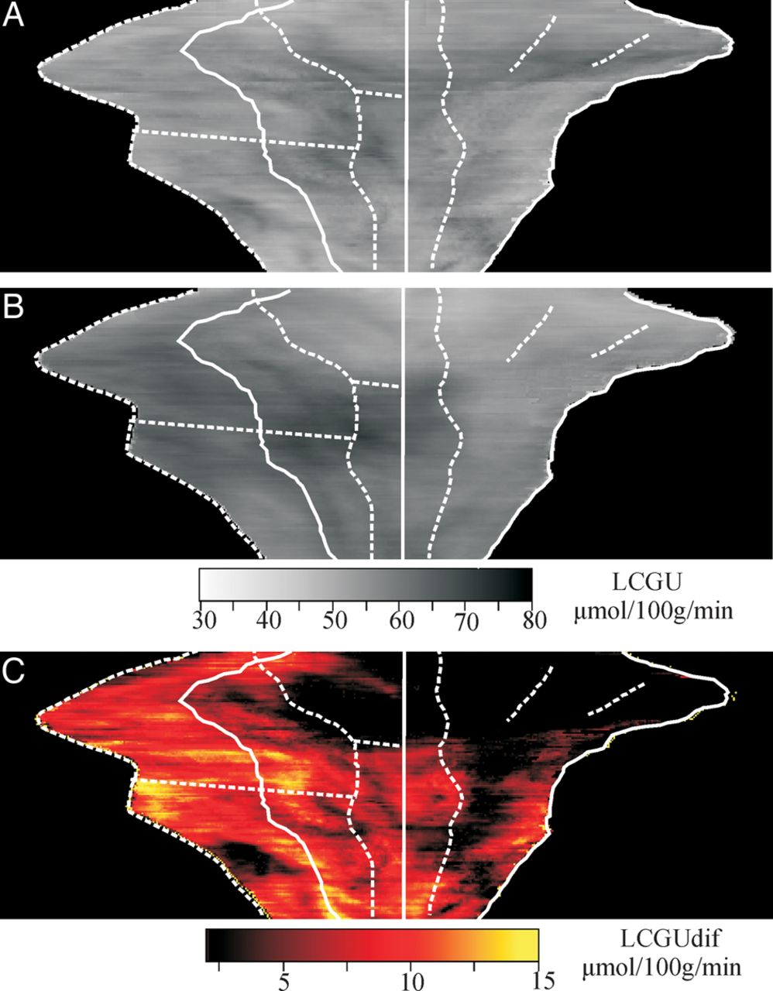
Figure 4. Two-dimensional reconstructed maps of LCGU values (μmol/100 g/min) in the unfolded As and the prearcute ...
Notes:
Figure 4. Two-dimensional reconstructed maps of LCGU values (μmol/100 g/min) in the unfolded As and the prearcute convexity. (A) Quantitative 2D map of metabolic activity obtained after averaging the LCGU values, pixel by pixel, in the geometrically normalized maps of both hemispheres of the Cd monkey. White lines represent anatomical boundaries and surface landmarks as indicated in Figure 2C. (B) Average quantitative 2D map obtained from all hemispheres of all experimental monkeys, including those executing fixation, horizontal, upward, downward, and vertical saccades to visual targets. Gray-scale bar indicates LCGU values in micromoles per 100 g per minute and also applies to (A). (C) Quantitative 2D map of metabolic activity generated after subtracting the average Cd map (A) from the average saccade-related map shown in B. Color bar indicates LCGU difference from the Cd monkey in μmoles/100 g/minute.
Unless provided in the caption above, the following copyright applies to the content of this slide: © The Author 2014. Published by Oxford University Press. All rights reserved. For Permissions, please e-mail: journals.permissions@oup.com

Slide 5
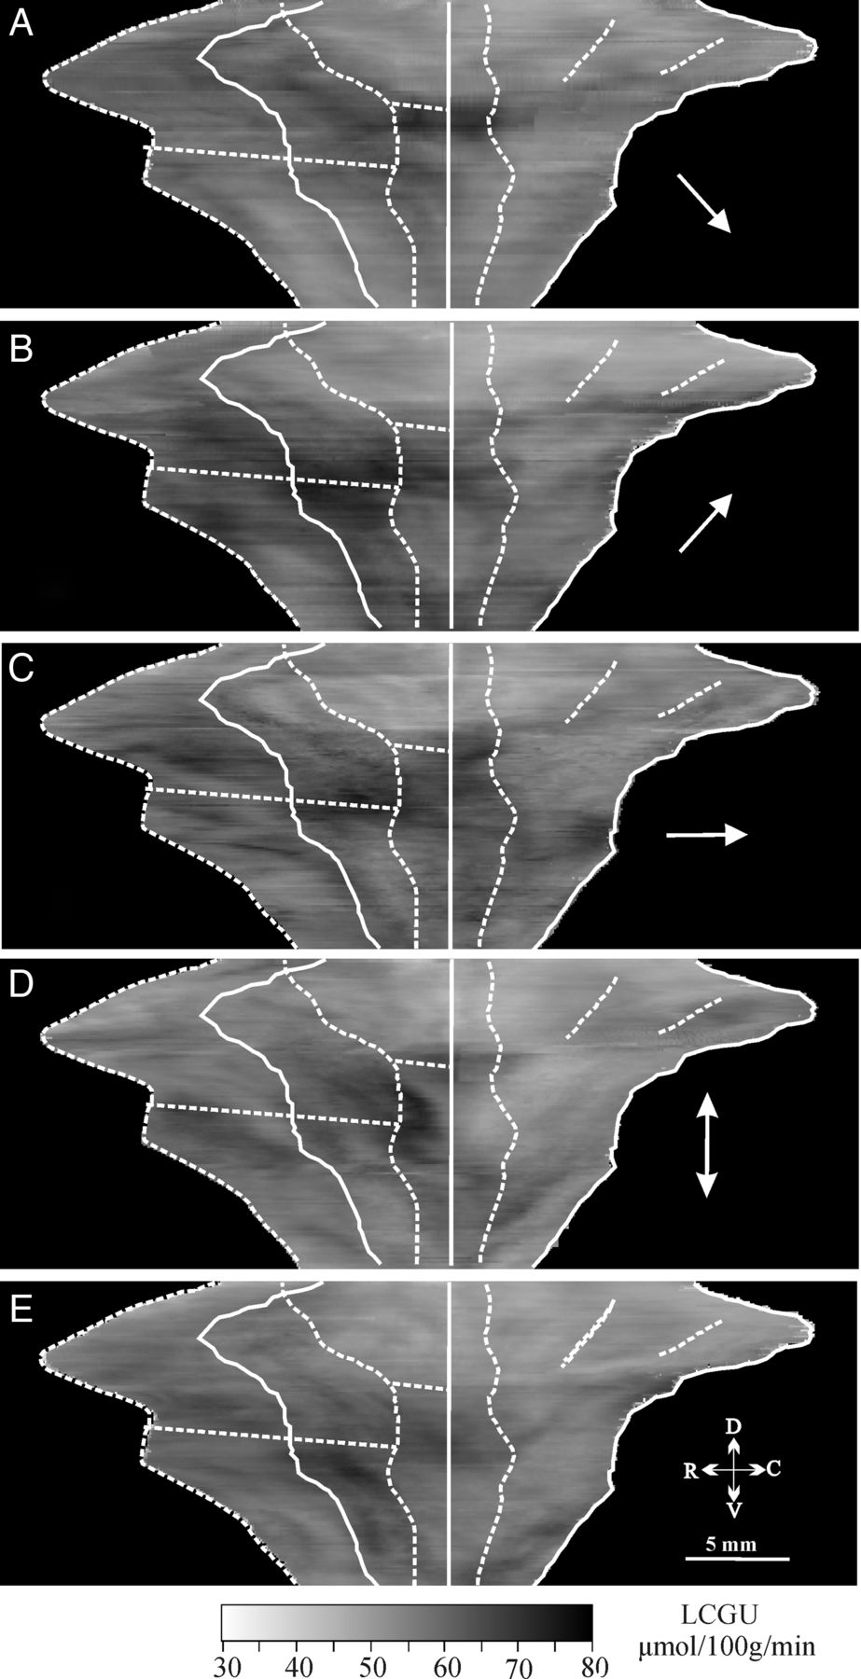
Figure 5. Two-dimensional reconstructions of the distribution of metabolic activity elicited by saccades of different ...
Notes:
Figure 5. Two-dimensional reconstructions of the distribution of metabolic activity elicited by saccades of different directions. (A) Map averaged from the three hemispheres of the monkeys executing contraversive oblique down saccades. (B) Map averaged from the three hemispheres of the monkeys executing contraversive oblique up saccades. (C) Map averaged from three hemispheres of monkeys executing contraversive horizontal saccades. (D) Map averaged from the two hemispheres of a monkey executing vertical up and down saccades. (E) Map averaged from the four hemispheres of the two fixating monkeys (Cf). The gray-scale bar indicates LCGU values in μmoles/100 g/minute. The white arrow in each panel demonstrates the direction of saccades to visual targets executed by the animals contributing to the map illustrated.
Unless provided in the caption above, the following copyright applies to the content of this slide: © The Author 2014. Published by Oxford University Press. All rights reserved. For Permissions, please e-mail: journals.permissions@oup.com

Slide 6
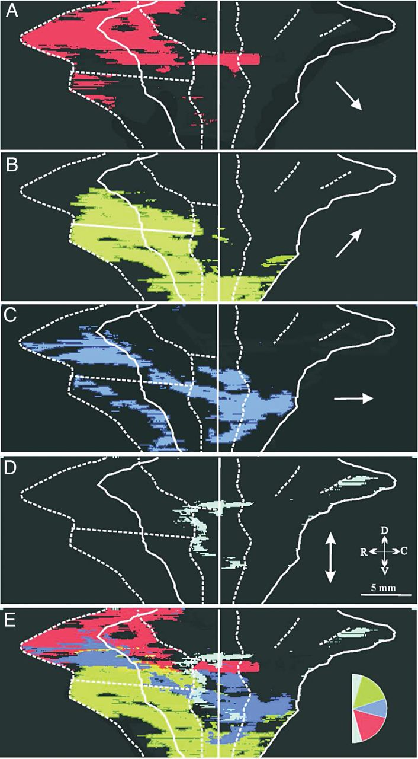
Figure 6. Representation of visuo-oculomotor space in the periarcuate frontal cortex. (A) Pixels of the map averaged ...
Notes:
Figure 6. Representation of visuo-oculomotor space in the periarcuate frontal cortex. (A) Pixels of the map averaged from the hemispheres contralateral to oblique down saccades (red), displaying LCGU values 10% higher than the corresponding ones of the Cd map. (B) Similarly for contralateral oblique up saccades (green), horizontal saccades (dark blue, C) and vertical saccades (light blue, D). (E) Superimposition of the areas activated for downward (red), upward (green), horizontal (dark blue), and vertical (light blue) saccades shown in A–D.
Unless provided in the caption above, the following copyright applies to the content of this slide: © The Author 2014. Published by Oxford University Press. All rights reserved. For Permissions, please e-mail: journals.permissions@oup.com

Slide 7
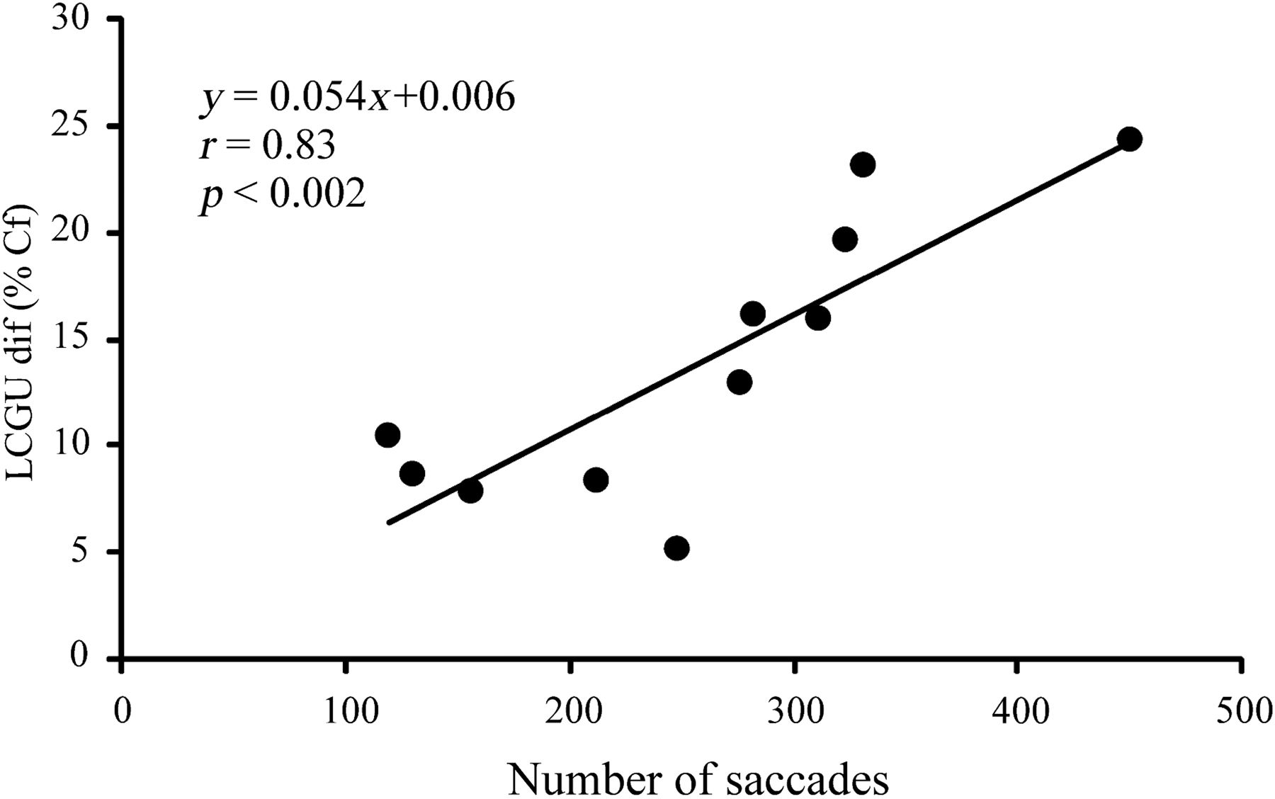
Figure 7. Two-dimensional plot of the number of contraversive visually guided saccades (abscissa) versus increase in ...
Notes:
Figure 7. Two-dimensional plot of the number of contraversive visually guided saccades (abscissa) versus increase in glucose consumption relative to the fixating monkey (LCGU-dif, %Cf) in different subregions of the periarcuate cortex (ordinate). Each data point is from a different hemisphere. The solid line is the linear regression line through the data and obeys the equation displayed.
Unless provided in the caption above, the following copyright applies to the content of this slide: © The Author 2014. Published by Oxford University Press. All rights reserved. For Permissions, please e-mail: journals.permissions@oup.com

