Slide 1
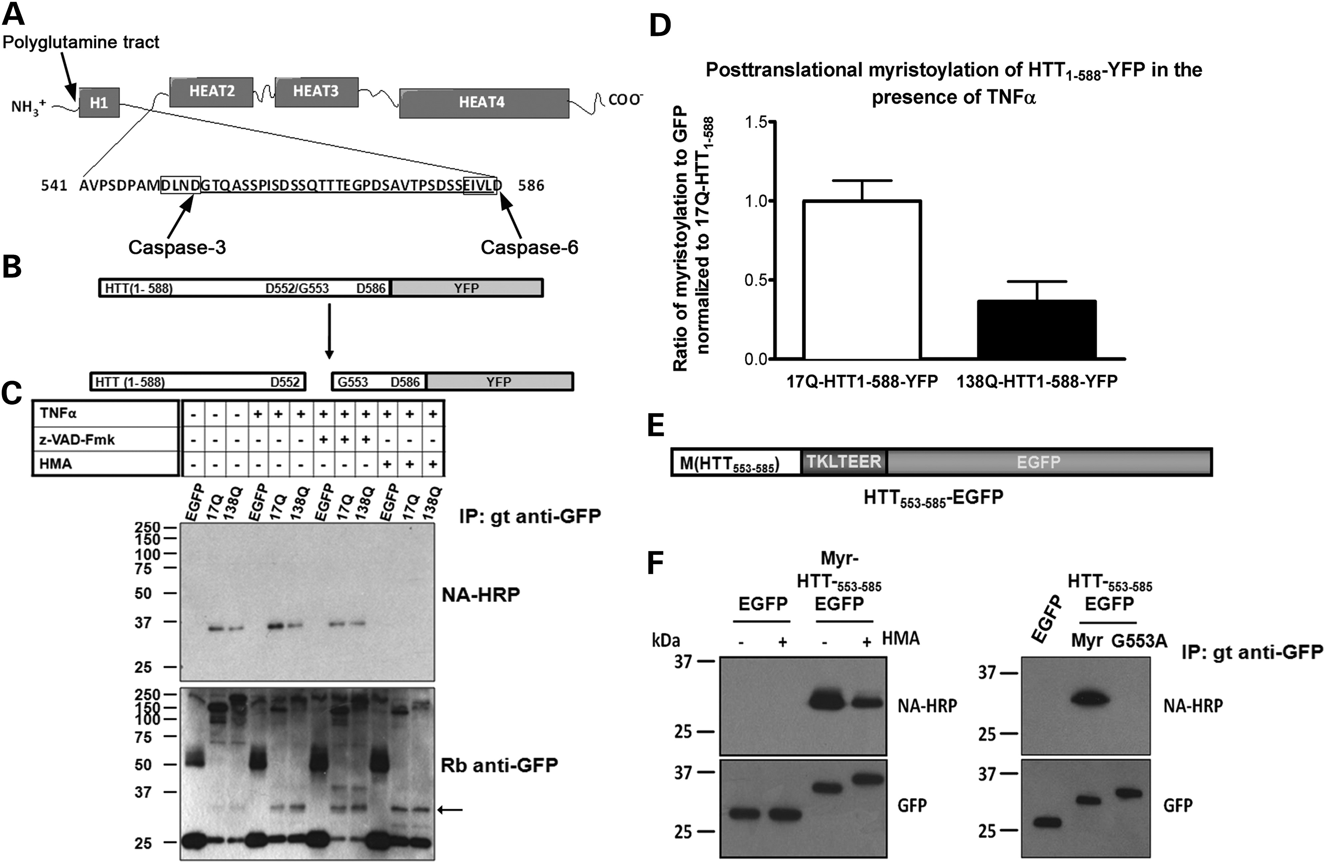
Figure 1. Myristoylation of caspase-cleaved HTT at Gly553. (A) Schematic representation of full-length HTT. The ...
Notes:
Figure 1. Myristoylation of caspase-cleaved HTT at Gly553. (A) Schematic representation of full-length HTT. The 3144-amino acid protein is comprised of 5 HEAT domains, punctuated by unstructured domains. The polyQ tract is located at the N-terminus. The site of cleavage by caspase-3 and caspase-6 are indicated with the amino acid sequence of the released fragment that is predicted to be myristoylated at Gly553. (B) Diagram of HTT1–588–YFP which contains the first 588 amino acids of the N-terminus of HTT fused to YFP. Cleavage of HTT1–588–YFP at Asp552 exposes the N-terminal Gly residue at position 553 within a myristoylation consensus sequence. (C) HeLa cells transiently expressing HTT1–588–YFP were induced to undergo apoptosis with TNFα in the presence of Alk-Myr. Incorporation of Alk-Myr was inhibited by the addition of the general caspase inhibitor (z-VAD-Fmk) and HMA (arrow indicates the HTT553–588–YFP fragment released by caspase cleavage). (D) In the presence of the polyQ mutation, post-translational myristoylation of HTT was decreased nearly 70% compared with 17Q-HTT1–588–YFP in the presence of TNFα. Bands were measured using ImageJ and presented as a ratio of myristoylation (NA) signal over cleaved HTT–YFP (indicated by arrow in C) and normalized to 17Q-HTT1–588–YFP (n = 3, P = 0.024, t-test). Error bars represent standard deviation. (E) The 33 amino acids between the caspase-3 and caspase-6 sites were appended to GFP, and an initiator Met was added (HTT553–585–EGFP). Asp586 was excluded to prevent secondary caspase cleavage between the test sequence and EGFP. (F) Immunoprecipitated myr-HTT553–585–EGFP incorporated Alk-Myr. Incorporation of Alk-Myr was decreased by the addition of HMA (left panel) and completely inhibited by substitution of Gly to Ala into HTT553–585–EGFP (right panel).
Unless provided in the caption above, the following copyright applies to the content of this slide: © The Author 2014. Published by Oxford University Press. All rights reserved. For Permissions, please email: journals.permissions@oup.com

Slide 2
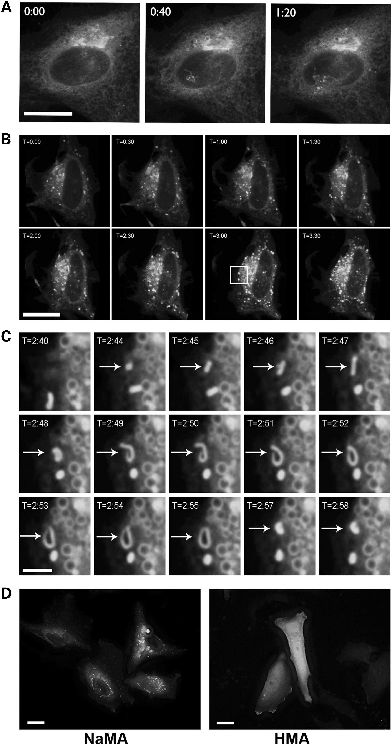
Figure 2. Expression of myr-HTT_{553–585}–EGFP in HeLa cells promotes the formation of vesicular structures ...
Notes:
Figure 2. Expression of myr-HTT553–585–EGFP in HeLa cells promotes the formation of vesicular structures reminiscent of autophagosomes. (A) HeLa cells were transiently transfected for 22 h and imaged using live-cell confocal spinning-disk microscopy. In A, myr-HTT553–585–EGFP localized to the endomembrane system in a reticulated pattern. Over time, the formation of small vesicles was observed (Supplementary Material, Video S1). (B) The formation of vesicular structures (0.5–2 µm) as observed over time and (C) the formation of one vesicle from the boxed region in B (Supplementary Material, Video S2). In D, cells were transfected for 18 h and treated with either 1 mm sodium myristic acid (NaMA) (left) or 1 mm HMA (right) for an additional day. Images were acquired by wide-field microscopy and deconvolved using Huygens SVI. Scale bar represents 20 µm (A, C and D) or 2.5 µm (B).
Unless provided in the caption above, the following copyright applies to the content of this slide: © The Author 2014. Published by Oxford University Press. All rights reserved. For Permissions, please email: journals.permissions@oup.com

Slide 3
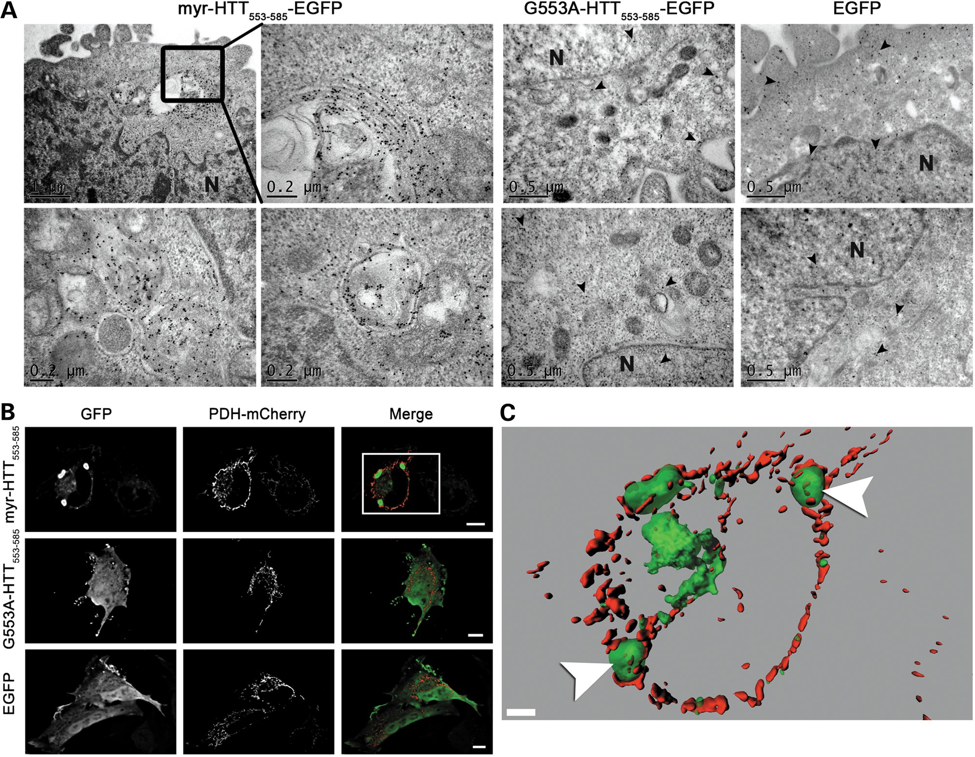
Figure 3. Expression of myr-HTT_{553–585}–EGFP induces the formation of autophagocytic vesicles. HeLa cells ...
Notes:
Figure 3. Expression of myr-HTT553–585–EGFP induces the formation of autophagocytic vesicles. HeLa cells transiently expressing HTT553–585–EGFP for 24 h were fixed and prepared for immunogold EM (A) using rabbit anti-GFP antibodies and donkey anti-rabbit conjugated to 18nm colloidal gold particles. The ‘inset’ illustrates an expanded view of the boxed area in myr-HTT553–585–EGFP panel showing a vesicle originating from the ER. Arrowheads indicate gold beads and ‘N’ marks nucleus. (B) HeLa cells co-expressing PDH-mCherry and myr-HTT553–585–EGFP. Images were acquired by wide-field live-cell microscopy and deconvolved using SVI Huygens deconvolution software. Images are presented as 3D z-stacks. Scale bars are representative of 10 µm. (C) A 3D reconstruction of the boxed region of inset from B. Arrowheads indicate the presence of mitochondria within the myr-HTT553–585–EGFP-containing large vesicular structures.
Unless provided in the caption above, the following copyright applies to the content of this slide: © The Author 2014. Published by Oxford University Press. All rights reserved. For Permissions, please email: journals.permissions@oup.com

Slide 4
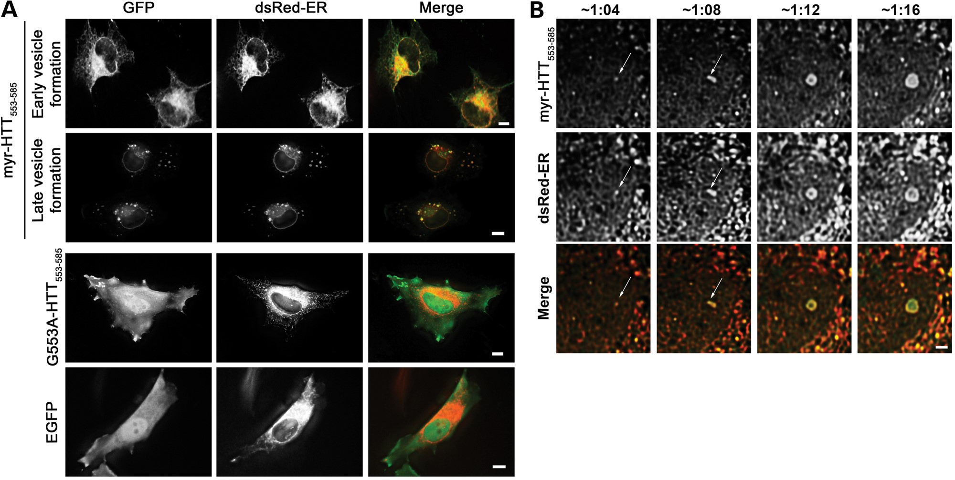
Figure 4. The autophagic vesicles induced by the expression of myr-HTT_{553–585}–EGFP arise from the ER. HeLa ...
Notes:
Figure 4. The autophagic vesicles induced by the expression of myr-HTT553–585–EGFP arise from the ER. HeLa cells were co-transfected with dsRed-ER and HTT553–585–EGFP. Images in A were acquired by wide-field microscopy and deconvolved using SVI Huygens deconvolution software. Images are presented as 3D z-stacks. Scale bars represent 10 µm. (B) HeLa cells transiently expressing dsRed-ER and myr-HTT553–585–EGFP were starved in HBSS media and viewed using live-cell confocal spinning-disc fluorescence microscopy (Supplementary Material, Video S4). The arrows indicate the formation of a vesicle containing both myr-HTT553–585–EGFP and dsRed-ER. Scale bar is representative of 1 µm.
Unless provided in the caption above, the following copyright applies to the content of this slide: © The Author 2014. Published by Oxford University Press. All rights reserved. For Permissions, please email: journals.permissions@oup.com

Slide 5
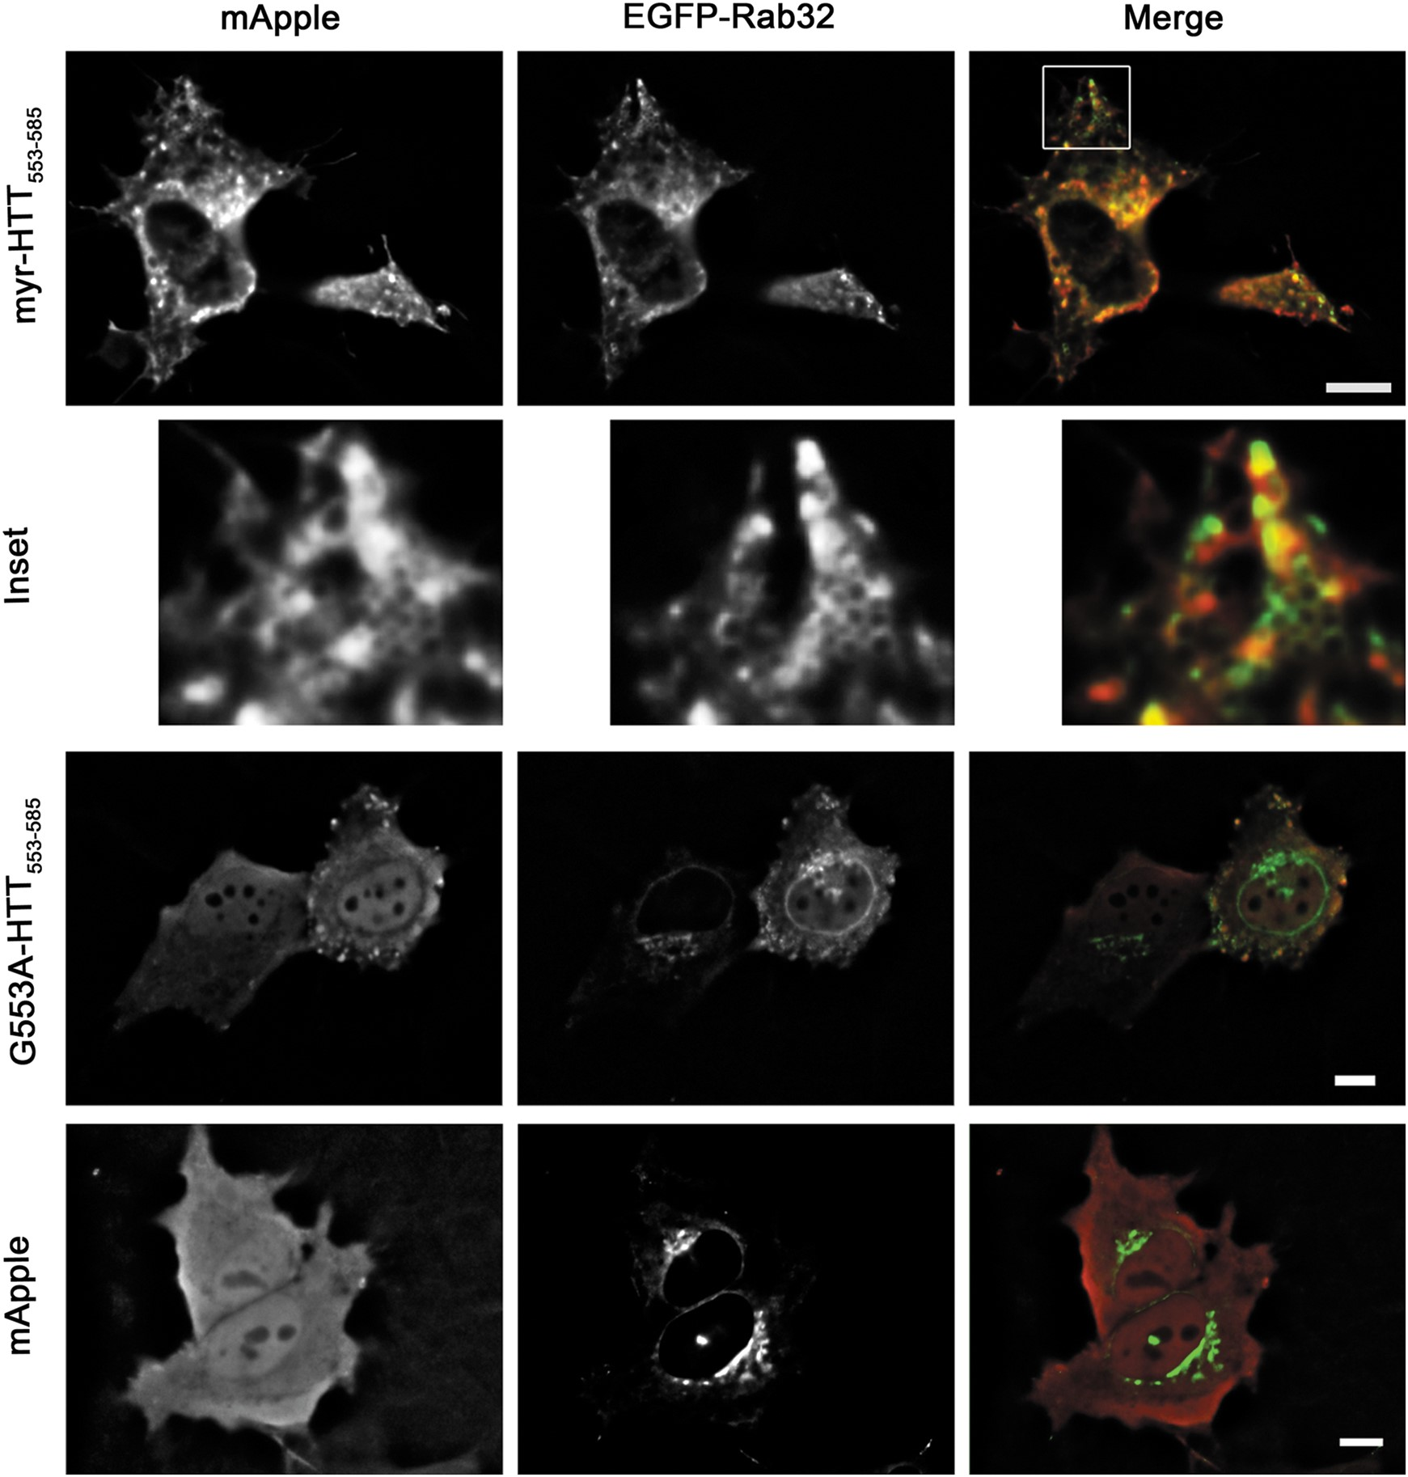
Figure 5. Myr-HTT_{553–585}–mApple and EGFP-Rab32 localize to similar autophagic vesicles. (A). ...
Notes:
Figure 5. Myr-HTT553–585–mApple and EGFP-Rab32 localize to similar autophagic vesicles. (A). Myr-HTT553–585 and G553A-HTT553–585 were appended to the monomeric fluorescent protein mApple and co-transiently transfected with EGFP-Rab32 in HeLa cells for 24 h. Images were acquired by wide-field live-cell microscopy and deconvolved using SVI Huygens Deconvolution software. Images are presented as z-stacks. Scale bar is representative of 10 µm.
Unless provided in the caption above, the following copyright applies to the content of this slide: © The Author 2014. Published by Oxford University Press. All rights reserved. For Permissions, please email: journals.permissions@oup.com

Slide 6
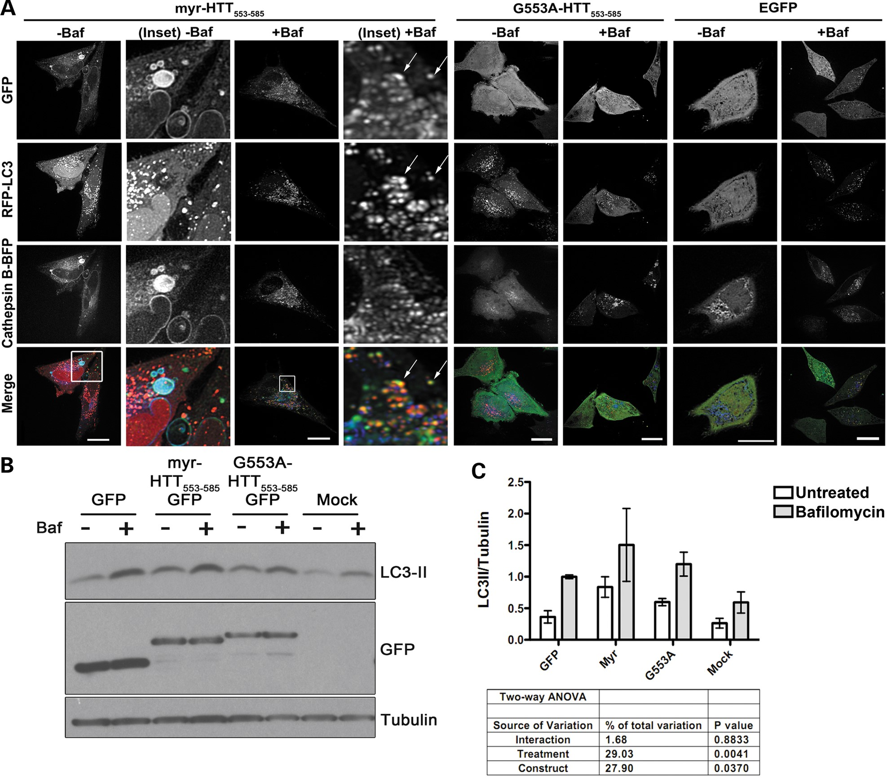
Figure 6. Effect of bafilomycin A1 on LC3 in HeLa cells expressing myr-HTT_{553–585}–EGFP. (A) HeLa cells were ...
Notes:
Figure 6. Effect of bafilomycin A1 on LC3 in HeLa cells expressing myr-HTT553–585–EGFP. (A) HeLa cells were transiently co-transfected with the lysosomal marker Cathepsin B-BFP and the autophagosomal marker RFP-LC3 for 24 h with the indicated EGFP constructs and treated with 0.5 µm Baf for an additional 24 h. Images were acquired by live-cell fluorescence spinning-disc microscopy and deconvolved using SVI Huygens deconvolution software. Images are presented as 3D z-stacks. Scale bars represent 10 µm. (B) HeLa cells were transiently transfected with myr-HTT553–585–EGFP for 20 h and treated in the presence or absence of 0.5 µm Baf for 4 h. Cell lysates were subjected to SDS–PAGE and western blot analysis. Tubulin is included as a loading control. (C) Graphical representation of LC3-II levels compared with tubulin from western blot analysis (n = 3). Protein levels were quantified using Image J software. Data were analyzed using two-way ANOVA.
Unless provided in the caption above, the following copyright applies to the content of this slide: © The Author 2014. Published by Oxford University Press. All rights reserved. For Permissions, please email: journals.permissions@oup.com

Slide 7
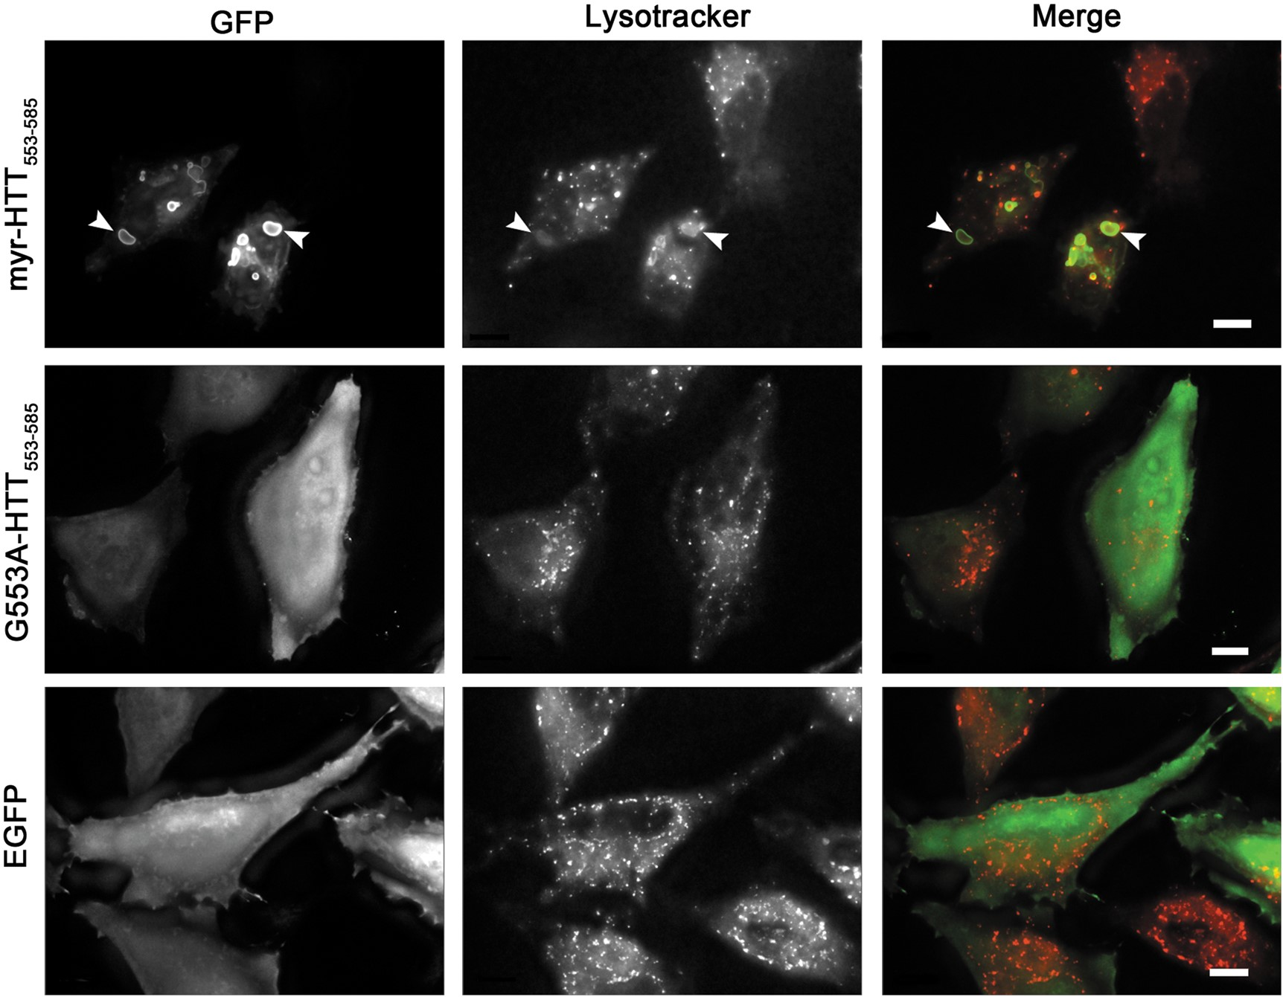
Figure 7. Myr-HTT_{553–585}–EGFP localizes to weakly acidic enlarged lysosomes labeled with the fluorescent ...
Notes:
Figure 7. Myr-HTT553–585–EGFP localizes to weakly acidic enlarged lysosomes labeled with the fluorescent acidotrophic dye LysoTracker™. HeLa cells were transiently transfected for 24 h with myr-HTT553–585–EGFP and stained with 1 µm LysoTracker® for 30 min. Images were acquired by wide-field live-cell microscopy and deconvolved using SVI Huygens deconvolution software. Arrows denote weakly acidic large lysosomes labeled with fluorescent acidotrophic Lysotracker™ dye. Images are presented as 3D z-stacks. Scale bars are representative of 10 µm.
Unless provided in the caption above, the following copyright applies to the content of this slide: © The Author 2014. Published by Oxford University Press. All rights reserved. For Permissions, please email: journals.permissions@oup.com

