Slide 1
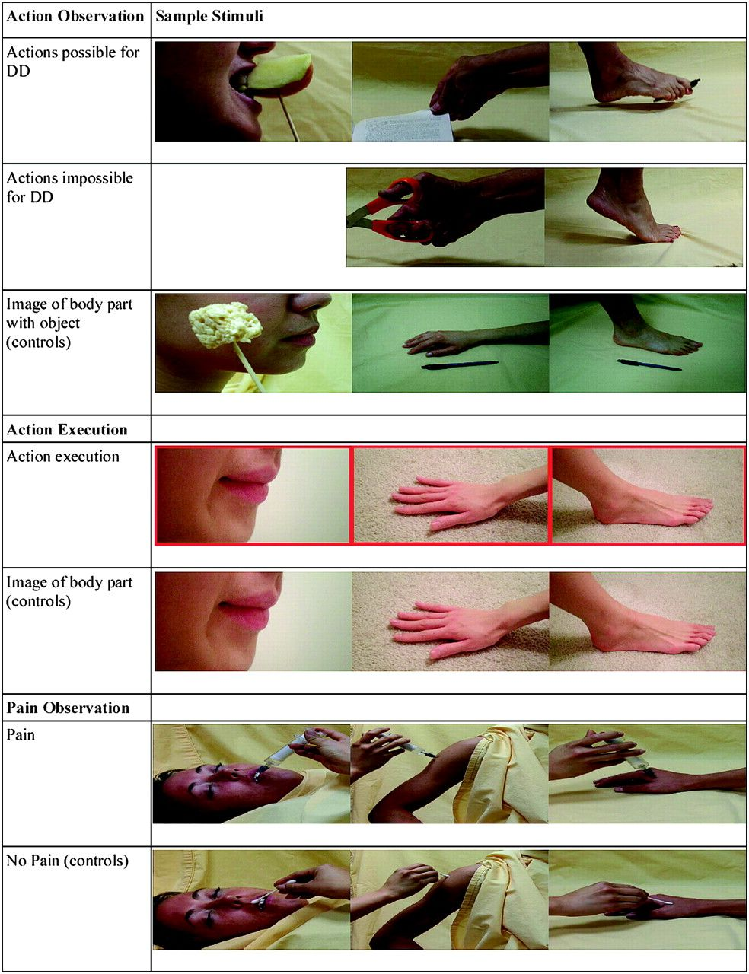
Figure 1. Examples of task stimuli. Sample visual stimuli used in the action observation, action execution, and pain ...
Notes:
Figure 1. Examples of task stimuli. Sample visual stimuli used in the action observation, action execution, and pain observation tasks are presented.
Unless provided in the caption above, the following copyright applies to the content of this slide: Published by Oxford University Press 2011.

Slide 2
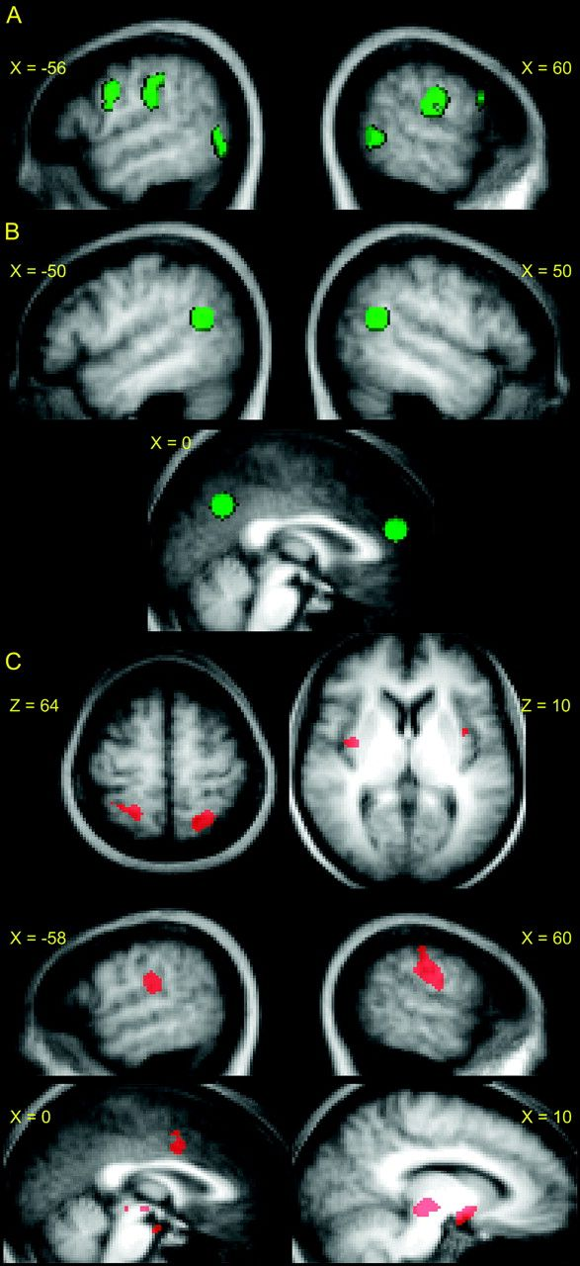
Figure 2. ROIs. (A) Mirror system ROIs (green) consisting of L/R precentral gyrus (premotor), L/R IPL, L/R posterior ...
Notes:
Figure 2. ROIs. (A) Mirror system ROIs (green) consisting of L/R precentral gyrus (premotor), L/R IPL, L/R posterior middle temporal gyrus/superior temporal sulcus (pSTS). (B) Mentalizing system ROIs (green) consisting of L/R TPJ, the mPFC, and medial precuneus. (C) ROIs for pain observation (red). These include bilateral postcentral gyri (SI), bilateral insula, bilateral inferior parietal/lateral postcentral gyri (SII), mid cingulate gyrus, and portions of the midbrain. All ROIs were overlaid onto a mean anatomical image constructed from the 13 TD participants’ structural scans (normalized to MNI space).
Unless provided in the caption above, the following copyright applies to the content of this slide: Published by Oxford University Press 2011.

Slide 3
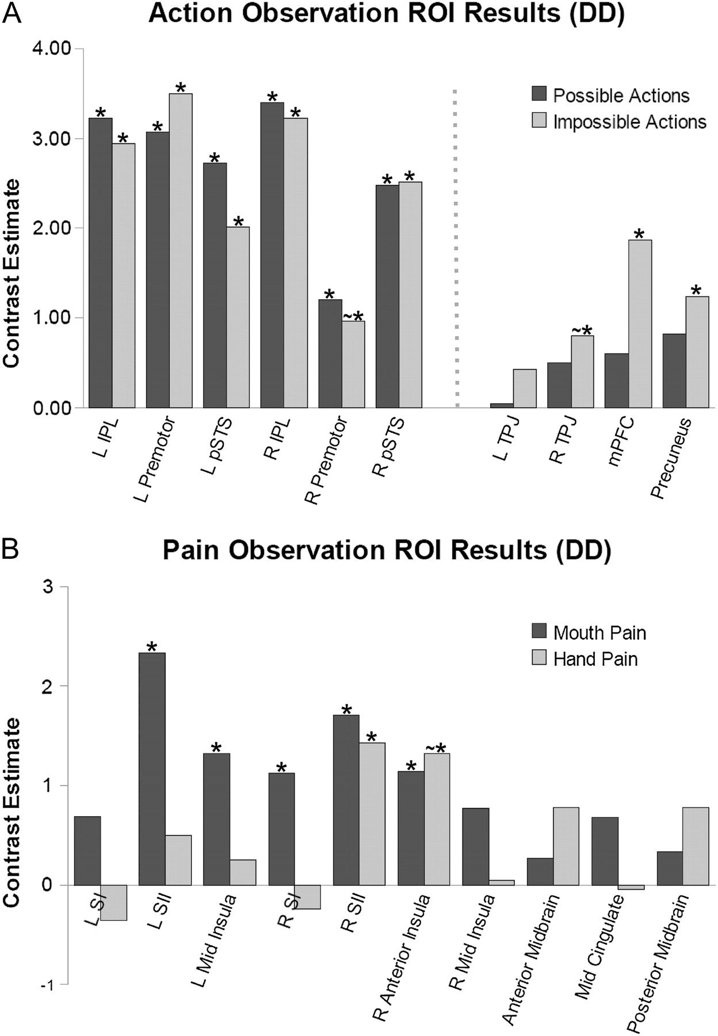
Figure 3. Action observation and pain observation ROI results for D.D. (A) Contrast estimates in mirror system (left) ...
Notes:
Figure 3. Action observation and pain observation ROI results for D.D. (A) Contrast estimates in mirror system (left) and mentalizing (right) ROIs for D.D. during observation of possible actions and impossible actions (each contrasted against controls). (B) Contrast estimates in pain observation ROIs for D.D. during observation of mouth pain and hand pain (contrasted with mouth no pain, hand no pain, respectively). * indicates P < 0.05; ∼* indicates P < 0.1.
Unless provided in the caption above, the following copyright applies to the content of this slide: Published by Oxford University Press 2011.

