Slide 1
Figure 1. A single trial of the working memory task. Subjects were instructed to remember the tree in which the monkey ...
Notes:
Figure 1. A single trial of the working memory task. Subjects were instructed to remember the tree in which the monkey hid his bananas during the delay period.
Unless provided in the caption above, the following copyright applies to the content of this slide: © The Author 2015. Published by Oxford University Press. All rights reserved. For Permissions, please e-mail: journals.permissions@oup.com

Slide 2
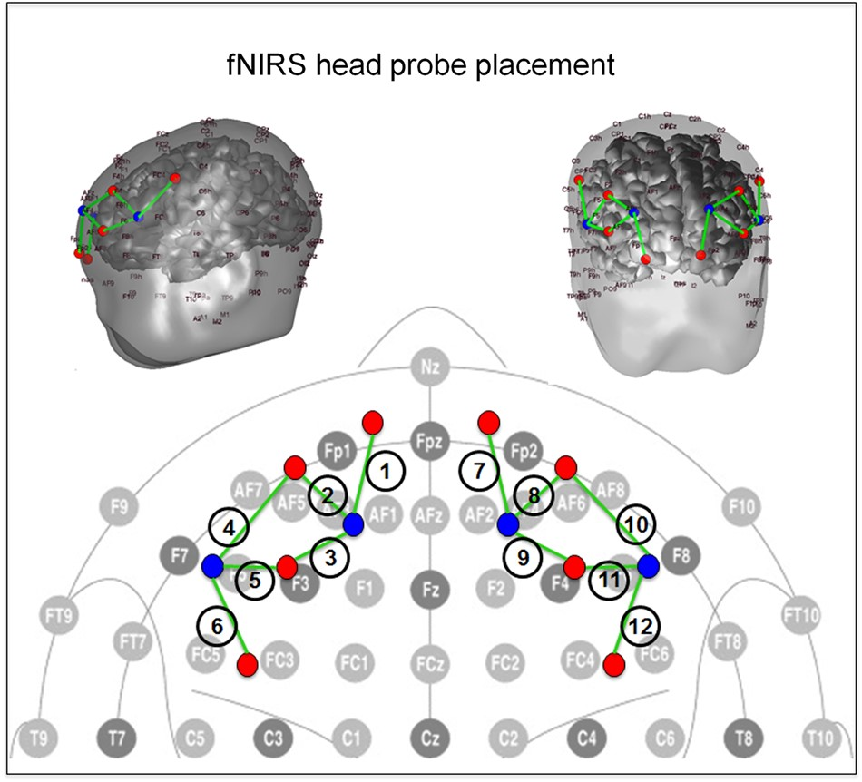
Figure 2. A schematic of the fNIRS cap layout design including international 10/20 coordinates.
Notes:
Figure 2. A schematic of the fNIRS cap layout design including international 10/20 coordinates.
Unless provided in the caption above, the following copyright applies to the content of this slide: © The Author 2015. Published by Oxford University Press. All rights reserved. For Permissions, please e-mail: journals.permissions@oup.com

Slide 3
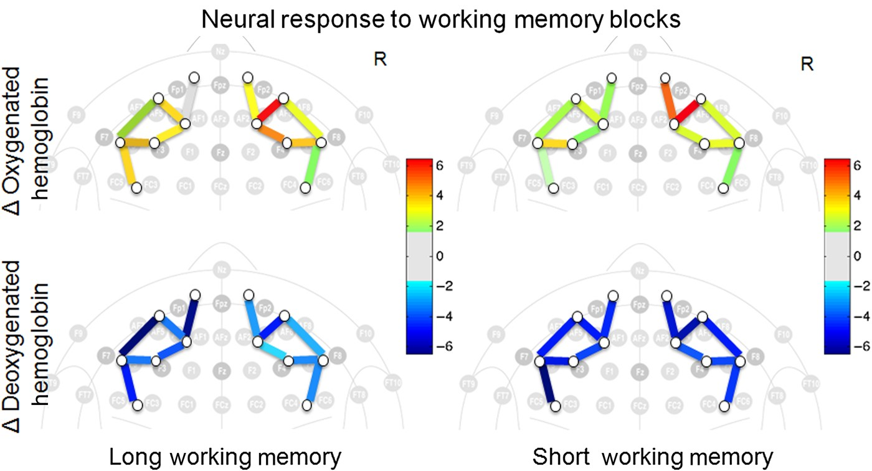
Figure 3. Brain activity contrast for the group-level hemoglobin signals during the working memory blocks minus the ...
Notes:
Figure 3. Brain activity contrast for the group-level hemoglobin signals during the working memory blocks minus the rest blocks. The color of each line indicates the T-statistic for the comparison of the 2 conditions in the general linear model for each fNIRS source–detector pair. The approximate locations of the closest international 10–20 coordinates to the fNIRS probe are shown. Oxy- and deoxyhemoglobin signals are shown in top and bottom panels, respectively.
Unless provided in the caption above, the following copyright applies to the content of this slide: © The Author 2015. Published by Oxford University Press. All rights reserved. For Permissions, please e-mail: journals.permissions@oup.com

Slide 4
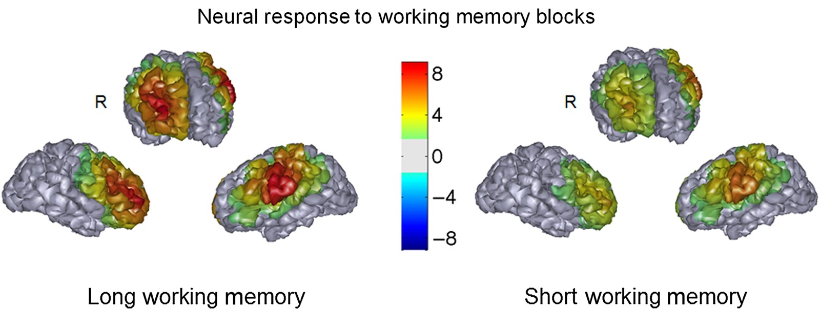
Figure 4. Reconstructed images of brain activity for the oxyhemoglobin contrast of the long and short working memory ...
Notes:
Figure 4. Reconstructed images of brain activity for the oxyhemoglobin contrast of the long and short working memory blocks minus rest. Colors represent T-statistic for the comparison of the 2 conditions (working memory, rest) in the general linear model. FNIRS data were reconstructed and displayed using an age-matched template of a brain for visualization purposes.
Unless provided in the caption above, the following copyright applies to the content of this slide: © The Author 2015. Published by Oxford University Press. All rights reserved. For Permissions, please e-mail: journals.permissions@oup.com

Slide 5
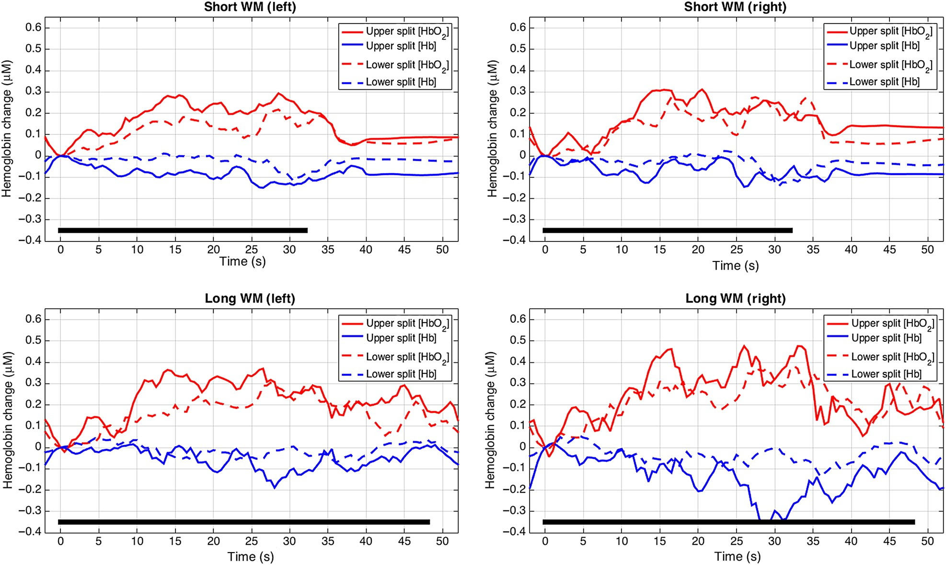
Figure 5. The group averaged time-course of the evoked oxy- (red) and deoxyhemoglobin (blue) responses are shown for ...
Notes:
Figure 5. The group averaged time-course of the evoked oxy- (red) and deoxyhemoglobin (blue) responses are shown for the lower and upper groupings of subjects from a median split on age. The data are shown from the average of all significant (P < 0.05) channels on the left and right sides of the probe.
Unless provided in the caption above, the following copyright applies to the content of this slide: © The Author 2015. Published by Oxford University Press. All rights reserved. For Permissions, please e-mail: journals.permissions@oup.com

Slide 6
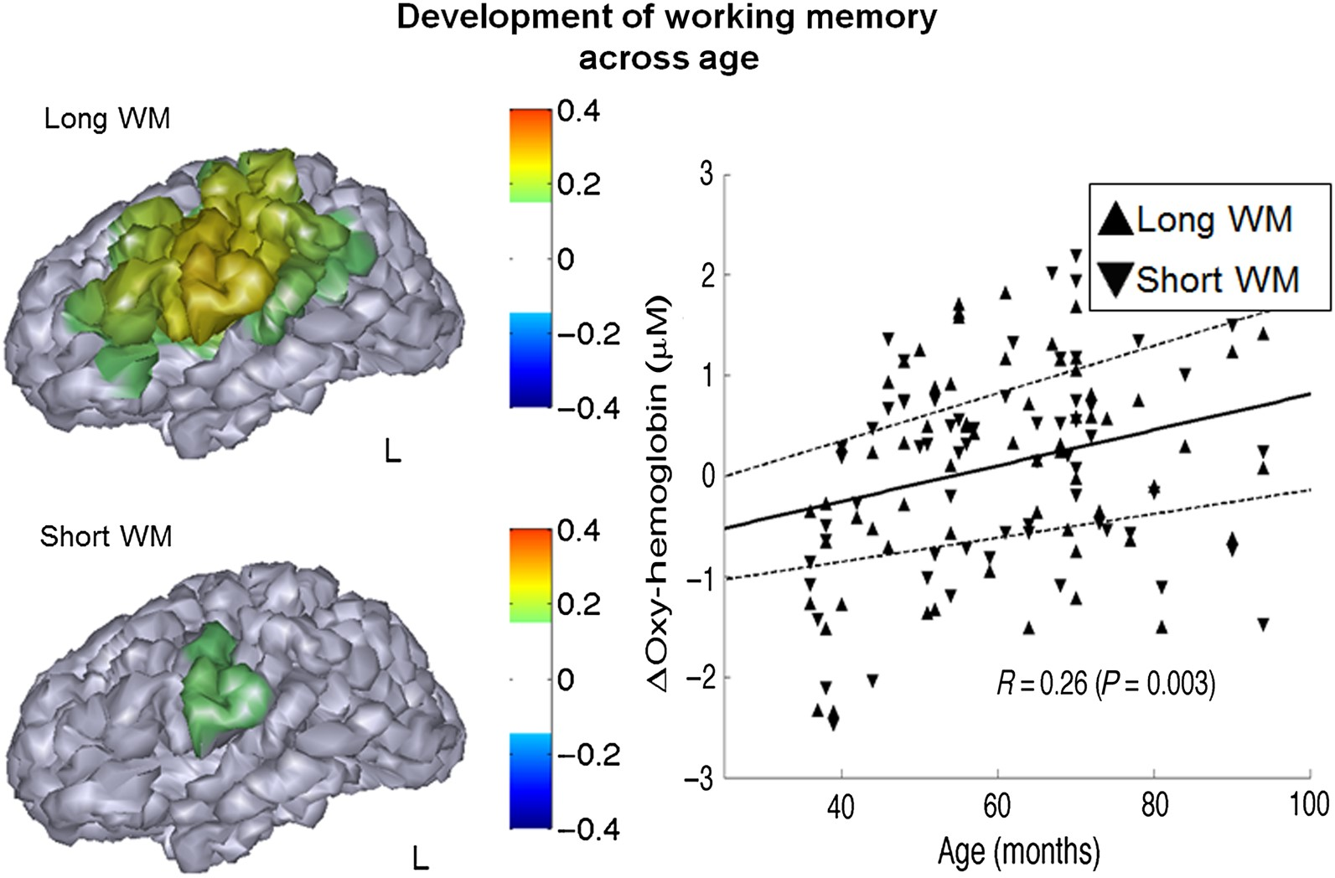
Figure 6. Map of brain regions correlated (P < 0.05) with age in a group-level ANOVA regression model. Scatter plots of ...
Notes:
Figure 6. Map of brain regions correlated (P < 0.05) with age in a group-level ANOVA regression model. Scatter plots of the mean oxyhemoglobin from regions of interest and age for each subject is pictured at right. Positive correlation is observed between age and the oxyhemoglobin contrast of the long and short working memory blocks and rest in the left LPFC. The solid line shows the linear fit of the correlation (linear) model and 1 standard deviation from the fit to the short and long WM data.
Unless provided in the caption above, the following copyright applies to the content of this slide: © The Author 2015. Published by Oxford University Press. All rights reserved. For Permissions, please e-mail: journals.permissions@oup.com

