Slide 1
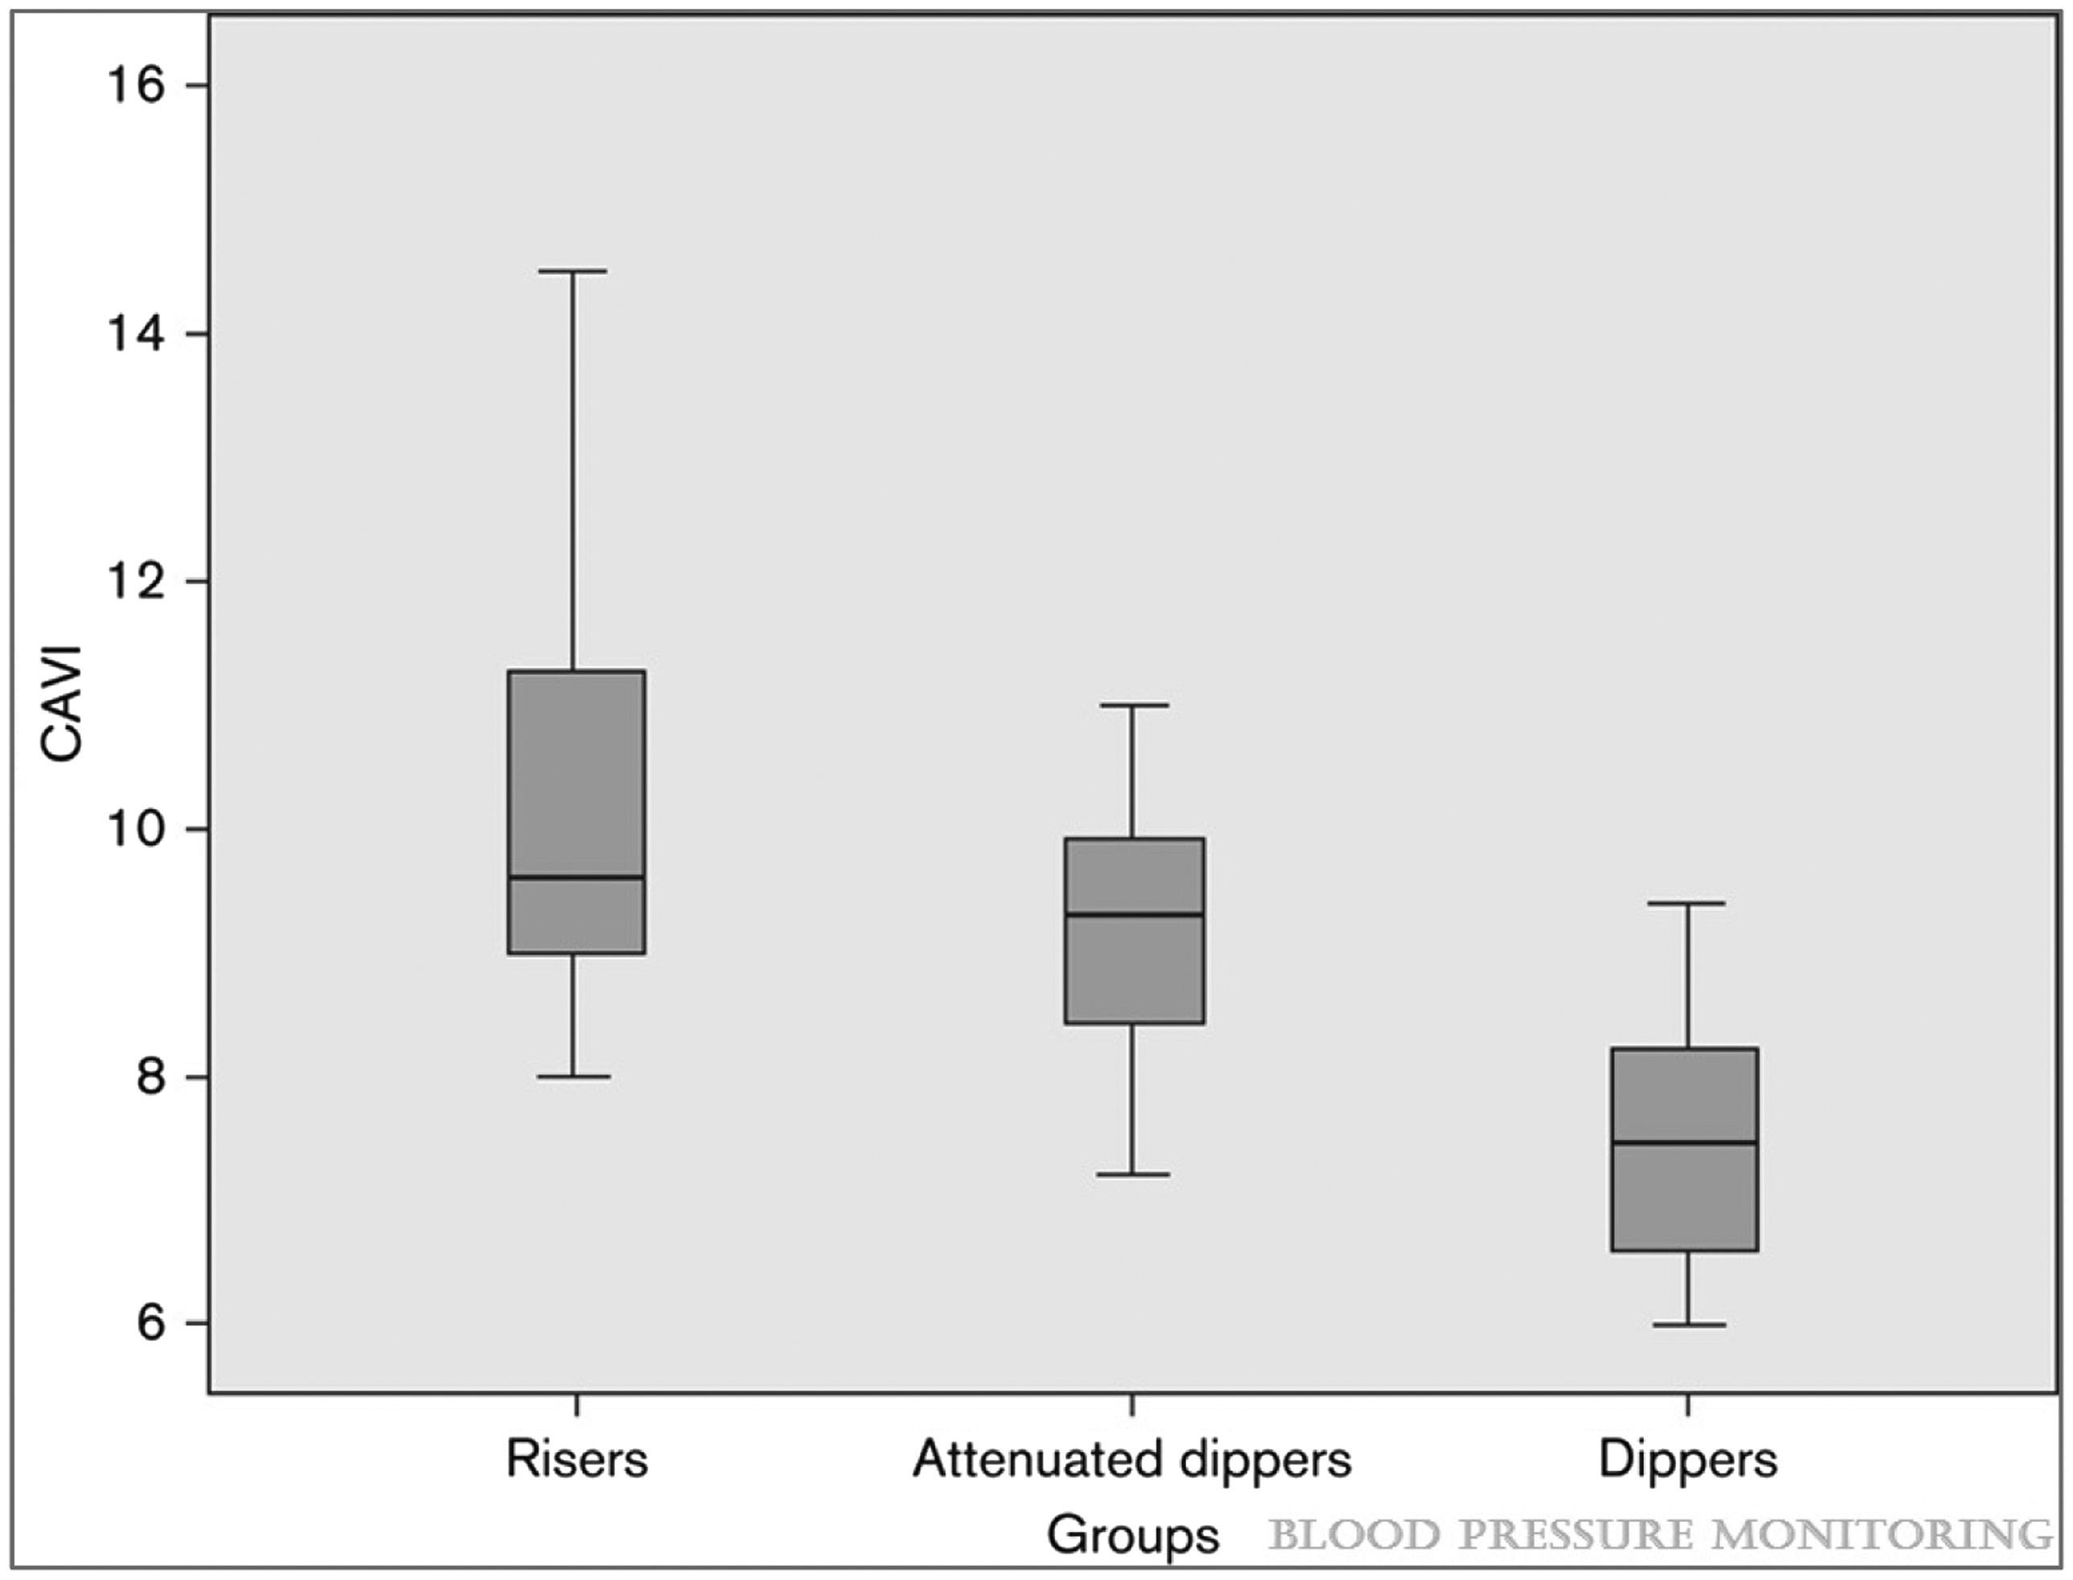
Figure 1 Cardio-ankle vascular index (CAVI) values in groups of hypertensive diabetic patients defined by the degree ...
Notes:
Figure 1 Cardio-ankle vascular index (CAVI) values in groups of hypertensive diabetic patients defined by the degree of nocturnal decrease in mean arterial pressure. Taken from Kalaycioglu et al.31 with permission.
Unless provided in the caption above, the following copyright applies to the content of this slide: Published on behalf of the European Society of Cardiology. All rights reserved. © The Author 2017. For permissions please email: journals.permissions@oup.com.

Slide 2
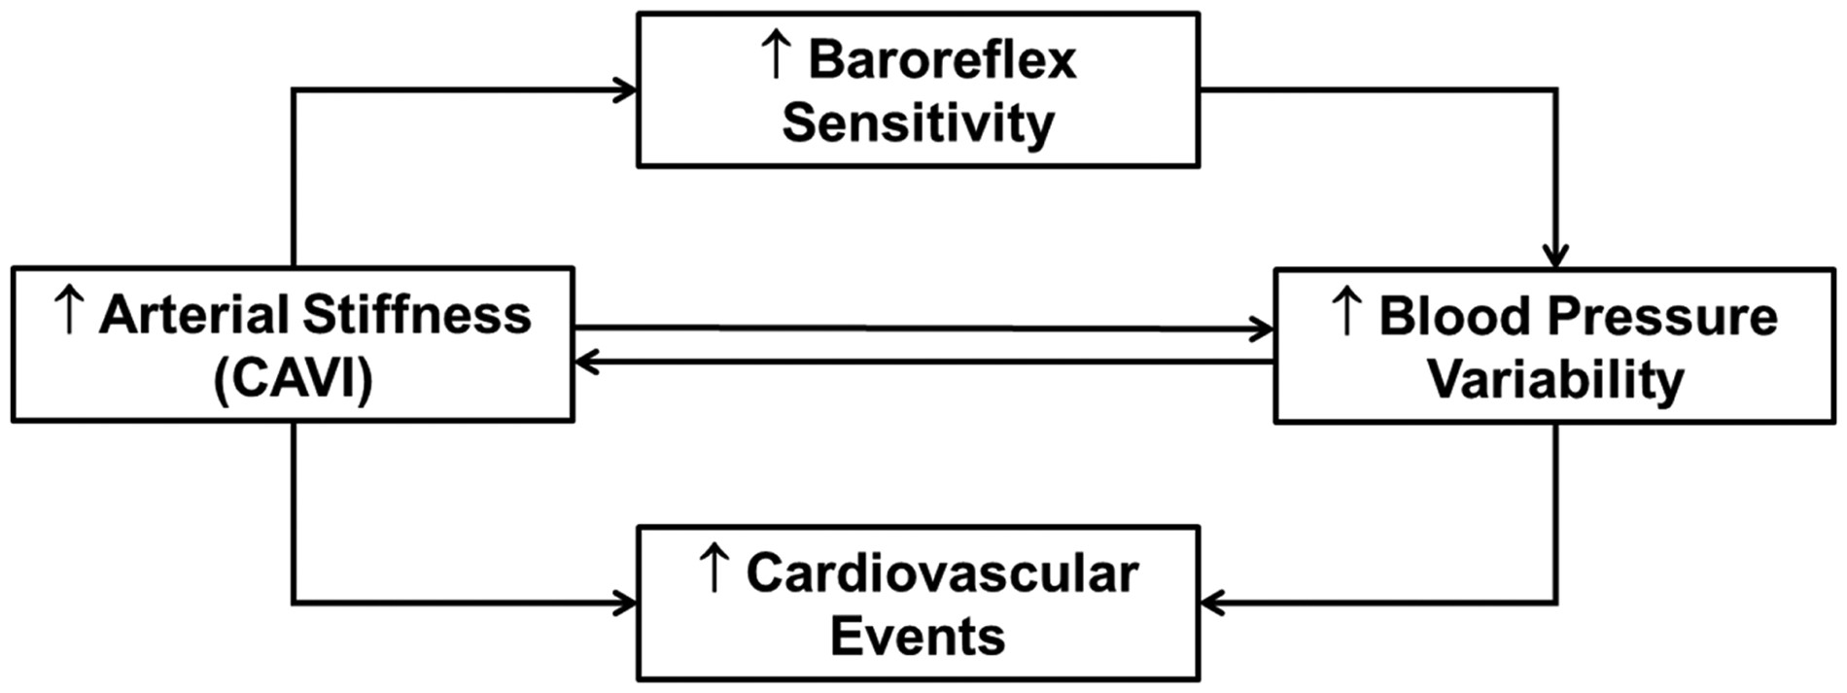
Figure 2 Relationship between arterial stiffness, blood pressure variability, baroreflex sensitivity, and ...
Notes:
Figure 2 Relationship between arterial stiffness, blood pressure variability, baroreflex sensitivity, and cardiovascular complications.
Unless provided in the caption above, the following copyright applies to the content of this slide: Published on behalf of the European Society of Cardiology. All rights reserved. © The Author 2017. For permissions please email: journals.permissions@oup.com.

Slide 3
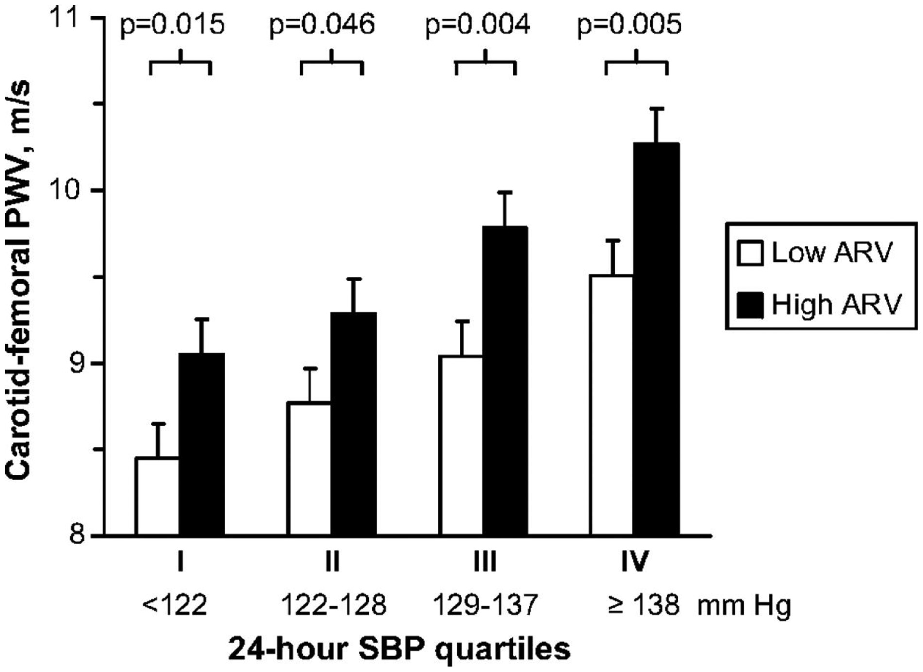
Figure 3 Age-adjusted carotid-femoral pulse wave velocity in 911 hypertensive subjects, divided into four groups ...
Notes:
Figure 3 Age-adjusted carotid-femoral pulse wave velocity in 911 hypertensive subjects, divided into four groups according to increasing values of 24-h systolic blood pressure (SBP). Subjects in each quartile were subdivided into two classes according to whether the average real variability (ARV) of 24-h systolic blood pressure was below (white bars) or above (black bars) the median SD of the group. Taken from Schillaci et al.13 with permission.
Unless provided in the caption above, the following copyright applies to the content of this slide: Published on behalf of the European Society of Cardiology. All rights reserved. © The Author 2017. For permissions please email: journals.permissions@oup.com.

