Slide 1
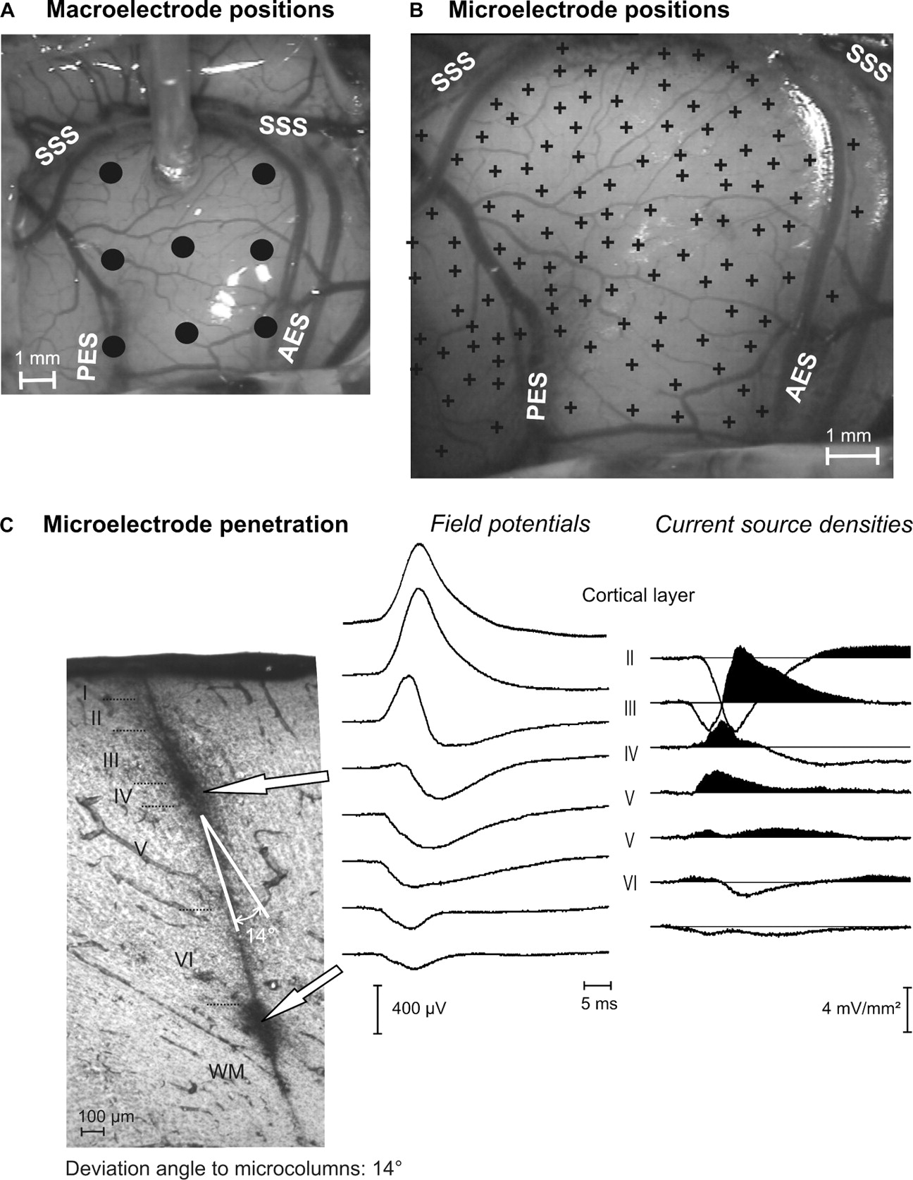
Figure 1. Example of recording positions in the field A1 of cats. (A) Photograph of the auditory cortex; rostral = ...
Notes:
Figure 1. Example of recording positions in the field A1 of cats. (A) Photograph of the auditory cortex; rostral = right; dorsal = top. A silver-ball electrode is positioned underneath the superior sylvian sulcus (SSS). Black dots indicate other recording positions. (B) Microelectrode recording positions (crosses) in the same animal. (C) Histologically reconstructed penetration of a HRP-filled microelectrode with two dye deposits in the auditory cortex (frontal section) with the current source density profile determined with the same electrode (right; sinks are filled). PES = posterior ectosylvian sulcus; AES = anterior ectosylvian sulcus. Determination of cortical layers takes deviation angle into account.
Unless provided in the caption above, the following copyright applies to the content of this slide: Cerebral Cortex V 15 N 5 © Oxford University Press 2004; all rights reserved

Slide 2
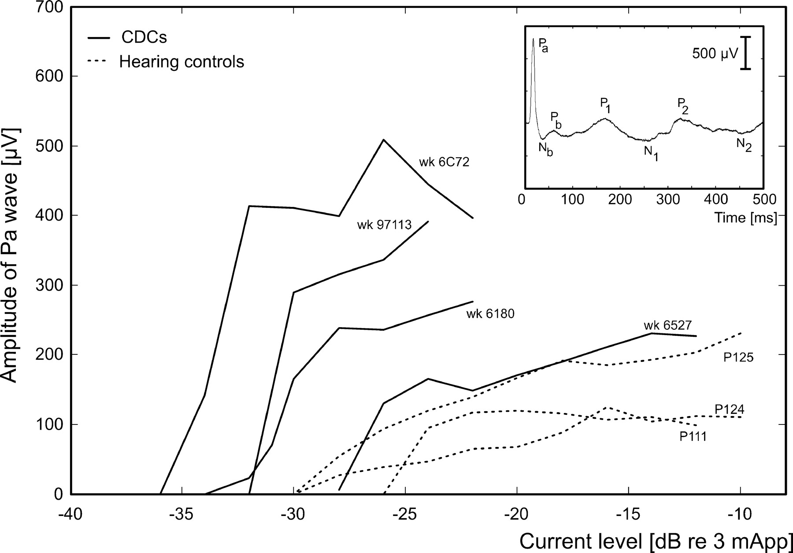
Figure 2. Amplitude-intensity functions of macroelectrode-recorded mid-latency responses (P_{a} waves). ...
Notes:
Figure 2. Amplitude-intensity functions of macroelectrode-recorded mid-latency responses (Pa waves). Stimulus: biphasic charge-balanced pulse, 200 μs/phase, monopolar electrode configuration. Designation of the field potential waves used in the present paper is shown in the inset. Animal identification is shown above each function, all animals were >4 months age.
Unless provided in the caption above, the following copyright applies to the content of this slide: Cerebral Cortex V 15 N 5 © Oxford University Press 2004; all rights reserved

Slide 3
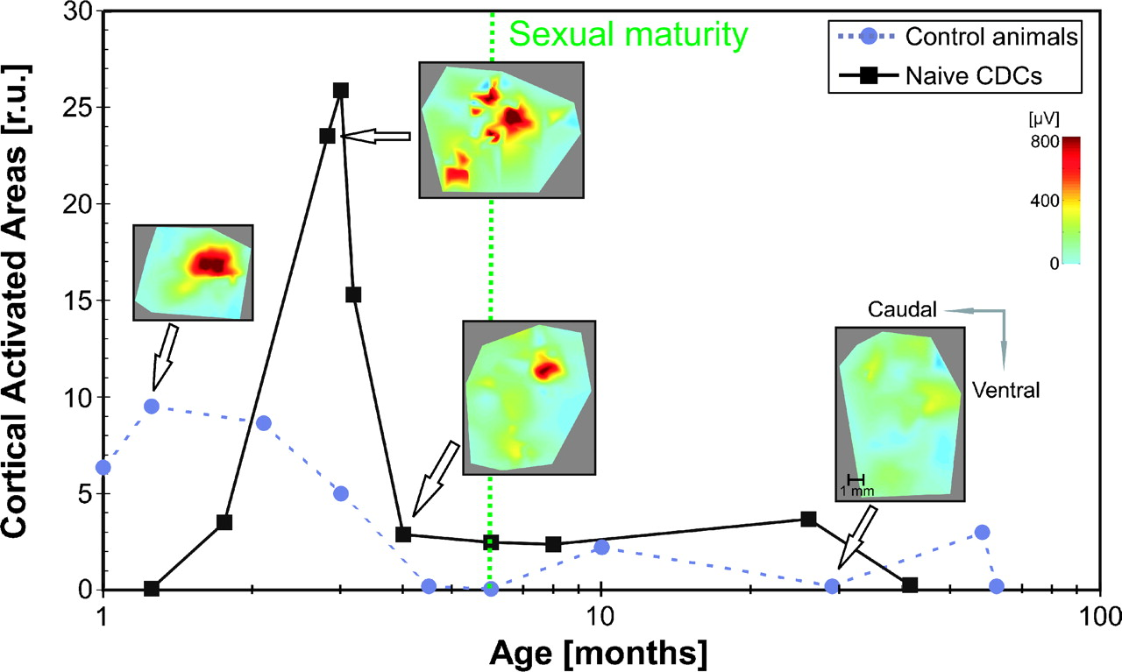
Figure 3. Cortical activated areas as a function of age. Cortical activation maps computed from P_{a} ...
Notes:
Figure 3. Cortical activated areas as a function of age. Cortical activation maps computed from Pa amplitudes are shown as insets for selected animals. Color code is shown on the right. Cats were considered sexually mature around the sixth month p.n.
Unless provided in the caption above, the following copyright applies to the content of this slide: Cerebral Cortex V 15 N 5 © Oxford University Press 2004; all rights reserved

Slide 4
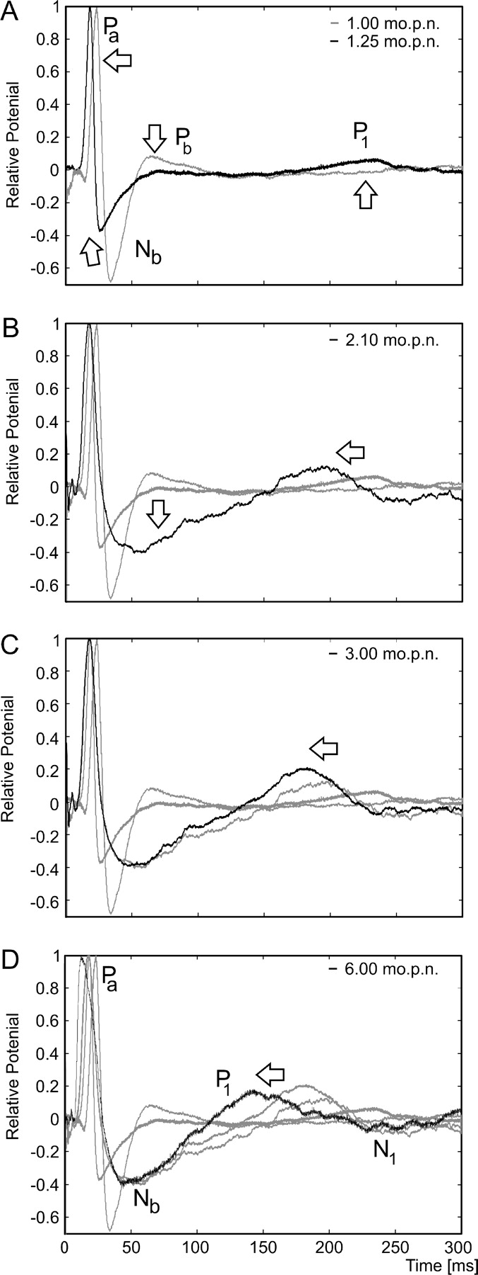
Figure 4. Development of morphology of field potentials in control (hearing) cats. Each LFP represents a normalized ...
Notes:
Figure 4. Development of morphology of field potentials in control (hearing) cats. Each LFP represents a normalized mean local field potential of six recordings within the most activated cortical regions (ROI). Youngest investigated animals are shown in the top panel, arrows indicate the direction of change with increasing age. In each panel, local field potentials from younger animals (shown in the panels above) are presented as grey curves.
Unless provided in the caption above, the following copyright applies to the content of this slide: Cerebral Cortex V 15 N 5 © Oxford University Press 2004; all rights reserved

Slide 5
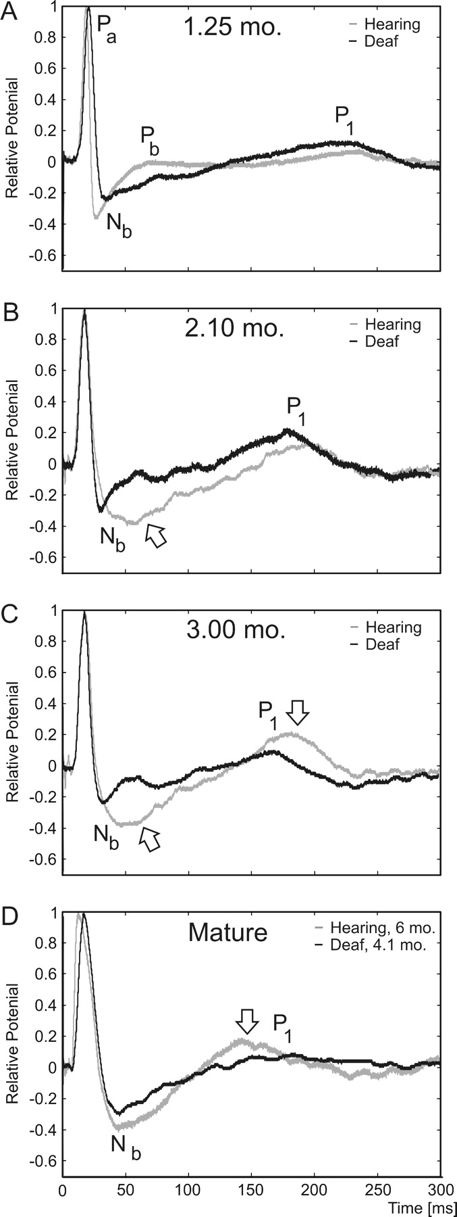
Figure 5. Comparison of morphology of field potentials between deaf cats and controls. Each LFP represents a normalized ...
Notes:
Figure 5. Comparison of morphology of field potentials between deaf cats and controls. Each LFP represents a normalized mean local field potential of six recordings within the most activated cortical regions (ROI). Grey lines show normalized mean LFPs of hearing controls, black lines normalized mean LFPs of deaf cats. Arrows indicate differences between deafs and controls. (A) Comparison of LFPs in animals at 1.25 months p.n. (B) Comparison of LFPs in animals at 2.1 months p.n. (C) Comparison of LFPs in animals at 3 months p.n. (D) Comparison of a 4.1-month-old deaf animal with an adult control (6 months), showing that at 4.1 months the Nb wave in deaf cats approaches the mature shape and P1 can no longer be differentiated.
Unless provided in the caption above, the following copyright applies to the content of this slide: Cerebral Cortex V 15 N 5 © Oxford University Press 2004; all rights reserved

Slide 6
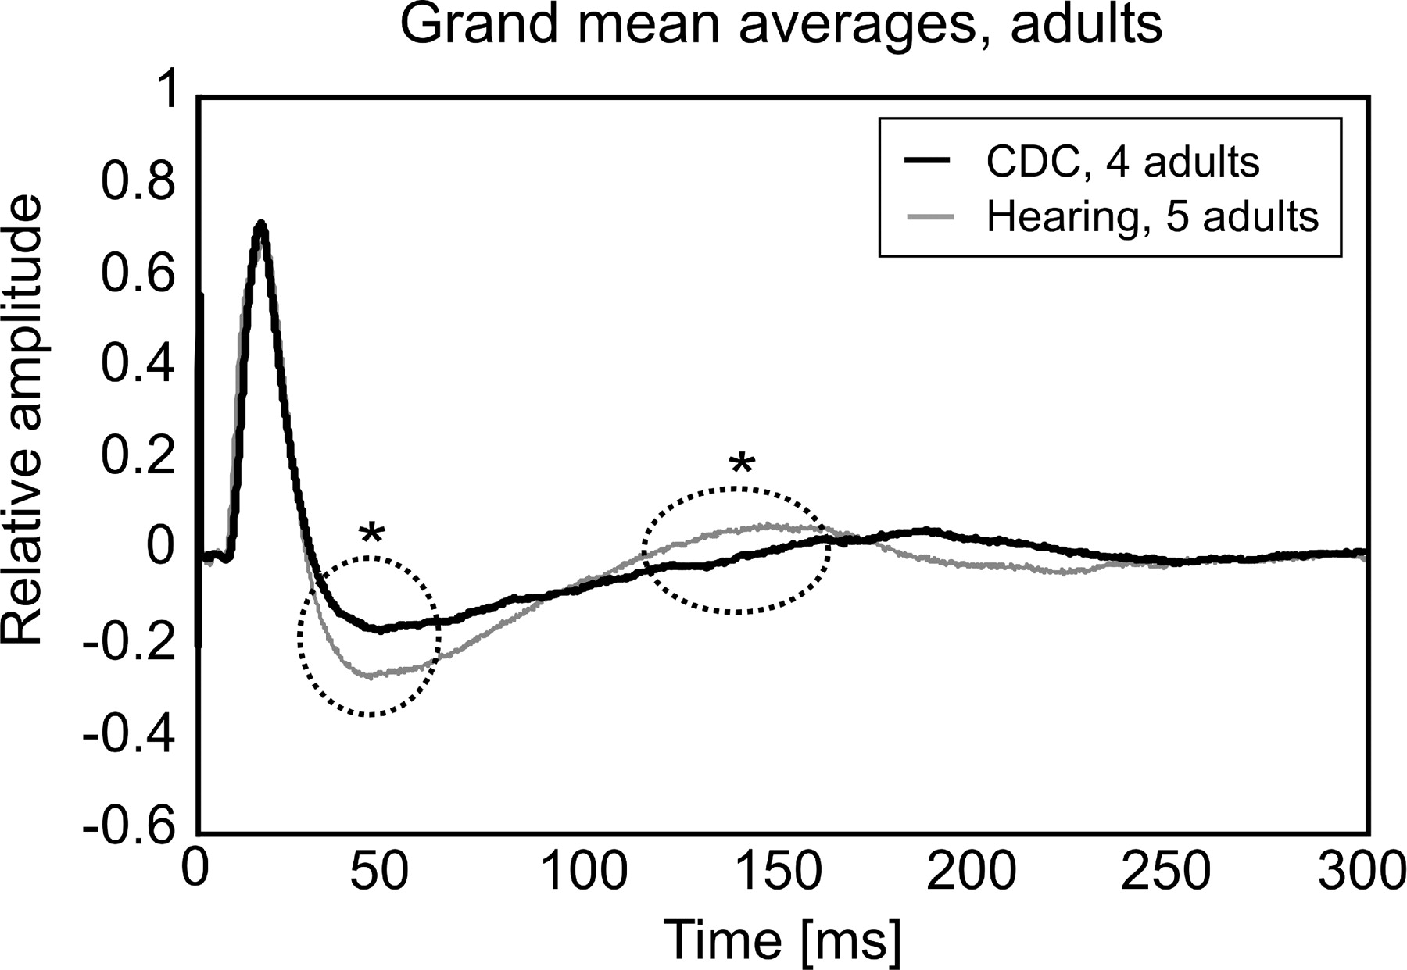
Figure 6. Grand mean averages of normalized mean LFPs from ROI of adult animals show two significant differences: a ...
Notes:
Figure 6. Grand mean averages of normalized mean LFPs from ROI of adult animals show two significant differences: a smaller Nb wave and a delayed, smaller and more ‘diffuse’ P1 wave in deaf cats. Statistical comparison by gliding window two-tailed Wilcoxon-Mann-Whitney test at each sampling interval (100 μs), α = 5%.
Unless provided in the caption above, the following copyright applies to the content of this slide: Cerebral Cortex V 15 N 5 © Oxford University Press 2004; all rights reserved

Slide 7
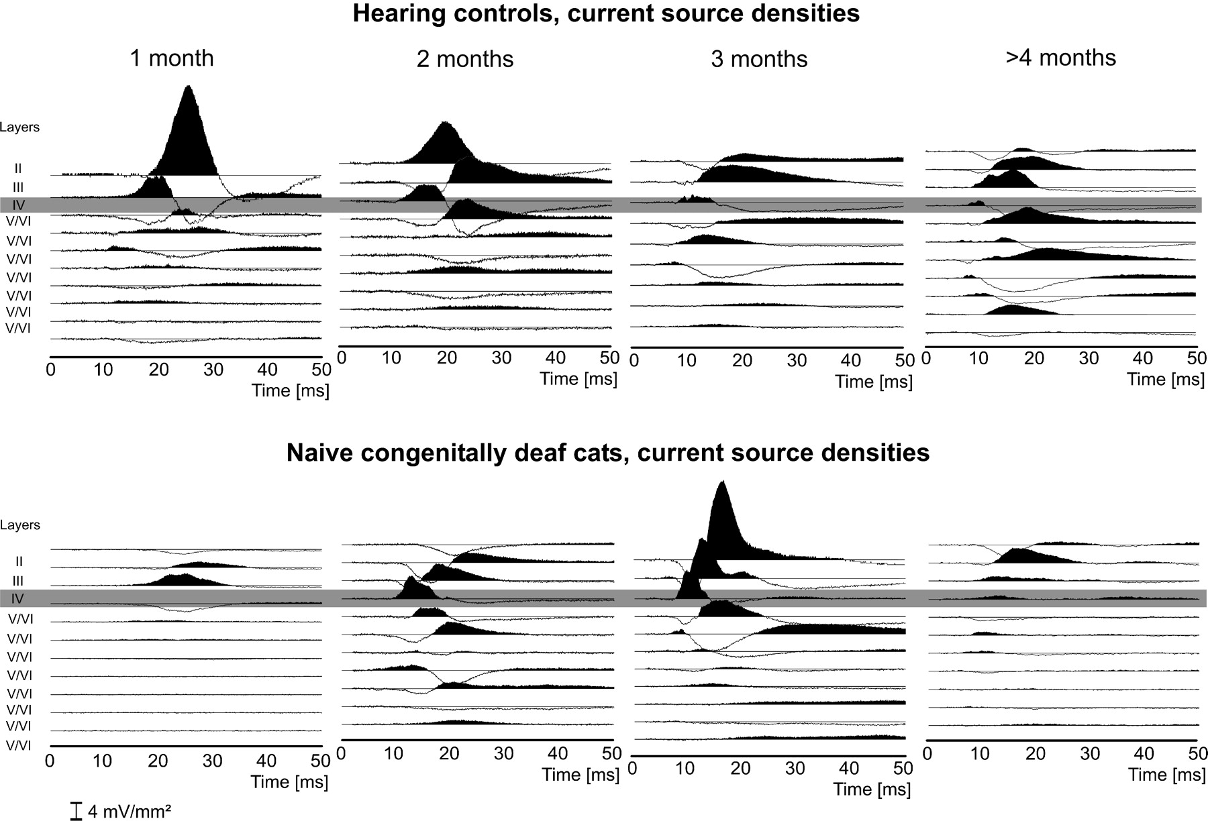
Figure 7. Gross synaptic currents in cortical layers within the ROI as determined by the current source density ...
Notes:
Figure 7. Gross synaptic currents in cortical layers within the ROI as determined by the current source density technique for the first 50 ms after the stimulus; shown are penetrations with largest currents in the given animal. Current sinks are the upward deflections of the signal and were filled black. Penetration of the microelectrode was histologically reconstructed and the current source densities were vertically aligned to match according to individual cortical layers. Layer IV is marked with a grey bar. Top: control cats, bottom: deaf cats.
Unless provided in the caption above, the following copyright applies to the content of this slide: Cerebral Cortex V 15 N 5 © Oxford University Press 2004; all rights reserved

