Slide 1
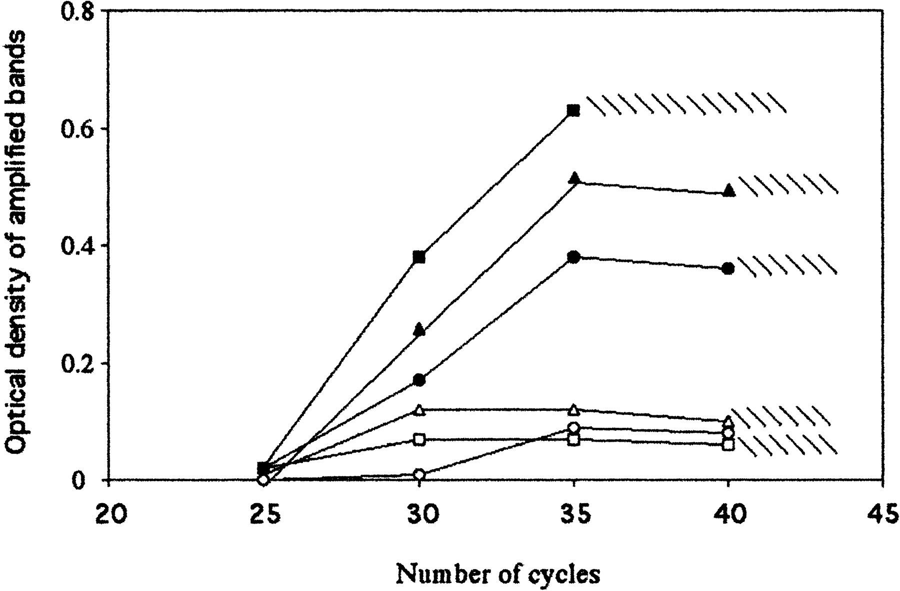
Fig. 1. Effect of the presence of nDNA on the amplification of mtDNA. A pGEM T easy plasmid containing a 274-bp ...
Notes:
Fig. 1. Effect of the presence of nDNA on the amplification of mtDNA. A pGEM T easy plasmid containing a 274-bp fragment of the mitochondrial 16S rRNA gene was amplified under standard conditions. Filled symbols represent amplifications carried out in the absence of nuclear DNA with 1 (•), 10 (▴), and 100 (█) copies of plasmid. Open symbols represent amplifications carried out in the presence of 0.5 μg of nDNA from human ρ° cells with 1 (○), 10 (▵), and 100 (□) copies of plasmid. Hatched marks represents smeared amplification bands obtained when more than 35–40 cycles were carried out
Unless provided in the caption above, the following copyright applies to the content of this slide: © 2003 by the Society for the Study of Reproduction, Inc.

Slide 2
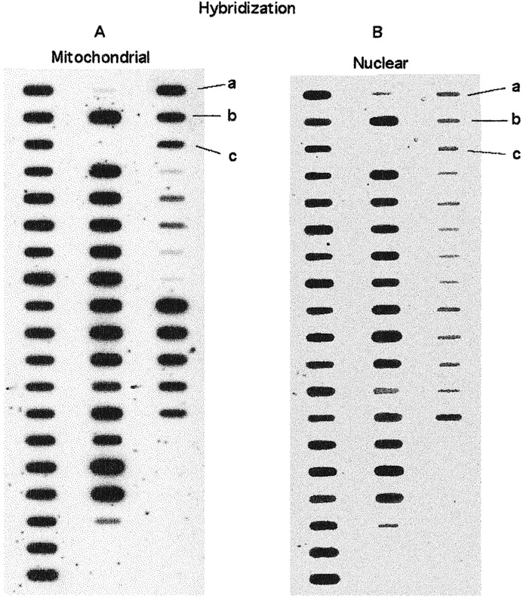
Fig. 2. Autoradiography of 143B cell and human sperm DNA, detected by slot-blot hybridization with a mitochondrial ...
Notes:
Fig. 2. Autoradiography of 143B cell and human sperm DNA, detected by slot-blot hybridization with a mitochondrial (A) and nuclear (B) rDNA probe. Each slot corresponds to a different human sperm DNA sample, except those loaded with a) 1 μg, b) 0.75 μg, and c) 0.5 μg of 143B DNA
Unless provided in the caption above, the following copyright applies to the content of this slide: © 2003 by the Society for the Study of Reproduction, Inc.

Slide 3
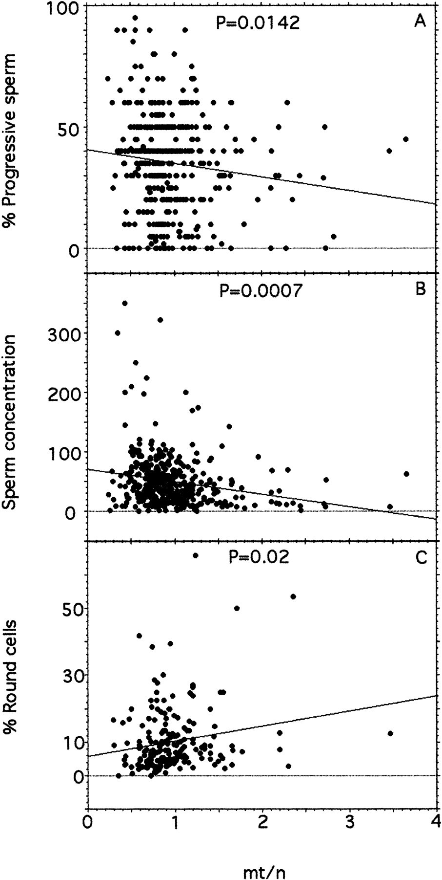
Fig. 3. Correlation between the relative mtDNA content and some parameters of seminal quality. A) Percentage of ...
Notes:
Fig. 3. Correlation between the relative mtDNA content and some parameters of seminal quality. A) Percentage of progressive sperm (P = 0.0142, r = 0.176; ANOVA). B) Spermatozoa concentration (P = 0.0007, r = 0.2; ANOVA). C) Percentage of round cells (P = 0.02, r = 0.17; ANOVA)
Unless provided in the caption above, the following copyright applies to the content of this slide: © 2003 by the Society for the Study of Reproduction, Inc.

Slide 4
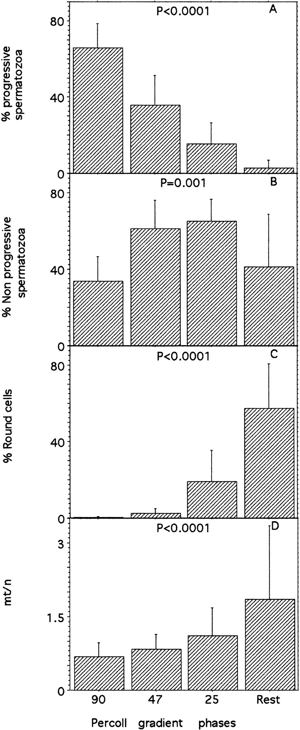
Fig. 4. Fractionation of seminal cells in a discontinuous density Percoll gradient. Bars represent the mean ± SD of ...
Notes:
Fig. 4. Fractionation of seminal cells in a discontinuous density Percoll gradient. Bars represent the mean ± SD of seven experiments with different fresh semen samples. A) Progressive spermatozoa. Significant differences among all phases. B) Nonprogressive spermatozoa. Significant differences for 90% vs. 47% or 25%, 47% vs. Rest, and 25% vs. Rest. C) Round cells. Significant differences among all phases except 90% vs. 47%. D) Mitochondrial DNA:nDNA ratio in each phase. Significant differences for 90%, 47%, and 25% vs. Rest
Unless provided in the caption above, the following copyright applies to the content of this slide: © 2003 by the Society for the Study of Reproduction, Inc.

Slide 5
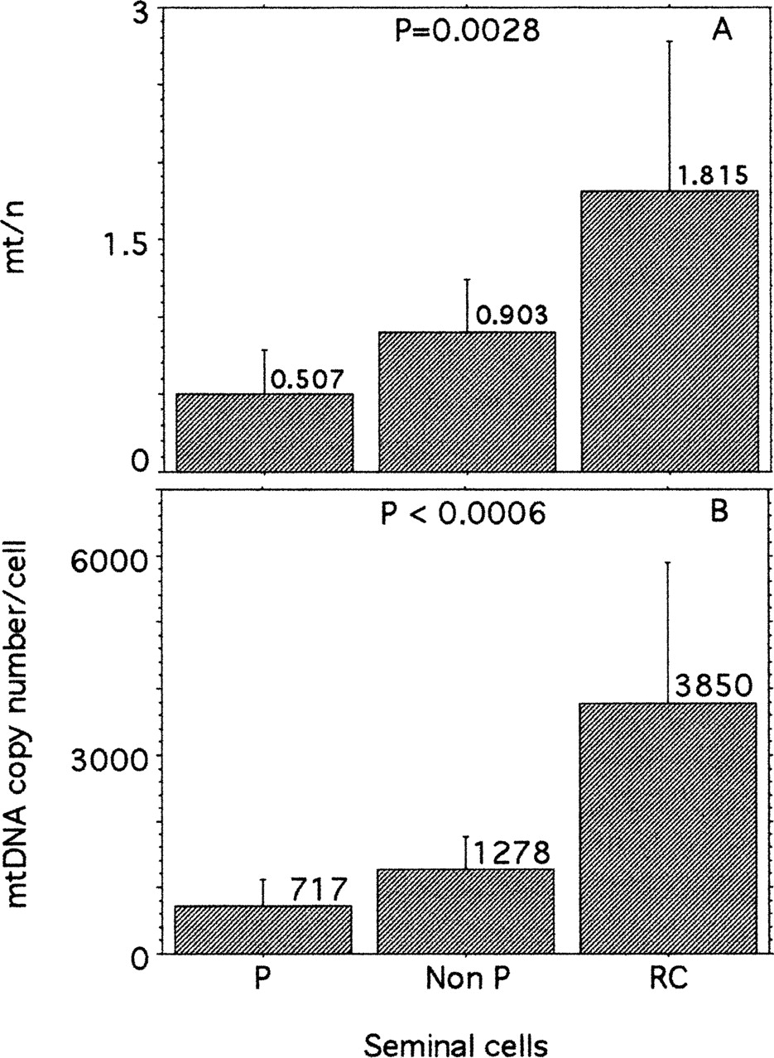
Fig. 5. Relative mtDNA content in the different semen cell types. A) The means (±SD) of the relative mtDNA content ...
Notes:
Fig. 5. Relative mtDNA content in the different semen cell types. A) The means (±SD) of the relative mtDNA content were 0.507 (±0.279) in progressive spermatozoa, 0.903 (±0.337) in nonprogressive spermatozoa, and 1.815 (±0.970) in round cells. B) Characteristic mtDNA copy number in different types of seminal cells. These values were calculated by comparison with the 143B cell line (mtDNA:nDNA = 3.217) with copy number 9100, taking into account that spermatozoa are haploid cells, round cells are haploid and diploid (estimated 50% of each cell ploidy), and 143B cells are diploid
Unless provided in the caption above, the following copyright applies to the content of this slide: © 2003 by the Society for the Study of Reproduction, Inc.

Slide 6
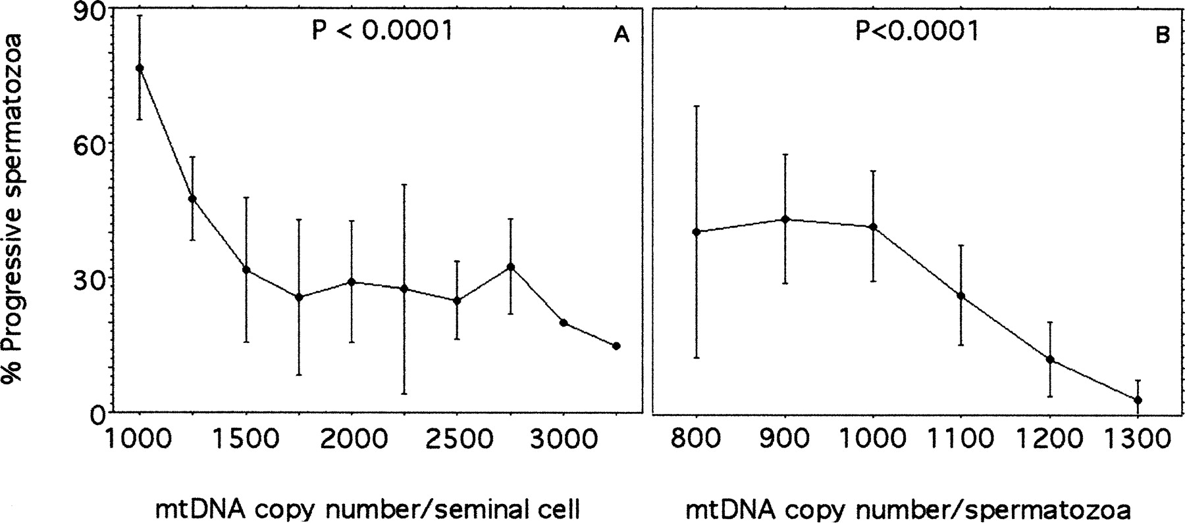
Fig. 6. Correlation between the percentage of progressive spermatozoa and mtDNA copy number per cell. A) Average was ...
Notes:
Fig. 6. Correlation between the percentage of progressive spermatozoa and mtDNA copy number per cell. A) Average was estimated considering the contribution of round cells. B) The contributions of only progressive and nonprogressive spermatozoa were taken into account
Unless provided in the caption above, the following copyright applies to the content of this slide: © 2003 by the Society for the Study of Reproduction, Inc.

Slide 7
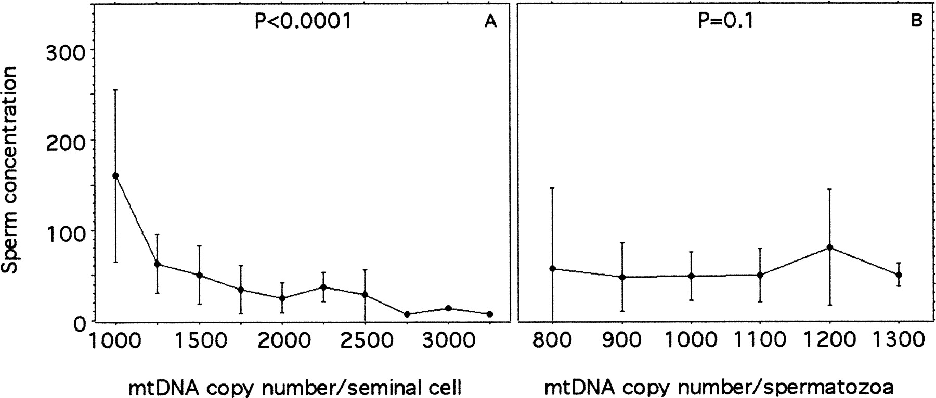
Fig. 7. Correlation between spermatozoon concentration and mtDNA copy number per cell. A) Average was estimated ...
Notes:
Fig. 7. Correlation between spermatozoon concentration and mtDNA copy number per cell. A) Average was estimated considering the contribution of round cells. B) The contributions of only progressive and nonprogressive spermatozoa were taken into account
Unless provided in the caption above, the following copyright applies to the content of this slide: © 2003 by the Society for the Study of Reproduction, Inc.

