Slide 1
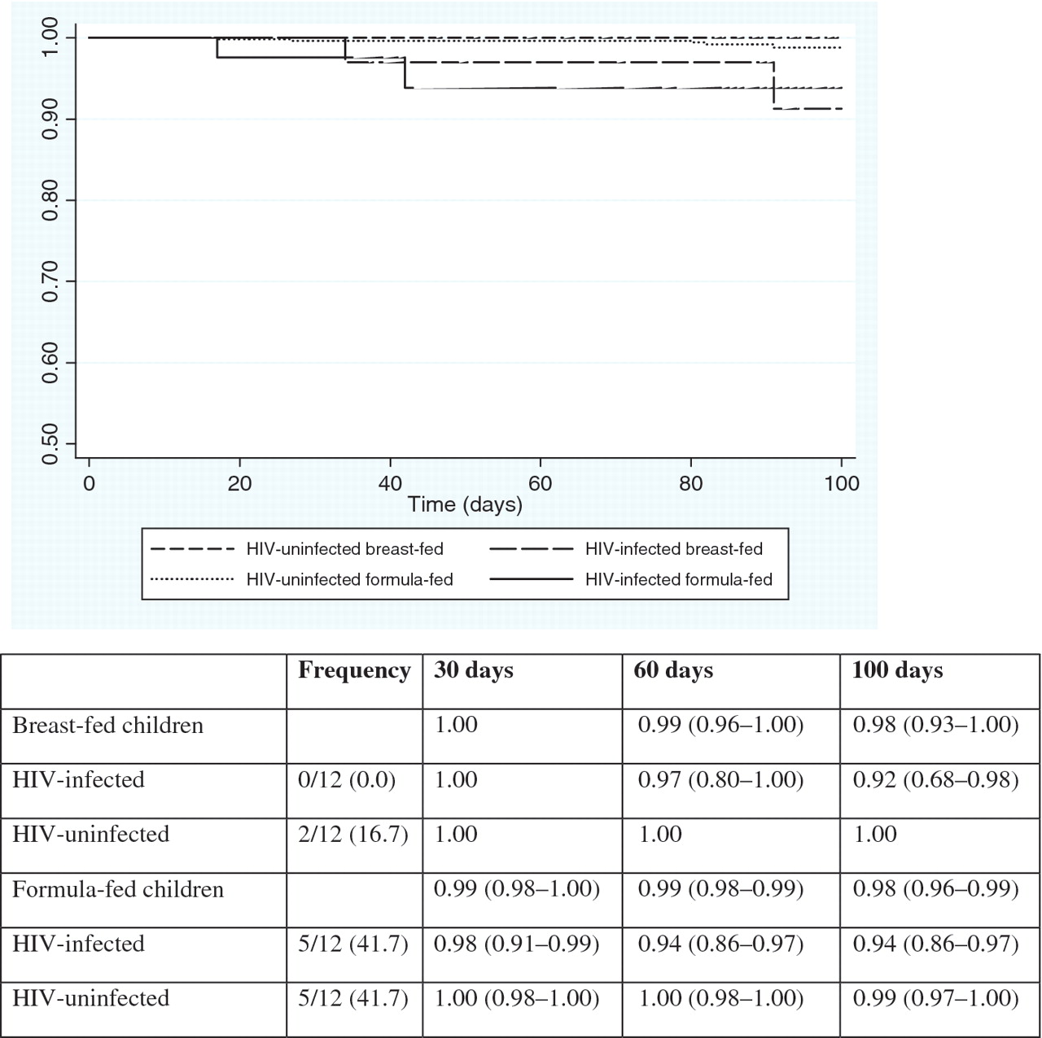
Fig. 2. Kaplan–Meier: probability (95% CI) of remaining alive within the first 100 days of live according to infant ...
Notes:
Fig. 2. Kaplan–Meier: probability (95% CI) of remaining alive within the first 100 days of live according to infant HIV status and mode of infant feeding. The overall log-rank p-value was p = 0.0003. The overall log-rank p-value between breast- and formula-fed infants was p = 0.6689. The overall log-rank p-value between HIV-infected and HIV-uninfected infants was p < 0.0001. Among breast-fed infants, the log-rank p-value between HIV-infected and HIV-uninfected infants was p = 0.0047. Among formula-fed infants, the log-rank p-value between HIV-infected and HIV-uninfected infants was p = 0.0005.
Unless provided in the caption above, the following copyright applies to the content of this slide: © The Author [2010]. Published by Oxford University Press. All rights reserved. For Permissions, please email: journals.permissions@oup.com

Slide 2
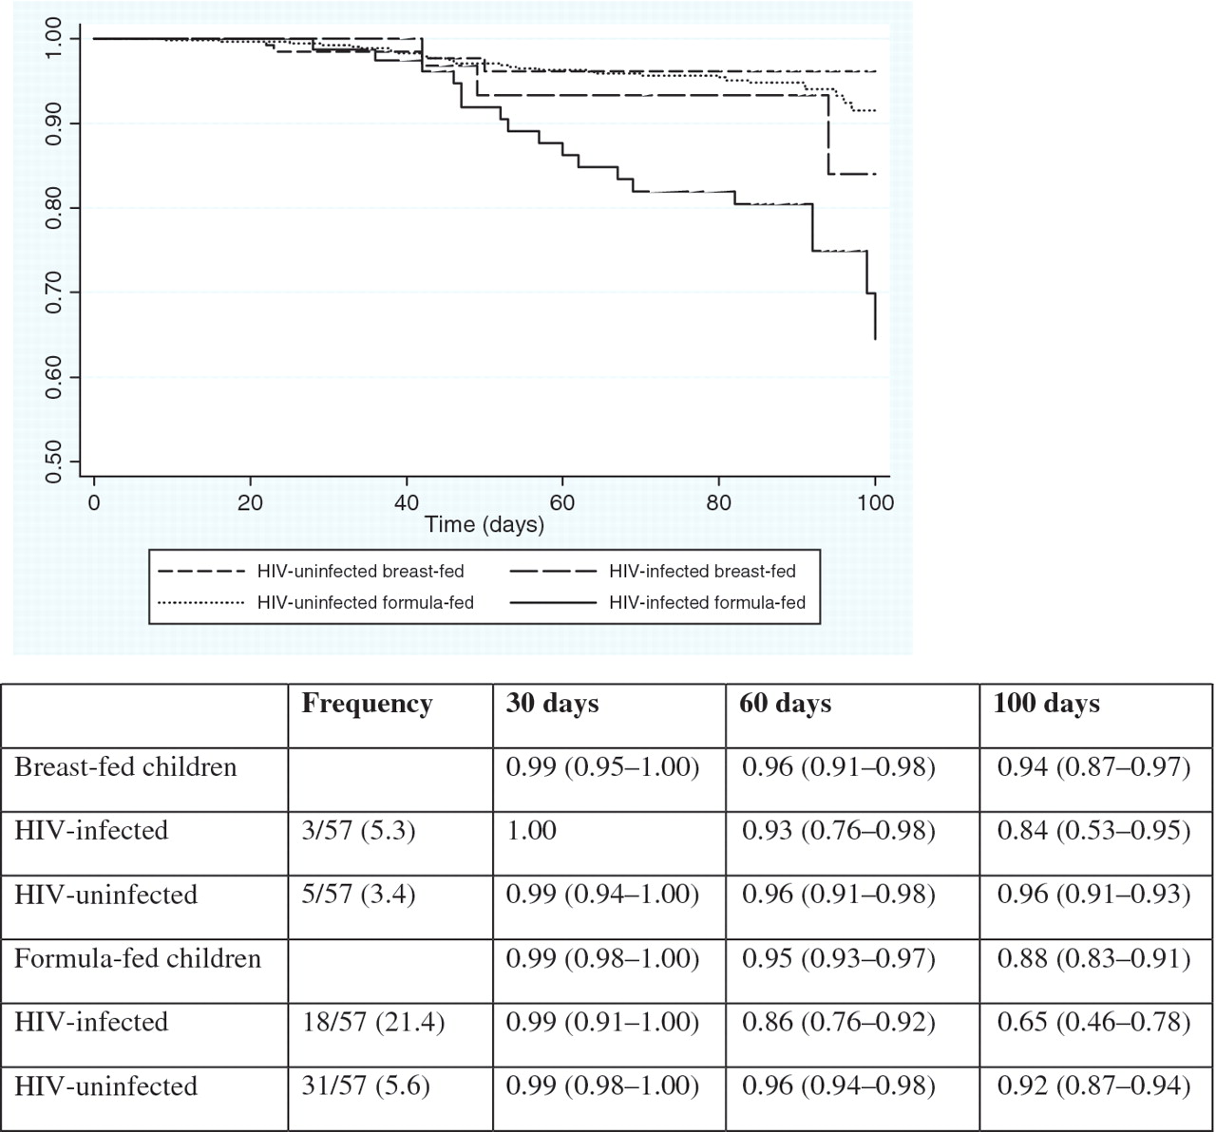
Fig. 1. Kaplan–Meier: Probability (95% CI) of remaining free from hospitalization within the first 100 days of life ...
Notes:
Fig. 1. Kaplan–Meier: Probability (95% CI) of remaining free from hospitalization within the first 100 days of life according to infant HIV status and mode of infant feeding.The overall log-rank p-value was p < 0.001. The overall log-rank p-value between breast- and formula-fed infants was p = 0.1406. The overall log-rank p-value between HIV-infected and HIV-uninfected infants was p < 0.0001. Among breast-fed infants, the log-rank p-value between HIV-infected and HIV-uninfected infants was p = 0.1730. Among formula-fed infants, the log-rank p-value between HIV-infected and HIV-uninfected infants was p < 0.0001.
Unless provided in the caption above, the following copyright applies to the content of this slide: © The Author [2010]. Published by Oxford University Press. All rights reserved. For Permissions, please email: journals.permissions@oup.com

