Slide 1
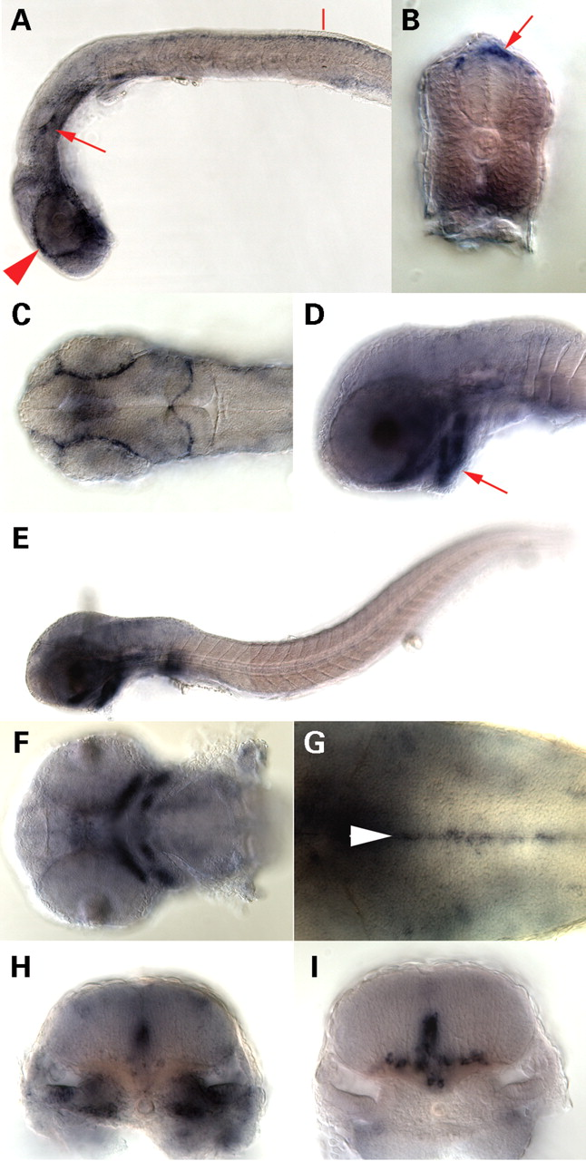
Figure 1. Analysis of disc1 expression in the developing zebrafish embryo. Whole-mount in situ hybridization of disc1 ...
Notes:
Figure 1. Analysis of disc1 expression in the developing zebrafish embryo. Whole-mount in situ hybridization of disc1 ( A – H ) and olig2 ( I ) riboprobes to zebrafish embryos at 26 hpf (A–C) and 50 hpf (D–I). Lateral views of whole embryos at 26 (A) and 50 hpf (E). (A) Strong expression of disc1 is visible in cells surrounding the optic vesicles (arrowhead) and in two ventral patches within each otic vesicle (arrow). (B) Transverse section through the trunk at the level of the red line shown in (A) reveals disc1 expression in delaminating neural crest (arrow). (C) Dorsal view of the head shows disc1 expression between the optic vesicles and tectum and across the midbrain-hindbrain boundary. (D) Lateral view of the head at 50 hpf showing strong disc1 expression in lower jaw cartilages (arrow) and a uniform, lower level of expression in the brain. (E) Lateral view of 50 hpf embryo showing that abundant expression of disc1 is restricted to the brain, craniofacial structures and pectoral fin. (F) Ventral view showing strong disc1 expression in anterior neural crest-derived Meckel's and ceratohyal cartilages at 50 hpf. (G) Dorsal view of hindbrain showing strong disc1 expression in midline cells (arrowhead). (H and I) Transverse sections through the hindbrain at the level of r5 at 50 hpf, showing strong co-localization of disc1 (H) and olig2 (I) transcripts in a restricted sub-population of midline cells. Note that ventro-laterally located olig2 -expressing cells that have migrated away from the midline do not express detectable levels of disc1 .
Unless provided in the caption above, the following copyright applies to the content of this slide: © The Author 2008. Published by Oxford University Press. All rights reserved. For Permissions, please email: journals.permissions@oxfordjournals.org

Slide 2
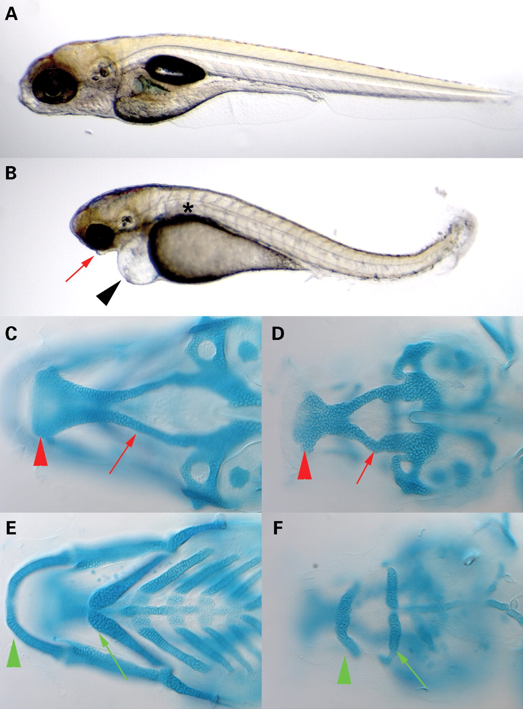
Figure 2. Morphological and craniofacial defects induced by disc1 knock-down. ( A and B ) Low power bright field ...
Notes:
Figure 2. Morphological and craniofacial defects induced by disc1 knock-down. ( A and B ) Low power bright field images of live 5 dpf embryos co-injected with either control and p53 morpholinos (A), or a disc1 translation-blocking morpholino (disc1aug) and a p53 morpholino (B). Injection of the disc1 morpholino specifically induces a p53-independent phenotype that includes small, mis-shapen eyes, a grossly mis-shapen head, pericardial oedema (black arrowhead), lack of a morphologically recognizable lower jaw (red arrow), abnormal pectoral fins, a curved trunk and tail, and failure of the swim bladder to inflate (asterisk). Morpholino-mediated knock-down of disc1 inhibits formation of the viscerocranial cartilages ( C – F ). Cartilage elements were stained using Alcian Blue in disc1 and p53 (D and F) and control and p53 morpholino-injected (C and E) embryos. Ventral views at the level of the ethmoid plate and trabeculae (C and D) and the viscerocranial cartilages (E and F) from the same embryos are shown. In disc1 morphants the ethmoid plate (red arrowhead) and trabeculae (red arrow) are smaller but correctly shaped [compare (D) with (C)], whereas the ceratobranchial, basihyal and basibranchial cartilages were absent, and the Meckel's (green arrowhead) and ceratohyal (green arrow) cartilages were much smaller than in control morpholino-injected embryos [compare (F) with (E)].
Unless provided in the caption above, the following copyright applies to the content of this slide: © The Author 2008. Published by Oxford University Press. All rights reserved. For Permissions, please email: journals.permissions@oxfordjournals.org

Slide 3
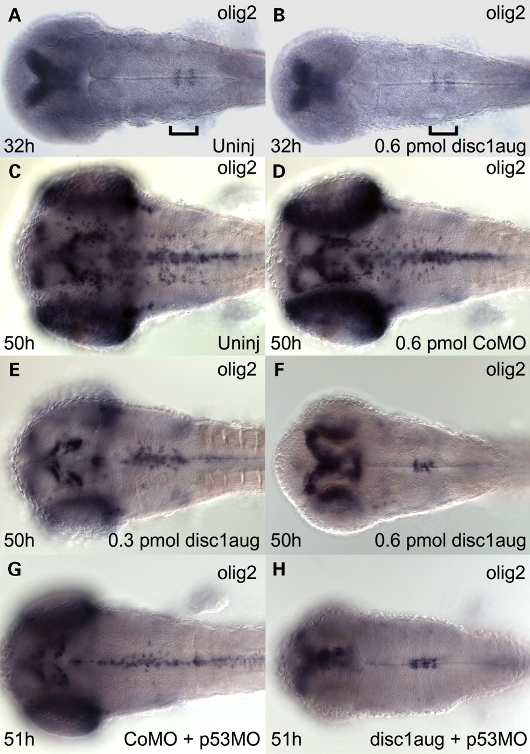
Figure 3. disc1 is required for expansion of the population of olig2 -positive cells in the hindbrain. Whole-mount in ...
Notes:
Figure 3. disc1 is required for expansion of the population of olig2 -positive cells in the hindbrain. Whole-mount in situ hybridization with an olig2 riboprobe was performed on embryos fixed at 32 hpf ( A and B ), 50 hpf ( C – F ) and 51 hpf ( G and H ). Expression of olig2 is initiated in hindbrain rhombomeres 5 and 6 midline cells of uninjected (A) and disc1aug morpholino-injected (B) embryos by 32 hpf. The location of hindbrain rhombomeres 5 and 6 is indicated by the brackets. Expression of olig2 is detected along the entire length of the hindbrain midline of uninjected (C) and control morpholino-injected (D) embryos at 50 hpf, whereas in contrast, expression of olig2 remained restricted to the midline of rhombomeres 5 and 6 in embryos injected with a high dose (0.6 pmol) of the disc1aug morpholino (F) at 50 hpf. Embryos injected with a lower dose (0.3 pmol) of the disc1aug morpholino showed a reduction in the number of olig2 -expressing cells in the hindbrain at 50 hpf (E). Similarly, in a separate experiment, expression of olig2 was detected along the entire length of the hindbrain midline of control morpholino- plus p53 morpholino-injected (G) embryos at 51hpf, whereas in disc1aug morpholino- plus p53 morpholino-injected embryos (H), expression of olig2 remained restricted to the midline of rhombomeres 5 and 6.
Unless provided in the caption above, the following copyright applies to the content of this slide: © The Author 2008. Published by Oxford University Press. All rights reserved. For Permissions, please email: journals.permissions@oxfordjournals.org

Slide 4
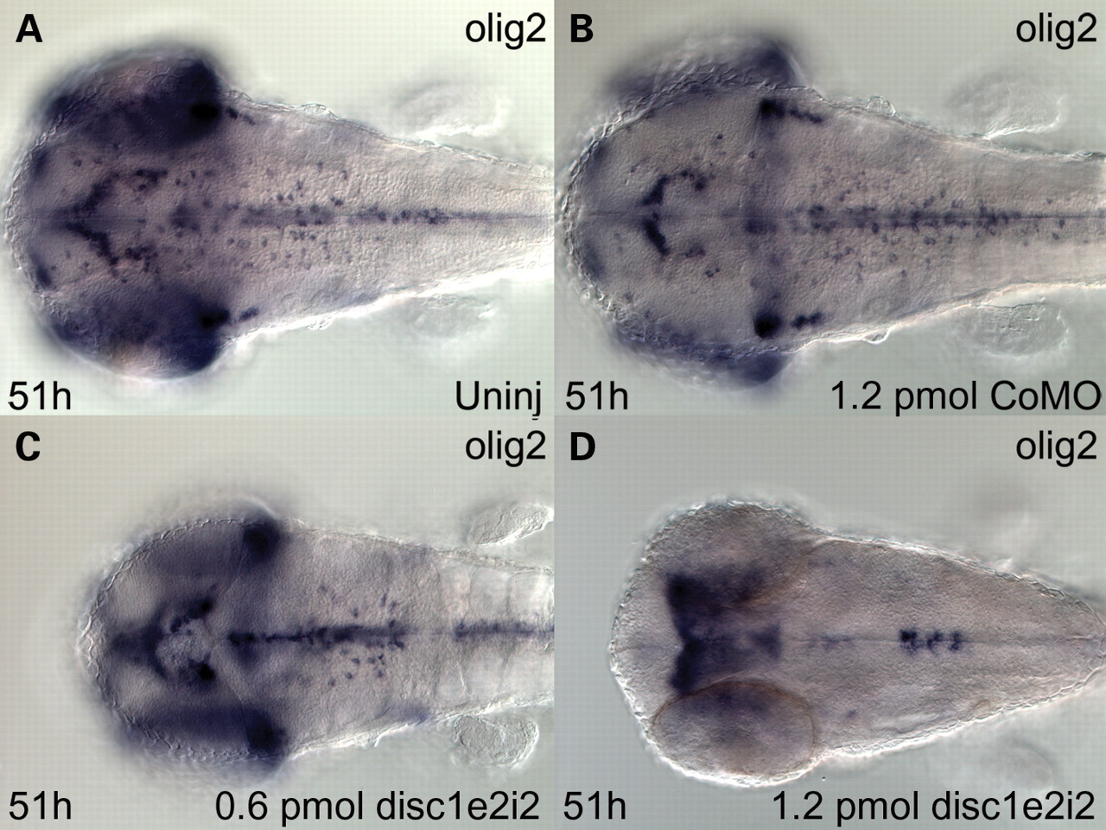
Figure 4. A disc1 splice-blocking morpholino (disc1e2i2) causes similar dose-dependent effects on olig2 expression in ...
Notes:
Figure 4. A disc1 splice-blocking morpholino (disc1e2i2) causes similar dose-dependent effects on olig2 expression in the hindbrain to the disc1 translation-blocking morpholino. Uninjected ( A ), 1.2 pmol control morpholino-injected ( B ), 0.6 pmol disc1e2i2- ( C ) and 1.2 pmol disc1e2i2-injected ( D ) embryos at 51 hpf are shown.
Unless provided in the caption above, the following copyright applies to the content of this slide: © The Author 2008. Published by Oxford University Press. All rights reserved. For Permissions, please email: journals.permissions@oxfordjournals.org

Slide 5
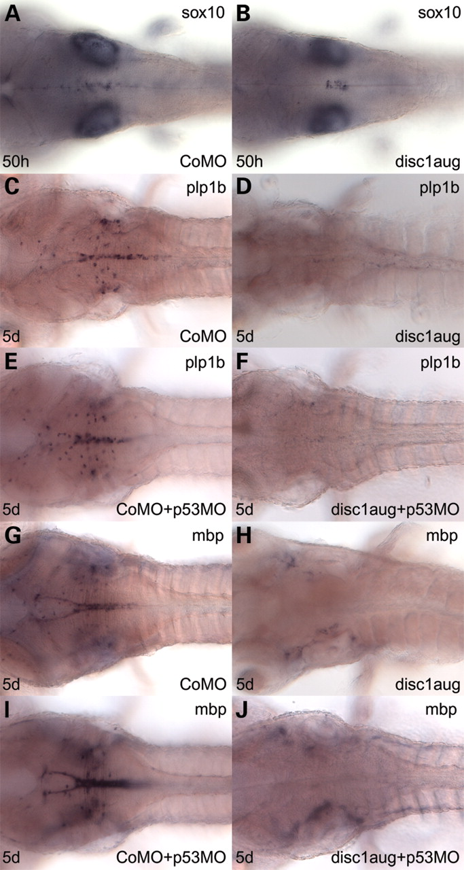
Figure 5. disc1 is required for development of the oligodendrocyte lineage in the zebrafish hindbrain. Whole-mount in ...
Notes:
Figure 5. disc1 is required for development of the oligodendrocyte lineage in the zebrafish hindbrain. Whole-mount in situ hybridization with sox10 ( A and B ), plp1b ( C – F ) and mbp ( G – J ) riboprobes on embryos microinjected with control (A, C, E, G and I) and disc1aug (B, D, F, H and J) morpholinos, then fixed at 50 hpf (A and B) and 5 dpf (C–J). Consistent with the olig2 expression patterns described in Figure 3 , the distribution of sox10 -expressing cells at 50 hpf also remained restricted to hindbrain rhombomeres 5 and 6 in disc1aug-injected embryos (B), whereas sox10 -expressing cells were distributed along the entire length of the hindbrain midline in control morpholino-injected embryos (A). In contrast, sox10 expression in the otic vesicle was unaffected by injection of disc1aug morpholino, compare (A) and (B). Expression of the oligodendrocyte differentiation markers plp1b and mbp in the hindbrain was greatly reduced in disc1aug-injected embryos at 5 dpf (D and H), as compared with their widespread expression in the hindbrain of control morpholino-injected sibling embryos (C and G), revealing a profound deficit of differentiated oligodendrocytes in disc1aug-injected embryos. These defects in oligodendrocyte development were p53-independent: Expression of plp1b and mbp in the hindbrain is widespread in a dispersed population of cells at 5 dpf in the hindbrain of embryos injected with a combination of control and p53 morpholinos (E and I), whereas the populations of plp1b and mbp -expressing cells are eliminated in embryos injected with a combination of disc1aug and p53 morpholinos (F and J).
Unless provided in the caption above, the following copyright applies to the content of this slide: © The Author 2008. Published by Oxford University Press. All rights reserved. For Permissions, please email: journals.permissions@oxfordjournals.org

Slide 6
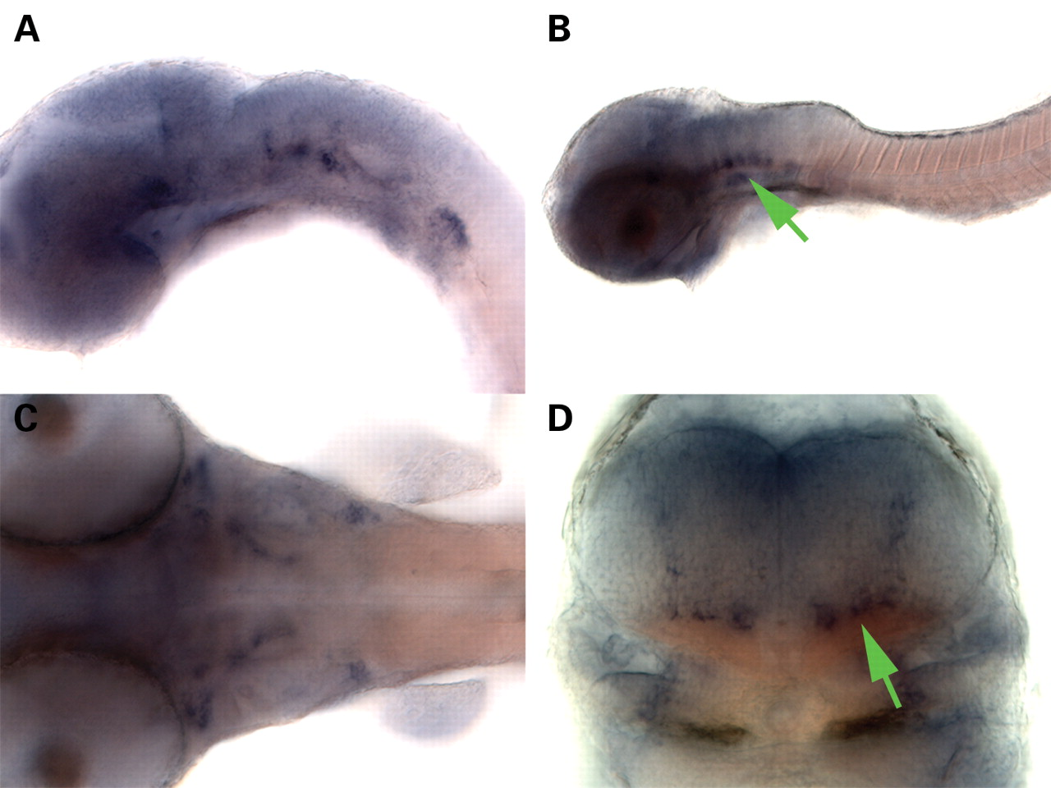
Figure 6. Analysis of embryonic nrg1 expression. Whole-mount in situ hybridization of an nrg1 riboprobe to zebrafish ...
Notes:
Figure 6. Analysis of embryonic nrg1 expression. Whole-mount in situ hybridization of an nrg1 riboprobe to zebrafish embryos at 30 hpf ( A ) and 50 hpf ( B – D ) stages. Lateral views of the head show that nrg1 is expressed uniformly throughout the brain at 30 hpf (A) with strongest expression in patches of cells in the hindbrain. At 50 hpf (B), nrg1 expression is strongest in ventral territories of the hindbrain (arrow). Dorsal view of the hindbrain further illustrating discrete patches of nrg1 expressing cells at 50 hpf, including two arcs of expression extending rostrally through rhombomeres 4 and 5 (C). Transverse sections through the hindbrain at the level of r5 at 50 hpf (D) demonstrate that nrg1 is prominently expressed in ventrally located cells that extend medio-laterally across the floor of the hindbrain (arrow), as well as in a column of cells that extends dorsally from the lateral margins of the ventral population of nrg1 -expressing cells on each side of the hindbrain.
Unless provided in the caption above, the following copyright applies to the content of this slide: © The Author 2008. Published by Oxford University Press. All rights reserved. For Permissions, please email: journals.permissions@oxfordjournals.org

Slide 7
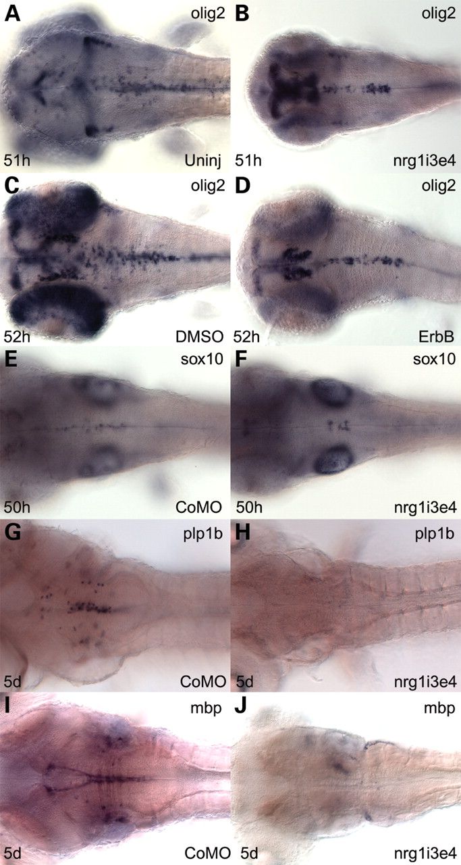
Figure 7. The Neuregulin-ErbB signalling pathway is required for oligodendrocyte development in the zebrafish ...
Notes:
Figure 7. The Neuregulin-ErbB signalling pathway is required for oligodendrocyte development in the zebrafish hindbrain. Whole-mount in situ hybridization with olig2 ( A – D ), sox10 ( E and F ), plp1b ( G and H ) and mbp ( I and J ) riboprobes on uninjected (A), DMSO-treated (C), control morpholino- (E, G and I), nrg1i3e4 morpholino-injected (B, F, H and J) and ErbB inhibitor treated (D) embryos fixed at 51 hpf (A and B), 52 hpf (C and D), 50 hpf (E and F) and 5 dpf (G–J). Dorsal views show that expression of olig2 in hindbrain of nrg1 morphants (B) is reduced and restricted to midline cells compared to uninjected controls (A). Constant exposure of wild-type embryos to 25 µM N -(4-((3-Chloro-4-fluorophenyl)amino)pyrido[3,4-d]pyrimidin-6-yl)2-butynamide (an inhibitor of ErbB receptor tyrosine kinases) in 2% DMSO, from 30–52 hpf (D) reduced the number of hindbrain olig2 -expressing cells and restricted their distribution to the midline, as was observed when either disc1 or nrg1 was knocked down, and these effects were not observed in control embryos exposed to DMSO alone (C). The distribution of sox10 -expressing cells was restricted to hindbrain rhombomeres 5 and 6 in nrg1i3e4-injected embryos at 50 hpf (F), whereas sox10 -expressing cells were distributed along the entire length of the hindbrain midline in control morpholino-injected embryos (E). Expression of plp1b (H) and mbp (J) was also substantially reduced in the hindbrain of nrg1 morphants, as compared with control morpholino-injected embryos (G and I), indicating a severe impairment of oligodendrocyte development.
Unless provided in the caption above, the following copyright applies to the content of this slide: © The Author 2008. Published by Oxford University Press. All rights reserved. For Permissions, please email: journals.permissions@oxfordjournals.org

Slide 8
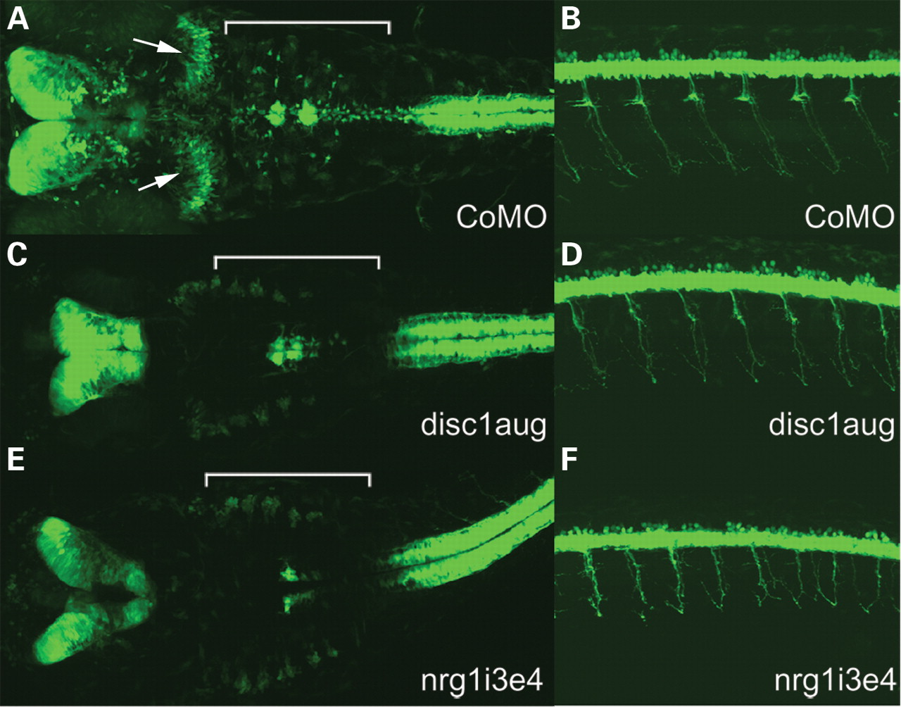
Figure 8. Disc1 and nrg1 are required for correct specification of olig2 -positive cerebellar neurones but not spinal ...
Notes:
Figure 8. Disc1 and nrg1 are required for correct specification of olig2 -positive cerebellar neurones but not spinal motor neurones. Confocal imaging of GFP fluorescence in olig2:gfp transgenic embryos at 50 hpf illustrates a near total loss of GFP-expressing cells in the cerebellum, which are a subset of neurones reported to have similarities to eurydendroid neurones ( 28 ). These cells are seen as two semicircular arcs in control morpholino-injected embryos (arrows in A ), but are almost completely absent in disc1aug- ( C ) and nrg1i3e4-injected ( E ) embryos. Consistent with our findings using whole-mount in situ hybridization for olig2 , GFP expression in the posterior hindbrain (bracketed) was mostly confined to midline cells in rhombomeres 5 and 6 in disc1 (C) and nrg1 (E) morphants, compared with control injected embryos (A). Conversely, knock-down of disc1 ( D ) or nrg1 ( F ) had minimal effects on specification of olig2 -positive cells in the spinal cord, although mild defects in spinal motor neurone axon outgrowth are apparent, more so in nrg1 morphants (F) than disc1 morphants (D).
Unless provided in the caption above, the following copyright applies to the content of this slide: © The Author 2008. Published by Oxford University Press. All rights reserved. For Permissions, please email: journals.permissions@oxfordjournals.org

