Slide 1
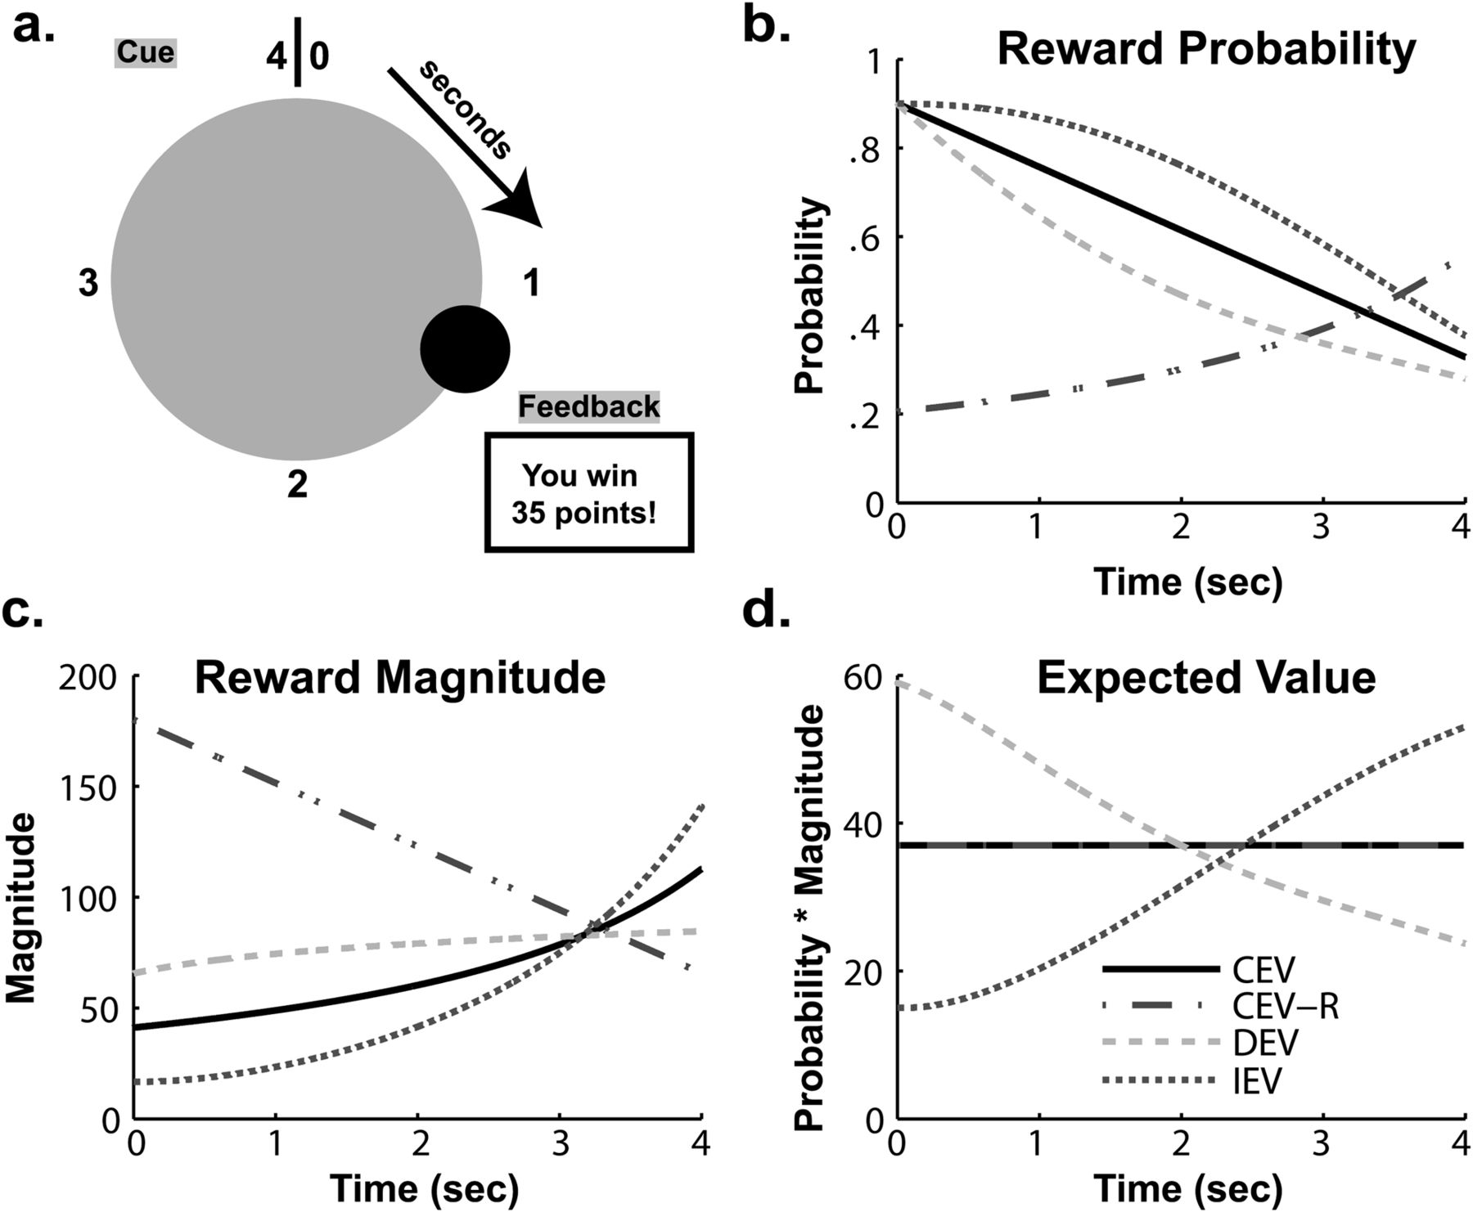
Figure 1. The task consisted of 4 blocks with varying EV of reward depending on RT. (a) Example trial where the ...
Notes:
Figure 1. The task consisted of 4 blocks with varying EV of reward depending on RT. (a) Example trial where the participant made a response ∼1.2 s, receiving a 35-point reward. Blocks consisted of different conditions that had varied probabilities (b) and magnitudes (c) or reward over time, creating separate EV distributions (d). To maximize reward, participants need to learn to respond faster when EV decreased (DEV) and slower when EV increased (IEV) compared with when it was constant (CEV). A fourth condition contained reversed magnitudes and probabilities with constant EV (CEV-R); slower responses on this block reflect a preference for magnitudes over probabilities and a risk-averse strategy.
Unless provided in the caption above, the following copyright applies to the content of this slide: © The Author 2011. Published by Oxford University Press. All rights reserved. For permissions, please e-mail: journals.permissions@oup.com

Slide 2
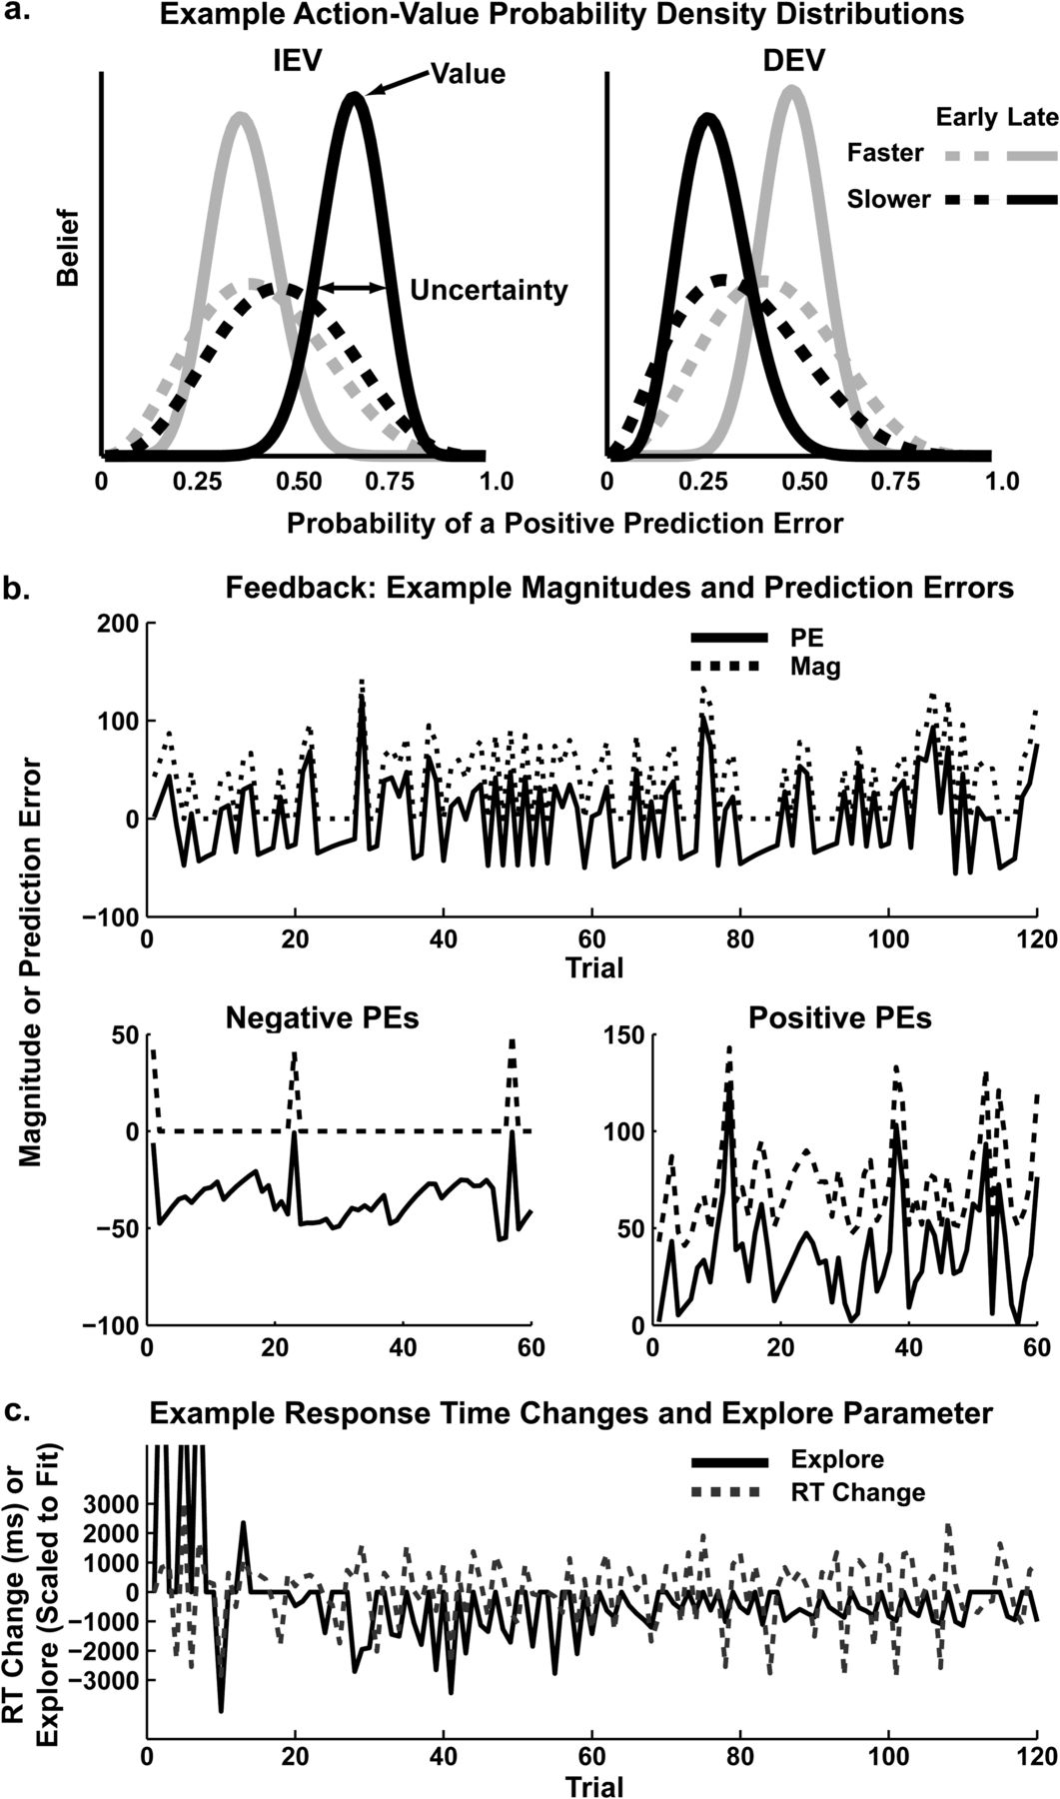
Figure 2. Example model outcomes from a single representative participant. (a) PDFs. Early in the block, probability ...
Notes:
Figure 2. Example model outcomes from a single representative participant. (a) PDFs. Early in the block, probability densities peak around 0.5 and have large variances. Later in learning, these migrate and sharpen to provide estimates of value (mean) and uncertainty (variance). This investigation used the relative difference between slower and faster variances to classify exploitative and exploratory strategies. (b) Feedback and prediction error. While positive prediction errors closely followed the magnitude of reward, negative prediction errors largely occur to zero-reward feedback and were estimated from the model. (c) Explore parameter and RT change. Large differences in uncertainty predicted RT swings in participants with high explore parameters.
Unless provided in the caption above, the following copyright applies to the content of this slide: © The Author 2011. Published by Oxford University Press. All rights reserved. For permissions, please e-mail: journals.permissions@oup.com

Slide 3
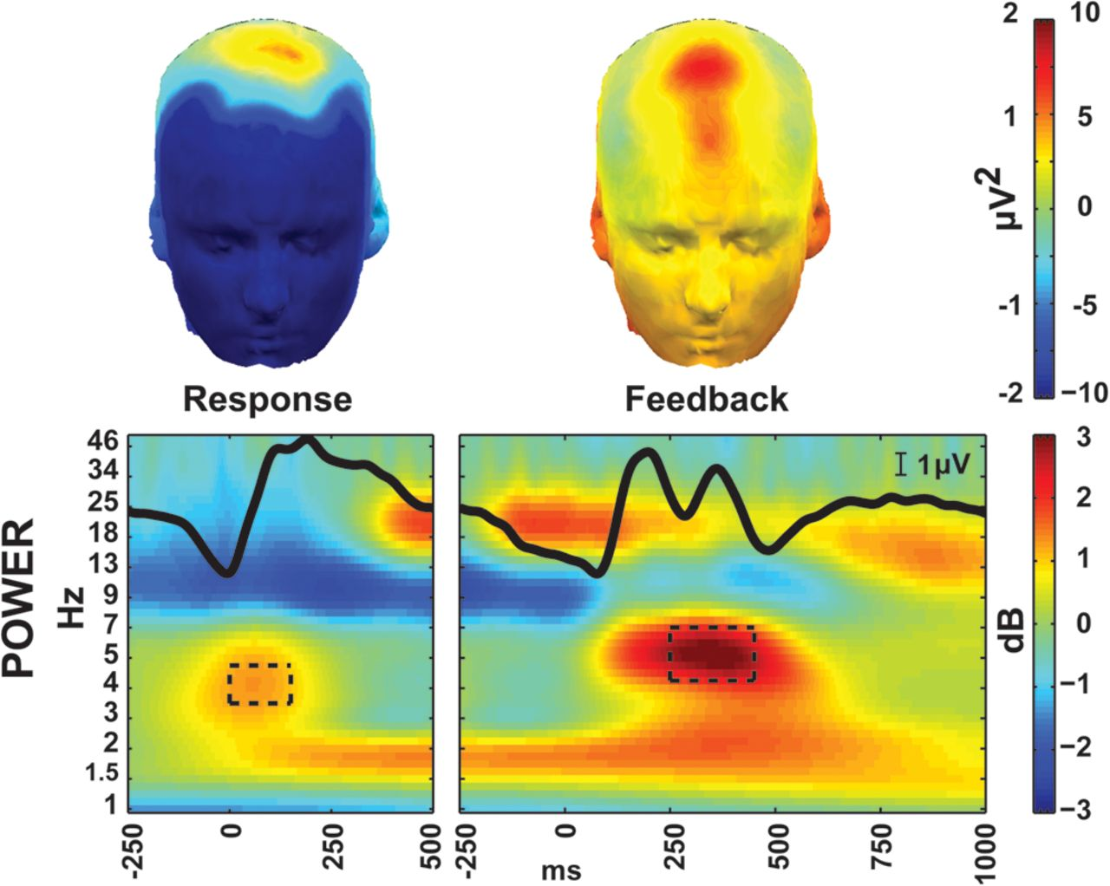
Figure 3. Event-related EEG at the FCz electrode to response and feedback. Positive amplitude is displayed up on the ...
Notes:
Figure 3. Event-related EEG at the FCz electrode to response and feedback. Positive amplitude is displayed up on the y-axis. The ERP is superimposed over the power plots in black. TF-ROIs are shown in the black boxes. Topomaps are taken from the TF-ROIs shown here (±10 μV2 for feedback, ±2 μV2 for response).
Unless provided in the caption above, the following copyright applies to the content of this slide: © The Author 2011. Published by Oxford University Press. All rights reserved. For permissions, please e-mail: journals.permissions@oup.com

Slide 4
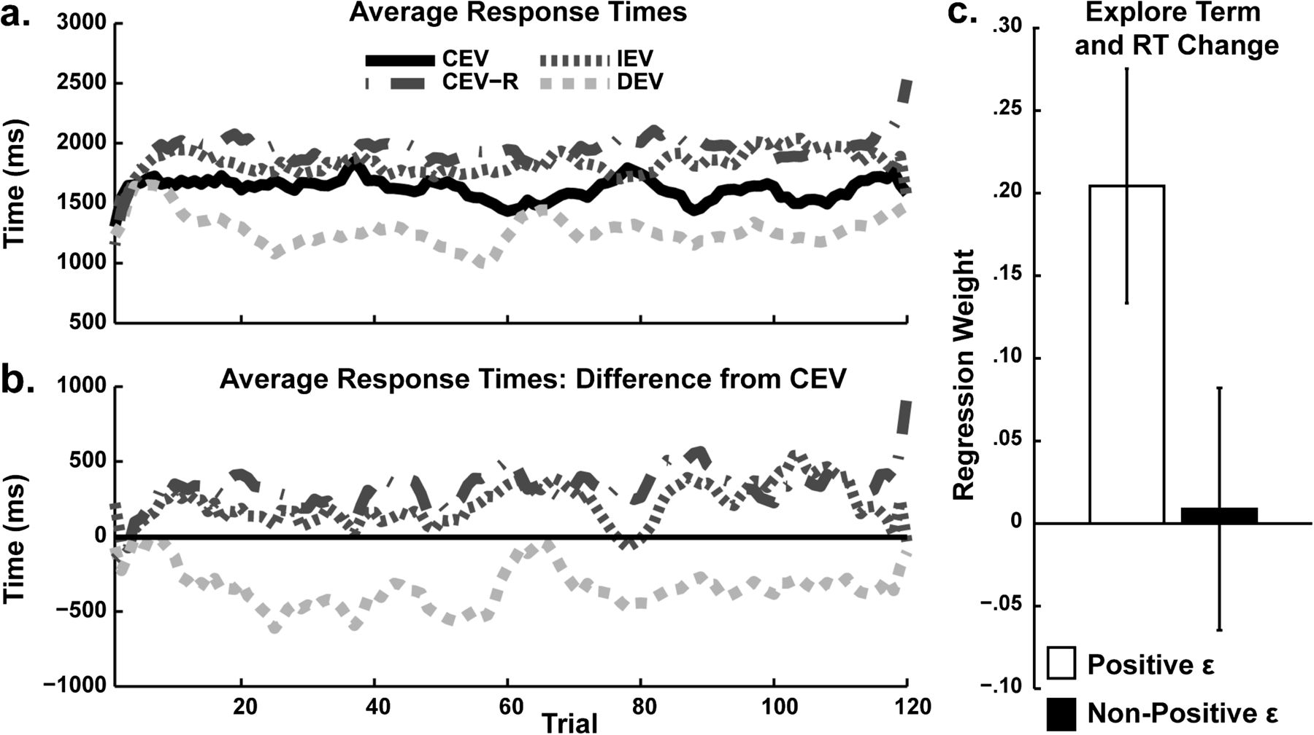
Figure 4. Average RT performance. (a, b) Participants learned to adapt RTs (smoothed with a 5-point kernel) depending ...
Notes:
Figure 4. Average RT performance. (a, b) Participants learned to adapt RTs (smoothed with a 5-point kernel) depending on block-specific reward structure. For example, participants responded slower when EV increased over time and they responded faster when EV decreased over time, even relative to their own performance when EV was constant. Slower RTs to the constant EV-reversed (CEV-R) condition demonstrate a preference for reward probability over magnitude (risk aversion). (c) Positive ϵ participants were characterized by the model as using relative uncertainty to guide exploration. Here it can be seen that this group was characterized by significant correlations between trial-to-trial measures of exploration and RT change.
Unless provided in the caption above, the following copyright applies to the content of this slide: © The Author 2011. Published by Oxford University Press. All rights reserved. For permissions, please e-mail: journals.permissions@oup.com

Slide 5
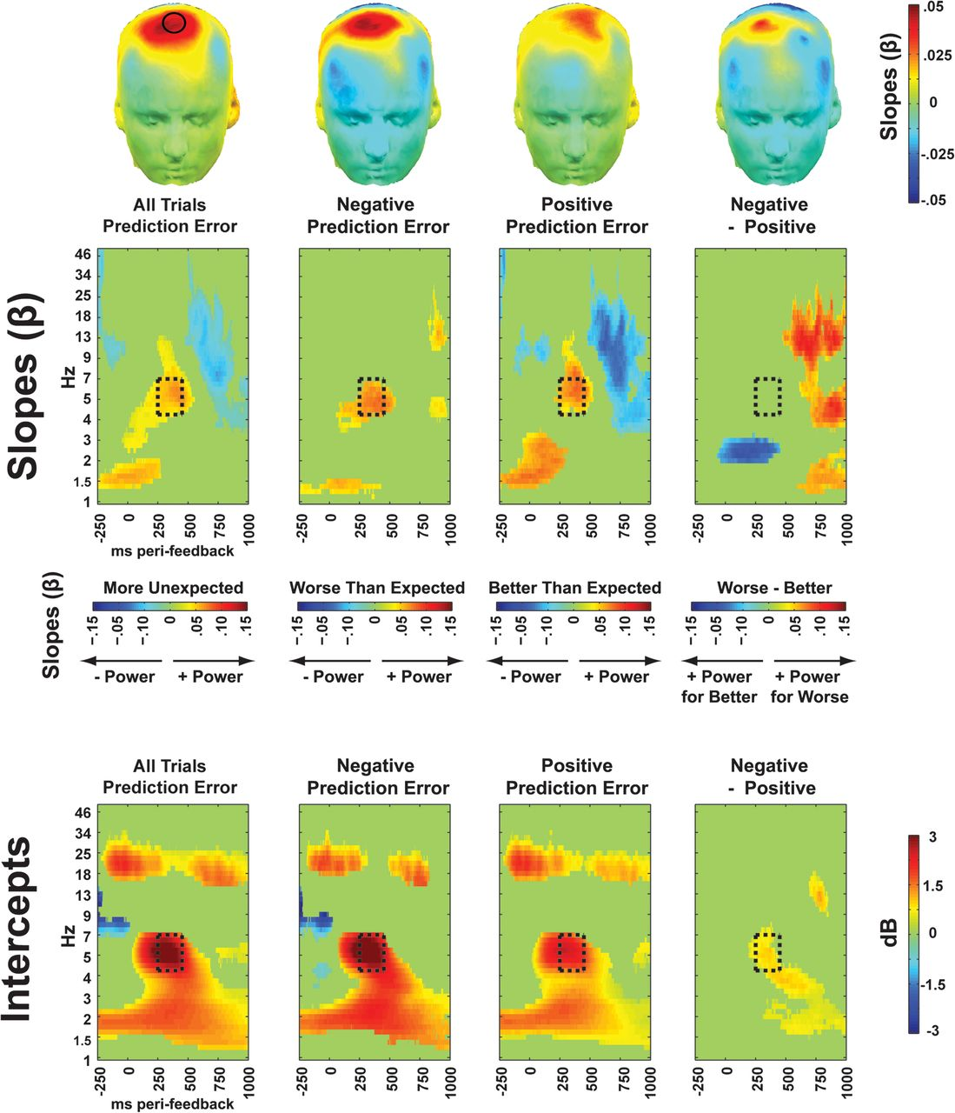
Figure 5. Mid-frontal (FCz) EEG relationships with prediction error measures. Topographic plots show regression slopes ...
Notes:
Figure 5. Mid-frontal (FCz) EEG relationships with prediction error measures. Topographic plots show regression slopes in the TF-ROIs. FCz is indicated on the first topoplot. Time–frequency plots of slopes show the regression weight with absolute prediction error, demonstrating that prediction error magnitude scales with mid-frontal theta. This theta-band relationship does not depend on the sign of the prediction error, as demonstrated by a lack of statistical difference between negative and positive prediction errors in the theta-band TF-ROI. In contrast, there was an intercept offset for negative compared with positive prediction errors in this TF-ROI (converted to decibel change from pre-cue baseline intercept). These plots demonstrate how mid-frontal theta does not reflect a signed prediction error; rather, it reflects the overall degree of surprise with an asymmetrical offset when events are worse than expected.
Unless provided in the caption above, the following copyright applies to the content of this slide: © The Author 2011. Published by Oxford University Press. All rights reserved. For permissions, please e-mail: journals.permissions@oup.com

Slide 6
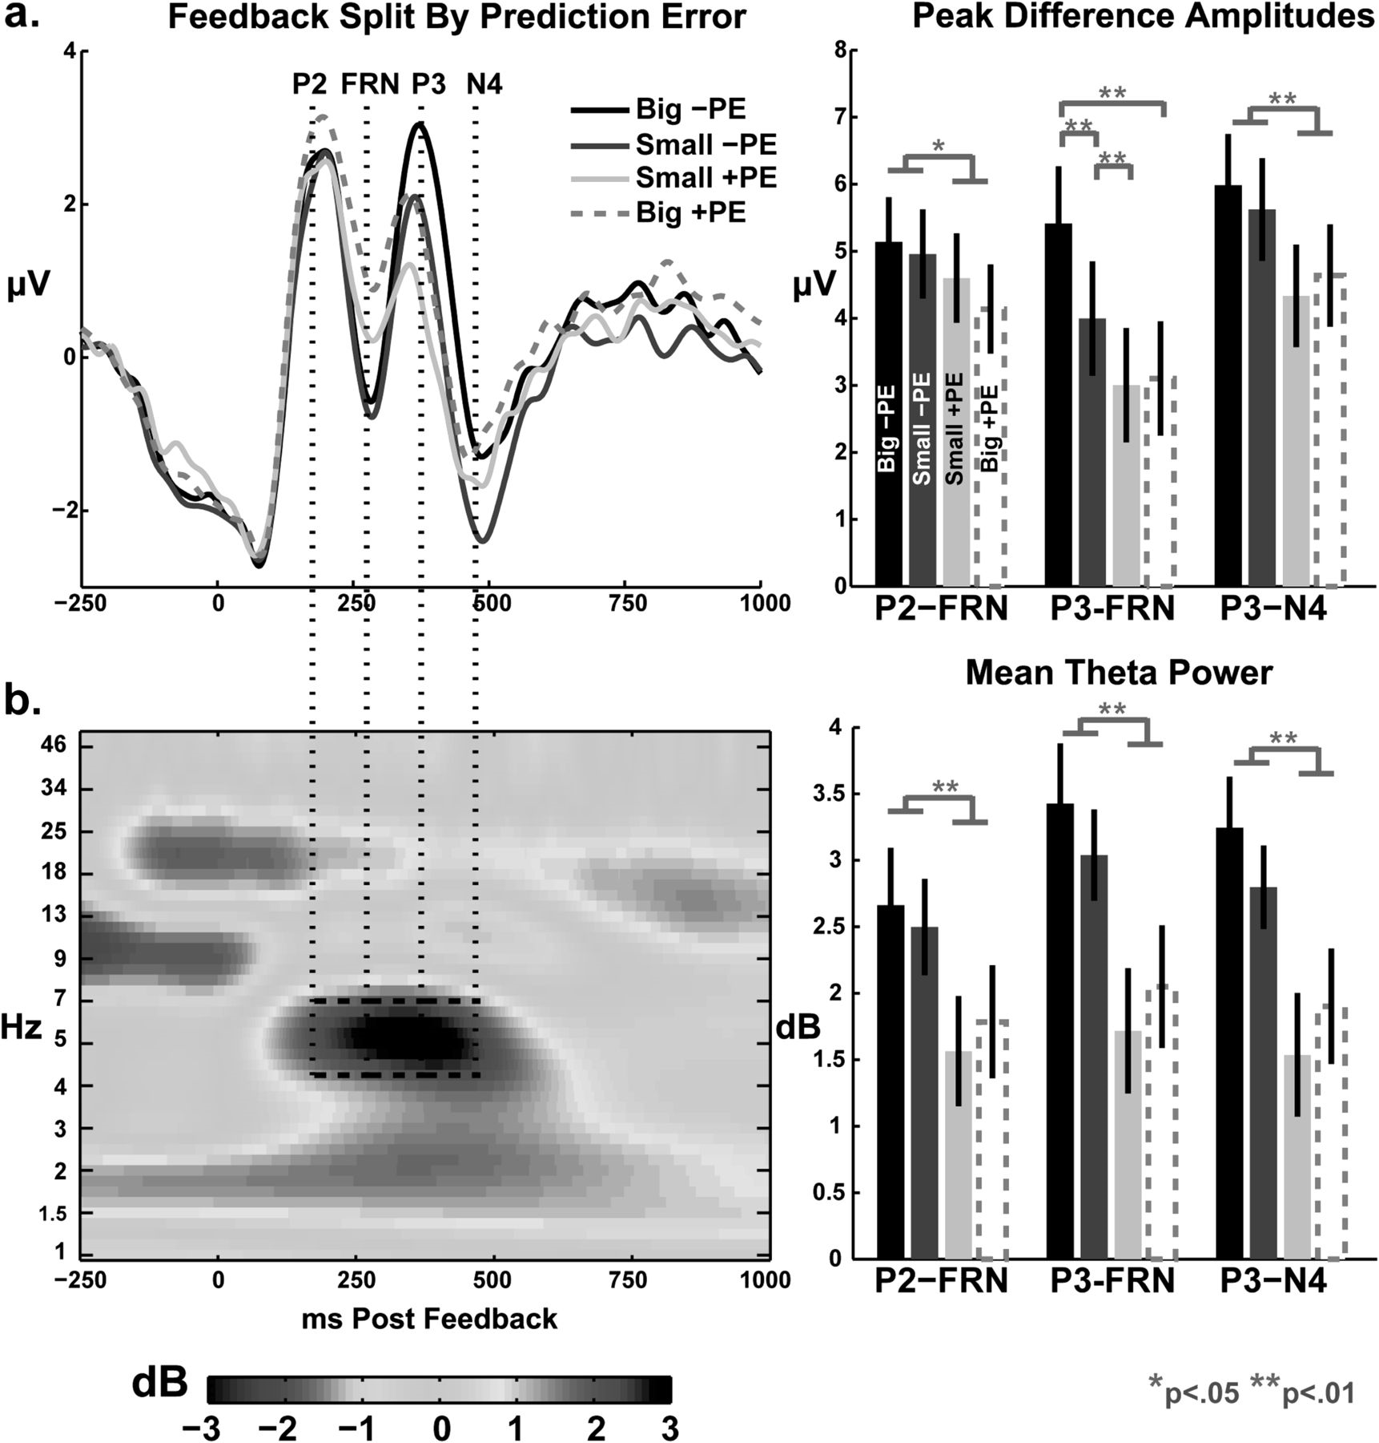
Figure 6. Feedback-locked ERP (a) and total theta power (b) from the FCz electrode, split by sign and magnitude of ...
Notes:
Figure 6. Feedback-locked ERP (a) and total theta power (b) from the FCz electrode, split by sign and magnitude of prediction error. Bar graphs display mean values (±SEM) taken from the time windows indicated by vertical dashed lines. For both EEG measurements, there was a strong and reliable effect for sign (negative > positive prediction error).
Unless provided in the caption above, the following copyright applies to the content of this slide: © The Author 2011. Published by Oxford University Press. All rights reserved. For permissions, please e-mail: journals.permissions@oup.com

Slide 7
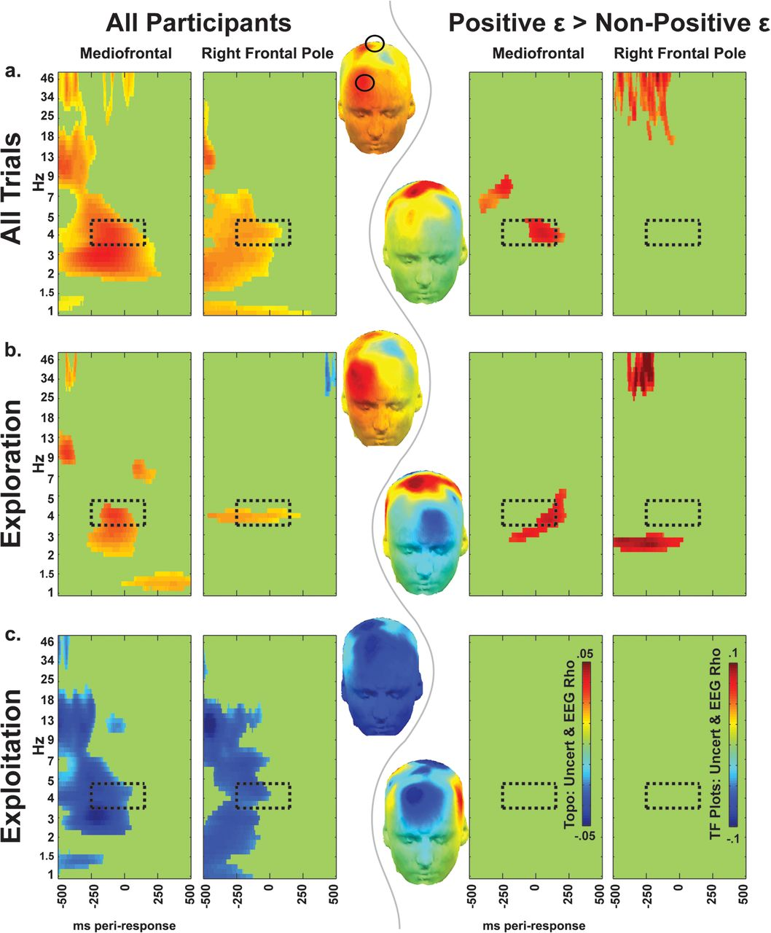
Figure 7. Nonparametric correlations (ρ values) between relative uncertainty (chosen–unchosen option) and EEG power at ...
Notes:
Figure 7. Nonparametric correlations (ρ values) between relative uncertainty (chosen–unchosen option) and EEG power at the time of the response, for all subjects (left columns) and positive ϵ > nonpositive ϵ groups (right columns). Topographic plots show EEG–uncertainty correlations in the extended TF-ROI (leftward topoplots are all subjects, rightward topoplots are positive ϵ > nonpositive ϵ). Mid-frontal and right frontopolar sites are indicated on the top topoplot. (a) Total relative uncertainty is characterized by a positive relationship with medial beta power and medial and frontopolar theta power. (b) When participants selected the response with greater uncertainty, similar patterns emerged: frontopolar theta and mid-frontal theta correlated with relative uncertainty. This specific effect was larger in subjects that the model identified as using uncertainty to guide exploration (positive ϵ). (c) In stark contrast, when participants selected the option with the lower relative uncertainty, there were widespread negative correlations between relative uncertainty and medio/lateral/frontal beta and theta power and no difference between ϵ groups.
Unless provided in the caption above, the following copyright applies to the content of this slide: © The Author 2011. Published by Oxford University Press. All rights reserved. For permissions, please e-mail: journals.permissions@oup.com

Slide 8
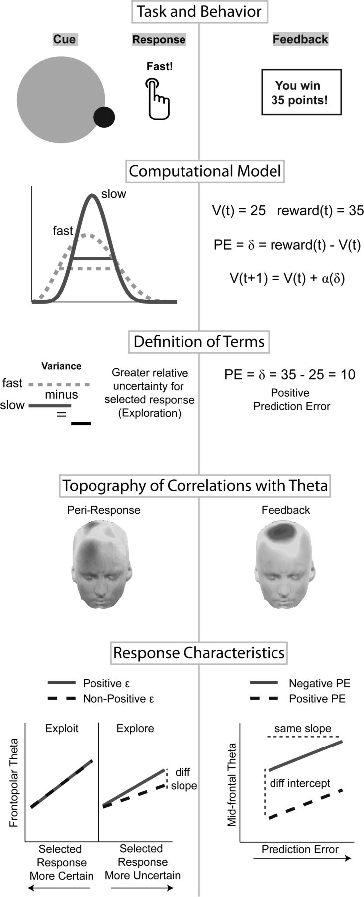
Figure 8. Summary figure. In the left column, a sample trial details that a fast response was chosen. Faster responses ...
Notes:
Figure 8. Summary figure. In the left column, a sample trial details that a fast response was chosen. Faster responses had higher probability distribution variance than slow responses; thus, there was more relative uncertainty for the chosen option, which was defined as an exploratory trial. Greater relative uncertainty correlated with peri-response theta power in mid-frontal and right frontopolar areas. Response characteristic slopes were taken from unthresholded TF-ROIs in Figure 7; conditions where participants selected the response with lower relative uncertainty (exploitation) were inverted from Figure 7c to demonstrate the continuous nature of the relationship between relative uncertainty of the selected response and theta power. This plot shows how individuals who used uncertainty to explore (positive ϵ) had significantly larger slopes only when exploring. The right column shows a sample feedback. Given the current estimation of action value for fast responses (25), this feedback (35) reflected a better-than-expected outcome (positive prediction error: +10). Prediction errors correlated with mid-frontal theta power. Response characteristic slopes were taken from unthresholded TF-ROIs from Figure 5; valenced prediction errors had similar slopes, yet negative prediction errors were characterized by a larger initial offset (greater power overall).
Unless provided in the caption above, the following copyright applies to the content of this slide: © The Author 2011. Published by Oxford University Press. All rights reserved. For permissions, please e-mail: journals.permissions@oup.com

