Slide 1
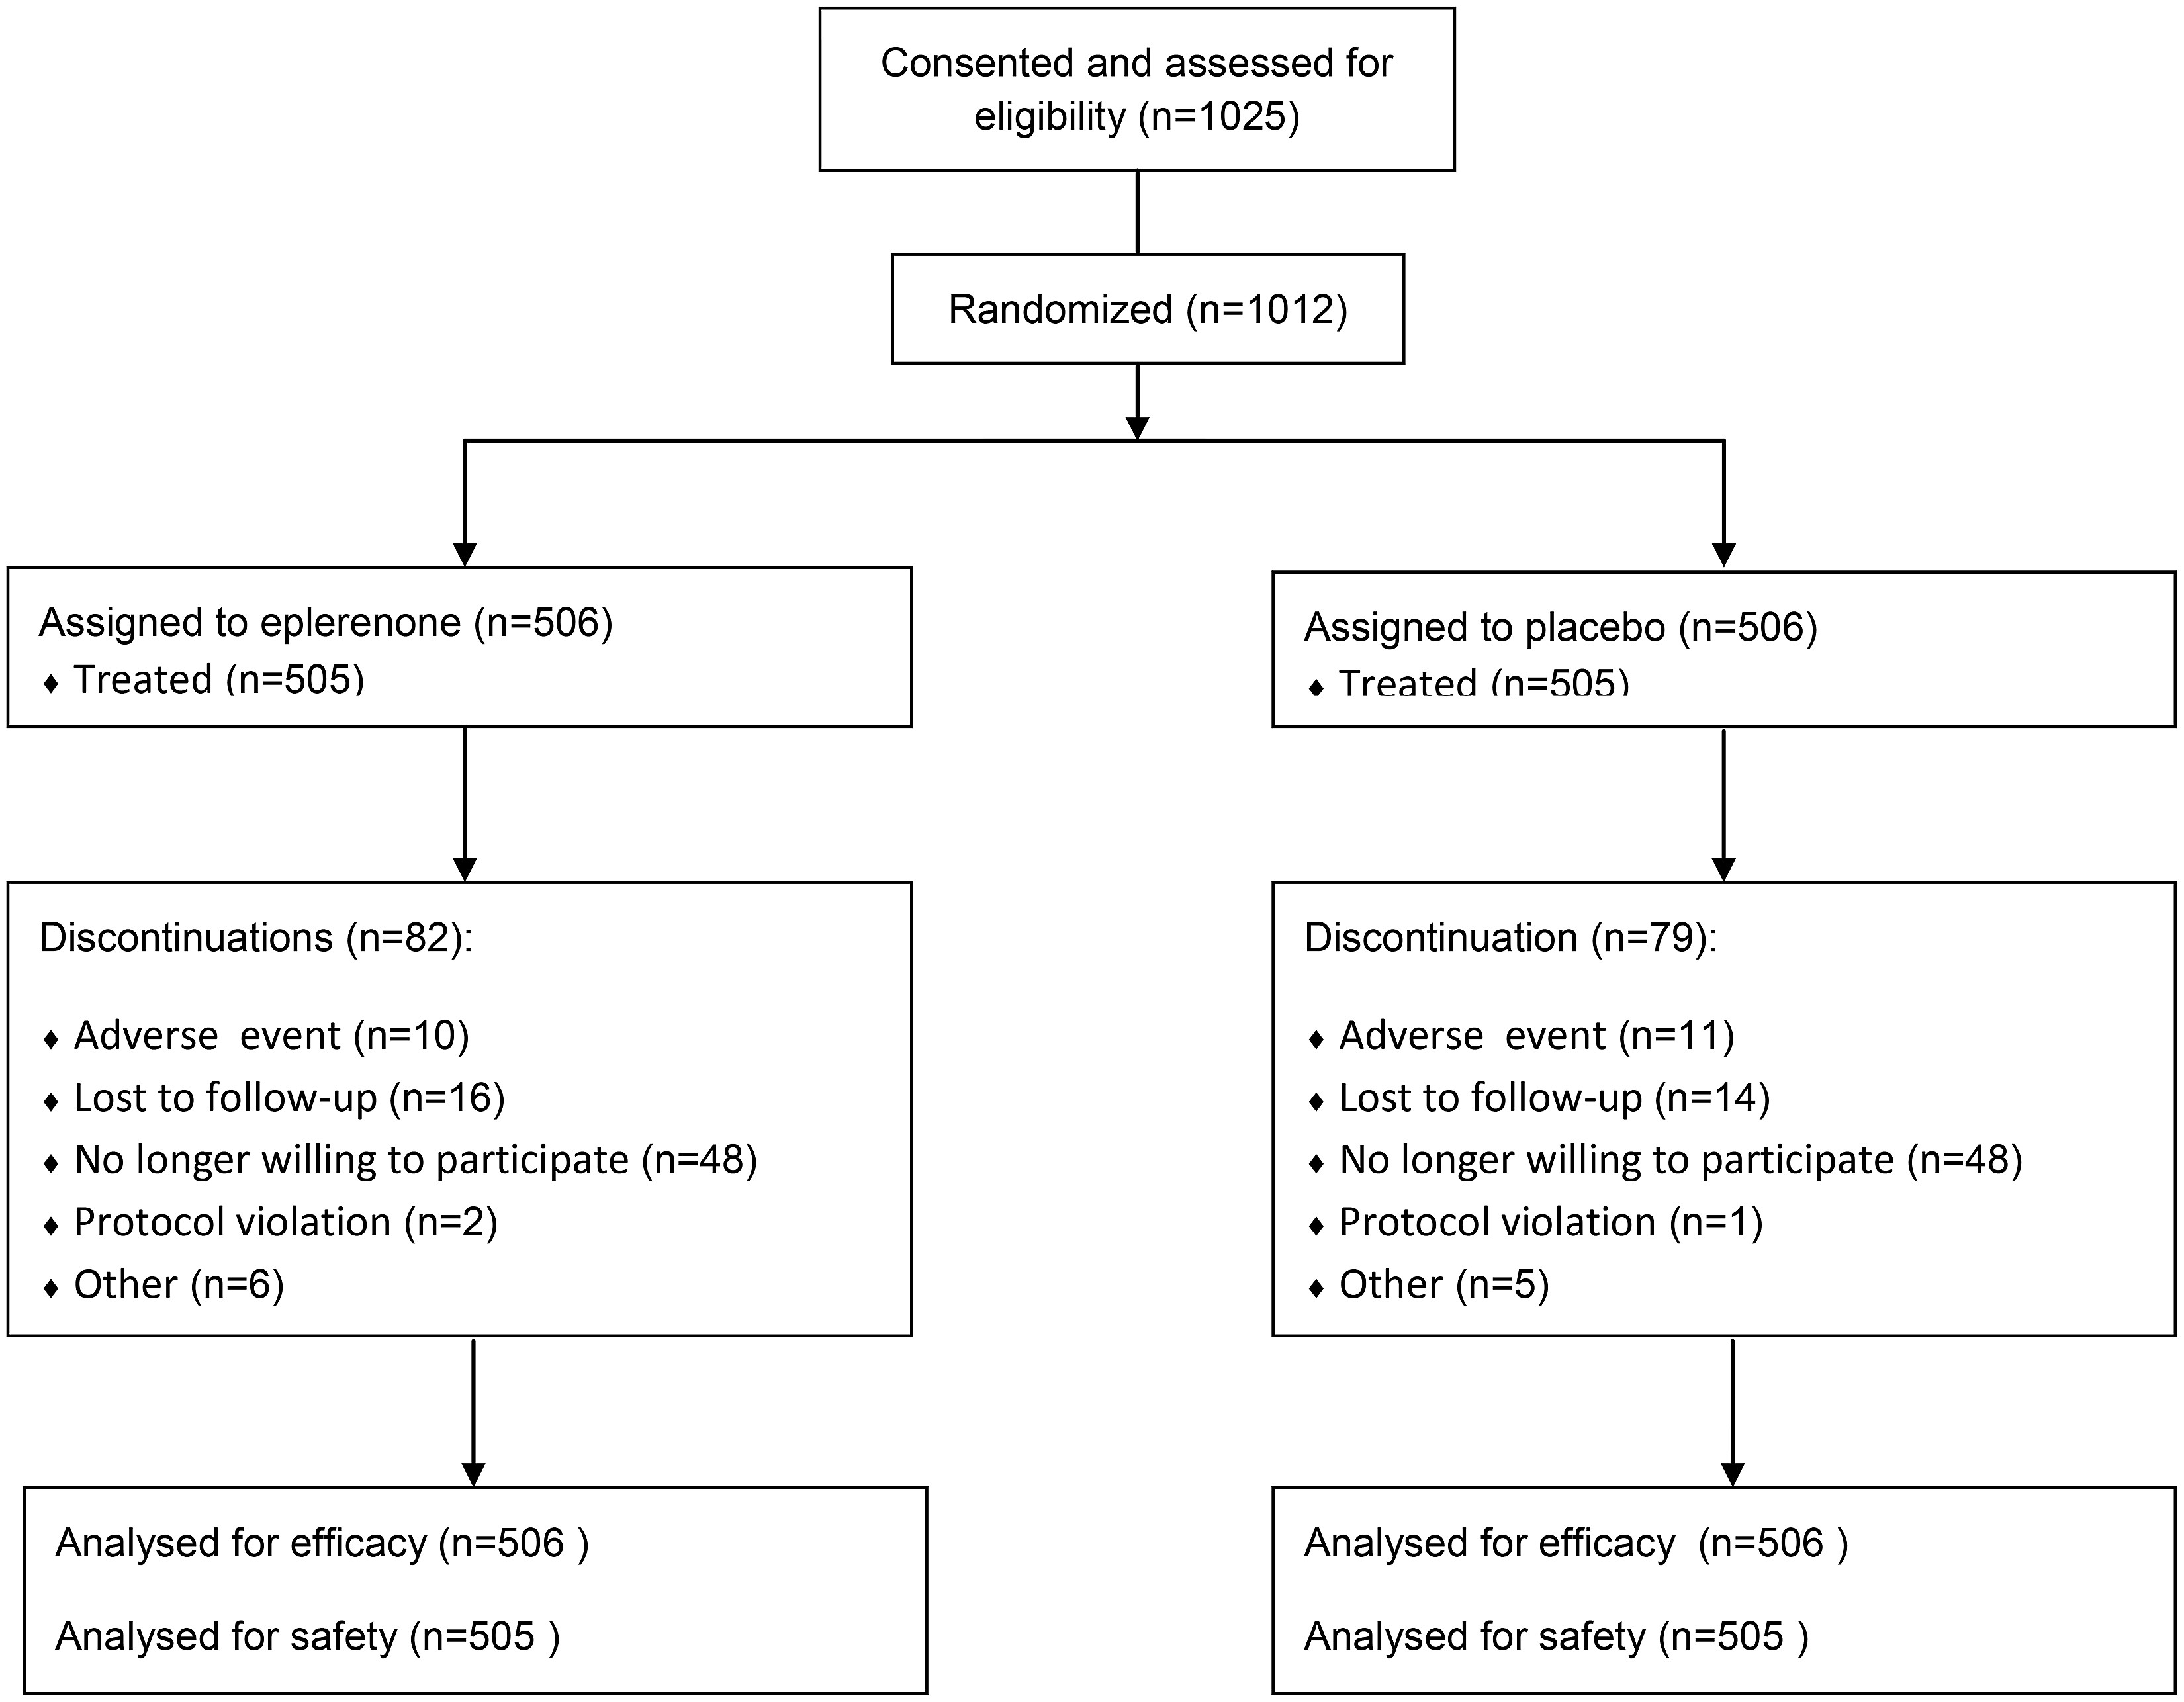
Figure 1 REMINDER flowchart.
Notes:
Figure 1 REMINDER flowchart.
Unless provided in the caption above, the following copyright applies to the content of this slide: Published on behalf of the European Society of Cardiology. All rights reserved. © The Author 2014. For permissions please email: journals.permissions@oup.com.

Slide 2
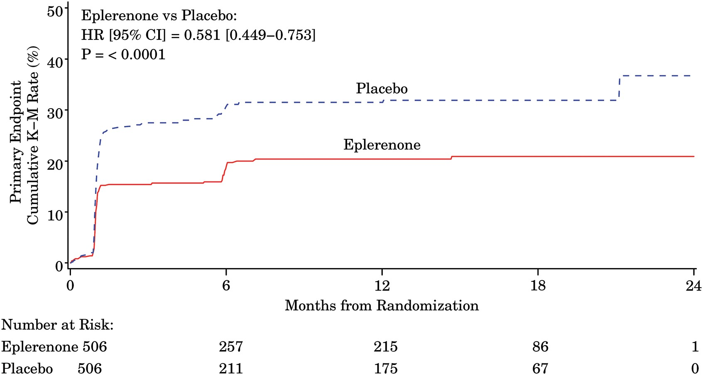
Figure 2 Cumulative Kaplan–Meier estimates of rates of the primary outcome according to study group.
Notes:
Figure 2 Cumulative Kaplan–Meier estimates of rates of the primary outcome according to study group.
Unless provided in the caption above, the following copyright applies to the content of this slide: Published on behalf of the European Society of Cardiology. All rights reserved. © The Author 2014. For permissions please email: journals.permissions@oup.com.

Slide 3
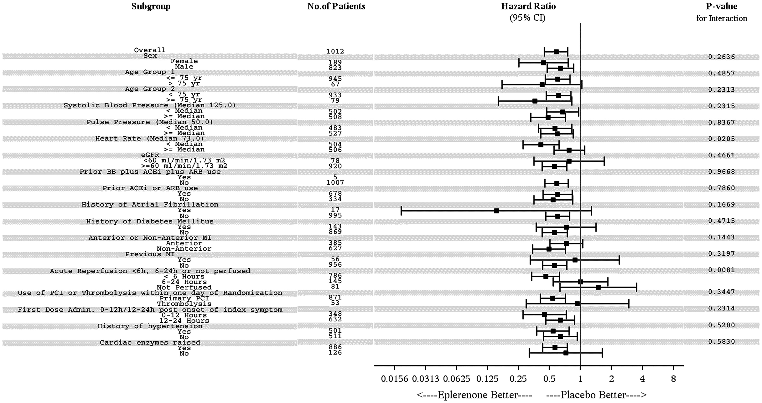
Figure 3 Forrest plot on the primary composite endpoint with eplerenone vs. placebo, according to pre-specified ...
Notes:
Figure 3 Forrest plot on the primary composite endpoint with eplerenone vs. placebo, according to pre-specified subgroups.
Unless provided in the caption above, the following copyright applies to the content of this slide: Published on behalf of the European Society of Cardiology. All rights reserved. © The Author 2014. For permissions please email: journals.permissions@oup.com.

