Slide 1
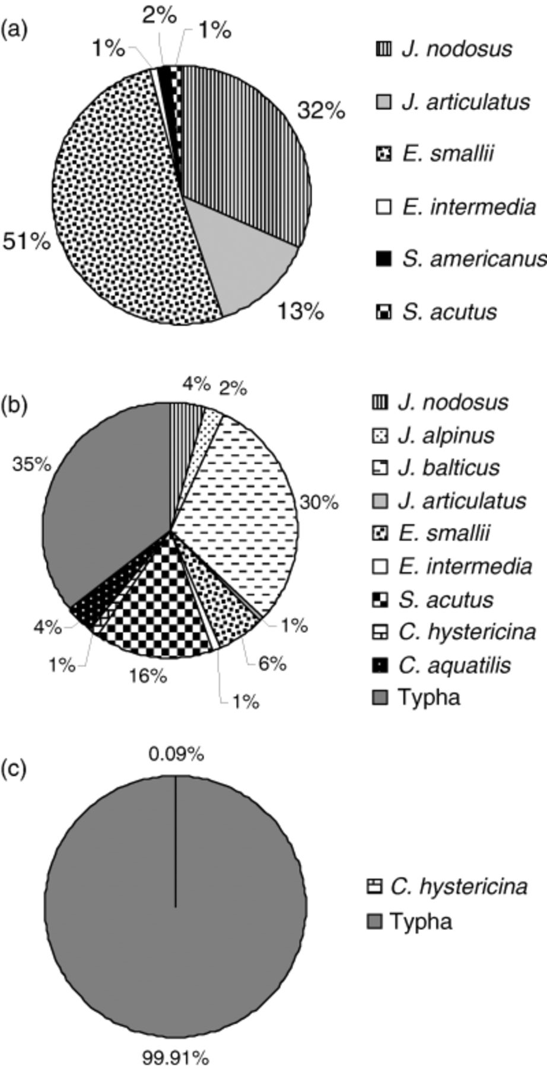
1 Relative biomass of plant species in native zone (a), transition zone (b), and Typha zone (c). Genus names ...
Notes:
1 Relative biomass of plant species in native zone (a), transition zone (b), and Typha zone (c). Genus names abbreviated as follows: J (Juncus), E (Eleocharis), S (Schoenoplectus), C (Carex).
Unless provided in the caption above, the following copyright applies to the content of this slide: © 2006 Federation of European Microbiological Societies

Slide 2
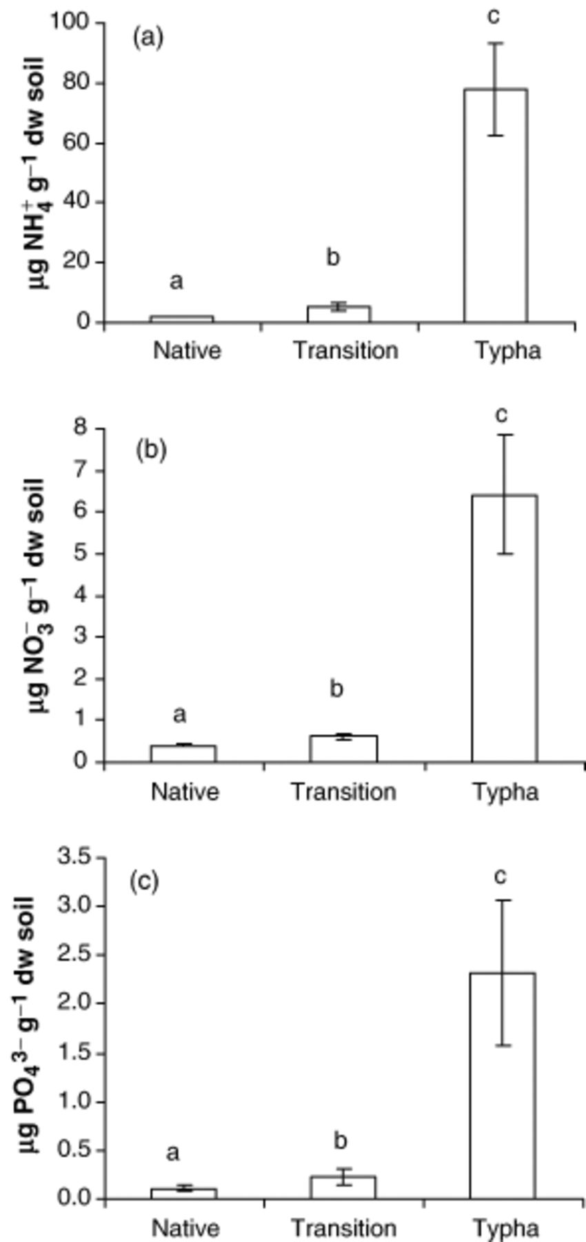
2 Total soluble inorganic NH₄⁺ (a), NO₃⁻ (b), and ...
Notes:
2 Total soluble inorganic NH4+ (a), NO3− (b), and PO43− (c) in soils of each vegetation zone. Bars represent means for each vegetation zone (n=5) and error bars represent±standard error. Values with different letters are significantly different based on anova followed by a Tukey test for pairwise differences (P<0.001) (systat v.11).
Unless provided in the caption above, the following copyright applies to the content of this slide: © 2006 Federation of European Microbiological Societies

Slide 3
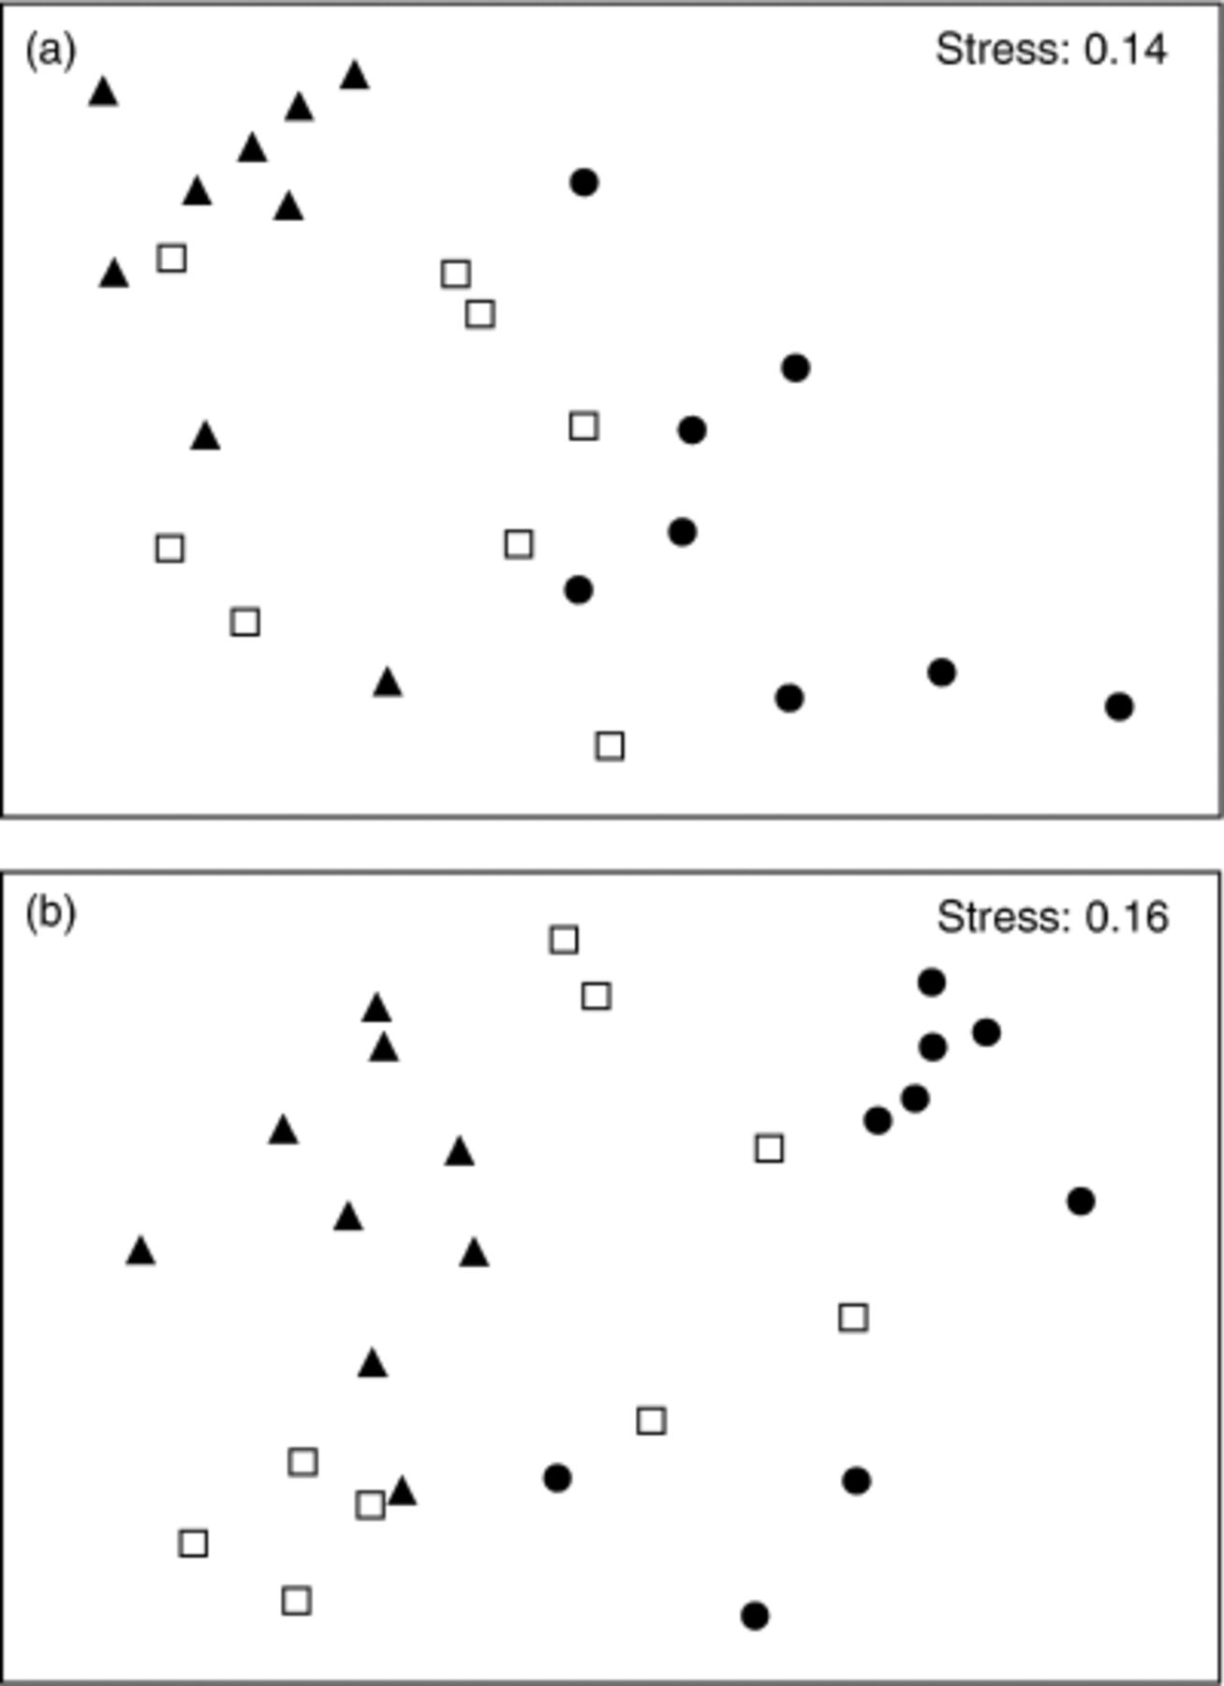
3 Nonmetric multidimensional scaling (MDS) analysis of 16S T-RFLP data (a) and nirS T-RFLP data (b). • (native ...
Notes:
3 Nonmetric multidimensional scaling (MDS) analysis of 16S T-RFLP data (a) and nirS T-RFLP data (b). • (native zone), □ (transition zone), ▲ (Typha zone).
Unless provided in the caption above, the following copyright applies to the content of this slide: © 2006 Federation of European Microbiological Societies

