Slide 1
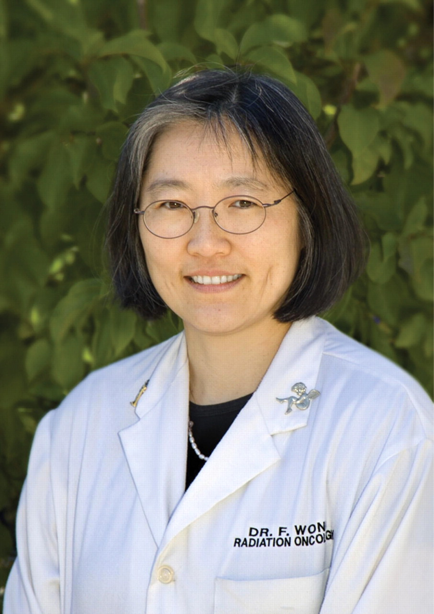
Frances Wong, M.D.
Notes:
Frances Wong, M.D.
Unless provided in the caption above, the following copyright applies to the content of this slide: © The Author 2012. Published by Oxford University Press. All rights reserved. For Permissions, please e-mail: journals.permissions@oup.com

