Slide 1
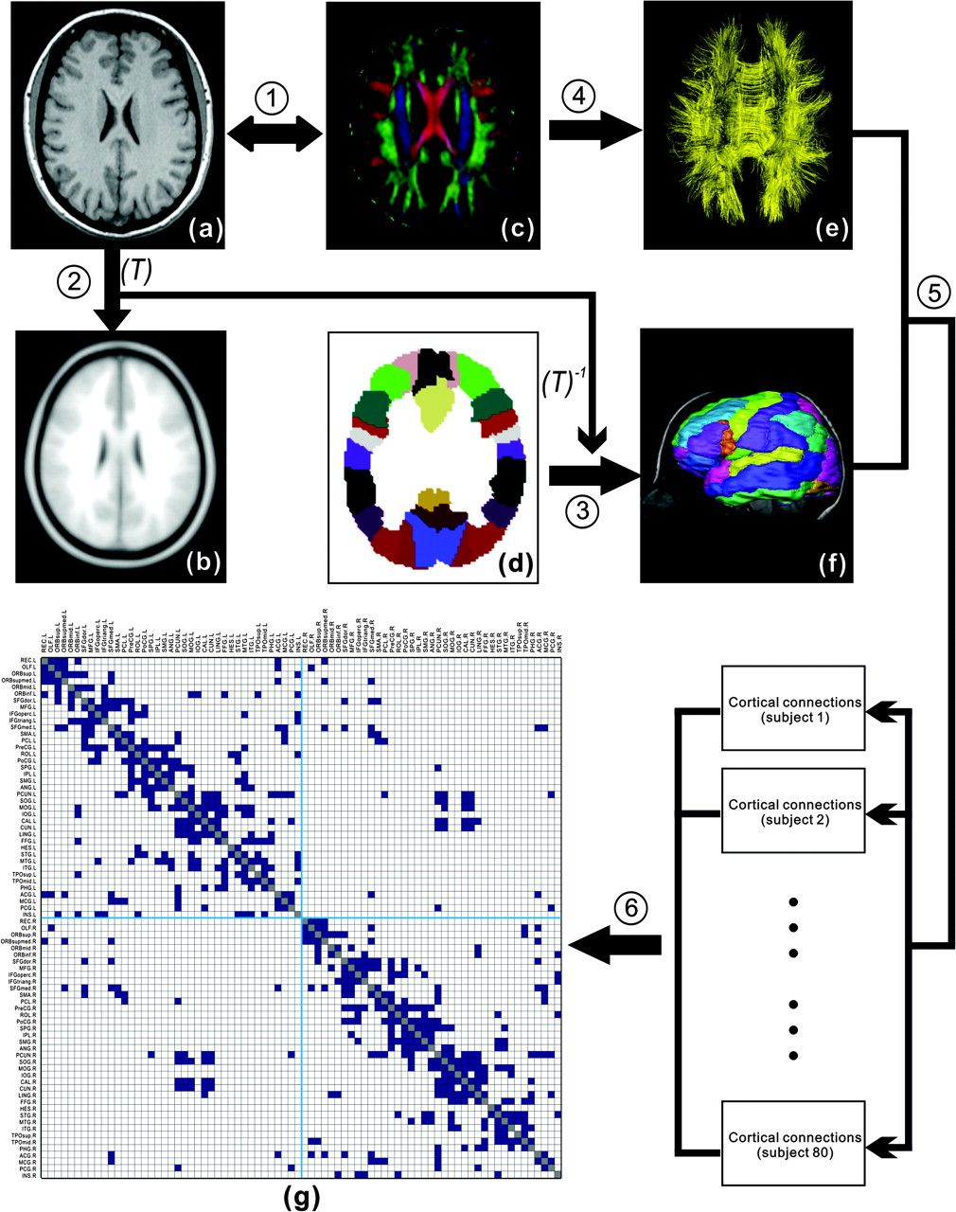
Figure 1. A flowchart for the construction of the cortical anatomical network in the human brain using DTI ...
Notes:
Figure 1. A flowchart for the construction of the cortical anatomical network in the human brain using DTI tractography. (1) Rigid coregistration from T1-weighted structural MRI (a) to DTI native space (c, DTI color-coded map; red: left to right; green: anterior to posterior; blue: inferior to superior) for each subject. (2) Nonlinear registration from the resultant structural MRI to T1 template of ICBM152 in the MNI space (b), resulting in a nonlinear transformation (T). (3) Applying the inverse transformation (T−1) to the AAL template in the MNI space (d), resulting in the subject-specific AAL mask in the DTI native space (f). All registrations were implemented in the SPM5 package. (4) Reconstructing all the WM fibers (e) in the whole brain by using DTI deterministic tractography. (5) Determining the WM fibers connecting every pair of cortical regions for each subject. (6) Identifying the population-based cortical network matrix (g, blue: 1; blank: 0) by applying nonparametric sign test to every pair of cortical regions (P < 0.05, Bonferroni corrected). For more details, see Materials and Methods. R, right; L, left. The abbreviations of the cortical regions were established by Achard et al. (2006) and are included as the Supplementary Table 1.
Unless provided in the caption above, the following copyright applies to the content of this slide: © The Author 2008. Published by Oxford University Press. All rights reserved. For permissions, please e-mail: journals.permissions@oxfordjournals.org

Slide 2
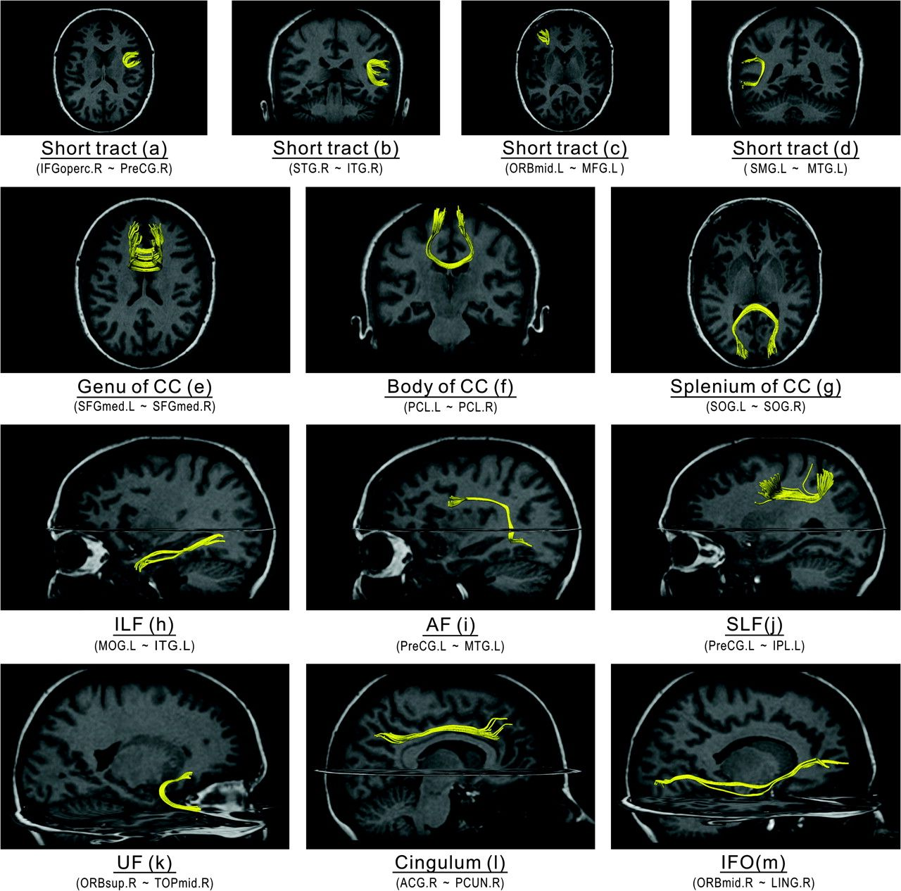
Figure 2. Examples of cortical connections and their corresponding WM fibers in one subject. The 13 selected cortical ...
Notes:
Figure 2. Examples of cortical connections and their corresponding WM fibers in one subject. The 13 selected cortical connection examples included 4 short WM tracts (a–d) and 9 well-known major WM tracts (e–g, CC; h, ILF; i, AF; j, SLF; k, UF; l, cingulum; m, IFO) that are well identified with DTI deterministic tractography. As well, the linked cortical regions for each selected connection are listed with the abbreviations in the Supplementary Table 1. It should be noted that the fiber bundles shown here are only a part of a specific major WM tract, rather than the entire tract.
Unless provided in the caption above, the following copyright applies to the content of this slide: © The Author 2008. Published by Oxford University Press. All rights reserved. For permissions, please e-mail: journals.permissions@oxfordjournals.org

Slide 3
Figure 3. The topological parameters as a function of the statistical threshold. (a) The sparsity of the cortical ...
Notes:
Figure 3. The topological parameters as a function of the statistical threshold. (a) The sparsity of the cortical anatomical networks decreases as the P value threshold lowers (i.e., more conservative statistical criterion). (b) The clustering coefficient ratio (gamma) increases as the P value threshold lowers. (c) The path length ratio (lambda) shows little change as the P value threshold lowers. Overall, the small-worldness of the cortical anatomical network tends to increase as a function of lowering the P value threshold. The cortical anatomical network also exhibits small-world attributes even under very relaxing statistical criterion. The black arrow indicates the values of topological parameter of the human cortical network under our conservative statistical criterion (P < 0.05, Bonferroni corrected, which corresponds to 0.05/(78 × 77/2) = 0.05/3003 ∼1 × 10−5 without correction).
Unless provided in the caption above, the following copyright applies to the content of this slide: © The Author 2008. Published by Oxford University Press. All rights reserved. For permissions, please e-mail: journals.permissions@oxfordjournals.org

Slide 4
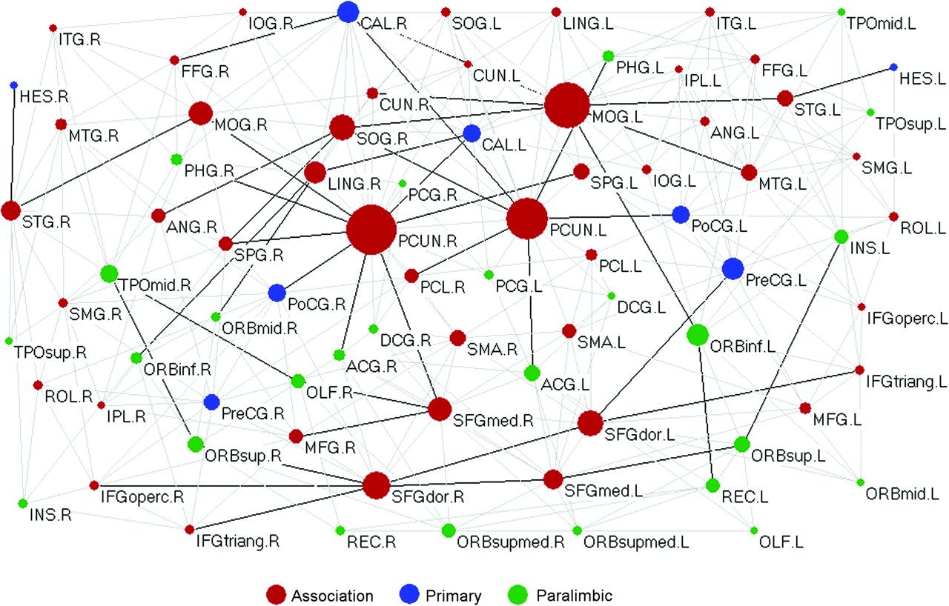
Figure 4. The topological map of human cortical network. In the map, nodes represent brain cortical regions and lines ...
Notes:
Figure 4. The topological map of human cortical network. In the map, nodes represent brain cortical regions and lines represent the DTI tractography–derived anatomical connections between regions. Circle size (i.e., diameter) represents the magnitude of normalized node-betweenness centrality (Table 2 and Supplementary Table 2). Association, primary, and paralimbic cortex regions are marked as red, blue, and green, respectively. Dark solid lines represent bridge connections with high normalized edge-betweenness values (Table 3). The geometric distance between regions on the drawing space approximately corresponds to the shortest path length between them. The network was visualized with the Pajek software with slight manual adjustment for the locations of brain regions (Batagelj and Mrvar 1998). For the abbreviations of the regions, see Supplementary Table 1.
Unless provided in the caption above, the following copyright applies to the content of this slide: © The Author 2008. Published by Oxford University Press. All rights reserved. For permissions, please e-mail: journals.permissions@oxfordjournals.org

Slide 5
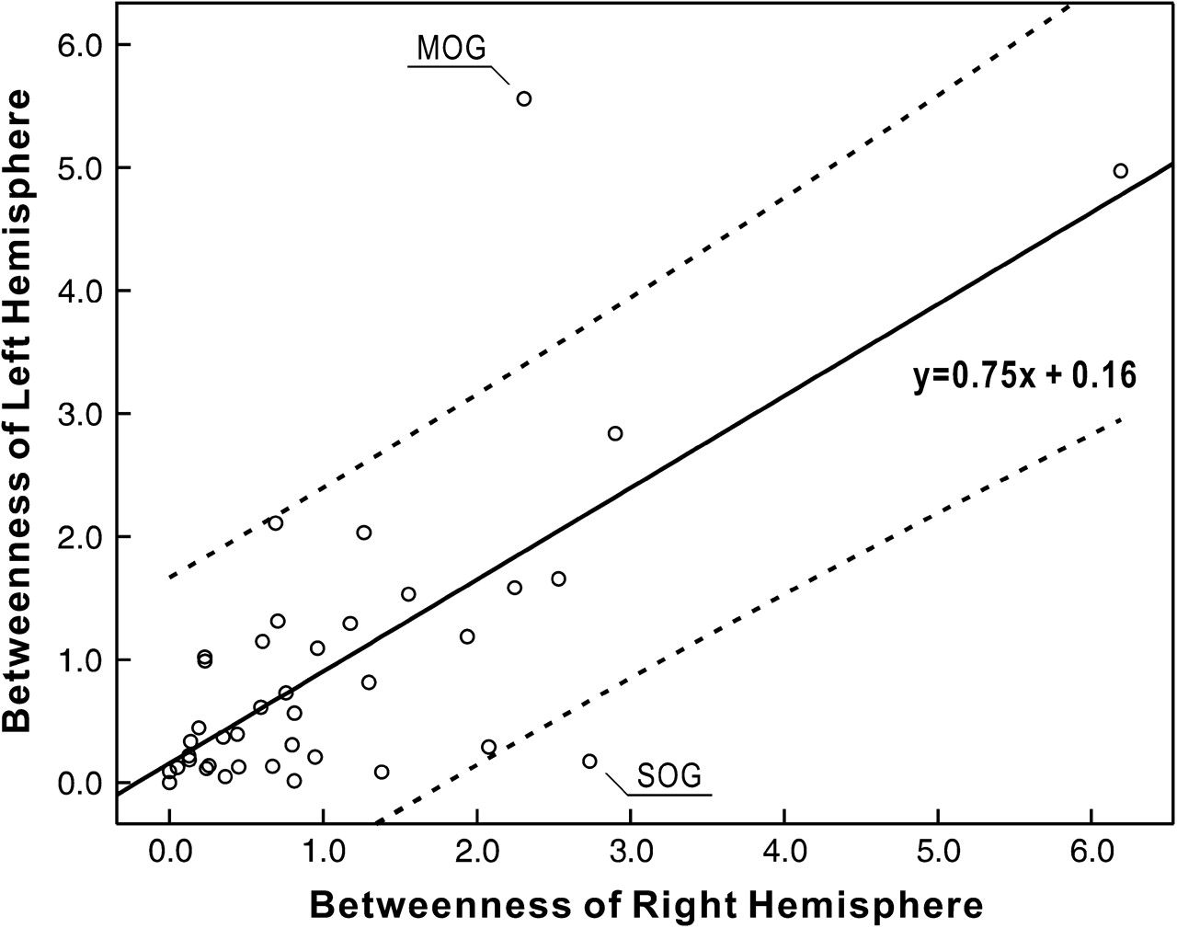
Figure 5. The relation between the node betweenness of left and right hemispheres. Each circle represents one cortical ...
Notes:
Figure 5. The relation between the node betweenness of left and right hemispheres. Each circle represents one cortical region (39 in total). The black line indicates the linear-fitted curve and the dash lines indicate 95% confidence interval. The node betweenness of left hemisphere is linearly correlated with that of right hemisphere (t = 6.2, P < 10−6). Of note, the absolute betweenness centrality of some individual cortical regions (e.g., MOG and SOG) demonstrates large hemispheric asymmetry.
Unless provided in the caption above, the following copyright applies to the content of this slide: © The Author 2008. Published by Oxford University Press. All rights reserved. For permissions, please e-mail: journals.permissions@oxfordjournals.org

Slide 6
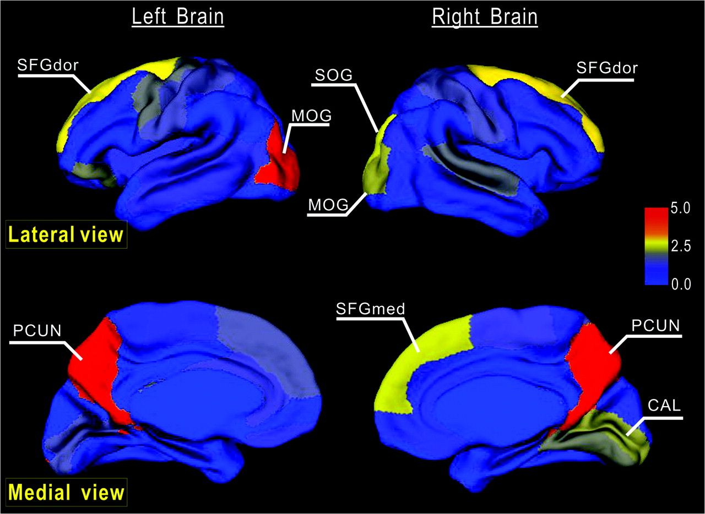
Figure 6. Node betweenness centrality map on the human cerebral cortex. According to the AAL template (Tzourio-Mazoyer ...
Notes:
Figure 6. Node betweenness centrality map on the human cerebral cortex. According to the AAL template (Tzourio-Mazoyer et al. 2002), the cerebral cortex was parcellated into 78 regions (39 per hemisphere), each representing a node in the anatomical cortical network. Regions were mapped into an average cortical surface obtained from ICBM152 according to their normalized betweenness centrality values. The color bar indicating the range of normalized node betweenness is shown on the right. Hub regions identified in this study are marked on the map. Note that several hubs (PCUN, SFGdor, and MOG) appear in a bilaterally symmetric fashion (for details, see Table 2).
Unless provided in the caption above, the following copyright applies to the content of this slide: © The Author 2008. Published by Oxford University Press. All rights reserved. For permissions, please e-mail: journals.permissions@oxfordjournals.org

Slide 7
Figure 7. The degree and betweenness distributions of the human cortical network. (a) Log-log plot of the cumulative ...
Notes:
Figure 7. The degree and betweenness distributions of the human cortical network. (a) Log-log plot of the cumulative node degree distribution; (b) log-log plot of the cumulative node-betweenness distribution; (c) log-log plot of the cumulative edge-betweenness distribution. The plus sign represents observed data, the solid line is the fit of the exponentially truncated power-law (p(x) ∼ xα−1exp(x/xc)), the dashed line is an exponential (p(x) ∼ exp(x/xc)), and the dotted line is a power-law (p(x) ∼ xα−1). R2 was calculated to assess the goodness-of-fit (a larger value indicates a better fitting; Retp, R2 for exponentially truncated power-law fit; Re, R2 for exponential fit; Rp, R2 for power-law fit). The exponentially truncated power-law is the best fitting for all the 3 distributions (a, estimated exponent α = 1.66 and cutoff degree kcnode = 3.65; b, estimated exponent α = 0.96 and cutoff betweenness Bcnode = 76.93; c, estimated exponent α = 1.10 and cutoff betweenness Bcedge = 18.95).
Unless provided in the caption above, the following copyright applies to the content of this slide: © The Author 2008. Published by Oxford University Press. All rights reserved. For permissions, please e-mail: journals.permissions@oxfordjournals.org

