Slide 1
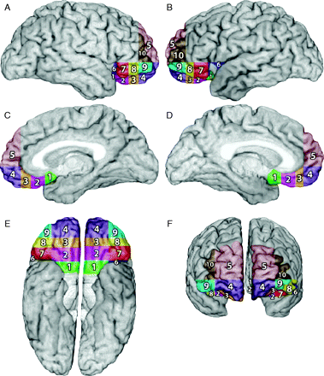
Fig. 1 Subdivisions of the orbital and medial frontal lobe. Cells 1–10 were obtained using the following principles: ...
Notes:
Fig. 1 Subdivisions of the orbital and medial frontal lobe. Cells 1–10 were obtained using the following principles: (A) a plane passing through the superior frontal sulcus perpendicular to the horizontal plane containing anterior commissure–posterior commissure (AC–PC plane) provided the separation into medial and dorsolateral sectors; (B) another plane, parallel to the AC–PC plane and touching the lower edge of the beak of the corpus callosum, separated the orbital sector; (C) the lateral and mesial aspects of this orbital sector were separated by the continuation of the plane described in (A); (D) the anterior–posterior subdivisions of the orbital sector were obtained by coronal planes perpendicular to the AC–PC plane, drawn at the anterior-most edge of the cingulate sulcus and the anterior edge of the corpus callosum (creating the polar region and the anterior middle region); (E) the region behind the middle anterior sector was divided into two halves, a posterior middle and a posterior region; (F) the subdivisions in the lateral orbital sector were obtained as in (D) and (E). Cells 1–4 = VMPC sub-regions; posterior; middle posterior; middle anterior and anterior, respectively. Cell 5 = medial superior. Cells 6–9 = lateral orbital sub-regions; posterior, middle posterior, middle anterior and anterior, respectively. Cell 10 = anterior dorsolateral.
Unless provided in the caption above, the following copyright applies to the content of this slide: © The Author (2005). Published by Oxford University Press on behalf of the Guarantors of Brain. All rights reserved. For Permissions, please email: journals.permissions@oxfordjournals.org

Slide 2
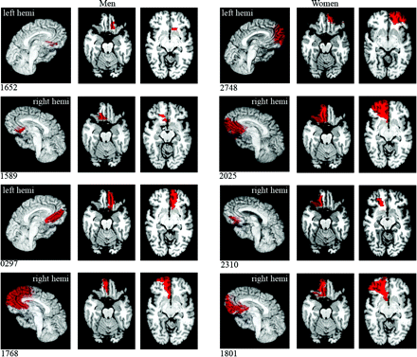
Fig. 2 Depiction of the lesions of the participants after transfer onto a template brain (MAP-3 technique). Four men ...
Notes:
Fig. 2 Depiction of the lesions of the participants after transfer onto a template brain (MAP-3 technique). Four men are on the left side of the figure; four women are on the right side. R and L indicate the hemispheres; left is depicted on the right, and right is depicted on the left. Specific case contrasts highlighted in the Results section are 1652 versus 1589; 0297 versus 1768; 2748 versus 2025; 1589 versus 2310; 1768 versus 2025 and 1801; and 2748 versus 0297.
Unless provided in the caption above, the following copyright applies to the content of this slide: © The Author (2005). Published by Oxford University Press on behalf of the Guarantors of Brain. All rights reserved. For Permissions, please email: journals.permissions@oxfordjournals.org

