Slide 1
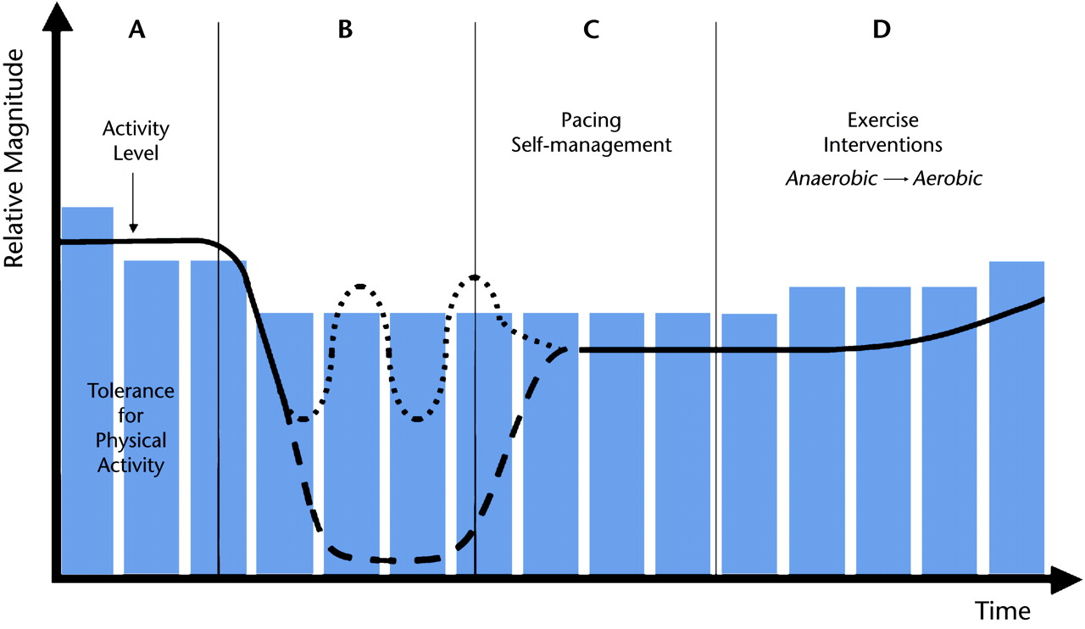
Figure 1 Conceptual model for clinical management of people with chronic fatigue syndrome/myalgic encephalomyelitis ...
Notes:
Figure 1 Conceptual model for clinical management of people with chronic fatigue syndrome/myalgic encephalomyelitis (CFS/ME). (A) The first presentation of symptoms in people with CFS/ME hypothetically occurs when the intensity of physical activity (solid line) exceeds the tolerance for physical activity (bars). (B) In response to symptoms, people with CFS/ME adapt their behaviors by either activity and symptom avoidance (dashed line) or activity and symptom fluctuation (dotted line). (C) The initiation of a pacing self-management program is hypothesized to stabilize activity levels within the tolerance for physical activity, such as that indicated by heart rate biofeedback below the anaerobic threshold. (D) After symptoms and function are stabilized, progression of anaerobic exercise to graded aerobic exercise may be used to increase tolerance for physical activity.
Unless provided in the caption above, the following copyright applies to the content of this slide: © 2010 American Physical Therapy Association

Slide 2
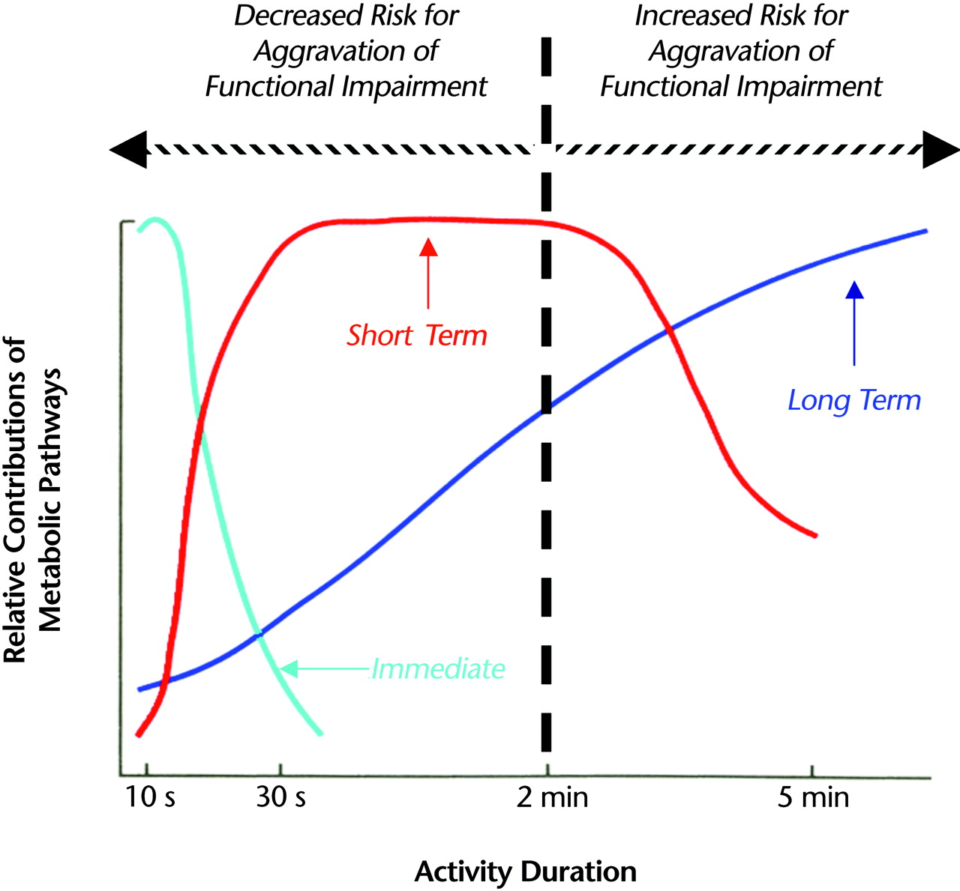
Figure 2 Hypothetical relationship among duration of functional activity, metabolic energy pathways, and functional ...
Notes:
Figure 2 Hypothetical relationship among duration of functional activity, metabolic energy pathways, and functional impairments in people with chronic fatigue syndrome/myalgic encephalomyelitis (CFS/ME). The creatine phosphate-adenosine triphosphate immediate (teal line) and anaerobic short-term (red line) energy systems predominate during the first 2 minutes of activity (dashed black line). Activities longer than 2 minutes in duration are characterized by a rapid decrease in the contributions of these short-term energy systems and an exponential increase in the contribution of the aerobic long-term energy system (blue line). It has been hypothesized that activities longer than 2 minutes in duration aggravate symptoms and functional deficits in people with CFS/ME because they have aerobic system impairments.
Unless provided in the caption above, the following copyright applies to the content of this slide: © 2010 American Physical Therapy Association

