Slide 1
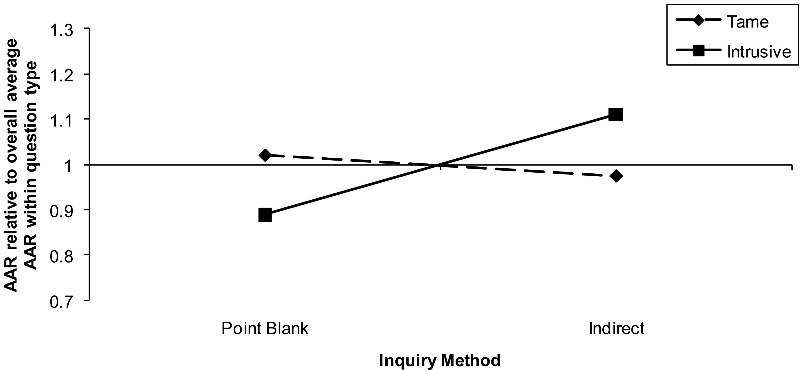
Figure 1. Experiment 1: Mean affirmative admission rates (AARs) across experimental conditions and tame versus ...
Notes:
Figure 1. Experiment 1: Mean affirmative admission rates (AARs) across experimental conditions and tame versus intrusive questions Note.—AARs have been normed, question by question, on the overall average AAR for the question. The value of one on the Y-axis represents the overall average AAR within question type.
Unless provided in the caption above, the following copyright applies to the content of this slide: © 2010 by JOURNAL OF CONSUMER RESEARCH, Inc.

Slide 2
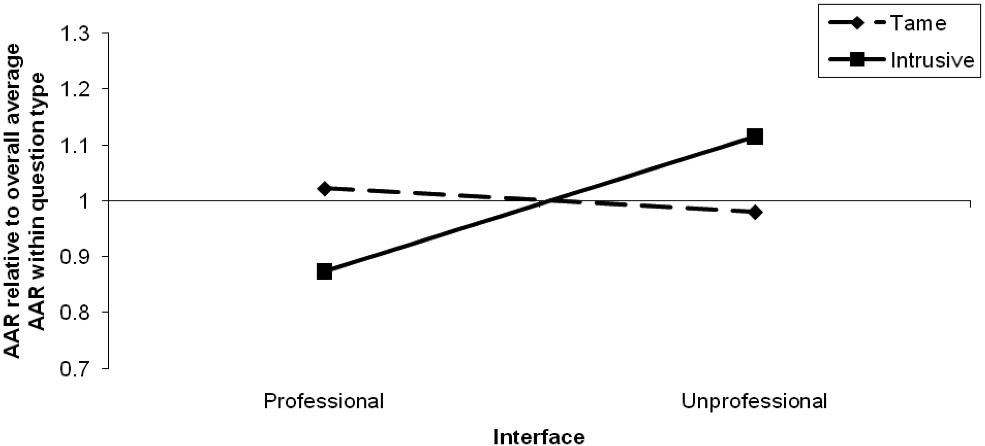
Figure 2. Experiment 3: Mean affirmative admission rates (AARs) across experimental conditions and tame versus ...
Notes:
Figure 2. Experiment 3: Mean affirmative admission rates (AARs) across experimental conditions and tame versus intrusive questions Note.—AARs have been normed, question by question, on the overall average AAR for the question. The value of one on the Y-axis represents the overall average AAR within question type.
Unless provided in the caption above, the following copyright applies to the content of this slide: © 2010 by JOURNAL OF CONSUMER RESEARCH, Inc.

Slide 3
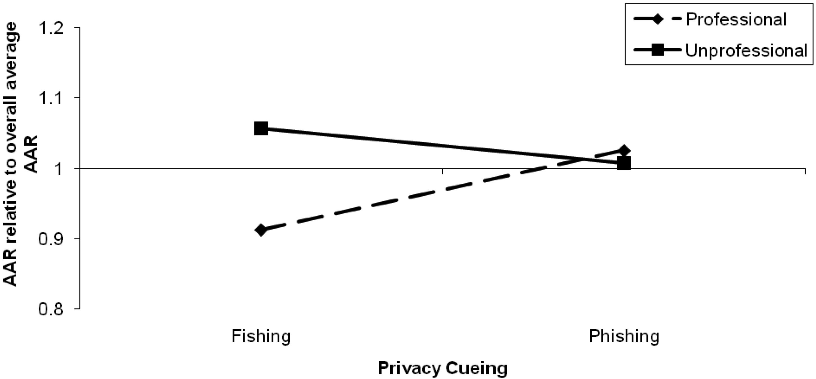
Figure 3. Experiment 4: Mean affirmative admission rates (AARs) across experimental conditions Note.—AARs have been ...
Notes:
Figure 3. Experiment 4: Mean affirmative admission rates (AARs) across experimental conditions Note.—AARs have been normed, question by question, on the overall average AAR for the question. The value of one on the Y-axis represents the overall average AAR.
Unless provided in the caption above, the following copyright applies to the content of this slide: © 2010 by JOURNAL OF CONSUMER RESEARCH, Inc.

Slide 4
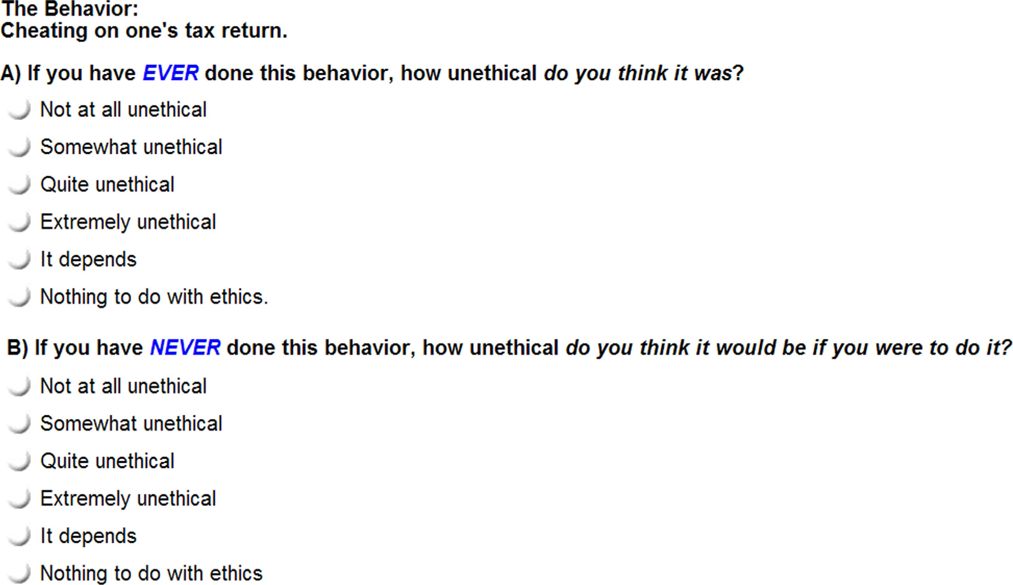
Figure A1. Experiment 1: Question layout in indirect-inquiry condition
Notes:
Figure A1. Experiment 1: Question layout in indirect-inquiry condition
Unless provided in the caption above, the following copyright applies to the content of this slide: © 2010 by JOURNAL OF CONSUMER RESEARCH, Inc.

Slide 5
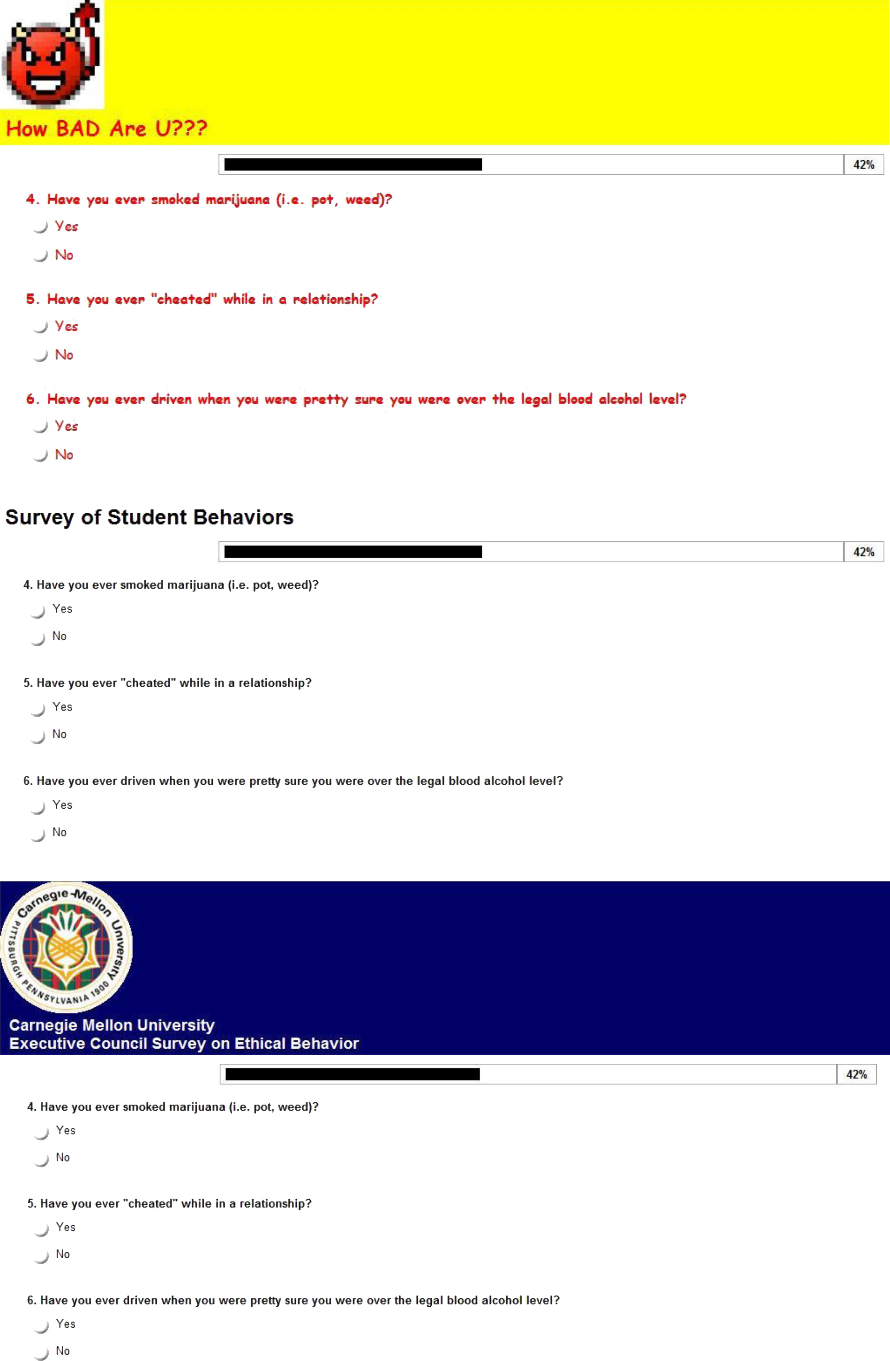
Figure A2. Experiment 2: Survey interface manipulation (in order: unprofessional, baseline, professional)
Notes:
Figure A2. Experiment 2: Survey interface manipulation (in order: unprofessional, baseline, professional)
Unless provided in the caption above, the following copyright applies to the content of this slide: © 2010 by JOURNAL OF CONSUMER RESEARCH, Inc.

