Slide 1
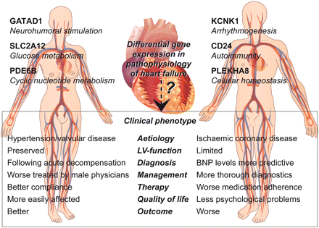
Figure 1 Gender differences in heart failure are based on distinct characteristics in diagnosis, management, and ...
Notes:
Figure 1 Gender differences in heart failure are based on distinct characteristics in diagnosis, management, and prognosis in men and women. Molecular details of cardiac pathophysiology may influence the clinical phenotype. Genes differentially expressed (top) and phenotypic characteristics (bottom) are depicted relative to the other gender, where the left column represents genes and characteristics more prevalent in women, and the right column those more prevalent in men.
Unless provided in the caption above, the following copyright applies to the content of this slide: Published on behalf of the European Society of Cardiology. All rights reserved. © The Author 2010. For permissions please email: journals.permissions@oxfordjournals.org

