Slide 1
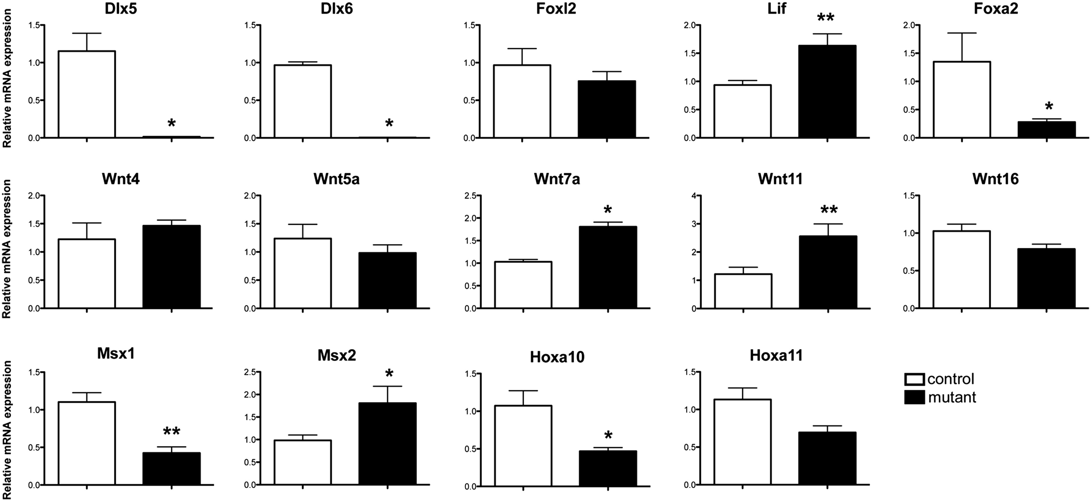
Figure 5. Effect of Dlx5 and Dlx6 inactivation on the expression of key genes of uterine maturation. Relative mRNA ...
Notes:
Figure 5. Effect of Dlx5 and Dlx6 inactivation on the expression of key genes of uterine maturation. Relative mRNA expression of genes implicated in post-natal development of the uterus from PN25 Dlx5/6flox/flox and Pgrcre/+; Dlx5/6flox/flox mice; (n = 6). Reference gene: Sdha. *P < 0.05, **P < 0.01, Mann–Whitney test analysis.
Unless provided in the caption above, the following copyright applies to the content of this slide: © The Author 2015. Published by Oxford University Press. All rights reserved. For Permissions, please email: journals.permissions@oup.com

Slide 2
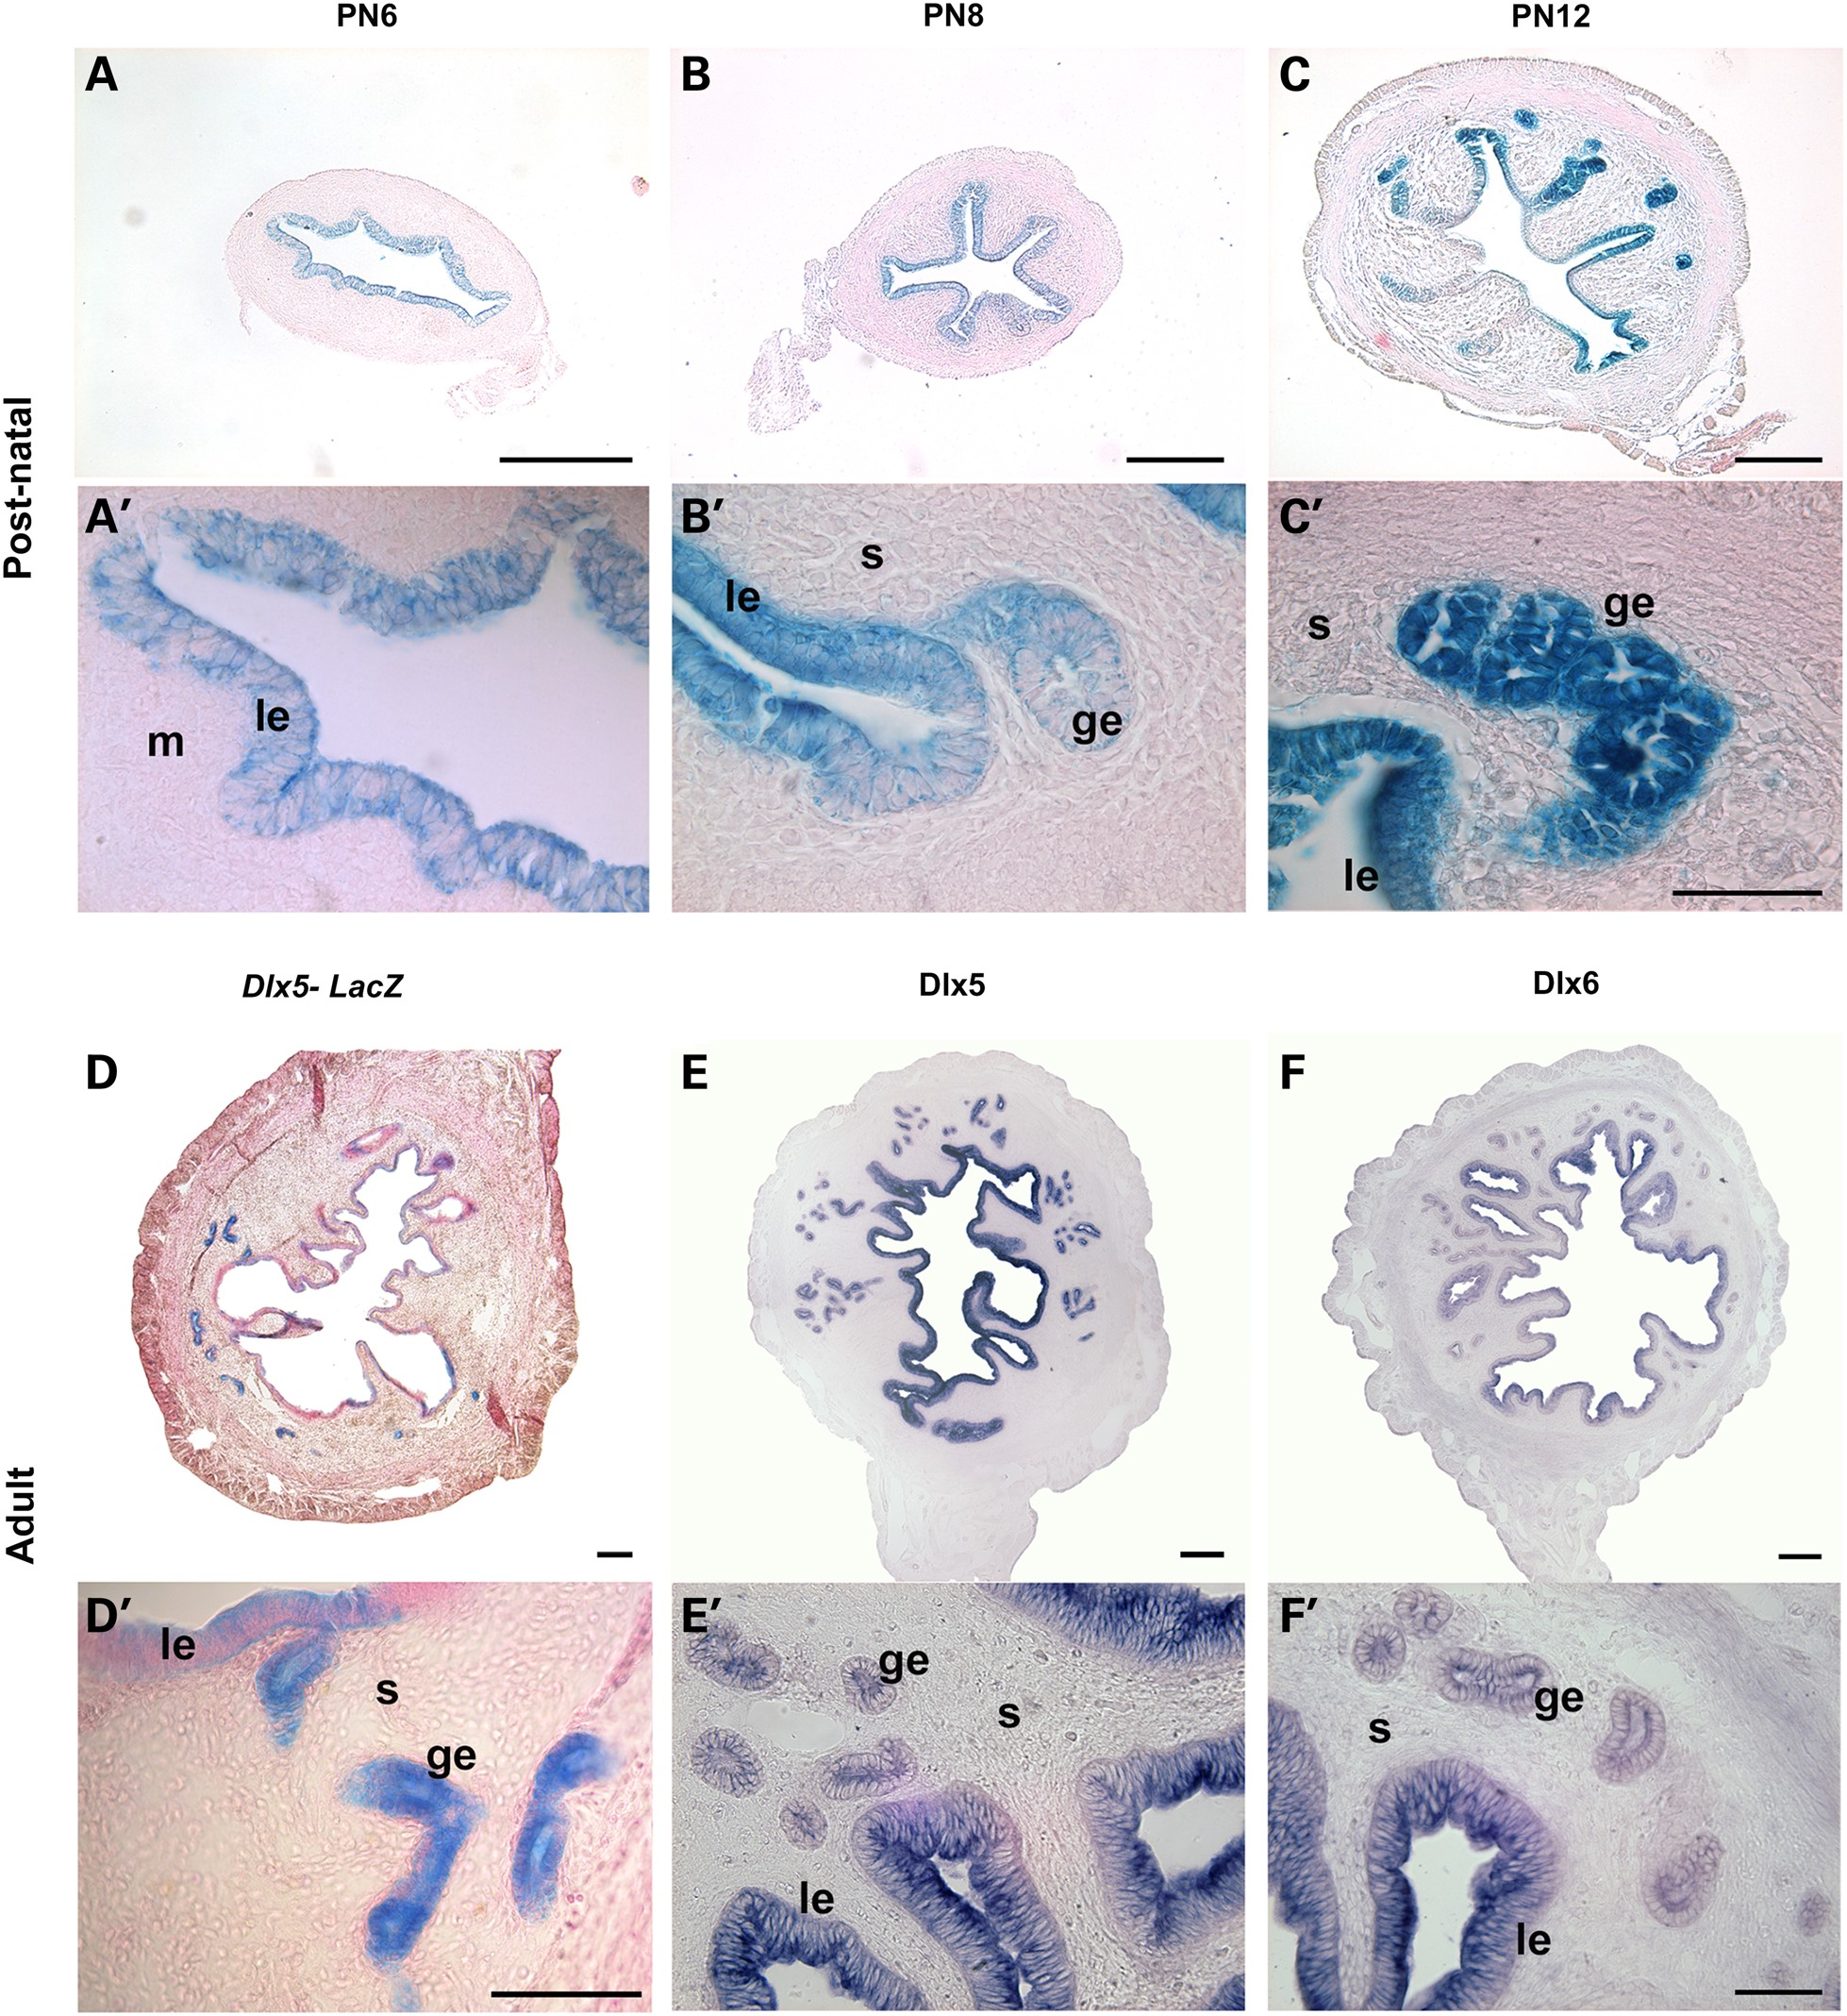
Figure 2. Dlx5 and Dlx6 expression during uterine post-natal development. Uterine LacZ expression in ...
Notes:
Figure 2. Dlx5 and Dlx6 expression during uterine post-natal development. Uterine LacZ expression in Dlx5LacZ/+ mice during uterine post-natal development (A, A′, B, B′, C, C′) and in the adult (D, D′). Dlx5 is expressed by the LE and GE during adenogenesis. In the adult, Dlx5 expression is present in GE and in portions of the LE. In situ hybridization for Dlx5 (E, E′) and Dlx6 mRNA (F, F′) shows that both transcripts are present in GE and LE of the adult uterus. Le, luminal epithelium; m, mesenchyme; ge, glandular epithelium; s, stroma. Scale bar: (A, B, C, D, E, F) 100 µm, (A′, B′, C′, D′, E′, F′) 50 µm.
Unless provided in the caption above, the following copyright applies to the content of this slide: © The Author 2015. Published by Oxford University Press. All rights reserved. For Permissions, please email: journals.permissions@oup.com

Slide 3
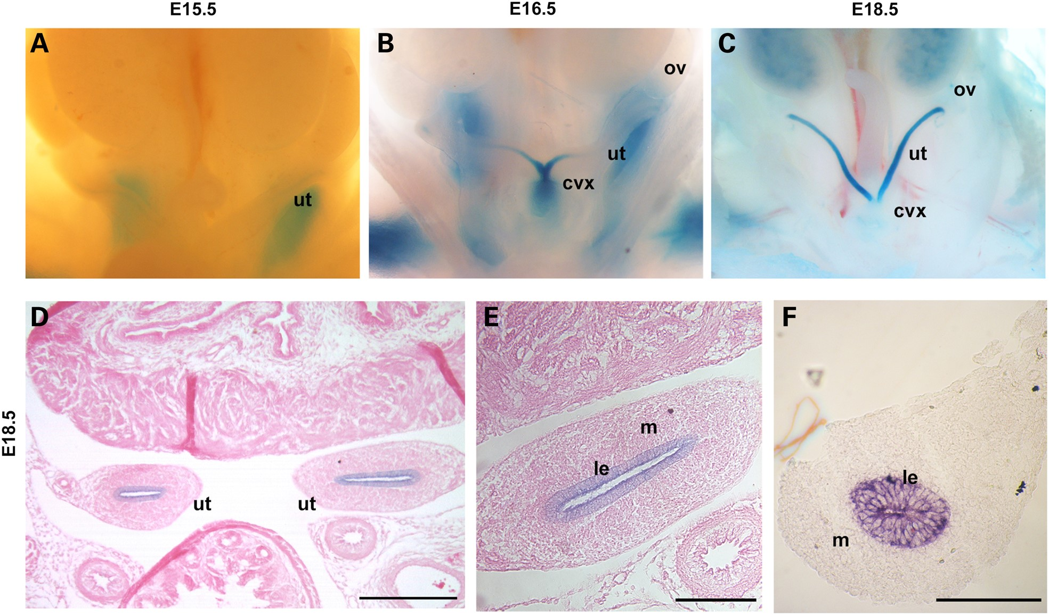
Figure 1. Dlx5 expression during uterine development. LacZ expression in the female reproductive tract of ...
Notes:
Figure 1. Dlx5 expression during uterine development. LacZ expression in the female reproductive tract of Dlx5LacZ/+ mice at E15.5 (A), E16.5 (B) and E18.5 (C). Before birth, Dlx5 is expressed in the medial part of the Müllerian duct that corresponds to the future uterus. At E18.5, Dlx5 expression is localized in the LE of the prospective uterus as seen in Dlx5LacZ/+ mice (D, E) and by in situ hybridization on sections of wild-type pups (F). ut, uterus; cvx, cervix; ov, ovary; m, mesenchyme. Scale bar: (D) 100 µm, (E and F) 50 µm.
Unless provided in the caption above, the following copyright applies to the content of this slide: © The Author 2015. Published by Oxford University Press. All rights reserved. For Permissions, please email: journals.permissions@oup.com

Slide 4
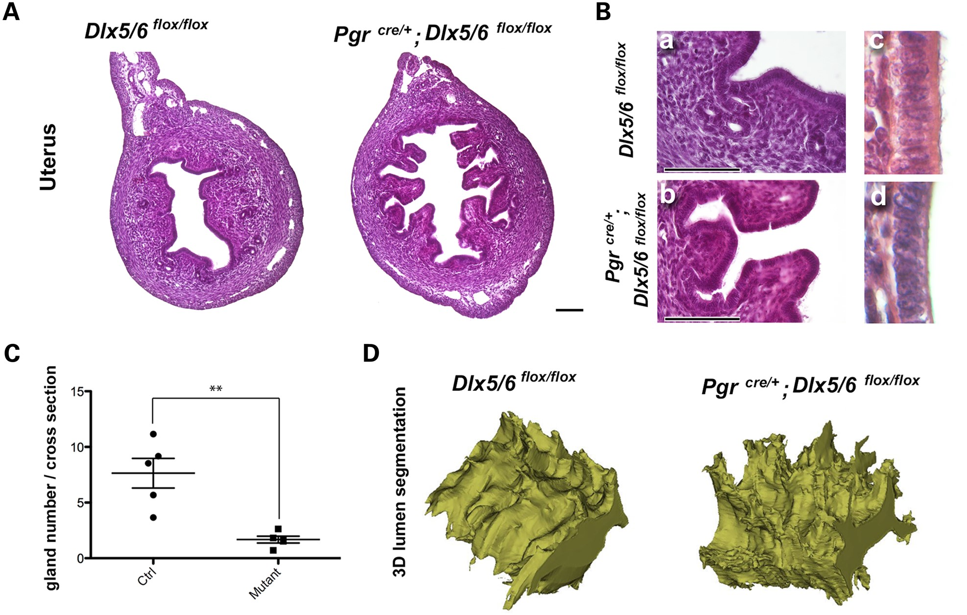
Figure 4. Dlx5/6 conditional deletion leads to abnormal lumen invaginations and impaired adenogenesis. Phenotype ...
Notes:
Figure 4. Dlx5/6 conditional deletion leads to abnormal lumen invaginations and impaired adenogenesis. Phenotype resulting from Dlx5/6 uterine ablation in PN25 mouse. (A) The uterine lumen presents a higher number of large and bifurcated epithelial invaginations. (B) Fewer or no uterine glands are observed in Pgrcre/+; Dlx5/6flox/flox uteri in comparison to Dlx5/6flox/flox uteri. (C) The number of uterine glands/section was significantly (P = 0.0024) lower in the mutant (1.7 ± 0.3) than in controls (7.6 ± 1.3). (D) 3D reconstruction of the luminal shape: a 512-µm-long uterine portion was reconstructed showing that, in mutants, invaginations are large and branched and extend on long segments of the uterus while in controls, invaginations are narrower and more regionalized. The LE of PgrCre/+; Dlx5/6flox/flox uteri is abnormal: control LE have an elongated nucleus localized in the basal side (B-c) while, in mutant animals, the cytoplasm is not elongated at the apical side and the nucleus is round and localized in the center of the cell (B-d). Scale bar: A, 250 µm; B, 100 µm (a, b); 65 µm (c, d).
Unless provided in the caption above, the following copyright applies to the content of this slide: © The Author 2015. Published by Oxford University Press. All rights reserved. For Permissions, please email: journals.permissions@oup.com

Slide 5
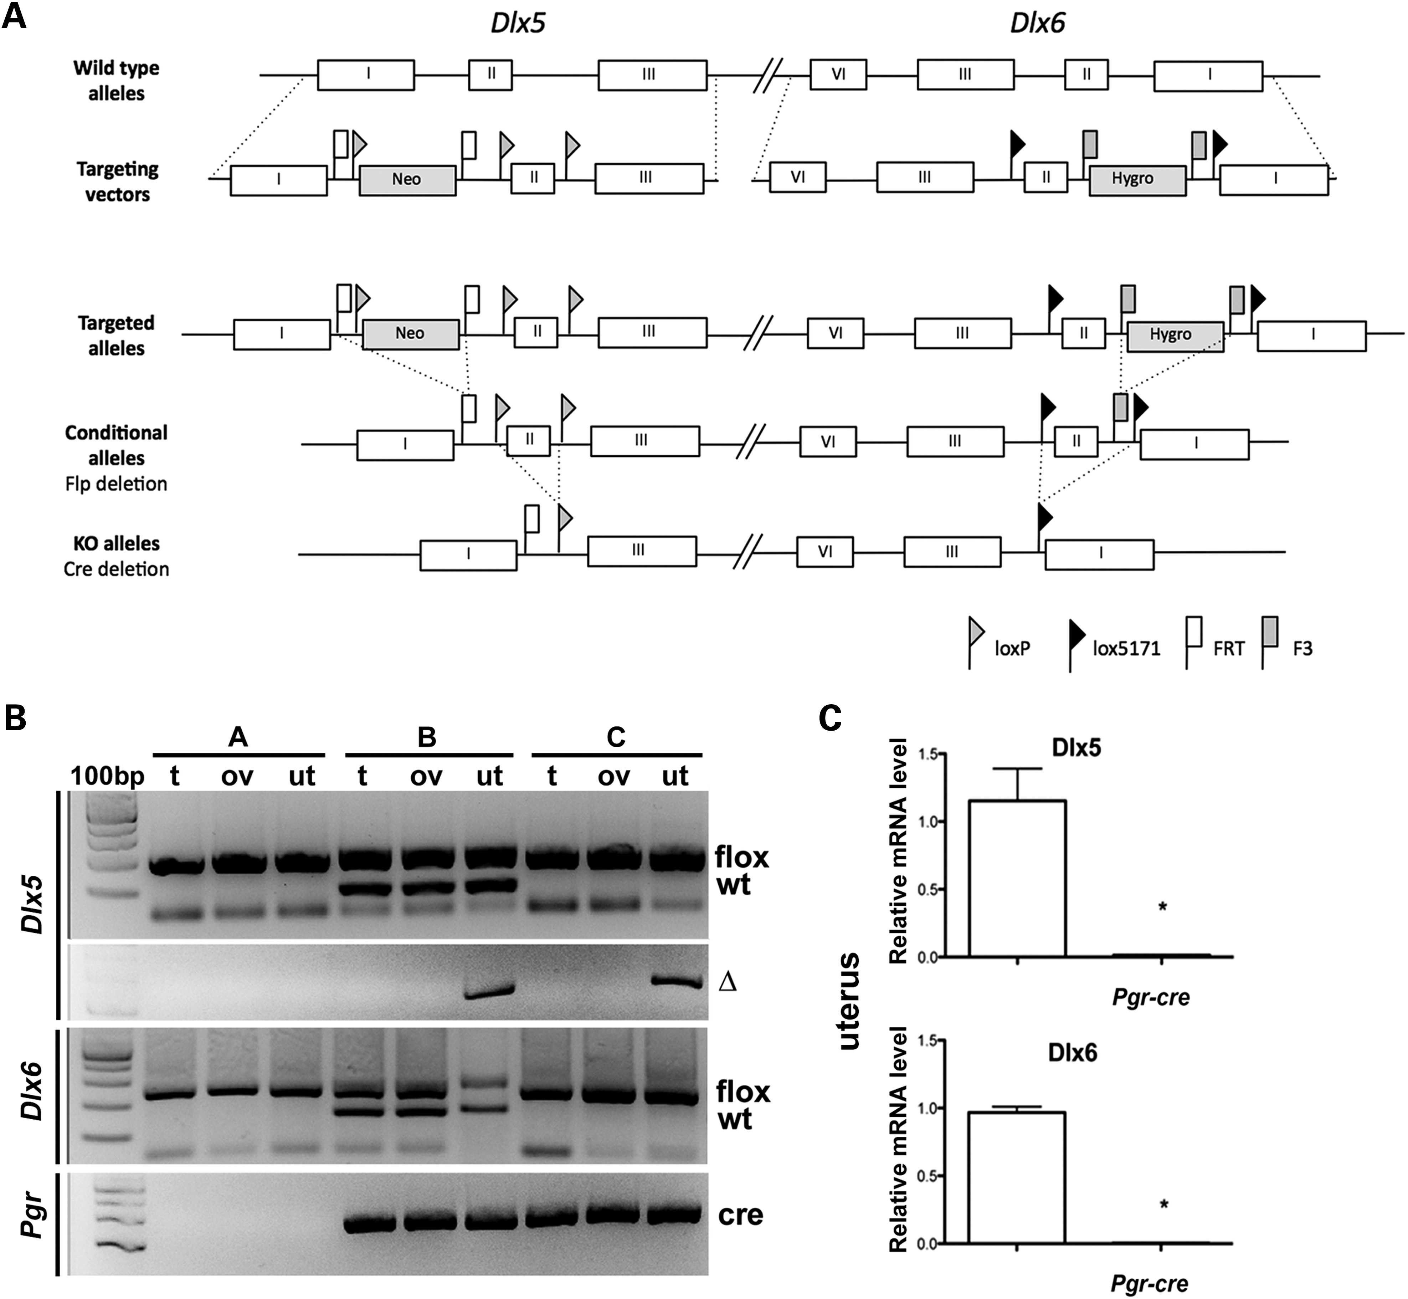
Figure 3. Post-natal deletion of Dlx5 and Dlx6 in the uterus. (A) Targeting strategy to generate ...
Notes:
Figure 3. Post-natal deletion of Dlx5 and Dlx6 in the uterus. (A) Targeting strategy to generate Dlx5/6flox/flox mice; at the end of the procedure, exons 2 of Dlx5 and Dlx6 were framed between LoxP and Lox5171 sequences, respectively, with selection markers (Neo and Hygro) were framed between flippase recognition sequences (FRT and F3). Selection markers were excised by flippase deletion in vivo. In the mutant allele generated by cre-recombinase mediated deletion, exons 2 of Dlx5 and Dlx6 are excised. Neo, neomycin; Hygro, hygromycin. (B) After crossing Dlx5/6flox/flox females with Pgrcre/+; Dlx5/6flox/+ males, the litter was analysed at PN25. The Dlx5 and Dlx6 floxed (flox) and the deleted (Δ) alleles of Dlx5 were detected by PCR. PCR product for the Dlx5 allele in tissues derived from different genotypes: (A) Dlx5/6flox/flox, (B) Pgrcre/+; Dlx5/6flox/+, (C) Pgrcre/+; Dlx5/6flox/flox and from different tissues: t, tail; ut, uterus; ov, ovary. The Δ allele was present only in the uterus. (C) qPCR shows relative expression of Dlx5 and Dlx6 mRNA in Dlx5/6flox/flox and Pgrcre/+; Dlx5/6flox/flox uteri at PN25. Dlx5 and Dlx6 mRNA are no longer detectable in the cre-deleted uterus. Reference gene for qPCR: Sdha.
Unless provided in the caption above, the following copyright applies to the content of this slide: © The Author 2015. Published by Oxford University Press. All rights reserved. For Permissions, please email: journals.permissions@oup.com

Slide 6
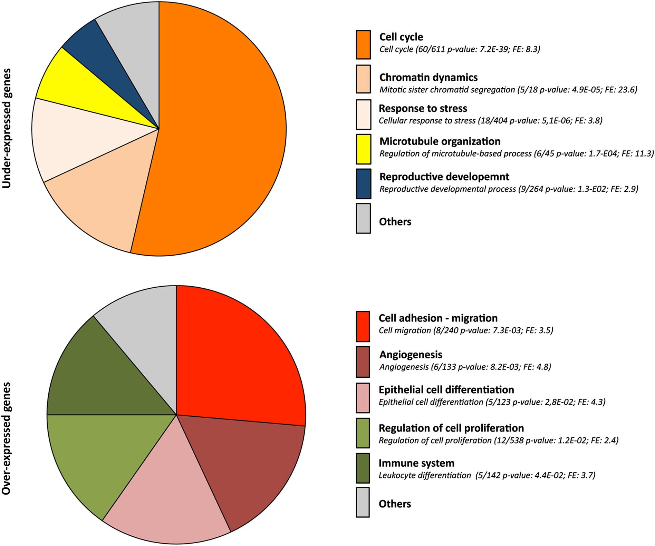
Figure 6. Pie chart showing distribution of differentially expressed transcripts in Pgr^{cre/+}; ...
Notes:
Figure 6. Pie chart showing distribution of differentially expressed transcripts in Pgrcre/+; Dlx5/6flox/flox uterus according to potential propriety. DAVID was used to determine GO terms (biological process and molecular function) and classified in different groups according to their potential biological function. Most upregulated genes are implicated in cellular differentiation. Most downregulated genes are implicated in cell cycle or cell division.
Unless provided in the caption above, the following copyright applies to the content of this slide: © The Author 2015. Published by Oxford University Press. All rights reserved. For Permissions, please email: journals.permissions@oup.com

Slide 7
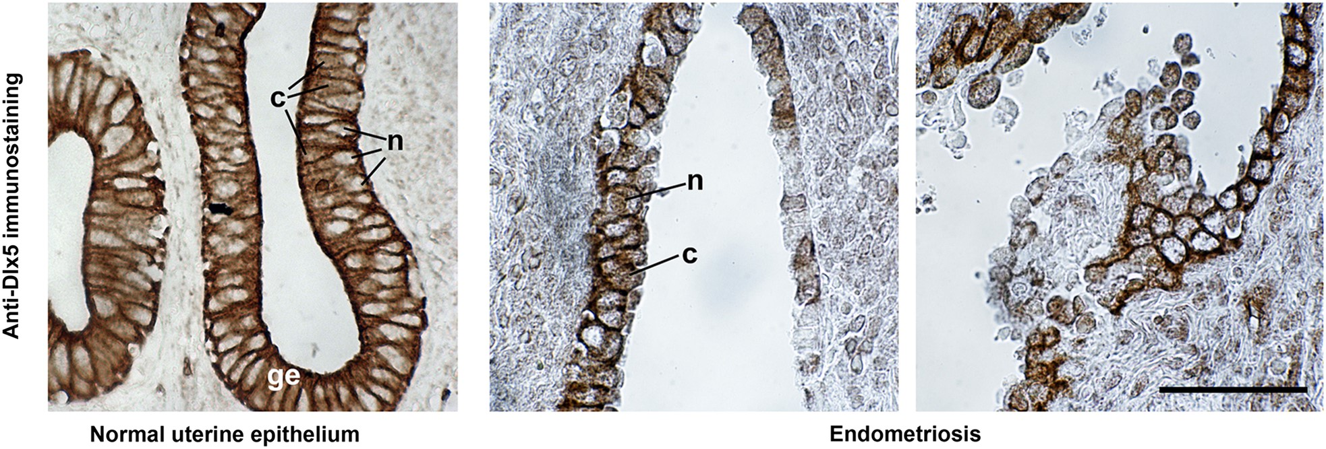
Figure 7. DLX5 immunostaining of normal human endometrium and endometriotic lesions. DLX5 protein is detected in the ...
Notes:
Figure 7. DLX5 immunostaining of normal human endometrium and endometriotic lesions. DLX5 protein is detected in the nucleus (n) and in the cytoplasm (c) of GE cells of the normal endometrium (ge). The epithelium of endometriotic lesions shows an heterogenous and weak immunoreactivity to anti-DLX5 antibodies which is also localized both in the nucleus and in the cytoplasm.
Unless provided in the caption above, the following copyright applies to the content of this slide: © The Author 2015. Published by Oxford University Press. All rights reserved. For Permissions, please email: journals.permissions@oup.com

