Slide 1
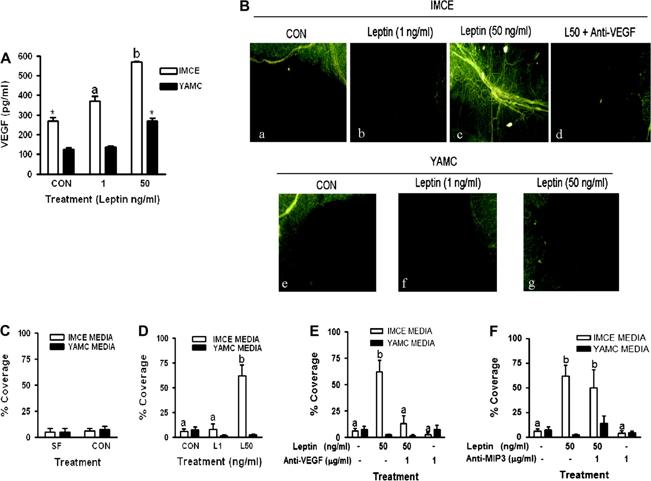
Fig. 1. VEGF production from IMCE and YAMC cells treated with leptin and induction of angiogenesis. ( A ) The effect ...
Notes:
Fig. 1. VEGF production from IMCE and YAMC cells treated with leptin and induction of angiogenesis. ( A ) The effect of leptin on IMCE ( ApcMin/+ ) and YAMC ( Apc +/+ ) cell production of VEGF. Cells were treated with leptin (1 or 50 ng/ml) for 48 h; media was collected and analyzed for VEGF using ELISA. Results are representative of at least three separate experiments. * P < 0.01 (compared with YAMC CON); a = P < 0.05 (compared with IMCE CON). ( B ) Epifluorescence visualization of microvessels in rat mesenteric windows using the Griffonia simplicifolia I lectin. Rat mesenteric windows were treated with conditioned media collected at 48 h from IMCE ( ApcMin/+ ) or YAMC ( Apc+/+ ) control or leptin (1 or 50 ng/ml) treated cells. Representative stimulus-specific capillary coverage is illustrated by G.simplicifolia I labeling for: (a) media from IMCE control cells, (b) media from IMCE leptin (1 ng/ml)-treated cells, (c) media from IMCE leptin (50 ng/ml)-treated cells, (d) media from IMCE leptin (50 ng/ml)-treated cells cotreated with anti-VEGF antibody (1 ug/ml), (e) media from control YAMC cells, (f) media from YAMC leptin (1 ng/ml)-treated cells and (g) media from YAMC leptin (50 ng/ml)-treated cells. ( C ) Graphical illustration of percent capillary coverage of rat mesenteric windows comparing control media from IMCE and YAMC cells, which was not different. ( D ) Graphical illustration of percent capillary coverage of rat mesenteric windows after treatment with conditioned media from leptin (1 and 50 ng/ml)-treated IMCE and YAMC cells. Only the L50 media induced a significant increase in capillary coverage of the rat mesentery window. ( E ) Graphical illustration of percent capillary coverage of rat mesenteric windows after a pretreatment with an anti-VEGF neutralization antibody followed by treatment with conditioned media from leptin (0 and 50 ng/ml) treated IMCE and YAMC cells. The capillary formation induced by the leptin (50 ng/ml)-treated IMCE media was blocked by cotreatment with anti-VEGF antibody. ( F ) Graphical illustration of percent capillary coverage of rat mesenteric windows after a pretreatment with an anti-MIP3 neutralization antibody followed by treatment with conditioned media from leptin (0 and 50 ng/ml)-treated IMCE and YAMC cells. Cotreatment of leptin (50 ng/ml)-treated IMCE media with an antibody against MIP3 did not block capillary formation. Data shown are the mean ± standard deviation of 10 mesenteric windows per treatment from one representative experiment. The experiments were repeated three times. a = no statistical difference; b = P < 0.001 (compared with all treatments). CON = conditioned media from control IMCE or YAMC cells, L1 = conditioned media from leptin (1 ng/ml) treated IMCE or YAMC cells, L50 = conditioned media from leptin (50 ng/ml) treated IMCE or YAMC cells.
Unless provided in the caption above, the following copyright applies to the content of this slide: © The Author 2009. Published by Oxford University Press. All rights reserved. For Permissions, please email: journals.permissions@oxfordjournals.org

Slide 2
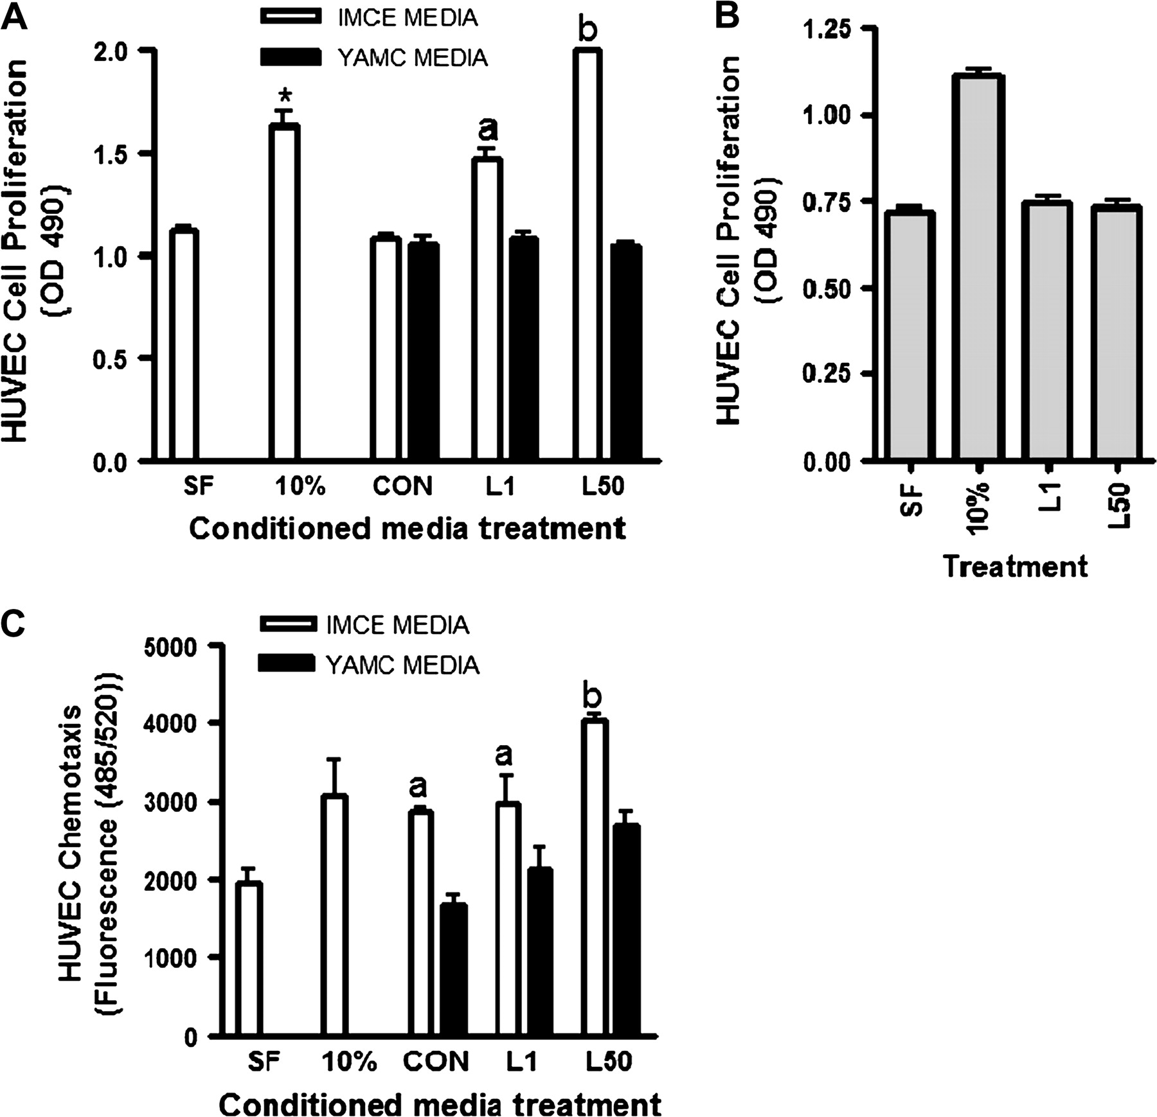
Fig. 2. HUVEC proliferation and migration in response to conditioned media. ( A ) The effect of conditioned media ...
Notes:
Fig. 2. HUVEC proliferation and migration in response to conditioned media. ( A ) The effect of conditioned media from IMCE ( ApcMin/+ ) or YAMC ( Apc+/+ ) control or leptin (1 or 50 ng/ml)-treated cells on HUVEC cell proliferation as measured using the Aqueous One kit. * P < 0.05 (compared with SF control); a = P < 0.05 (compared with CON); b = P < 0.001 (compared with CON). ( B ) The effect of direct leptin treatment alone on HUVEC cell proliferation. ( C ) The effect of conditioned media from IMCE ( ApcMin/+ ) or YAMC ( Apc+/+ ) control or leptin (1 or 50 ng/ml)-treated cells on HUVEC cell migration using the QCM chemotaxis assay. a = P < 0.05 (compared with SF control); b = P < 0.001 (compared with CON and L1). Results are representative of three separate experiments. SF = treatment with serum free medium alone, 10% = treatment with media that contained 10% serum (as a positive control), CON = conditioned media from control IMCE or YAMC cells, L1 = conditioned media from leptin (1 ng/ml) treated IMCE or YAMC cells, L50 = conditioned media from leptin (50 ng/ml) treated IMCE or YAMC cells.
Unless provided in the caption above, the following copyright applies to the content of this slide: © The Author 2009. Published by Oxford University Press. All rights reserved. For Permissions, please email: journals.permissions@oxfordjournals.org

Slide 3
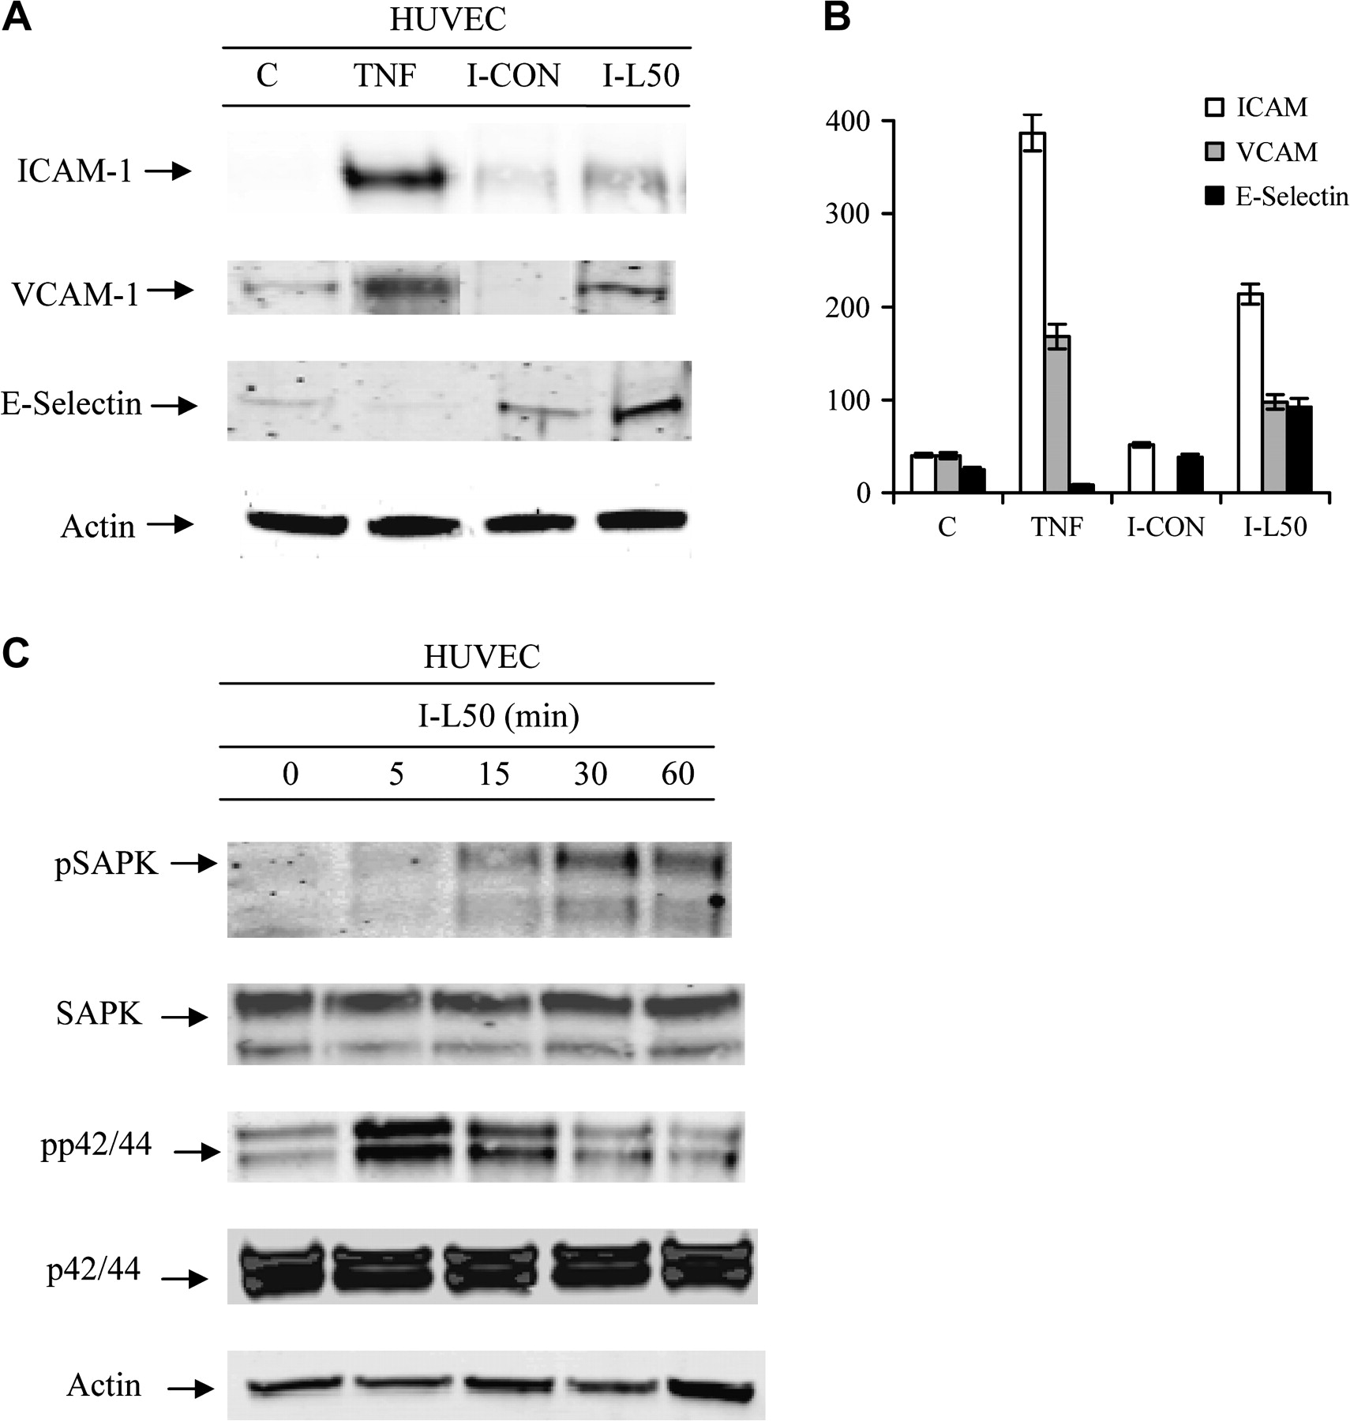
Fig. 3. Adhesion molecule production by and activation of HUVECs as demonstrated by western blot. ( A ) The effect ...
Notes:
Fig. 3. Adhesion molecule production by and activation of HUVECs as demonstrated by western blot. ( A ) The effect of conditioned media from IMCE ( ApcMin/+ ) control or leptin (50 ng/ml)-treated cells on ICAM-1, VCAM-1 or E-Selectin upregulation at 6 h post-treatment of HUVEC cells. ( B ) Densitometric representation of the western blots in A for ICAM, VCAM and E-Selectin. ( C ) The effect of conditioned media from leptin (50 ng/ml)-treated IMCE ( ApcMin/+ ) cells at various time points on HUVEC cell activation (phosphorylation) of SAPK or p42/44. Total protein controls pair matched for SAPK and p42/44 are shown. Actin shown as a protein loading control. Results are representative of two separate experiments. C = media from HUVEC control cells, TNF = 5 ng/ml tumor necrosis factor-α as positive control, I-CON = conditioned media from IMCE ( ApcMin/+ ) control cells, I-L50 = conditioned media from leptin (50 ng/ml) treated IMCE ( ApcMin/+ ) cells.
Unless provided in the caption above, the following copyright applies to the content of this slide: © The Author 2009. Published by Oxford University Press. All rights reserved. For Permissions, please email: journals.permissions@oxfordjournals.org

Slide 4
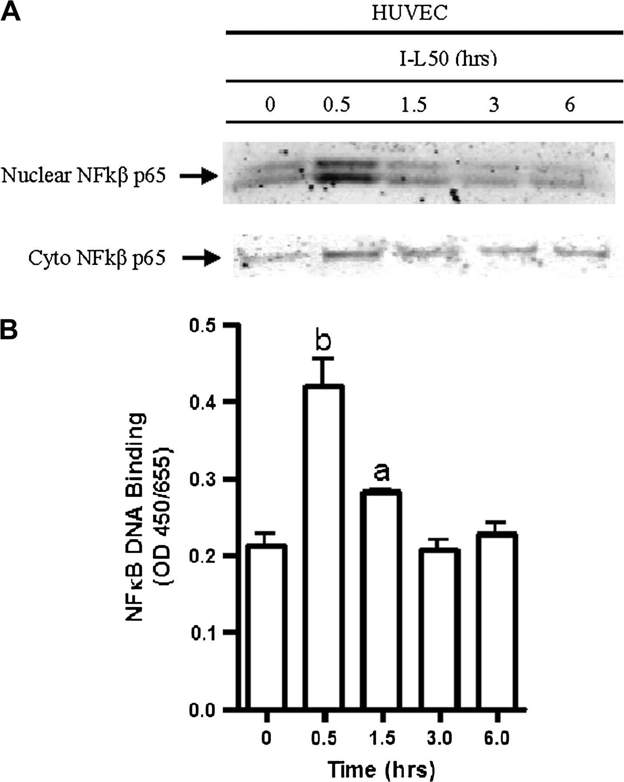
Fig. 4. NFκB nuclear translocation and DNA binding in HUVECs following conditioned media treatment. ( A ) The effect ...
Notes:
Fig. 4. NFκB nuclear translocation and DNA binding in HUVECs following conditioned media treatment. ( A ) The effect of conditioned media from leptin (50 ng/ml)-treated IMCE ( ApcMin/+ ) cells on HUVEC cytoplasmic and nuclear NFκB translocation. Cells were treated overnight in serum free medium prior to exposure to treatment. Nuclear extracts were collected at time points shown. ( B ) The effect of conditioned media from leptin (50 ng/ml)-treated IMCE ( ApcMin/+ ) cells on nuclear NFκB DNA binding at various time points using the TransAM NFκB kit. a = P < 0.05 (compared with 0 h); b = P < 0.001 (compared with 0 h). Results are representative of two separate experiments.
Unless provided in the caption above, the following copyright applies to the content of this slide: © The Author 2009. Published by Oxford University Press. All rights reserved. For Permissions, please email: journals.permissions@oxfordjournals.org

Slide 5
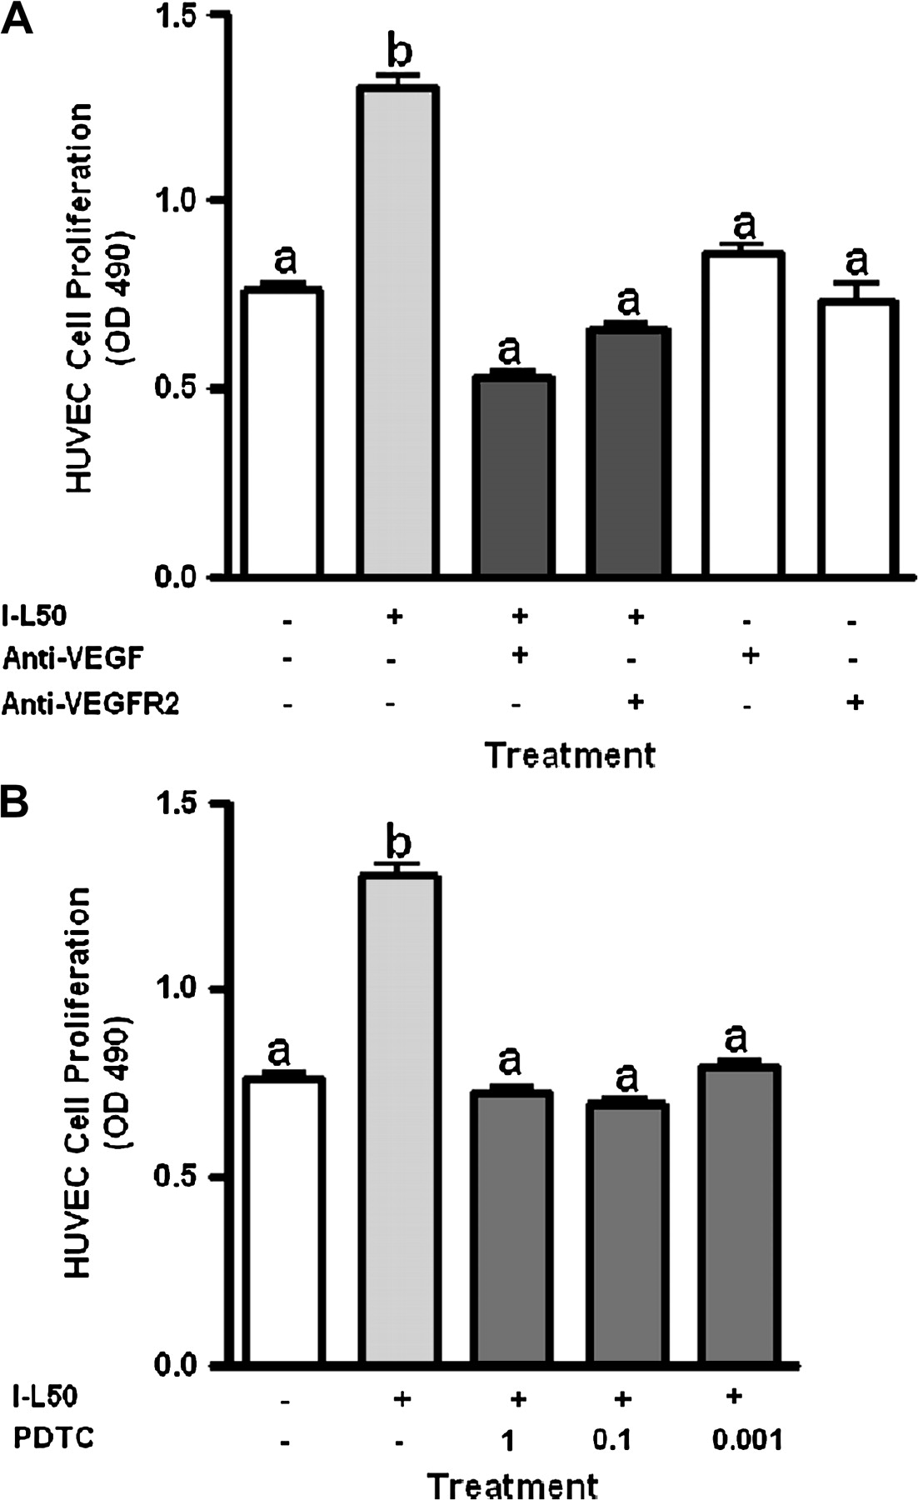
Fig. 5. Inhibition of conditioned media driven HUVEC cell proliferation. ( A ) The effect of conditioned media from ...
Notes:
Fig. 5. Inhibition of conditioned media driven HUVEC cell proliferation. ( A ) The effect of conditioned media from leptin (50 ng/ml)-treated IMCE ( ApcMin/+ ) cells and coincubation with anti-VEGF or anti-VEGFR-2 antibody (1 μg/ml) on HUVEC cell proliferation as measured using the Aqueous One proliferation assay. ( B ) The effect of conditioned media from leptin (50 ng/ml)-treated IMCE ( ApcMin/+ ) cells and cotreatment with pyrrolidine dithiocarbamate (PDTC; NFκB inhibitor) at 1.0, 0.1 or 0.001 μM on HUVEC cell proliferation. Results are representative of three separate experiments. a = no significant difference; b = P < 0.01 (compared with all treatments). I-L50 = conditioned media from leptin (50 ng/ml) treated IMCE ( ApcMin/+ ) cells.
Unless provided in the caption above, the following copyright applies to the content of this slide: © The Author 2009. Published by Oxford University Press. All rights reserved. For Permissions, please email: journals.permissions@oxfordjournals.org

