Slide 1
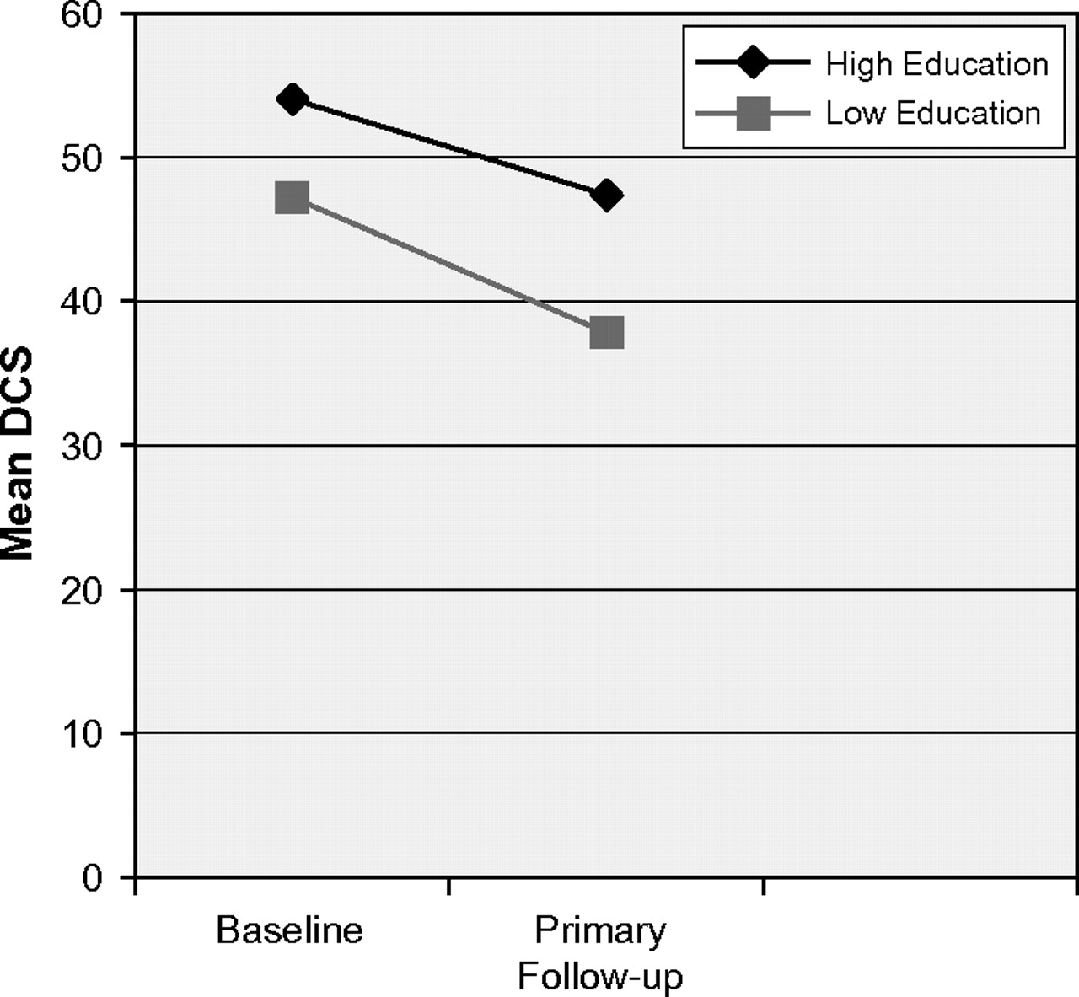
FIGURE 1 Mean DCS at baseline and follow-up in the control group
Notes:
FIGURE 1 Mean DCS at baseline and follow-up in the control group
Unless provided in the caption above, the following copyright applies to the content of this slide: © The Author 2007. Published by Oxford University Press. All rights reserved. For permissions, please e-mail: journals.permissions@oxfordjournals.org.

Slide 2
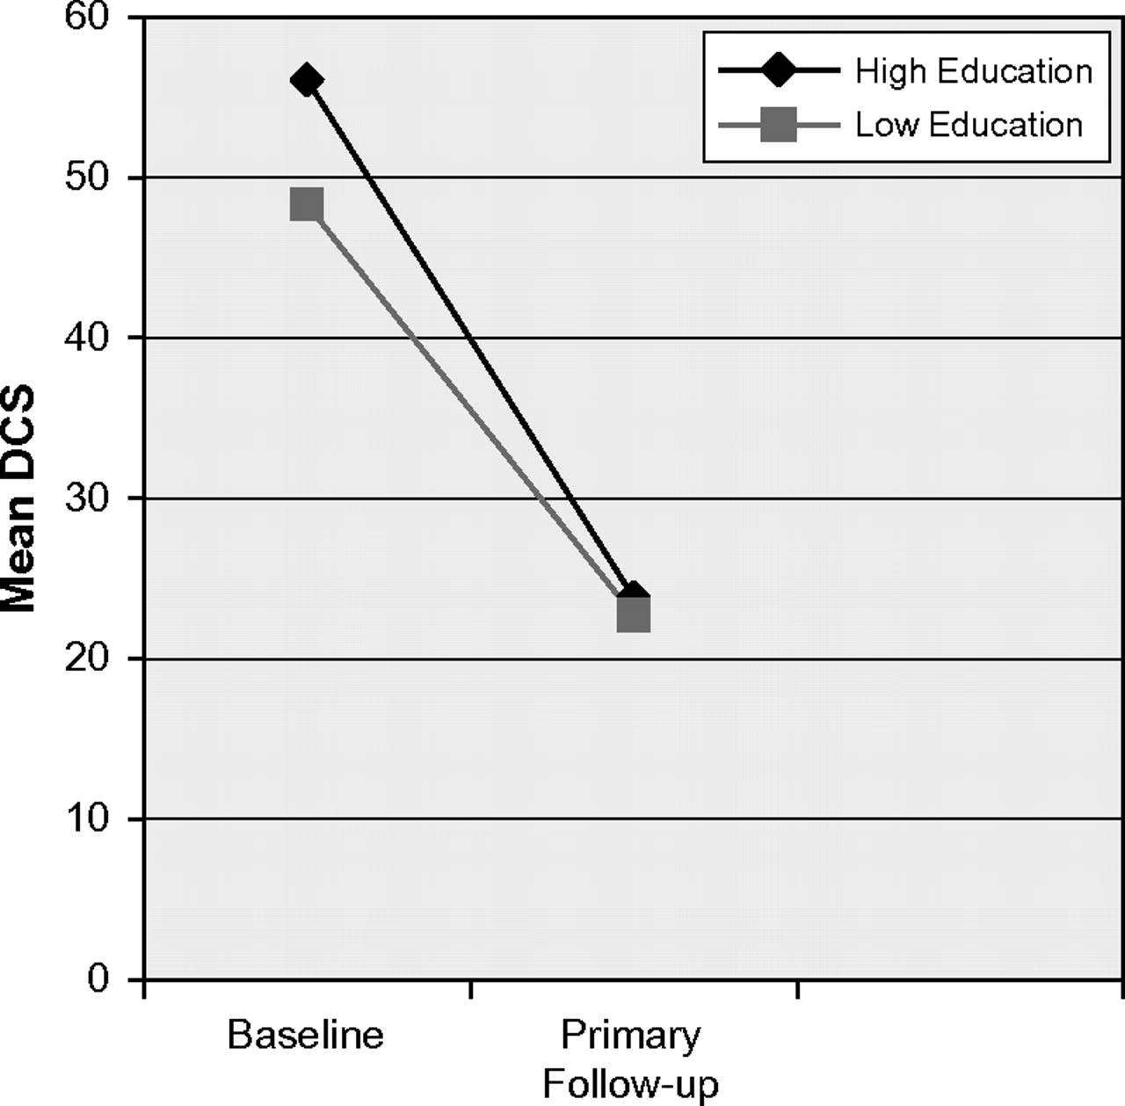
FIGURE 2 Mean DCS at baseline and follow-up in the intervention group
Notes:
FIGURE 2 Mean DCS at baseline and follow-up in the intervention group
Unless provided in the caption above, the following copyright applies to the content of this slide: © The Author 2007. Published by Oxford University Press. All rights reserved. For permissions, please e-mail: journals.permissions@oxfordjournals.org.

