Slide 1
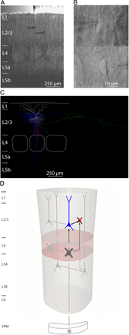
Figure 1. Paired whole-cell recordings of L2/3 pyramidal neurons and L2/3 interneurons. (A) Bright field image of the ...
Notes:
Figure 1. Paired whole-cell recordings of L2/3 pyramidal neurons and L2/3 interneurons. (A) Bright field image of the barrel field prior to recording. Positions of recorded cells are depicted by black arrows. (B) High-magnification DIC images of the pre- (bottom picture) and postsynaptic (upper picture) neuron. (C) Computer-aided reconstruction of soma, dendrites, and axon of the presynaptic (L2/3 interneuron, red, red, and blue) and postsynaptic (L2/3 pyramidal neuron, white, white, and green) neurons. (D) Schematic drawing of the L4-to-L2/3 microcircuit. The connection between L2/3 interneurons (red) and pyramidal neurons (blue) was characterized in this study. Previous studies by Feldmeyer et al. (1999, 2002, 2005, 2006) and Helmstaedter et al. (2008) characterized the intracolumnar connections shown in gray.
Unless provided in the caption above, the following copyright applies to the content of this slide: © The Author 2015. Published by Oxford University PressThis is an Open Access article distributed under the terms of the Creative Commons Attribution Non-Commercial License (http://creativecommons.org/licenses/by-nc/4.0/), which permits non-commercial re-use, distribution, and reproduction in any medium, provided the original work is properly cited. For commercial re-use, please contact journals.permissions@oup.com

Slide 2
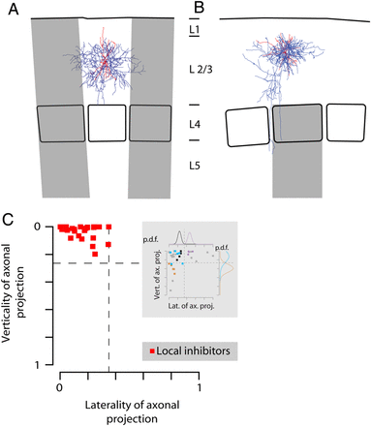
Figure 2. Quantitative analysis of the axonal projection domains. (A) Reconstruction of a L2/3 interneuron (soma and ...
Notes:
Figure 2. Quantitative analysis of the axonal projection domains. (A) Reconstruction of a L2/3 interneuron (soma and dendrites, black; axon, blue) from rat barrel cortex. Home column, white; area beyond home column and adjacent septa, gray. The laterality was defined as a linear combination of the ratio of axonal path length extending beyond the home column and the total lateral axonal extent (90% of the axonal length density, cf. Methods) extending beyond the home column in units of home-column width. (B) Reconstruction of a L2/3 interneuron from barrel cortex. Color code as above. The verticality was defined as the ratio of axonal path length extending vertically beyond the upper border of L4. (C) Distribution of axonal laterality and verticality for 26 local inhibitor interneurons (red). Maximum laterality and verticality of the axonal projection (laterality of axonal projection and verticality of axonal projection, respectively) for local inhibitors were derived from the probability density function (p.d.f.) of laterality and verticality of interneuron groups in a study by Helmstaedter et al. (2009a). An inset shows the axonal laterality and verticality of interneurons examined in this latter study (cf. Methods and Results; inset: local inhibitor group 1, black; lateral inhibitor group 1, purple; local inhibitor group 3, light blue; feedback inhibitor group 1, orange).
Unless provided in the caption above, the following copyright applies to the content of this slide: © The Author 2015. Published by Oxford University PressThis is an Open Access article distributed under the terms of the Creative Commons Attribution Non-Commercial License (http://creativecommons.org/licenses/by-nc/4.0/), which permits non-commercial re-use, distribution, and reproduction in any medium, provided the original work is properly cited. For commercial re-use, please contact journals.permissions@oup.com

Slide 3
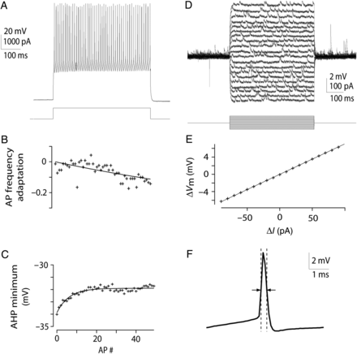
Figure 3. Quantification of intrinsic electrical parameters. (A) AP discharge pattern of a local inhibitor evoked by ...
Notes:
Figure 3. Quantification of intrinsic electrical parameters. (A) AP discharge pattern of a local inhibitor evoked by somatic injection of a 500-ms current pulse. The trace with an initial frequency closest to 100 Hz (interspike-interval of ∼10 ms) was chosen for further analysis. (B) AP frequency adaptation, measured as ratio between the initial and last frequency on a mono-exponential fit to the frequencies in the AP train shown in (A). (C) AP AHP minimum voltages in the AP train shown in (A). The offset between the first and the last AHP minimum voltage on a mono-exponential fit to the AHP minimum voltages was calculated as AHP minimum voltage adaptation. (F) AP half width of the first AP in the AP train shown in (A). (D) Membrane voltage responses of the same interneuron to subthreshold current injections at resting membrane potential. (E) I/V ratio corresponding to (D). The I/V ratio was used to constrain the somatic input resistance at resting membrane potential (cf. Methods).
Unless provided in the caption above, the following copyright applies to the content of this slide: © The Author 2015. Published by Oxford University PressThis is an Open Access article distributed under the terms of the Creative Commons Attribution Non-Commercial License (http://creativecommons.org/licenses/by-nc/4.0/), which permits non-commercial re-use, distribution, and reproduction in any medium, provided the original work is properly cited. For commercial re-use, please contact journals.permissions@oup.com

Slide 4
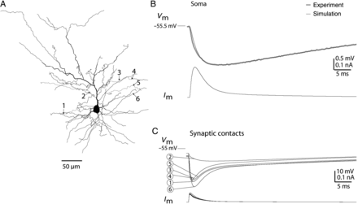
Figure 7. Extraction of synaptic parameters by fitting model to experiment. (A) A detailed compartmental model of the ...
Notes:
Figure 7. Extraction of synaptic parameters by fitting model to experiment. (A) A detailed compartmental model of the postsynaptic pyramidal neuron shown in Figure 6A. Six synaptic contacts (indicated by black arrows and numbered from 1 to 6) were inserted at the putative synaptic locations identified at the light microscopic level (compare Fig. 6A) and the synaptic parameters were optimized to fit the experimental observations (cf. Methods and Results). (B) Top gray trace: average somatic IPSP measured experimentally in the pair shown in Figure 6A. Top black trace: model fit using the detailed compartmental model shown in (A). Bottom black trace: model somatic IPSC. (C) Potential deflections (top traces) and currents (bottom traces) at the synaptic contacts during a simulation using the same model parameters as in (B).
Unless provided in the caption above, the following copyright applies to the content of this slide: © The Author 2015. Published by Oxford University PressThis is an Open Access article distributed under the terms of the Creative Commons Attribution Non-Commercial License (http://creativecommons.org/licenses/by-nc/4.0/), which permits non-commercial re-use, distribution, and reproduction in any medium, provided the original work is properly cited. For commercial re-use, please contact journals.permissions@oup.com

Slide 5
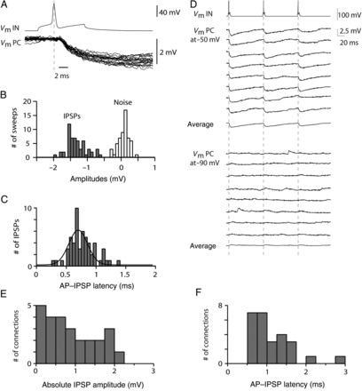
Figure 4. Properties of IPSPs in the local inhibitor-to-L2/3 pyramidal neuron connections. (A) Presynaptic AP and ...
Notes:
Figure 4. Properties of IPSPs in the local inhibitor-to-L2/3 pyramidal neuron connections. (A) Presynaptic AP and overlay of 20 successive postsynaptic IPSPs at a postsynaptic holding potential of −50 mV for the pair shown in Figure 6A. (B) IPSP unitary amplitude histogram for this connection. The unitary IPSP amplitudes (gray) of this pair were on average −1.75 ± 0.27 mV (n = 56 sweeps) and could be readily distinguished from noise (white). (C) AP–IPSP onset latency histogram for this connection. The AP–IPSP onset latency of this pair was on average 0.74 ± 0.17 ms. A Gaussian fit demonstrates the narrow distribution. (D) Train of 3 presynaptic APs at 10 Hz (top trace) and 8 consecutive sweeps at a postsynaptic holding potential of −50 mV (middle traces). The PSPs were on average hyperpolarizing and depressing in amplitude (middle trace). Eight consecutive sweeps at a hyperpolarized postsynaptic holding potential of −90 mV (bottom traces). The PSPs were depolarizing on average (bottom trace). All recordings were performed using a “low chloride” internal solution (4 mM Cl−). (E and F) Histograms of IPSP amplitudes and AP–IPSP onset latencies for all 26 local inhibitor-to-L2/3 pyramidal neuron connections, respectively.
Unless provided in the caption above, the following copyright applies to the content of this slide: © The Author 2015. Published by Oxford University PressThis is an Open Access article distributed under the terms of the Creative Commons Attribution Non-Commercial License (http://creativecommons.org/licenses/by-nc/4.0/), which permits non-commercial re-use, distribution, and reproduction in any medium, provided the original work is properly cited. For commercial re-use, please contact journals.permissions@oup.com

Slide 6
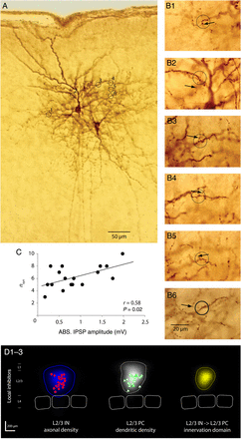
Figure 6. Light microscopic analysis of synaptic contacts and average axonal projection and innervation domain of local ...
Notes:
Figure 6. Light microscopic analysis of synaptic contacts and average axonal projection and innervation domain of local inhibitor-to-L2/3 pyramidal neuron connections. (A) Light microscopic image of a synaptically coupled local inhibitor-to-L2/3-pyramidal neuron pair at low magnification. Putative synaptic contacts made by the local inhibitor (lower, right neuron) are indicated by black circles and numbered from 1 to 6. (B1–B6) Images at higher magnification of the putative contacts 1–6 shown in (A). The presynaptic axon (indicated by black arrows) was found to intersect with the postsynaptic dendrite in a single focal plane. (C) The number of putative contacts identified using this method was significantly correlated with the IPSP amplitude of the respective connection (two-sided Pearson correlation). (D1) The axonal length density map of local inhibitors was largely confined to the borders of the home column and L2/3. (D2) Dendritic length–density map and soma positions of the pyramidal neurons contacted by local inhibitors. (D3) Inhibitory innervation probability map of local inhibitors. Inhibitory innervation probability maps were obtained by multiplication of the respective axonal (D1) and dendritic length densities (D2). The yellow contour comprises 90% of the inhibitory innervation probability (i.e., “innervation domain”). The innervation domain can be interpreted as the area in which 90% of the contacts are made if the distribution of these contacts depended mainly on spatial proximity. The blue and white contours in D1–2 comprise 90% of respective length–density.
Unless provided in the caption above, the following copyright applies to the content of this slide: © The Author 2015. Published by Oxford University PressThis is an Open Access article distributed under the terms of the Creative Commons Attribution Non-Commercial License (http://creativecommons.org/licenses/by-nc/4.0/), which permits non-commercial re-use, distribution, and reproduction in any medium, provided the original work is properly cited. For commercial re-use, please contact journals.permissions@oup.com

Slide 7
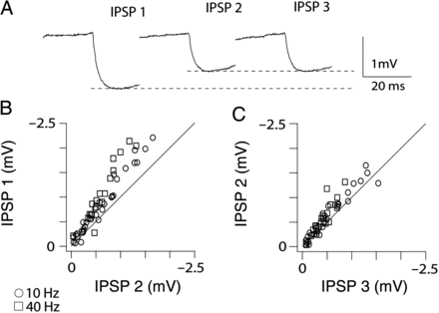
Figure 5. Short-term plasticity of local inhibitor-to-L2/3 pyramidal neuron connections. (A) Average amplitudes of 3 ...
Notes:
Figure 5. Short-term plasticity of local inhibitor-to-L2/3 pyramidal neuron connections. (A) Average amplitudes of 3 consecutive IPSPs at a depolarized postsynaptic potential evoked by stimulation of presynaptic APs at 10 Hz. The IPSPs in this connection were on average depressing in amplitude. (B and C) Ratio of first to second (B) and second to third (C) IPSP amplitude. Most connections were on average depressing in amplitude.
Unless provided in the caption above, the following copyright applies to the content of this slide: © The Author 2015. Published by Oxford University PressThis is an Open Access article distributed under the terms of the Creative Commons Attribution Non-Commercial License (http://creativecommons.org/licenses/by-nc/4.0/), which permits non-commercial re-use, distribution, and reproduction in any medium, provided the original work is properly cited. For commercial re-use, please contact journals.permissions@oup.com

Slide 8
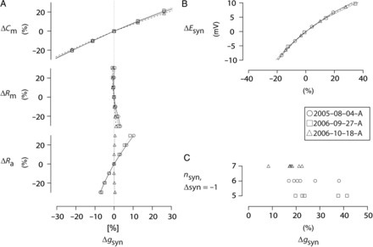
Figure 8. Sensitivity of conductance estimates to variations in other model parameters. (A) Sensitivity of the synaptic ...
Notes:
Figure 8. Sensitivity of conductance estimates to variations in other model parameters. (A) Sensitivity of the synaptic conductance estimates (gsyn,max) to variations in the membrane capacitance (Cm, top), membrane resistance (Rm, middle), and axial resistance (Ra, bottom). (B) Sensitivity of gsyn,max to variations in the synaptic reversal potential (Esyn). (C) Sensitivity of gsyn,max to the variations in the number of synapses (nsyn). Each synapse was deactivated one at a time and the resulting error in gsyn,max was estimated.
Unless provided in the caption above, the following copyright applies to the content of this slide: © The Author 2015. Published by Oxford University PressThis is an Open Access article distributed under the terms of the Creative Commons Attribution Non-Commercial License (http://creativecommons.org/licenses/by-nc/4.0/), which permits non-commercial re-use, distribution, and reproduction in any medium, provided the original work is properly cited. For commercial re-use, please contact journals.permissions@oup.com

Slide 9
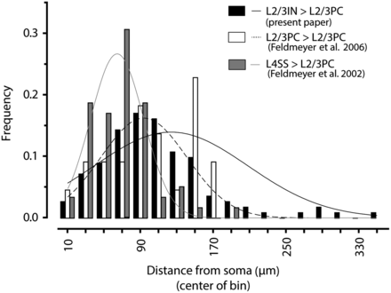
Figure 9. Location of synaptic contacts onto L2/3 pyramidal neurons by L2/3 local inhibitors, L4 spiny neurons, and ...
Notes:
Figure 9. Location of synaptic contacts onto L2/3 pyramidal neurons by L2/3 local inhibitors, L4 spiny neurons, and other L2/3 pyramidal neurons. The distribution of putative synaptic contacts made onto L2/3 pyramidal neurons by local inhibitors (this study, black bars) is strikingly similar with the distributions of those onto L2/3 pyramidal neurons by L4 spiny neurons (gray bars) and other L2/3 pyramidal neurons (white bars) reported previously [data points and histogram adapted from Feldmeyer et al. (2002); Feldmeyer et al. (2006) for comparison]. Given a near-synchronous activation of these connections, inhibition of L2/3 pyramidal neurons might be mediated by spatial and temporal proximity of inhibitory and excitatory contacts (shunting inhibition). Relative frequency distribution and Gaussian fits are shown.
Unless provided in the caption above, the following copyright applies to the content of this slide: © The Author 2015. Published by Oxford University PressThis is an Open Access article distributed under the terms of the Creative Commons Attribution Non-Commercial License (http://creativecommons.org/licenses/by-nc/4.0/), which permits non-commercial re-use, distribution, and reproduction in any medium, provided the original work is properly cited. For commercial re-use, please contact journals.permissions@oup.com

