Slide 1
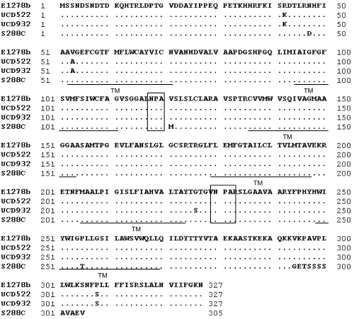
1 Sequence alignment of Aqy1p from UCD522, UCD932, and S288C with Aqy1-1 of Σ1278b. Residues that differ ...
Notes:
1 Sequence alignment of Aqy1p from UCD522, UCD932, and S288C with Aqy1-1 of Σ1278b. Residues that differ between sequences are shown. UCD522 is representative of an allele found in several of the investigated wine strains. TM refers to the transmembrane sequences and the boxed areas to NPA (Asn-Pro-Ala) sequences.
Unless provided in the caption above, the following copyright applies to the content of this slide: © 2006 Federation of European Microbiological Societies

Slide 2
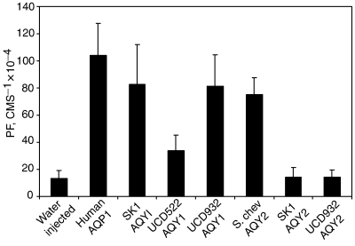
2 Bar diagram of osmotic water permeability (P_{f}) measurements. Oocytes were injected with water or ...
Notes:
2 Bar diagram of osmotic water permeability (Pf) measurements. Oocytes were injected with water or with cRNA to express the aquaporins. After 3 days in culture, oocytes were transferred from 200 mosM modified Barth's solution to 70 mosM, and swelling was measured.
Unless provided in the caption above, the following copyright applies to the content of this slide: © 2006 Federation of European Microbiological Societies

