Slide 1
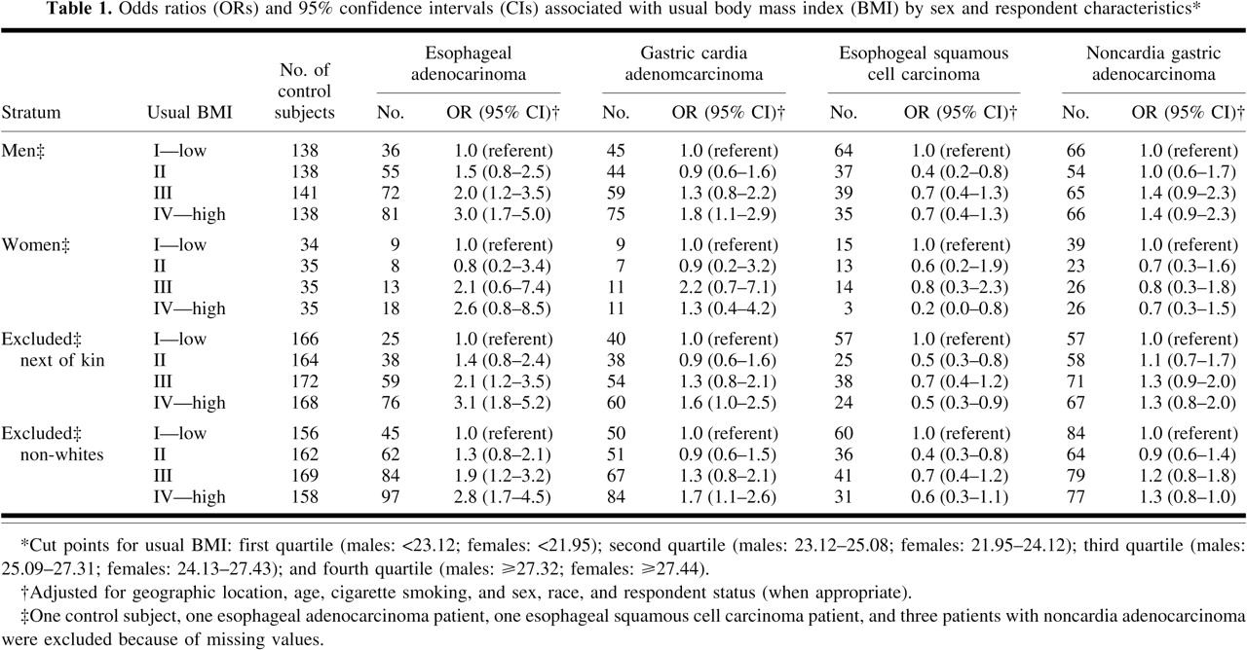
Table 1
Notes:
Table 1
Unless provided in the caption above, the following copyright applies to the content of this slide: © 1997 Oxford University Press

Slide 2
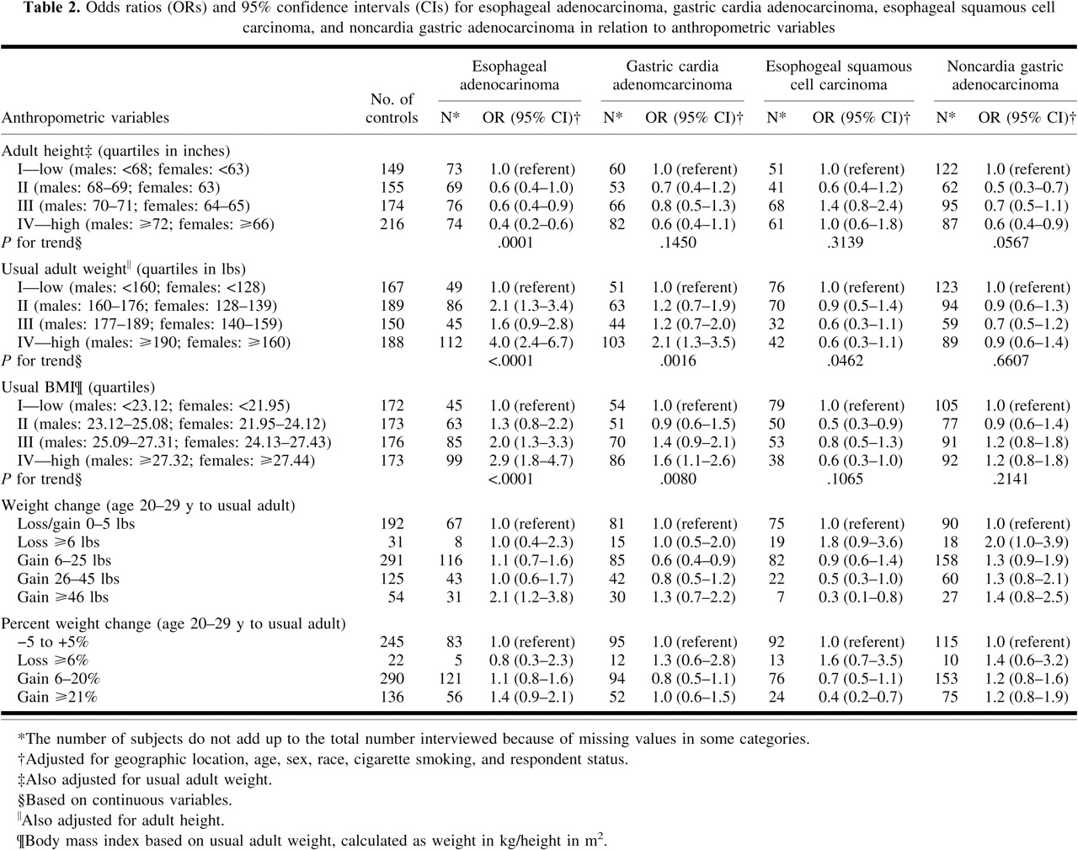
Table 2
Notes:
Table 2
Unless provided in the caption above, the following copyright applies to the content of this slide: © 1997 Oxford University Press

Slide 3
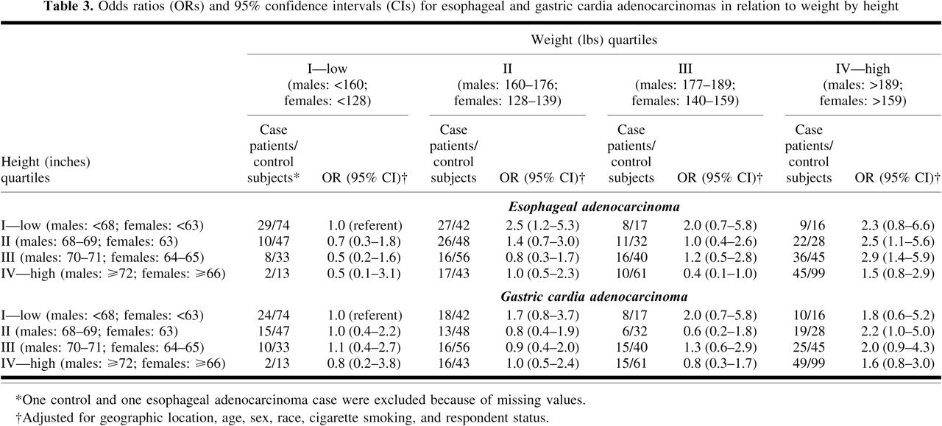
Table 3
Notes:
Table 3
Unless provided in the caption above, the following copyright applies to the content of this slide: © 1997 Oxford University Press

Slide 4
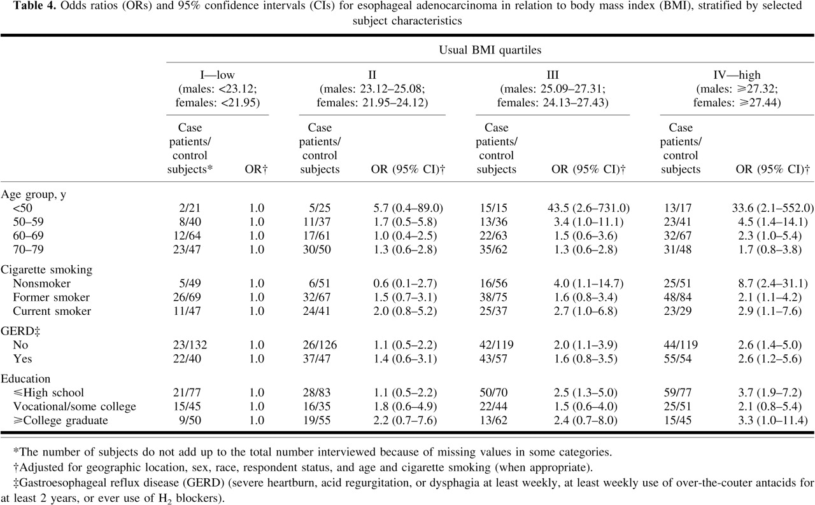
Table 4
Notes:
Table 4
Unless provided in the caption above, the following copyright applies to the content of this slide: © 1997 Oxford University Press

