Slide 1
Fig 2. Caspar David Friedrich, Solitary Tree, 1822. Oil on canvas, 55 x 71 cm. Alte Nationalgalerie, Berlin. Image ...
Notes:
Fig 2. Caspar David Friedrich, Solitary Tree, 1822. Oil on canvas, 55 x 71 cm. Alte Nationalgalerie, Berlin. Image courtesy of bpk/Nationalgalerie, SMB/Jörg P. Anders.
Unless provided in the caption above, the following copyright applies to the content of this slide: © British Society of Aesthetics 2009. Published by Oxford University Press on behalf of the British Society of Aesthetics. All rights reserved. For Permissions, please email: journals.permissions@oxfordjournals.org

Slide 2
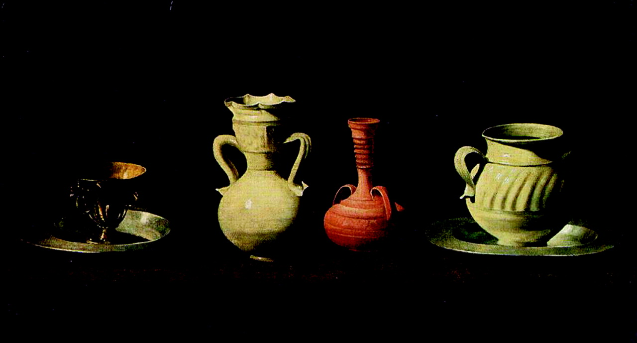
Fig 1. Francisco de Zurbaran, Pots, 1636. Oil on canvas, 46 x 84 cm. Museo Nacional del Prado, Madrid. Reproduced ...
Notes:
Fig 1. Francisco de Zurbaran, Pots, 1636. Oil on canvas, 46 x 84 cm. Museo Nacional del Prado, Madrid. Reproduced with the permission of the Museo Nacional del Prado, Madrid.
Unless provided in the caption above, the following copyright applies to the content of this slide: © British Society of Aesthetics 2009. Published by Oxford University Press on behalf of the British Society of Aesthetics. All rights reserved. For Permissions, please email: journals.permissions@oxfordjournals.org

Slide 3
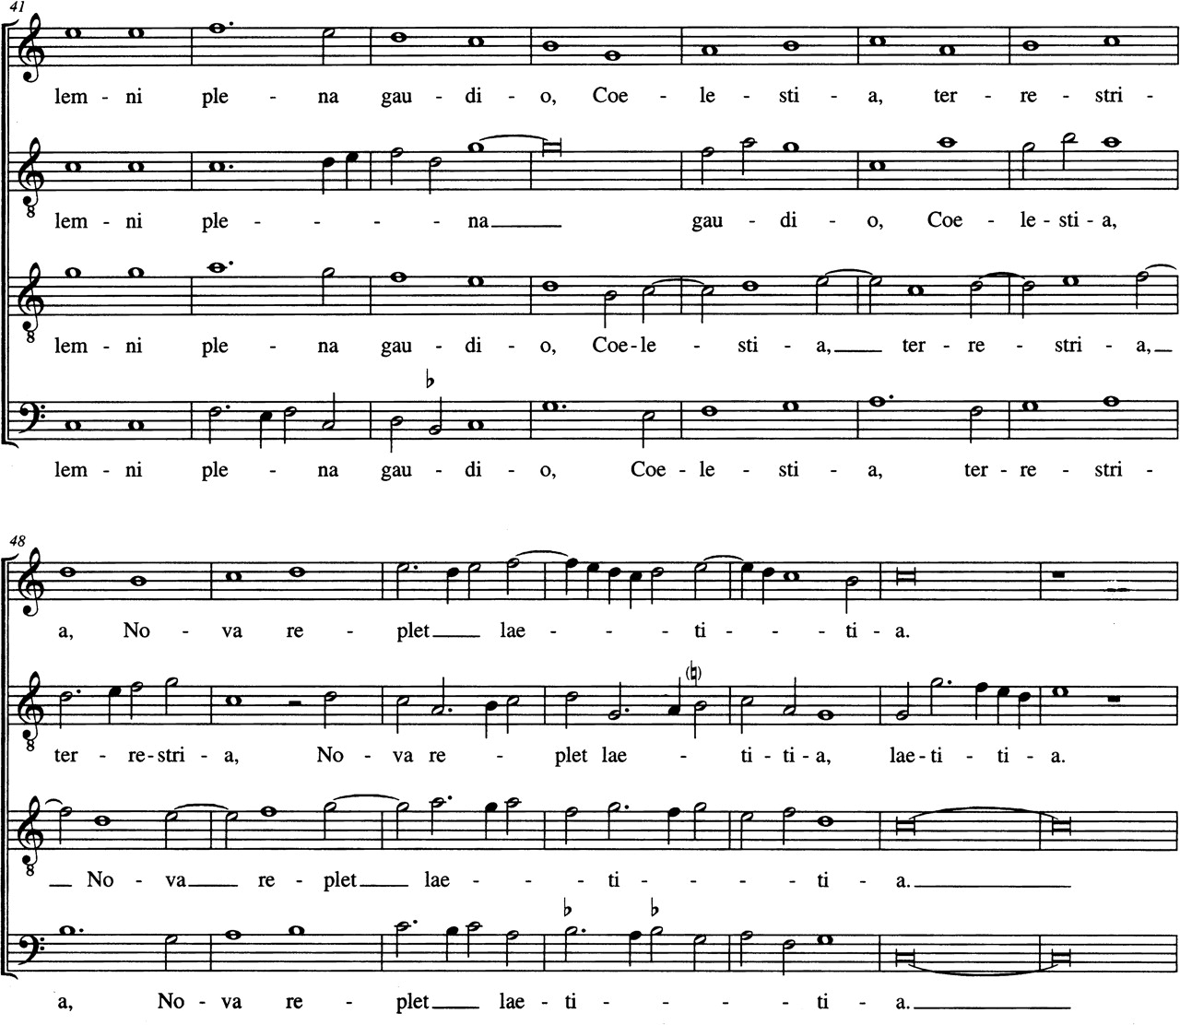
Example 1. From Josquin's Ave Maria.
Notes:
Example 1. From Josquin's Ave Maria.
Unless provided in the caption above, the following copyright applies to the content of this slide: © British Society of Aesthetics 2009. Published by Oxford University Press on behalf of the British Society of Aesthetics. All rights reserved. For Permissions, please email: journals.permissions@oxfordjournals.org

Slide 4
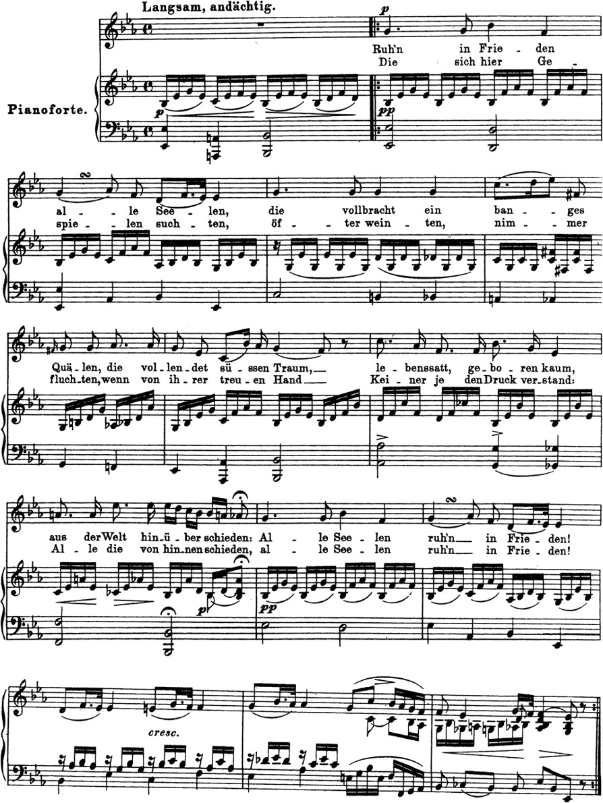
Example 2. From Schubert's Am Tage aller Seelen.
Notes:
Example 2. From Schubert's Am Tage aller Seelen.
Unless provided in the caption above, the following copyright applies to the content of this slide: © British Society of Aesthetics 2009. Published by Oxford University Press on behalf of the British Society of Aesthetics. All rights reserved. For Permissions, please email: journals.permissions@oxfordjournals.org

Slide 5
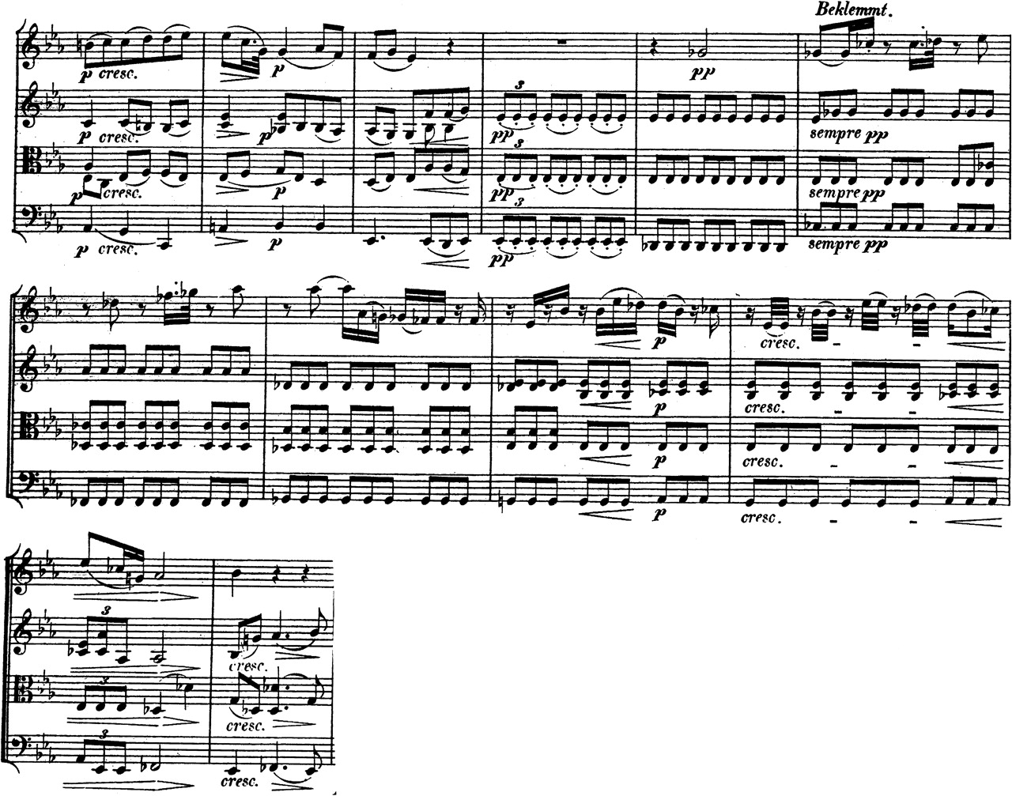
Example 3. From Beethoven's String Quartet in B flat, Opus 130.
Notes:
Example 3. From Beethoven's String Quartet in B flat, Opus 130.
Unless provided in the caption above, the following copyright applies to the content of this slide: © British Society of Aesthetics 2009. Published by Oxford University Press on behalf of the British Society of Aesthetics. All rights reserved. For Permissions, please email: journals.permissions@oxfordjournals.org

