Slide 1
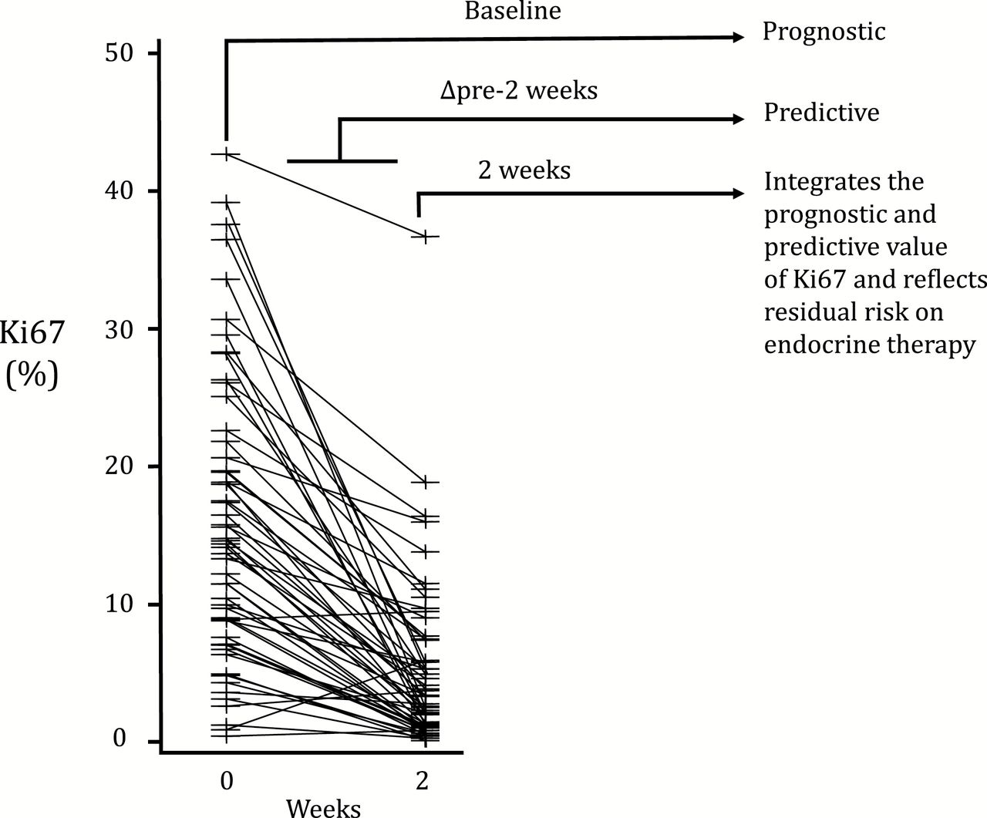
Figure 1. Individual Ki67 changes more than 2 weeks of anastrozole treatment in the Immediate Preoperative Anastrozole, ...
Notes:
Figure 1. Individual Ki67 changes more than 2 weeks of anastrozole treatment in the Immediate Preoperative Anastrozole, Tamoxifen, or Combined with Tamoxifen trial (2). Whereas the pretreatment Ki67 reflects the intrinsic prognosis, the change from baseline to 2 weeks predicts response to treatment, and the 2-week value combines both features and relates to residual risk on endocrine treatment.
Unless provided in the caption above, the following copyright applies to the content of this slide: © The Author 2015. Published by Oxford University Press. All rights reserved. For Permissions, please e-mail: journals.permissions@oup.com.

