Slide 1
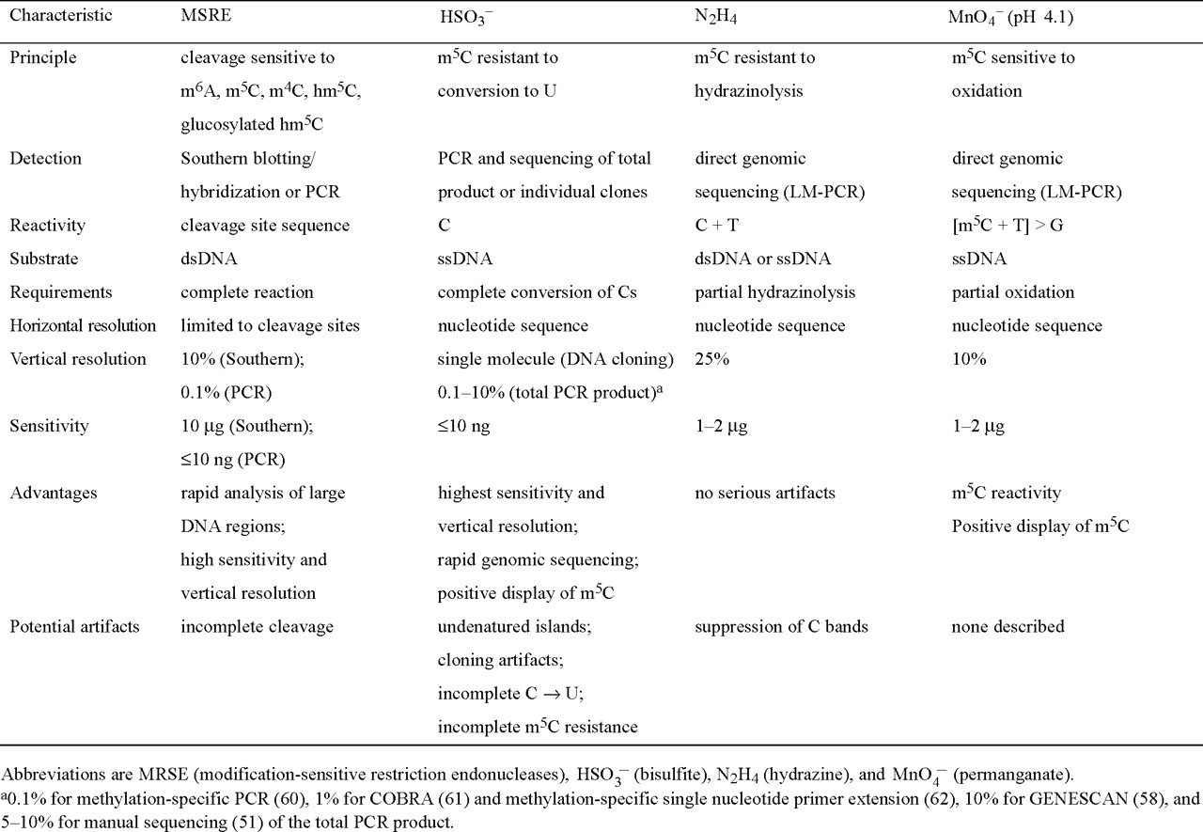
Table 1 Methods for mapping methylated bases at specific DNA sites in complex DNA genomes
Notes:
Table 1 Methods for mapping methylated bases at specific DNA sites in complex DNA genomes
Unless provided in the caption above, the following copyright applies to the content of this slide: © 1998 Oxford University Press

Slide 2
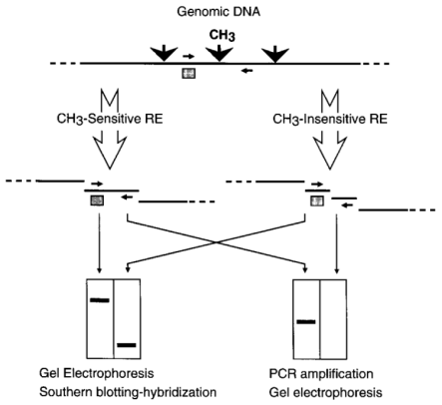
Figure 1 Methylation-sensitive restriction endonuclease protocol in combination with either Southern ...
Notes:
Figure 1 Methylation-sensitive restriction endonuclease protocol in combination with either Southern blotting-hybridization or PCR. Restriction enzyme (RE) sites (black downward arrows), one of which is methylated (CH3), a hybridization probe (shaded square) and PCR primers (horizontal arrows) are indicated.
Unless provided in the caption above, the following copyright applies to the content of this slide: © 1998 Oxford University Press

Slide 3
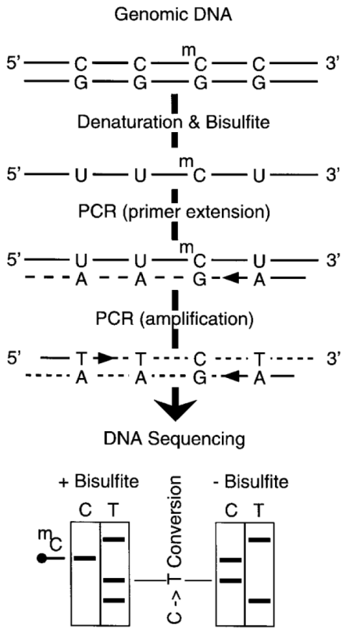
Figure 2 Bisulfite method. (A) Protocol. (B) Detection of m⁵CpG dinucleotides in genomic DNA from hamster ...
Notes:
Figure 2 Bisulfite method. (A) Protocol. (B) Detection of m5CpG dinucleotides in genomic DNA from hamster cells as outlined in (A) and detailed in ref 51.
Unless provided in the caption above, the following copyright applies to the content of this slide: © 1998 Oxford University Press

Slide 4
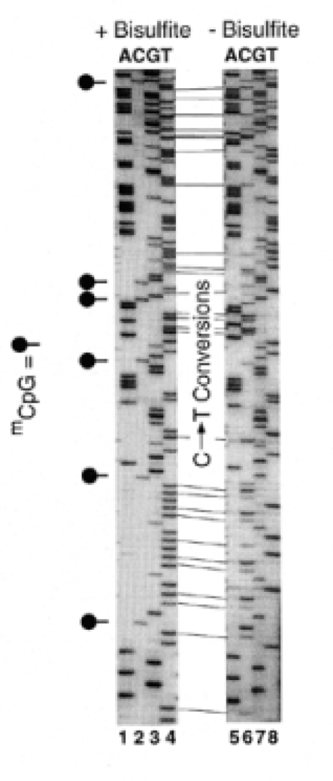
Figure 2 Bisulfite method. (A) Protocol. (B) Detection of m⁵CpG dinucleotides in genomic DNA from hamster ...
Notes:
Figure 2 Bisulfite method. (A) Protocol. (B) Detection of m5CpG dinucleotides in genomic DNA from hamster cells as outlined in (A) and detailed in ref 51.
Unless provided in the caption above, the following copyright applies to the content of this slide: © 1998 Oxford University Press

Slide 5
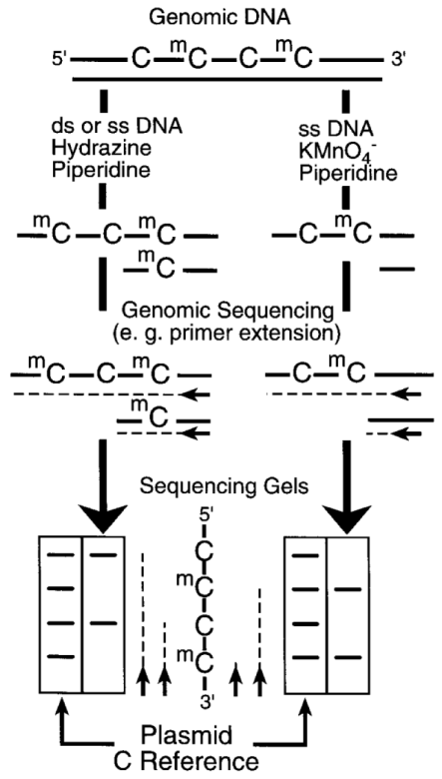
Figure 3 Hydrazine and permanganate methods. (A) Protocols. (B) Detection of a m⁵CpG dinucleotide in ...
Notes:
Figure 3 Hydrazine and permanganate methods. (A) Protocols. (B) Detection of a m5CpG dinucleotide in genomic DNA from hamster cells as outlined in (A) and detailed in ref 39. DNA was treated with hydrazine (lane 2) or permanganate (lane 4) followed by piperidine cleavage of the modified nucleotides. Cleaved sites were detected using LM-PCR. The same DNA sequence cloned into a plasmid (unmethylated DNA) was sequenced using hydrazine/piperidine and LM-PCR (lanes 1 and 3).
Unless provided in the caption above, the following copyright applies to the content of this slide: © 1998 Oxford University Press

Slide 6
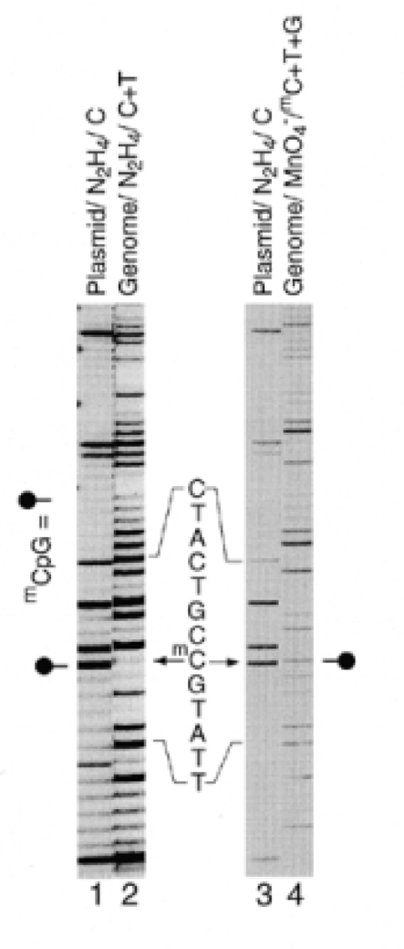
Figure 3 Hydrazine and permanganate methods. (A) Protocols. (B) Detection of a m⁵CpG dinucleotide in ...
Notes:
Figure 3 Hydrazine and permanganate methods. (A) Protocols. (B) Detection of a m5CpG dinucleotide in genomic DNA from hamster cells as outlined in (A) and detailed in ref 39. DNA was treated with hydrazine (lane 2) or permanganate (lane 4) followed by piperidine cleavage of the modified nucleotides. Cleaved sites were detected using LM-PCR. The same DNA sequence cloned into a plasmid (unmethylated DNA) was sequenced using hydrazine/piperidine and LM-PCR (lanes 1 and 3).
Unless provided in the caption above, the following copyright applies to the content of this slide: © 1998 Oxford University Press

