Slide 1
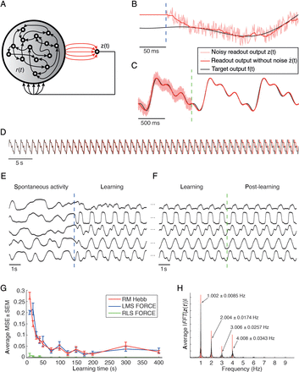
Figure 1. Emergence of periodic activity through reward-modulated learning. (A) A recurrent network receives feedback ...
Notes:
Figure 1. Emergence of periodic activity through reward-modulated learning. (A) A recurrent network receives feedback from a readout neuron, but no other inputs. Circuit neurons are indicated as open circles in the gray schematic network. The readout neuron (right, with red incoming arrows indicating connections from circuit neurons) is trained to produce a specific periodic trajectory composed of 4 sinusoids with an overall period of 1 s. Red connections are subject to reward-modulated plasticity. (B) Beginning of learning (first quarter period shown). The dashed blue line indicates the onset of learning. After less than 50 ms, the readout output without exploration noise $\hat z(t)$ (red) approximately follows the target function f(t) (black), a prerequisite for learning with direct readout feedback (i.e., without teacher forcing). The actual feedback signal z(t) (light red) that is provided to the network includes the exploration noise ξ(t), which is the driving force of learning. (C) The beginning of the testing interval where synaptic weights remain fixed (the last second of learning and first 2 s of testing shown). The dashed green line indicates the beginning of the testing period. After a short learning time (400 s for the presented example), the readout continues to approximately produce the target function without further weight adaptation. (D) During the testing interval, the readout output shows a small drift from the target function due to the fact that the frequencies of the oscillatory components are not learned perfectly (cf. also panel H). (E and F) Emergence of a stable periodic pattern of the network state through learning. Outputs of 5 randomly chosen units of the network are shown. The dashed blue line in panel E indicates the onset of learning. While the network produces spontaneous activity before learning, a stable periodic pattern emerges shortly after the onset of learning due to the drive of the feedback loop of the readout, with a rich set of diverse activity patterns across neurons within the network. The dashed green line in panel F indicates the beginning of the testing interval. After sufficiently long learning, the stable periodic pattern keeps being produced during the testing interval. (G) Comparison of the average test error for 3 different learning rules and varying learning times. While the nonlocal RLS-based FORCE rule (green) performs best, the reward-modulated Hebbian learning rule (red) performs similar to the local LMS-based FORCE rule (blue). (H) Variability of the frequency components of the trained signal. The average amplitude spectrum across the testing interval of all simulation trials with a learning time of 400 s is shown, together with the mean and standard deviation of the peak frequencies across successful trials (MSE <0.01). Target frequency components are shown in red. While the precision of the frequency components is high in general, the small deviations lead to the drift depicted in panel D.
Unless provided in the caption above, the following copyright applies to the content of this slide: © The Author 2012. Published by Oxford University Press. All rights reserved. For Permissions, please e-mail: journals.permissions@oup.com

Slide 2
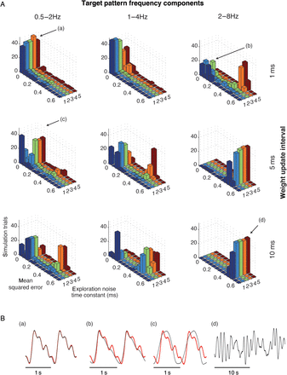
Figure 2. Necessary conditions for the emergence of periodic activity through reward-modulated Hebbian learning. (A) ...
Notes:
Figure 2. Necessary conditions for the emergence of periodic activity through reward-modulated Hebbian learning. (A) Simulations with varying target pattern frequency components (horizontally) and weight update intervals (vertically). Each panel shows the distribution of the MSE across 50 simulation trials per value of the exploration noise autocorrelation time constant (1–5 ms). Letters in brackets associate performance levels with the example readout outputs in panel B. (B) Representative example traces (black) of the readout activity that show the system behavior in simulation trials with varying performance during the testing period and target output (red). The panel indices (a–d) are being indicated by the indices with arrows in panel A. Note that the time scale of panel (d) is different from that of the other panels.
Unless provided in the caption above, the following copyright applies to the content of this slide: © The Author 2012. Published by Oxford University Press. All rights reserved. For Permissions, please e-mail: journals.permissions@oup.com

Slide 3
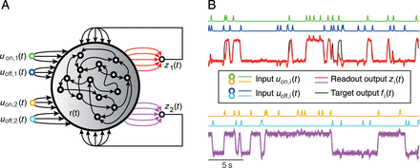
Figure 3. Emergence of task-specific working memory in a generic neural network through reward-modulated Hebbian ...
Notes:
Figure 3. Emergence of task-specific working memory in a generic neural network through reward-modulated Hebbian learning. (A) In this task, 2 readouts are trained by adapting their weights (red and purple arrows in panel A) using a common binary modulatory signal. Each readout zi(t) is trained to produce a memory trace [red and purple traces in panel B, the black trace represents the target function fi(t)] by changing its firing rate depending on the activity of the 2 input streams it is associated with. Input neurons are indicated by colored open circles on the left. If the associated “on” input (uon,i(t), green and orange inputs in panel A, and green and orange traces in panel B) is briefly activated, the readout is trained to switch to a high firing rate. If the associated “off” input (uoff,i(t), dark and light blue inputs in panel A, and dark and light blue traces in panel B) is activated, it is trained to switch to a low firing rate. (B) The last 30 s of a testing period after 500 s of learning are shown for readout z1(t) in the upper part (together with the inputs uon,1(t) and uoff,1(t) that determined its desired value). Traces of z2(t), uon,2(t), and uoff,2(t) are shown in the lower part. Both readouts nicely produce the desired memory traces.
Unless provided in the caption above, the following copyright applies to the content of this slide: © The Author 2012. Published by Oxford University Press. All rights reserved. For Permissions, please e-mail: journals.permissions@oup.com

Slide 4
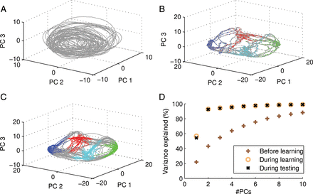
Figure 4. Working memory induce low-dimensional network dynamics. (A) First 3 principal components of the network ...
Notes:
Figure 4. Working memory induce low-dimensional network dynamics. (A) First 3 principal components of the network trajectories in the working memory task before learning (PCA performed on network trajectories before learning). The network exhibits rich dynamics with no signs of attracting subregions. (B and C) First 3 principal components (PCA performed on network trajectories after learning) of the network trajectories during the early learning phase (B) and after learning (C). The state of the 2 readouts is indicated in color in panels B and C (red: z1(t) < −0.3, z2(t) < −0.3; blue: z1(t) < −0.3, z2(t) > 0.3; cyan: z1(t) > 0.3, z2(t) > 0.3; green: z1(t) > 0.3, z2(t) < −0.3; gray otherwise). Clearly, the network dynamics visits 4 subspaces depending on the actual readout state during and after learning. (D) Percentage of variance that can be explained by the first 1–10 principal components (#PCs) before learning (brown crosses), during learning (yellow circles), and during testing (black “x”). During testing and learning, the network dynamics are low dimensional since the first 2 principal components are able to explain most of the variance of the network dynamics.
Unless provided in the caption above, the following copyright applies to the content of this slide: © The Author 2012. Published by Oxford University Press. All rights reserved. For Permissions, please e-mail: journals.permissions@oup.com

Slide 5
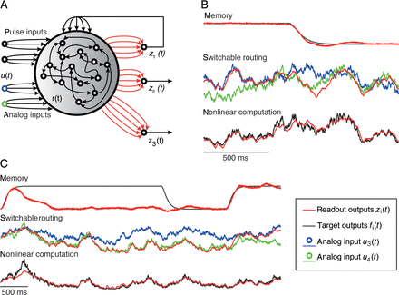
Figure 5. Simultaneous learning of working memory and state-dependent routing of information. (A) Three readouts are ...
Notes:
Figure 5. Simultaneous learning of working memory and state-dependent routing of information. (A) Three readouts are trained, using a common modulatory signal M(t). The first readout is expected to remember a state (defined by the first 2 inputs like in the preceding simulation task; see Fig. 3). The input signal u3(t) is expected to be routed to the second readout z2(t) if this state is “on,” and the input signal u4(t) instead if this state is “off.” The third readout is expected to learn a state-independent nonlinear computation on the same 2 input signals u3(t) and u4(t). (B) Output traces of the 3 readout units at the end of a 500-s testing period after 500 s of learning. The readout z1(t) (red, upper trace) switches properly from the “on” state to the “off” state. The readout z2(t) (red, middle trace) also switches from approximately reproducing the input u3(t) (blue) to reproducing the input u4(t) (green). The third readout z3(t) properly computes a nonlinear function of the 2 uncorrelated analog inputs u3(t) and u4(t). (C) An improper switch of the memory unit's state. The output z1(t) (upper trace) switches back to the “off” state, while its target state f1(t) is the “on” state. The second readout z2(t) (middle trace) nevertheless follows the computational rule it has learnt, and now transmits the wrong input, in this case u4(t) (green) instead of u3(t) (blue). As soon as the first readout is again in the correct state, the second readout transmits the correct input. The nonlinear computation of z3(t) remains largely unaffected by the wrong state switch.
Unless provided in the caption above, the following copyright applies to the content of this slide: © The Author 2012. Published by Oxford University Press. All rights reserved. For Permissions, please e-mail: journals.permissions@oup.com

Slide 6
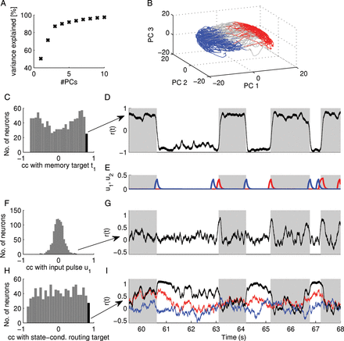
Figure 6. Analysis of network dynamics in the switchable routing task. (A) Percentage of variance that can be explained ...
Notes:
Figure 6. Analysis of network dynamics in the switchable routing task. (A) Percentage of variance that can be explained by the first 1–10 principal components (#PCs) after learning. (B) First 3 principal components of the network trajectory after learning. The dynamics visits 2 subregions depending on the state of the memory readout (red: z1(t) < −0.3; blue: z1(t) > 0.3) and transitions between these regions (gray). (C) The histogram of correlation coefficients ccMem between network neuron activities and the target function of the memory readout. (D) Neuron activity ri(t) of the neuron with maximal ccMem (indicated by the black bar in panel C and arrow). The neuron is highly active whenever the memory readout should be active (indicated by gray shaded areas). (E) Pulse inputs u1 (red) and u2 (blue). (F) The histogram of correlation coefficients ccu1 between network neuron activities and pulse input u1. (G) Neuron activity ri(t) of the neuron with maximal ccu1. The neuron exhibits peaks in its activity when a pulse in u1 appears (compare with panel E). (H) The histogram of correlation coefficients ccswitched u3 between network neuron activities and the target function of the routing readout at times when analog input u3 should be routed to the readout. (I) Neuron activity ri(t) of a neuron with large ccswitched u3 (black trace) along with analog inputs u3 (red) and u4 (blue). The neuron follows u3 (red trace) when u3 should be routed to the routing readout (indicated by gray shaded areas) and is preferentially highly active at other times.
Unless provided in the caption above, the following copyright applies to the content of this slide: © The Author 2012. Published by Oxford University Press. All rights reserved. For Permissions, please e-mail: journals.permissions@oup.com

