Slide 1
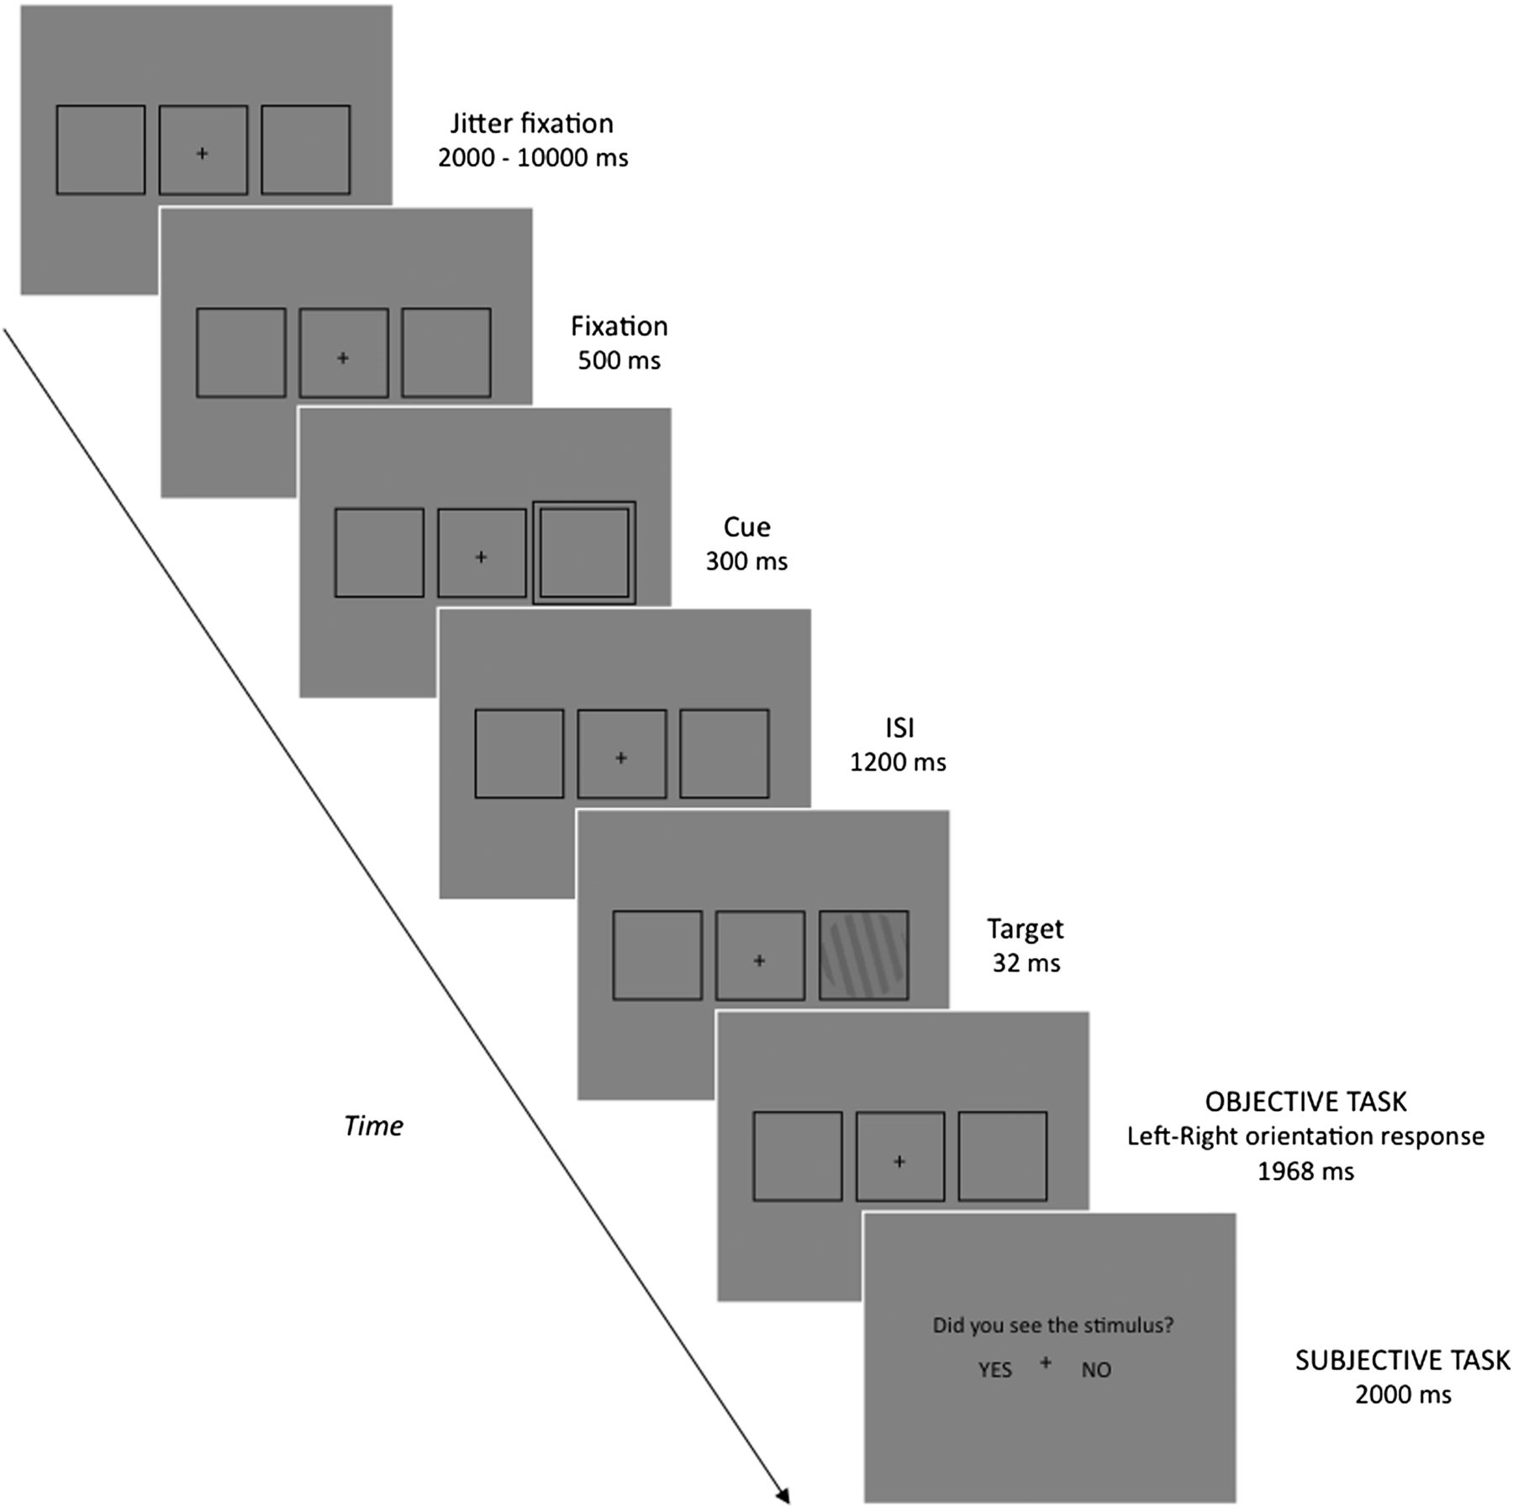
Figure 1. Schematic view of the task.
Notes:
Figure 1. Schematic view of the task.
Unless provided in the caption above, the following copyright applies to the content of this slide: © The Author 2012. Published by Oxford University Press. All rights reserved. For permissions, please e-mail: journals.permissions@oup.com

Slide 2
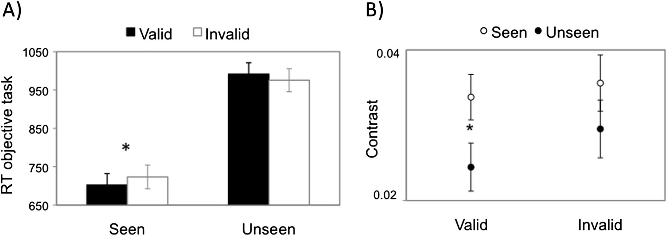
Figure 2. (A) Mean RT in the objective task, for each condition of Validity and Awareness. (B) Mean target contrast ...
Notes:
Figure 2. (A) Mean RT in the objective task, for each condition of Validity and Awareness. (B) Mean target contrast values used to achieve ∼50% “seen” and “unseen” targets presented at valid and invalid locations.
Unless provided in the caption above, the following copyright applies to the content of this slide: © The Author 2012. Published by Oxford University Press. All rights reserved. For permissions, please e-mail: journals.permissions@oup.com

Slide 3
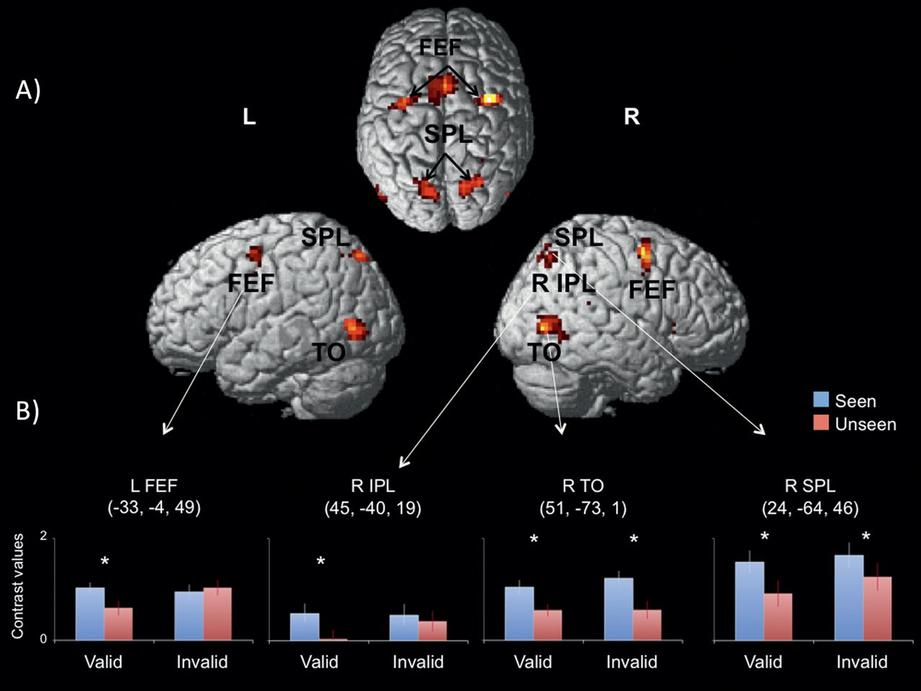
Figure 3. (A) Brain renderings showing activations for the Cue > Jitter Fixation whole-brain contrast (P < 0.001 FDR ...
Notes:
Figure 3. (A) Brain renderings showing activations for the Cue > Jitter Fixation whole-brain contrast (P < 0.001 FDR corrected, 5 voxels). (B) Average contrast values from ROI analyses as a function of Awareness and Validity in functionally identified brain ROIs showing significant clusters of activation in A. Center of mass of each ROI is shown in parentheses. Asterisks represent significant effects (Ps < 0.05).
Unless provided in the caption above, the following copyright applies to the content of this slide: © The Author 2012. Published by Oxford University Press. All rights reserved. For permissions, please e-mail: journals.permissions@oup.com

Slide 4
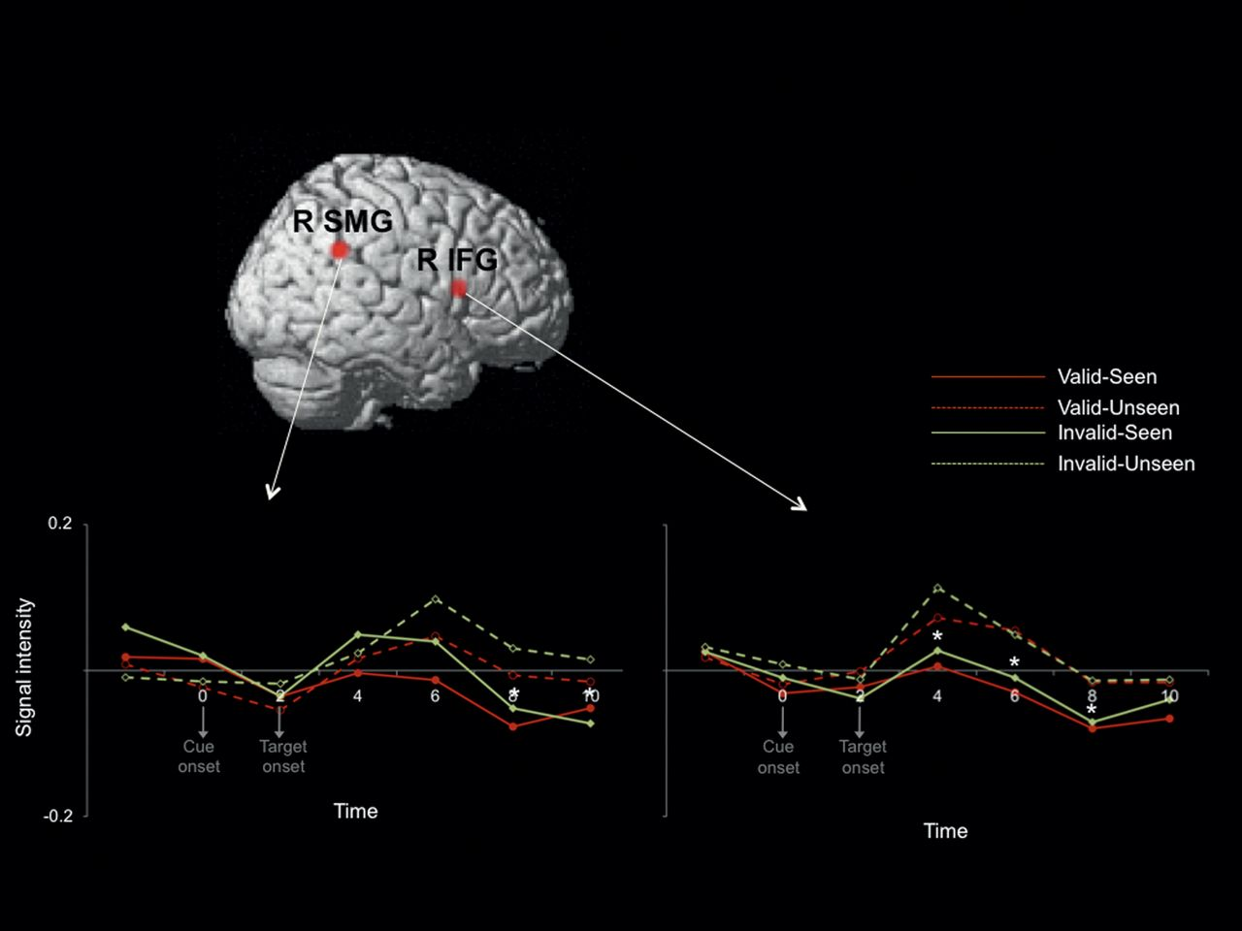
Figure 4. Averaged time courses of the right SMG and the right IFG activations on the 4 study conditions (valid and ...
Notes:
Figure 4. Averaged time courses of the right SMG and the right IFG activations on the 4 study conditions (valid and invalid trials, reported as “seen” or “unseen”). Time 0 represents the moment of cue onset; the target was presented 2 s (an MR frame) later. Asterisks represent significantly larger signal intensity for unseen versus seen targets at different time points (P< 0.05).
Unless provided in the caption above, the following copyright applies to the content of this slide: © The Author 2012. Published by Oxford University Press. All rights reserved. For permissions, please e-mail: journals.permissions@oup.com

Slide 5
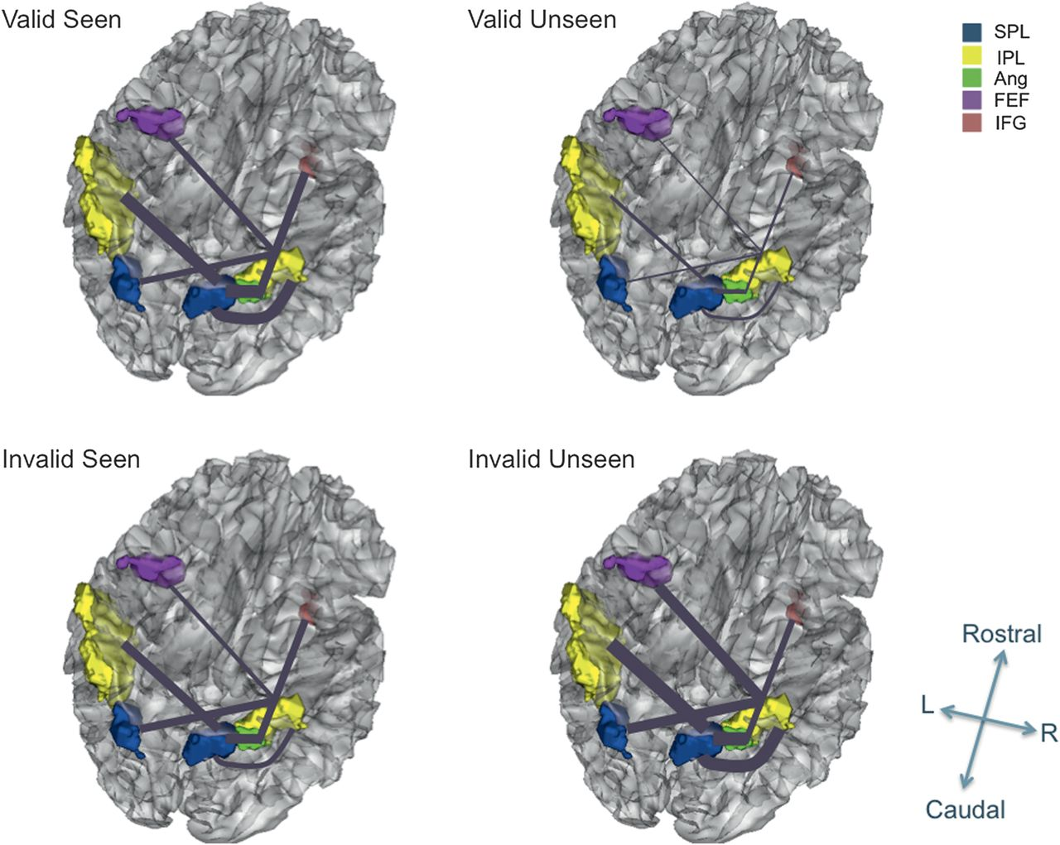
Figure 5. Representation of the frontoparietal regions demonstrating a significant interaction between Validity and ...
Notes:
Figure 5. Representation of the frontoparietal regions demonstrating a significant interaction between Validity and Awareness in the ANOVA of the beta correlation values. Line thickness represents the strength of the beta correlation value within 2 regions (see also Table 4). The figure shows that coupling between the regions was stronger for valid “seen” than valid “unseen” trials and for invalid “unseen” than invalid “seen” trials.
Unless provided in the caption above, the following copyright applies to the content of this slide: © The Author 2012. Published by Oxford University Press. All rights reserved. For permissions, please e-mail: journals.permissions@oup.com

