Slide 1
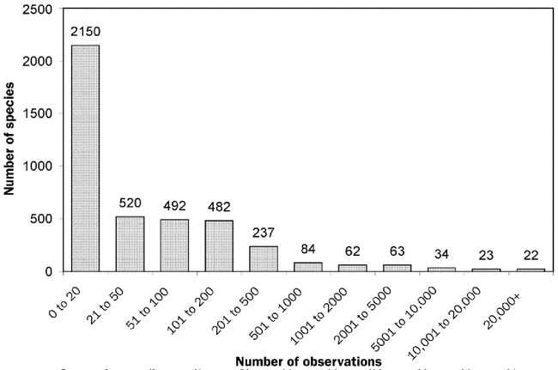
Figure 1. Number of species in each of 11 categories representing frequency of occurrence in the plant hardiness ...
Notes:
Figure 1. Number of species in each of 11 categories representing frequency of occurrence in the plant hardiness database.
Unless provided in the caption above, the following copyright applies to the content of this slide: © 2007 American Institute of Biological Sciences.

Slide 2
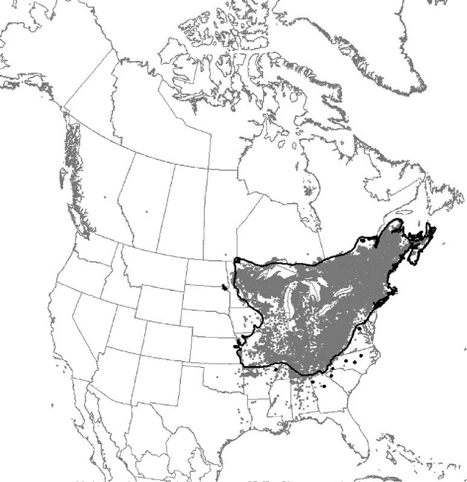
Figure 2. Occurrence records for sugar maple, overlaid by Little's (1971) range map.
Notes:
Figure 2. Occurrence records for sugar maple, overlaid by Little's (1971) range map.
Unless provided in the caption above, the following copyright applies to the content of this slide: © 2007 American Institute of Biological Sciences.

Slide 3
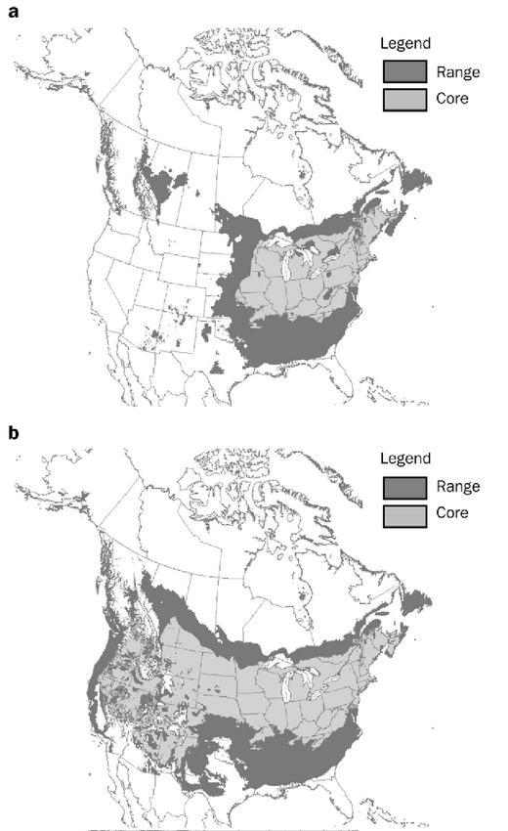
Figure 3. Climate envelopes (full and core range) for sugar maple, based on (a) temperature and precipitation variables ...
Notes:
Figure 3. Climate envelopes (full and core range) for sugar maple, based on (a) temperature and precipitation variables (i.e., the nonirrigated scenario), and (b) temperature variables only (i.e., the irrigated scenario).
Unless provided in the caption above, the following copyright applies to the content of this slide: © 2007 American Institute of Biological Sciences.

Slide 4
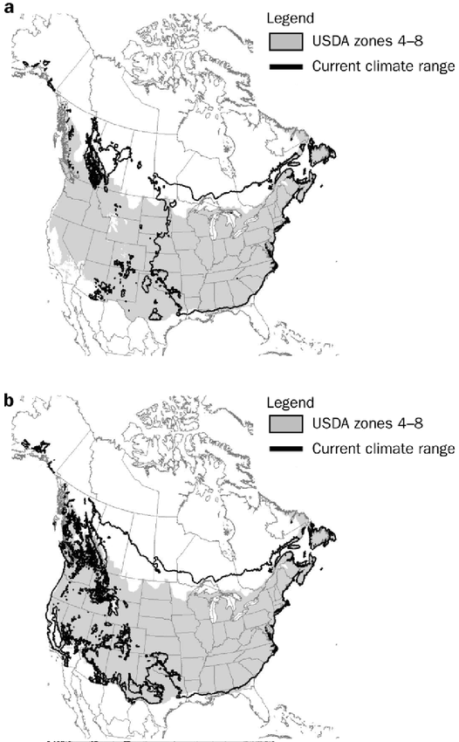
Figure 4. US Department of Agriculture plant hardiness zones 4–8 overlaid by the climate envelope for sugar maple, the ...
Notes:
Figure 4. US Department of Agriculture plant hardiness zones 4–8 overlaid by the climate envelope for sugar maple, the latter based on (a) temperature and precipitation variables (i.e., the nonirrigated scenario), and (b) temperature variables only (i.e., the irrigated scenario).
Unless provided in the caption above, the following copyright applies to the content of this slide: © 2007 American Institute of Biological Sciences.

Slide 5
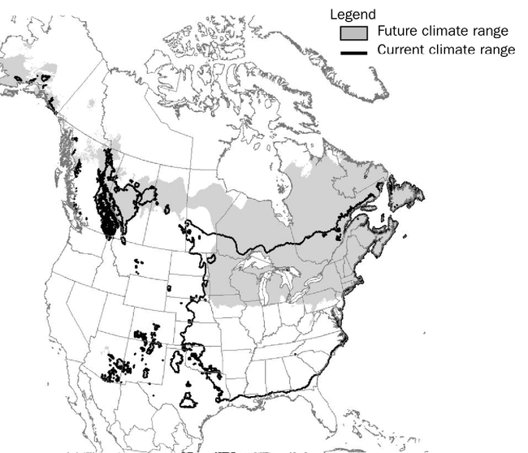
Figure 5. Current and future climate envelopes for sugar maple under the nonirrigated scenario. The future climate ...
Notes:
Figure 5. Current and future climate envelopes for sugar maple under the nonirrigated scenario. The future climate envelope is based on projected climate conditions for the period 2071–2100, using the Canadian Centre for Climate Modelling and Analysis's second-generation coupled global climate model and the A2 emissions scenario outlined by the Intergovernmental Panel on Climate Change.
Unless provided in the caption above, the following copyright applies to the content of this slide: © 2007 American Institute of Biological Sciences.

