Slide 1
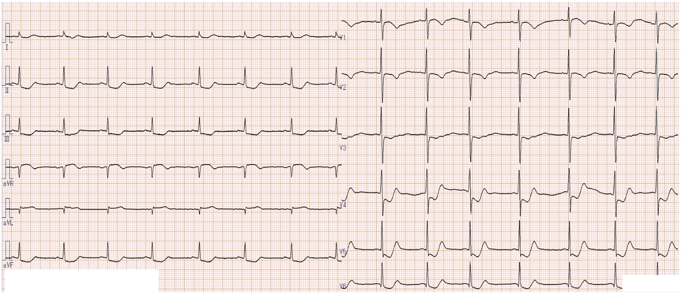
Figure 1 An ECG on arrival revealed normal sinus rhythm, ST segment elevations in aVR and aVL, ST segment depressions ...
Notes:
Figure 1 An ECG on arrival revealed normal sinus rhythm, ST segment elevations in aVR and aVL, ST segment depressions in II, III, aVF, V3-5, inverted T waves in V1-2 and no Q waves.
Unless provided in the caption above, the following copyright applies to the content of this slide: © The Author 2012. Published by Oxford University Press on behalf of the Association of Physicians. All rights reserved. For Permissions, please email: journals.permissions@oup.com

Slide 2
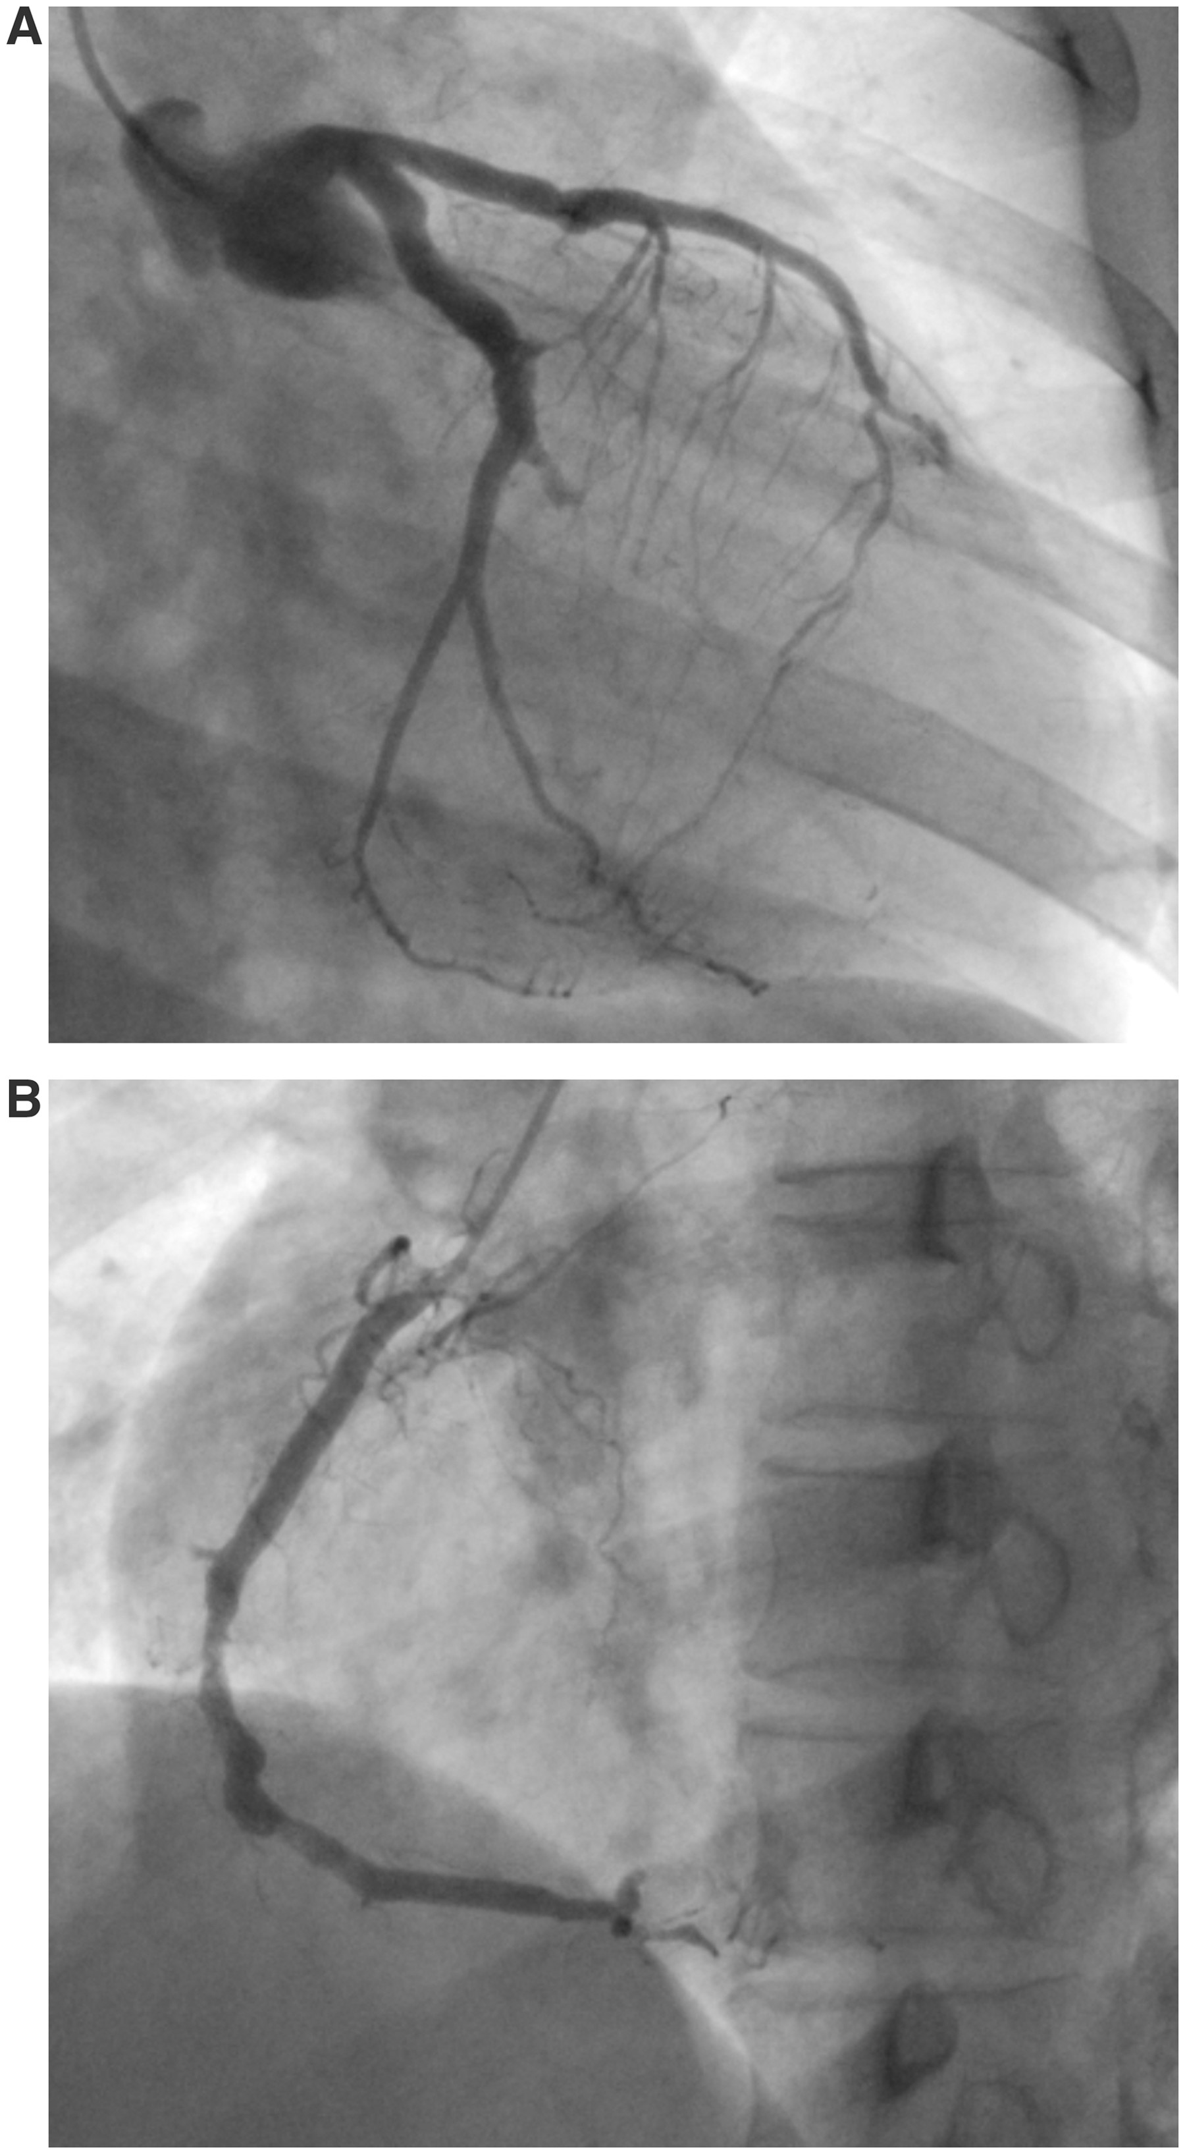
Figure 2 (A) CAG revealed significant stenosis of left coronary artery (LCA) [LAD #8 100%, #9 100% and #10 100%] and ...
Notes:
Figure 2 (A) CAG revealed significant stenosis of left coronary artery (LCA) [LAD #8 100%, #9 100% and #10 100%] and LCX [#12 proximal 100%, distal 100% and #14 100%]. (B) CAG also revealed significant stenosis of RCA [#2 75%, RV branch 100%, #3 75%, #4 AV 100% and #4 PD 99%]. The image of the left ventricle showed akinesis of the apical area and hyperkinesis of the basal area. The intracoronary acetylcholine infusion was not performed.
Unless provided in the caption above, the following copyright applies to the content of this slide: © The Author 2012. Published by Oxford University Press on behalf of the Association of Physicians. All rights reserved. For Permissions, please email: journals.permissions@oup.com

