Slide 1
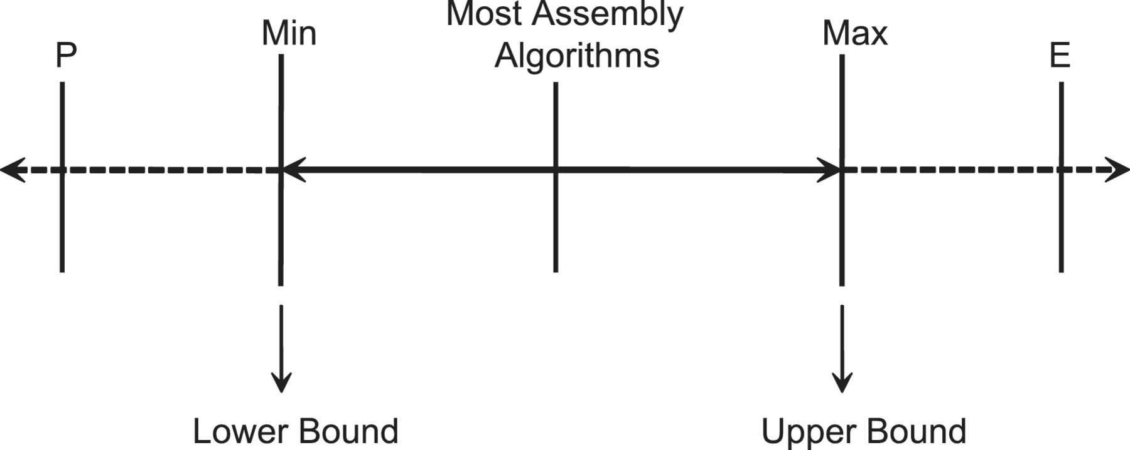
Figure 4: The number of inferred proteins under five circumstances. In this figure, ‘Max’ denotes the upper bound (the ...
Notes:
Figure 4: The number of inferred proteins under five circumstances. In this figure, ‘Max’ denotes the upper bound (the number of all associated proteins) and ‘Min’ denotes the lower bound (the number of proteins in the optimal solution of a set covering problem) when it is assumed that all identified peptides are true positives. Under this assumption, most existing peptide assembly algorithms can be regarded as the trade-off between two extreme solutions. If we relax the assumption that all identified peptides are correct, a new yet smaller lower bound ‘P’ could be achieved, which corresponds to the number of proteins in the optimal solution of a partial set covering problem. Similarly, we can obtain a new upper bound ‘E’ by introducing additional information from other data sources into the assembly procedure.
Unless provided in the caption above, the following copyright applies to the content of this slide: © The Author 2012. Published by Oxford University Press. For Permissions, please email: journals.permissions@oup.com

Slide 2
Figure 3: The bipartite graph represents the input of a standard peptide assembly problem. The top vertices represent ...
Notes:
Figure 3: The bipartite graph represents the input of a standard peptide assembly problem. The top vertices represent peptide identifications. The bottom vertices are candidate proteins in the sample: proteins with at least one matching peptide.
Unless provided in the caption above, the following copyright applies to the content of this slide: © The Author 2012. Published by Oxford University Press. For Permissions, please email: journals.permissions@oup.com

Slide 3
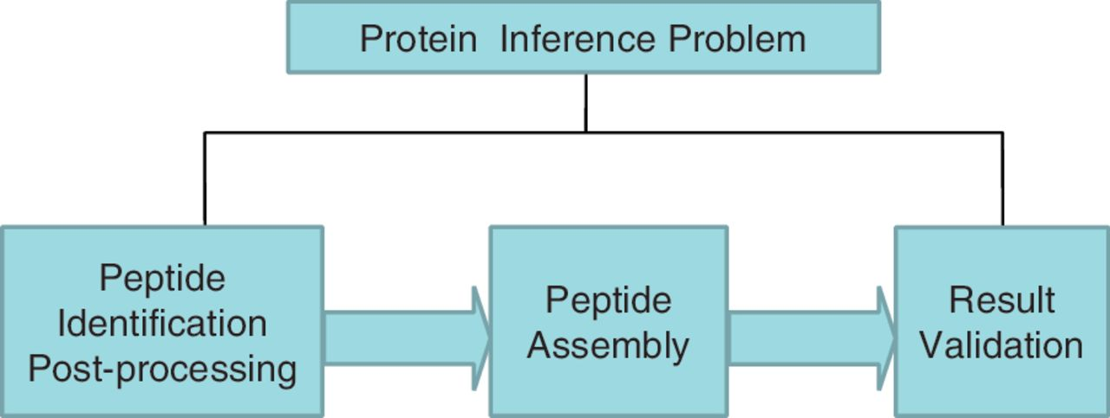
Figure 2: The composition of protein inference problem. It consists of three steps: peptide identification ...
Notes:
Figure 2: The composition of protein inference problem. It consists of three steps: peptide identification post-processing, peptide assembly and result validation.
Unless provided in the caption above, the following copyright applies to the content of this slide: © The Author 2012. Published by Oxford University Press. For Permissions, please email: journals.permissions@oup.com

Slide 4
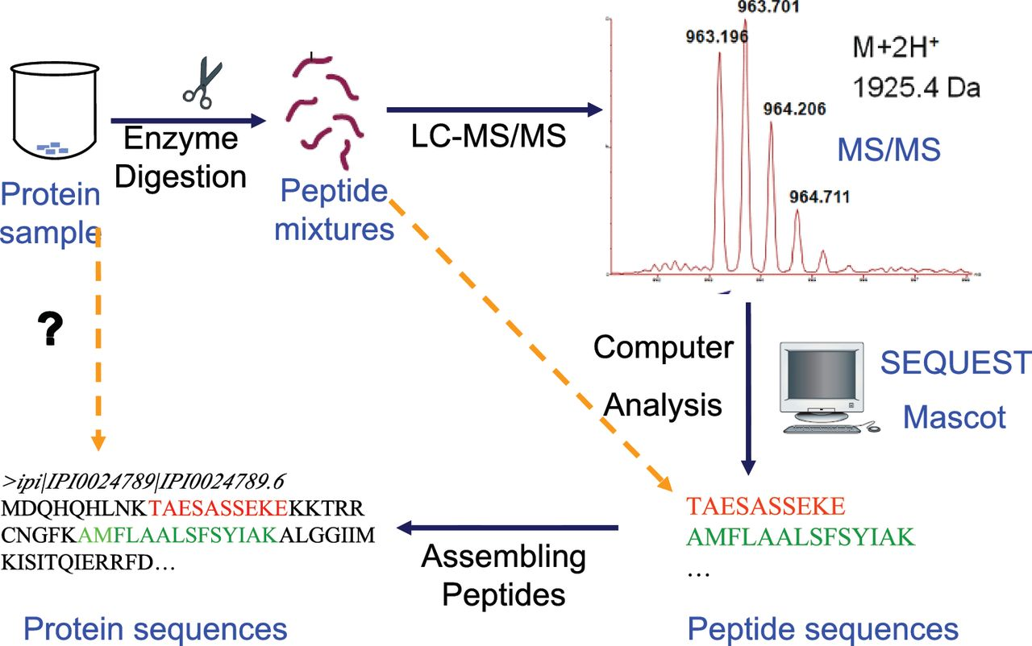
Figure 1: A general pipeline for the identification of proteins in shotgun proteomics.
Notes:
Figure 1: A general pipeline for the identification of proteins in shotgun proteomics.
Unless provided in the caption above, the following copyright applies to the content of this slide: © The Author 2012. Published by Oxford University Press. For Permissions, please email: journals.permissions@oup.com

Slide 5
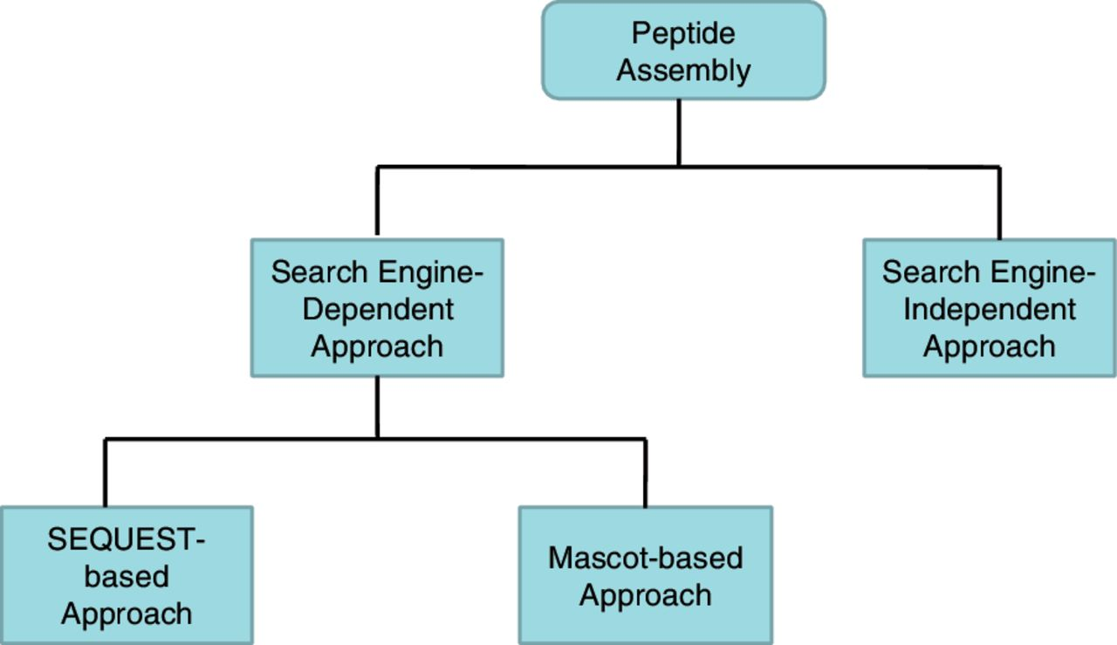
Figure 5: The first framework for categorizing peptide assembly methods. The classification criterion is the dependence ...
Notes:
Figure 5: The first framework for categorizing peptide assembly methods. The classification criterion is the dependence of assembly algorithms to the peptide search engines. Search engine-dependent approaches require that the identification results are obtained from some specific peptide search engine. In contrast, search engine-independent approaches can perform protein inference using output from any peptide search engines.
Unless provided in the caption above, the following copyright applies to the content of this slide: © The Author 2012. Published by Oxford University Press. For Permissions, please email: journals.permissions@oup.com

Slide 6
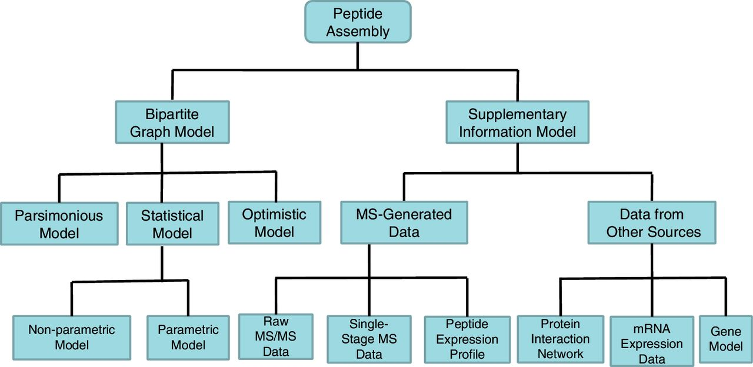
Figure 6: The second framework for categorizing peptide assembly methods. The classification criterion is based on the ...
Notes:
Figure 6: The second framework for categorizing peptide assembly methods. The classification criterion is based on the underlying algorithmic techniques. Bipartite graph model only utilizes information in the standard bipartite graph representation. To improve the identification coverage, supplementary information model borrows additional information from various data sources. Currently, extra information used in peptide assembly can be either MS-generated data such as peptide expression profile or data from other sources like protein interaction network.
Unless provided in the caption above, the following copyright applies to the content of this slide: © The Author 2012. Published by Oxford University Press. For Permissions, please email: journals.permissions@oup.com

Slide 7
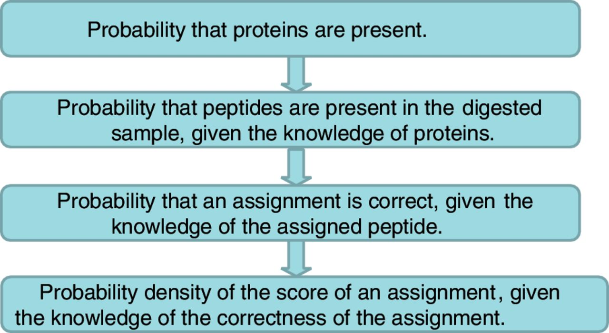
Figure 9: Four layers of the HSM. Layer 1 is a marginal distribution and the other three layers are conditional ...
Notes:
Figure 9: Four layers of the HSM. Layer 1 is a marginal distribution and the other three layers are conditional distributions.
Unless provided in the caption above, the following copyright applies to the content of this slide: © The Author 2012. Published by Oxford University Press. For Permissions, please email: journals.permissions@oup.com

Slide 8
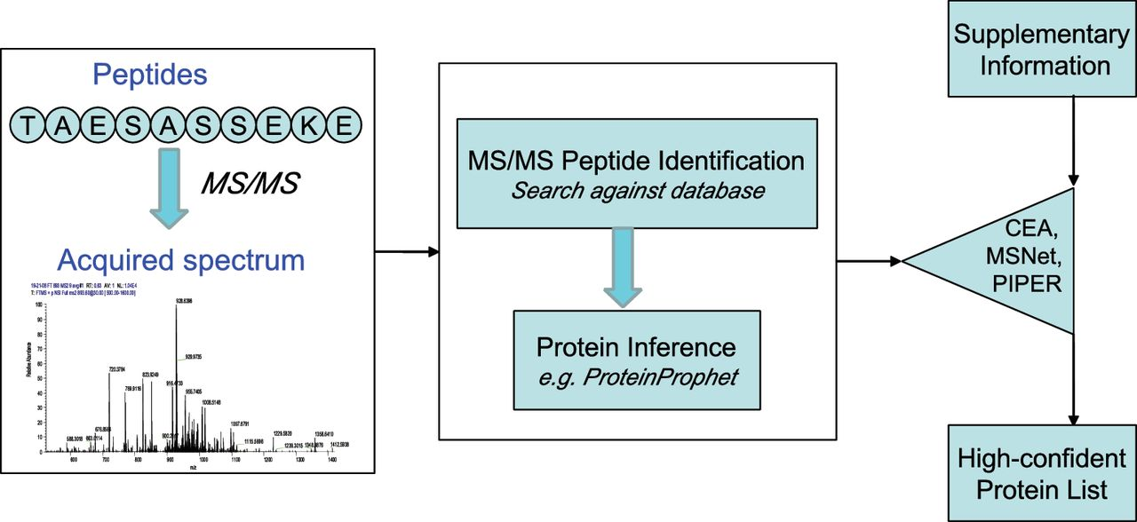
Figure 7: The sequential fusion strategy. Some methods such as CEA, MSNet, PIPER introduce an additional stage to ...
Notes:
Figure 7: The sequential fusion strategy. Some methods such as CEA, MSNet, PIPER introduce an additional stage to reprocess the protein list identified from the standard input.
Unless provided in the caption above, the following copyright applies to the content of this slide: © The Author 2012. Published by Oxford University Press. For Permissions, please email: journals.permissions@oup.com

Slide 9
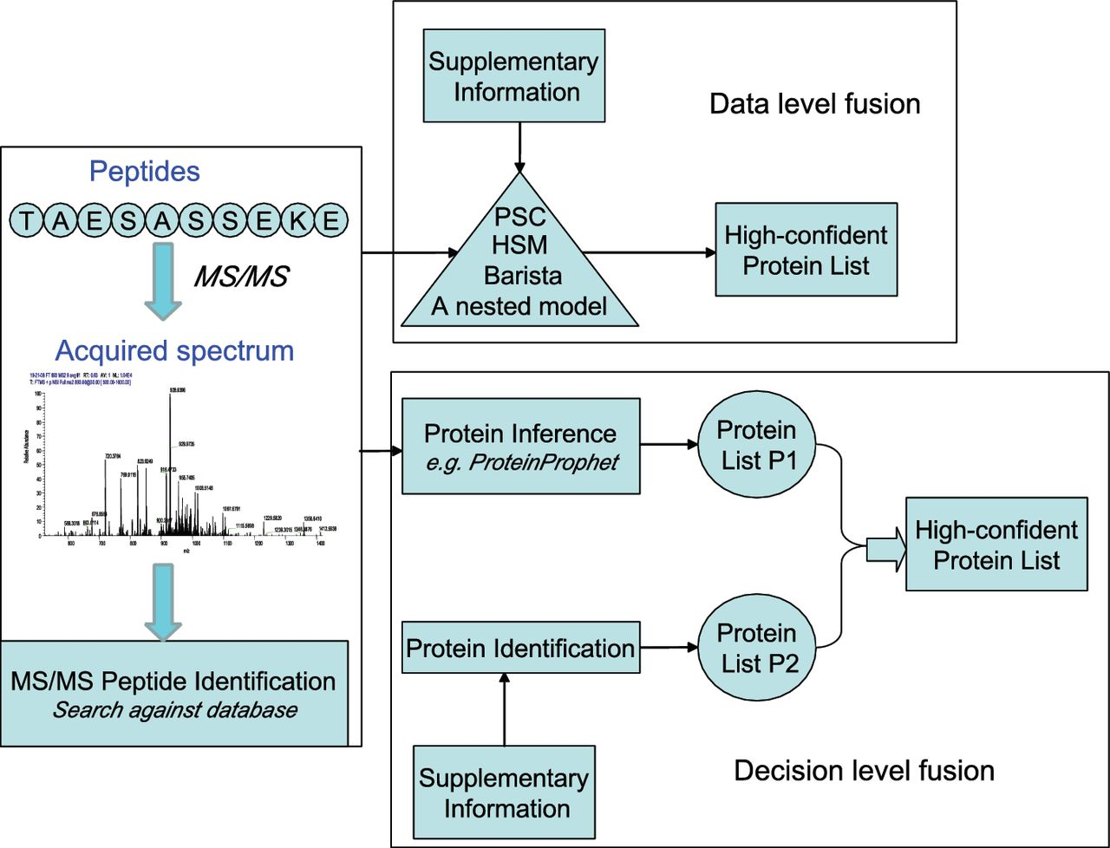
Figure 8: The parallel data fusion strategy: either at data level or at decision level. Data-level fusion, such as HSM, ...
Notes:
Figure 8: The parallel data fusion strategy: either at data level or at decision level. Data-level fusion, such as HSM, Barista, a nested model, directly combines standard input and supplementary data to generate the final result. The decision-level fusion strategy uses these information to generate two protein lists P1 and P2, respectively, and fuses P1 and P2 to create a high-confident protein list.
Unless provided in the caption above, the following copyright applies to the content of this slide: © The Author 2012. Published by Oxford University Press. For Permissions, please email: journals.permissions@oup.com

Slide 10
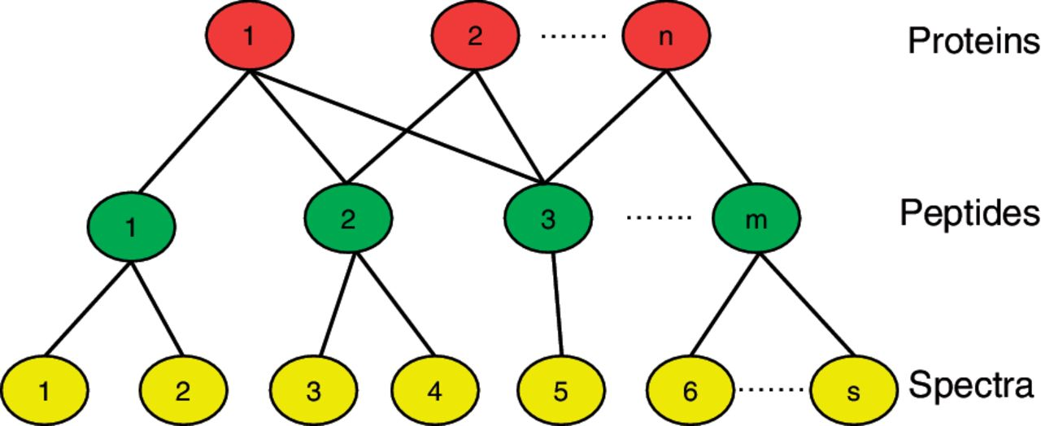
Figure 10: Barista. The tripartite graph represents the protein identification problem, with layers corresponding to ...
Notes:
Figure 10: Barista. The tripartite graph represents the protein identification problem, with layers corresponding to spectra (bottom), peptides (middle) and proteins (top). Barista computes a parameterized non-linear function on each PSM feature vector. The score assigned to a peptide is the maximum PSM score associated with it. The score assigned to a protein is a normalized sum of its peptide scores.
Unless provided in the caption above, the following copyright applies to the content of this slide: © The Author 2012. Published by Oxford University Press. For Permissions, please email: journals.permissions@oup.com

Slide 11
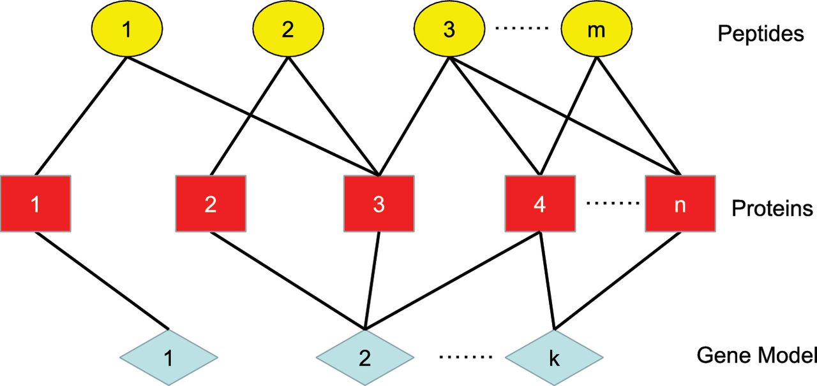
Figure 11: Selected example of connected components of the tripartite graph for gene model imported by MIPGEM.
Notes:
Figure 11: Selected example of connected components of the tripartite graph for gene model imported by MIPGEM.
Unless provided in the caption above, the following copyright applies to the content of this slide: © The Author 2012. Published by Oxford University Press. For Permissions, please email: journals.permissions@oup.com

Slide 12
Figure 12: The target–decoy strategy. The FDR can be estimated as the ratio of the number of decoy matches to that of ...
Notes:
Figure 12: The target–decoy strategy. The FDR can be estimated as the ratio of the number of decoy matches to that of target matches.
Unless provided in the caption above, the following copyright applies to the content of this slide: © The Author 2012. Published by Oxford University Press. For Permissions, please email: journals.permissions@oup.com

Slide 13
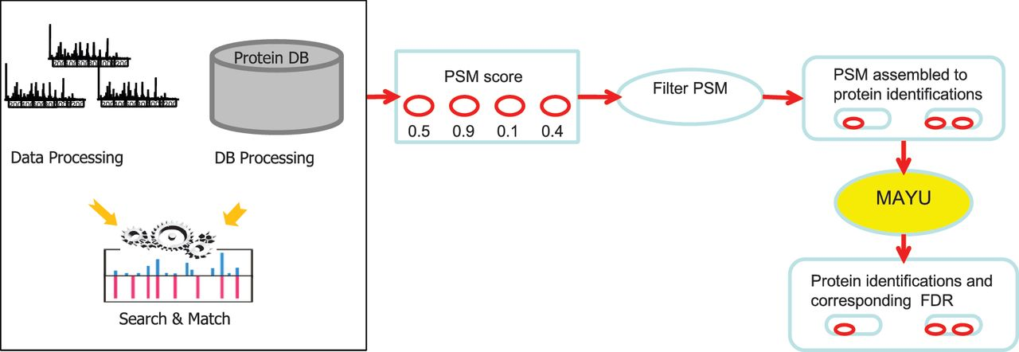
Figure 13: The process of MAYU. MAYU extends the well-established target–decoy strategy from PSM level to protein level. ...
Notes:
Figure 13: The process of MAYU. MAYU extends the well-established target–decoy strategy from PSM level to protein level. It assembles a user-defined set of PSMs to a list of protein identifications and estimates the expected number of false-positive identifications. Then protein identification FDR is computed as the ratio of expected number of false-positive protein identifications to the total amount of protein identifications mapping to the target database.
Unless provided in the caption above, the following copyright applies to the content of this slide: © The Author 2012. Published by Oxford University Press. For Permissions, please email: journals.permissions@oup.com

Slide 14
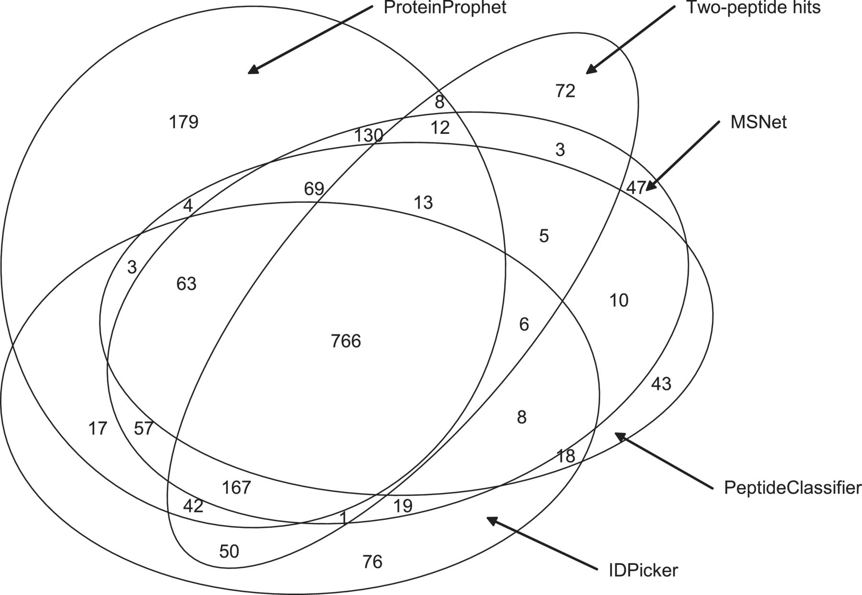
Figure 14: Five-way Venn diagram showing the overlap among five peptide assembly algorithms for Yeast_D1. The number of ...
Notes:
Figure 14: Five-way Venn diagram showing the overlap among five peptide assembly algorithms for Yeast_D1. The number of identified proteins by one or more algorithms is indicated, e.g. 766 proteins are identified based on a consensus of all five algorithms (intersection), whereas 1888 proteins are identified by one or more algorithms (union).
Unless provided in the caption above, the following copyright applies to the content of this slide: © The Author 2012. Published by Oxford University Press. For Permissions, please email: journals.permissions@oup.com

Slide 15
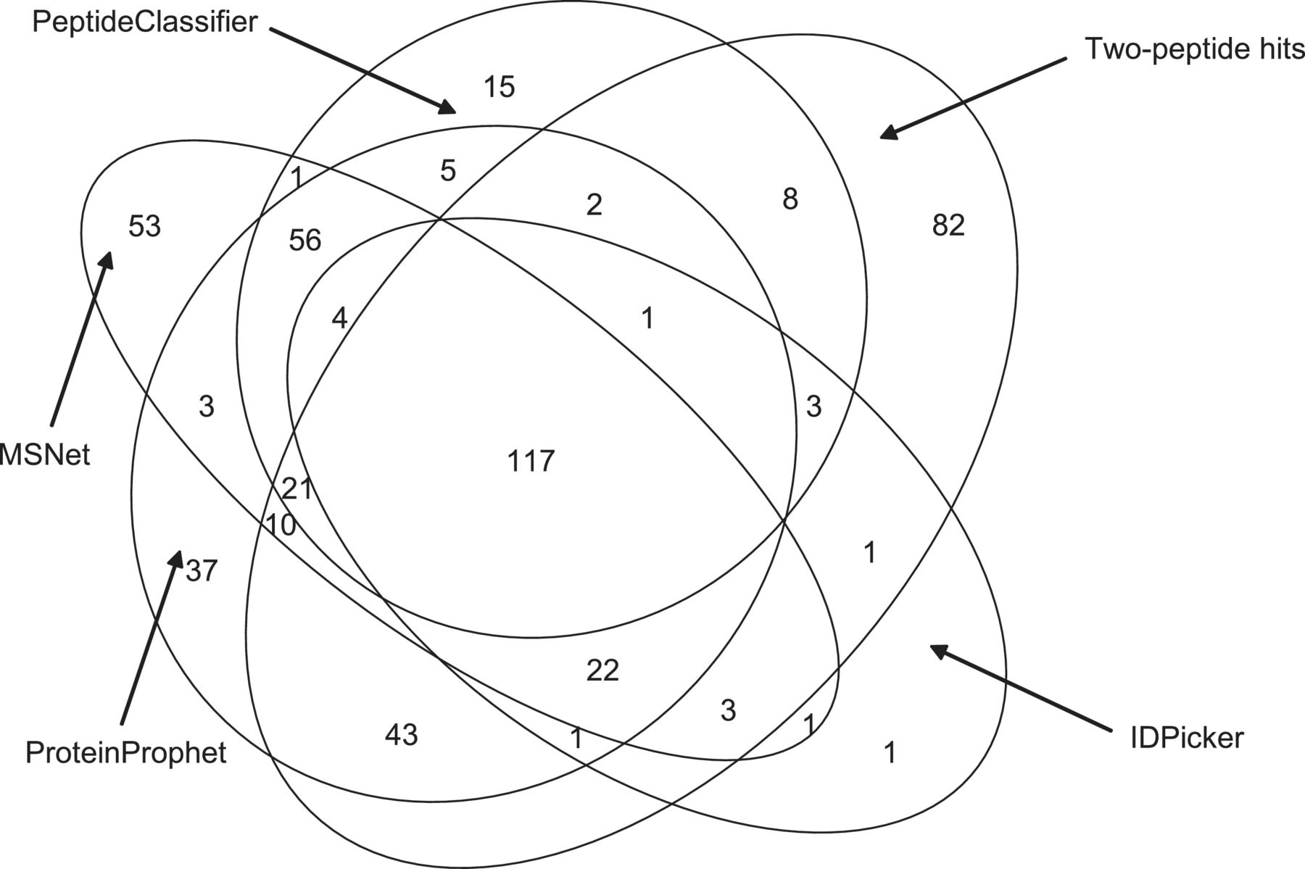
Figure 15: Five-way Venn diagram showing the overlap among five the peptide assembly algorithms for Yeast_D2.
Notes:
Figure 15: Five-way Venn diagram showing the overlap among five the peptide assembly algorithms for Yeast_D2.
Unless provided in the caption above, the following copyright applies to the content of this slide: © The Author 2012. Published by Oxford University Press. For Permissions, please email: journals.permissions@oup.com

