Slide 1
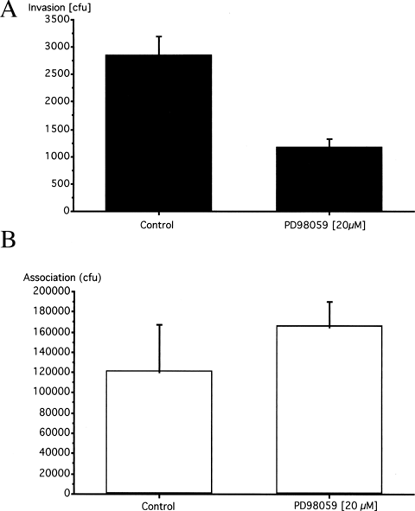
1 Effect of the MEK inhibitor PD98059 on P. aeruginosa 6294 invasion of (A) and association with (B) corneal ...
Notes:
1 Effect of the MEK inhibitor PD98059 on P. aeruginosa 6294 invasion of (A) and association with (B) corneal epithelial cells.
Unless provided in the caption above, the following copyright applies to the content of this slide: © 2002 Federation of European Microbiological Societies

Slide 2
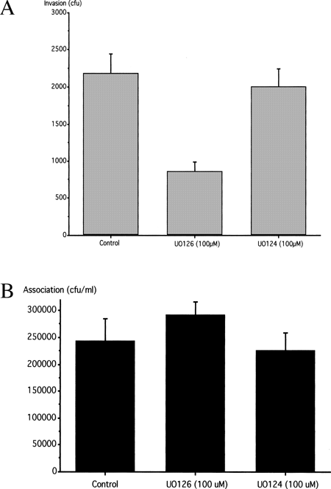
2 Effect of the MEK inhibitor UO126 and the negative control drug UO124 on P. aeruginosa 6294 invasion of (A) ...
Notes:
2 Effect of the MEK inhibitor UO126 and the negative control drug UO124 on P. aeruginosa 6294 invasion of (A) and association with (B) corneal epithelial cells.
Unless provided in the caption above, the following copyright applies to the content of this slide: © 2002 Federation of European Microbiological Societies

Slide 3
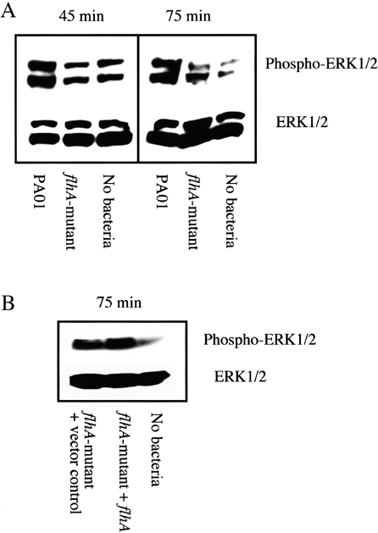
3 A: Tyrosine phosphorylation (upper panel) and total levels (lower panel) of ERK 1 (44 kDa) and ERK 2 (42 kDa) ...
Notes:
3 A: Tyrosine phosphorylation (upper panel) and total levels (lower panel) of ERK 1 (44 kDa) and ERK 2 (42 kDa) extracted from corneal epithelial cells following 45 and 75 min exposure to invasive P. aeruginosa PA01, the internalization-defective mutant PA01flhA::Cmr (flhA-mutant), and no bacteria. B: Tyrosine phosphorylation (upper panel) and total levels (lower panel) of ERK 1 (44 kDa) and ERK 2 (42 kDa) extracted from corneal epithelial cells following 75 min exposure to the internalization-defective mutant PA01flhA::Cmr complemented with pP375 (flhA-mutant+vector control) or with the plasmid pP375flhA (flhA-mutant+flhA). Each was compared to untreated control cells (no bacteria).
Unless provided in the caption above, the following copyright applies to the content of this slide: © 2002 Federation of European Microbiological Societies

Slide 4
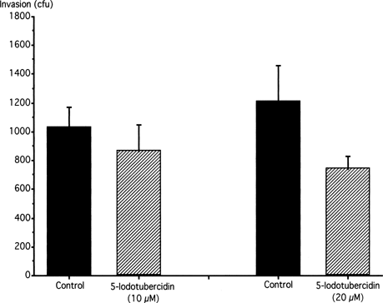
4 Effect of the ERK 2 inhibitor 5-iodotubercidin on P. aeruginosa 6294 invasion of corneal epithelial cells.
Notes:
4 Effect of the ERK 2 inhibitor 5-iodotubercidin on P. aeruginosa 6294 invasion of corneal epithelial cells.
Unless provided in the caption above, the following copyright applies to the content of this slide: © 2002 Federation of European Microbiological Societies

