Slide 1
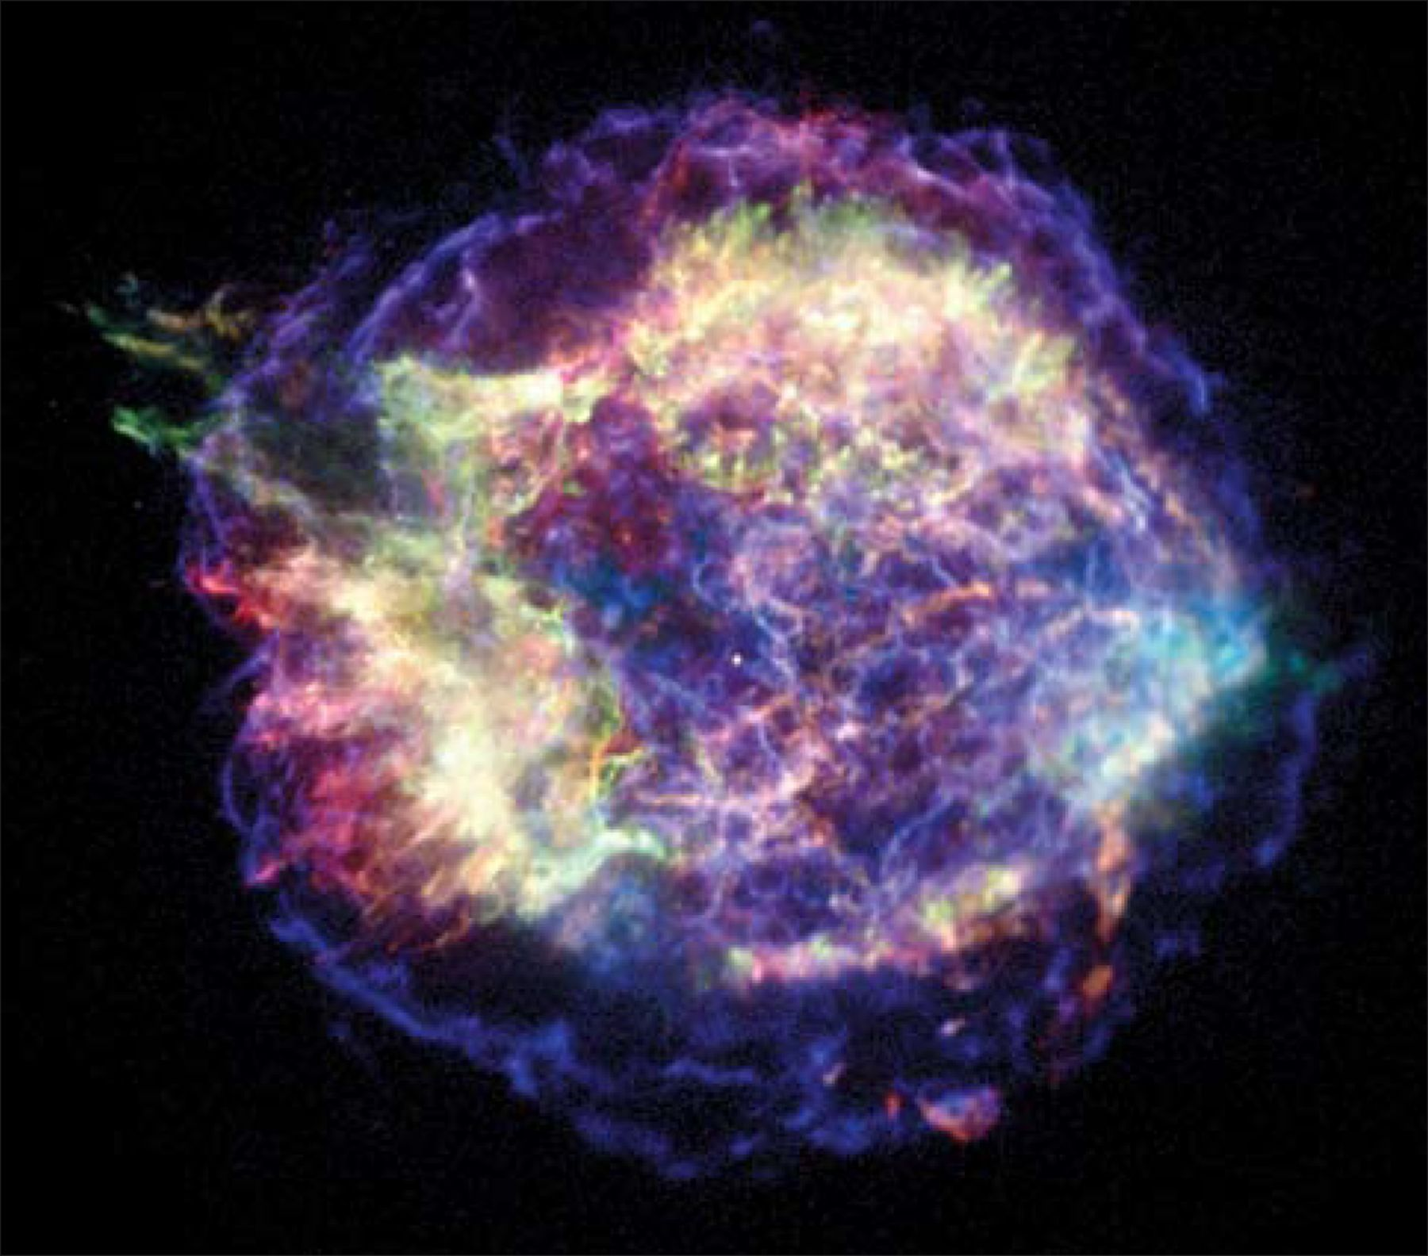
1: Cosmic rays (relativistic electrons) stirring in the Cassiopeia A supernova remnant make the wispy blue lines ...
Notes:
1: Cosmic rays (relativistic electrons) stirring in the Cassiopeia A supernova remnant make the wispy blue lines of energetic X-ray emissions seen by NASA's Chandra X-ray Observatory. (NASA/CXC/UMass Amherst/M D Stage et al.)
Unless provided in the caption above, the following copyright applies to the content of this slide:

Slide 2
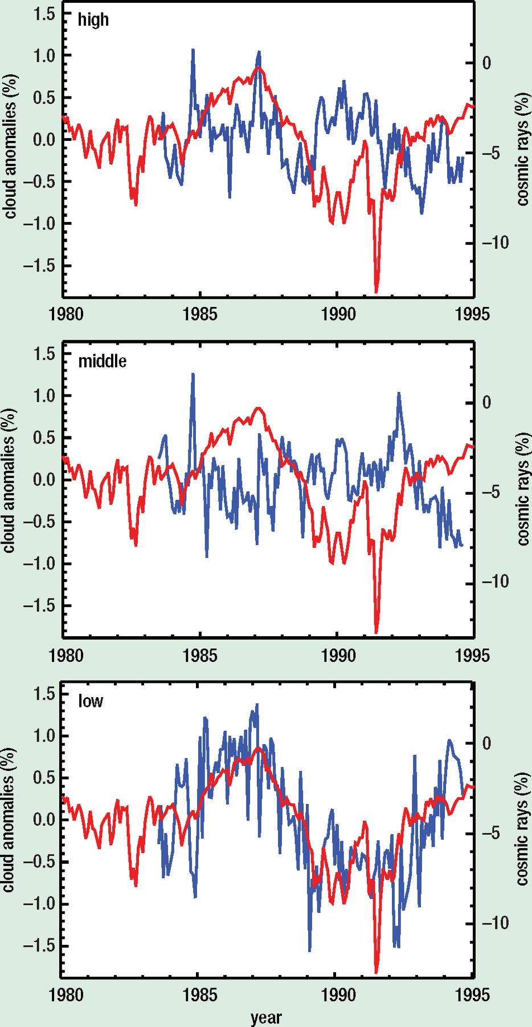
2: At different levels in the atmosphere (high >6.5 km, middle 6.5–3.2 km and low <3.2 km) the blue line shows ...
Notes:
2: At different levels in the atmosphere (high >6.5 km, middle 6.5–3.2 km and low <3.2 km) the blue line shows variations in global cloud cover collated by the International Satellite Cloud Climatology Project. The red line is the record of monthly variations in cosmic-ray counts at the Huancayo station. While there is no match at the higher altitudes, a close correspondence between cosmic rays and clouds low in the atmosphere is plain to see. (Marsh and Svensmark 2000)
Unless provided in the caption above, the following copyright applies to the content of this slide:

Slide 3
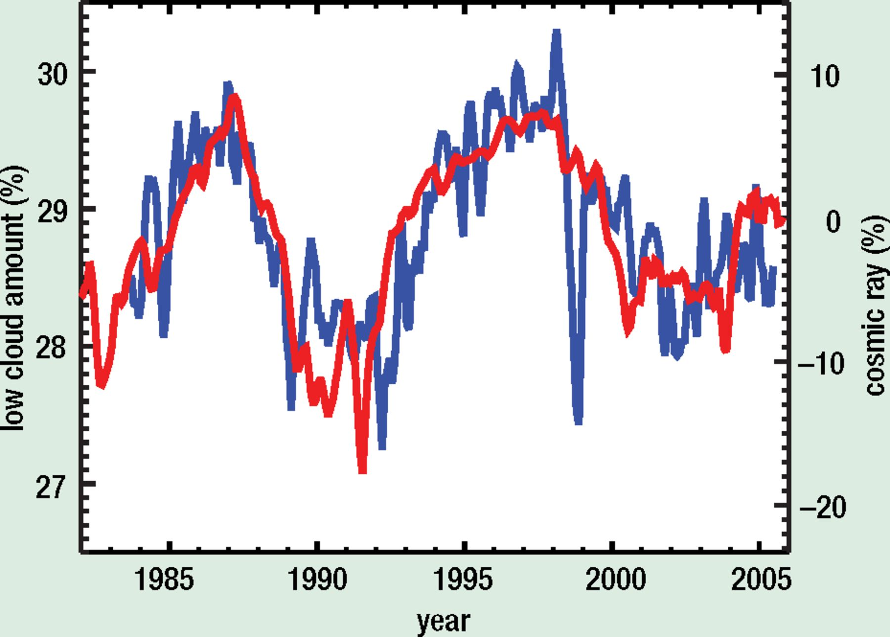
3: As in figure 2, the low-cloud comparison extends over a longer period.
Notes:
3: As in figure 2, the low-cloud comparison extends over a longer period.
Unless provided in the caption above, the following copyright applies to the content of this slide:

Slide 4
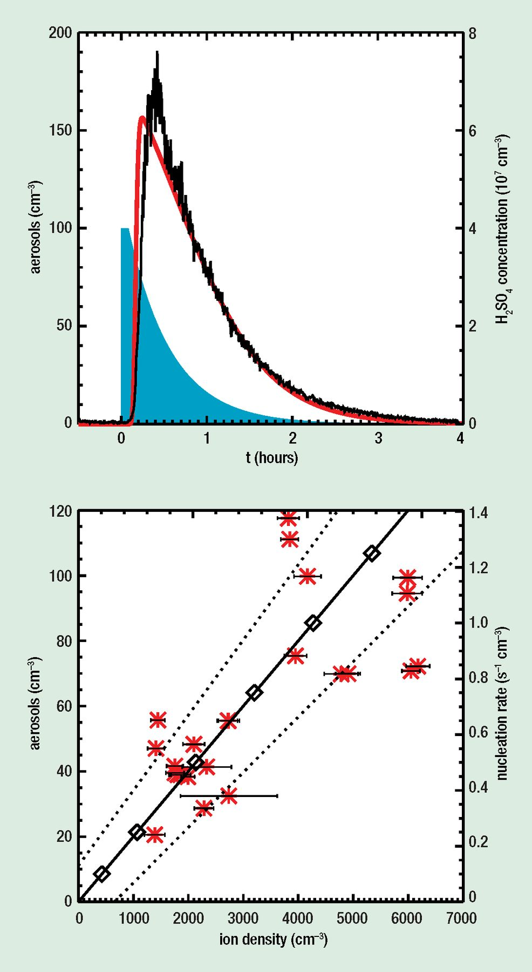
4: Creation of the building blocks of cloud condensation nuclei (top) under the influence of galactic cosmic ...
Notes:
4: Creation of the building blocks of cloud condensation nuclei (top) under the influence of galactic cosmic rays is seen in a typical run in the SKY experiment in Copenhagen (Svensmark et al. 2007). At time 0 a burst of UV light (simulating solar UV) triggers the formation, from trace gases in the air, of sulphuric acid molecules shown by the blue area and the right-hand scale. Within 10 minutes, great numbers of molecular clusters of sulphuric acid and water molecules larger than 3 nm appear in the reaction chamber (black curve and left-hand scale). The red curve is the fit of a simple model combining rates of production of clusters and their loss on the walls of the chamber. The lower diagram shows the linear relation between ion density and aerosol nucleation. Red stars are the experimental data. In the real atmosphere, in the absence of walls, the clusters would grow in a matter of hours to become cloud condensation nuclei.
Unless provided in the caption above, the following copyright applies to the content of this slide:

Slide 5
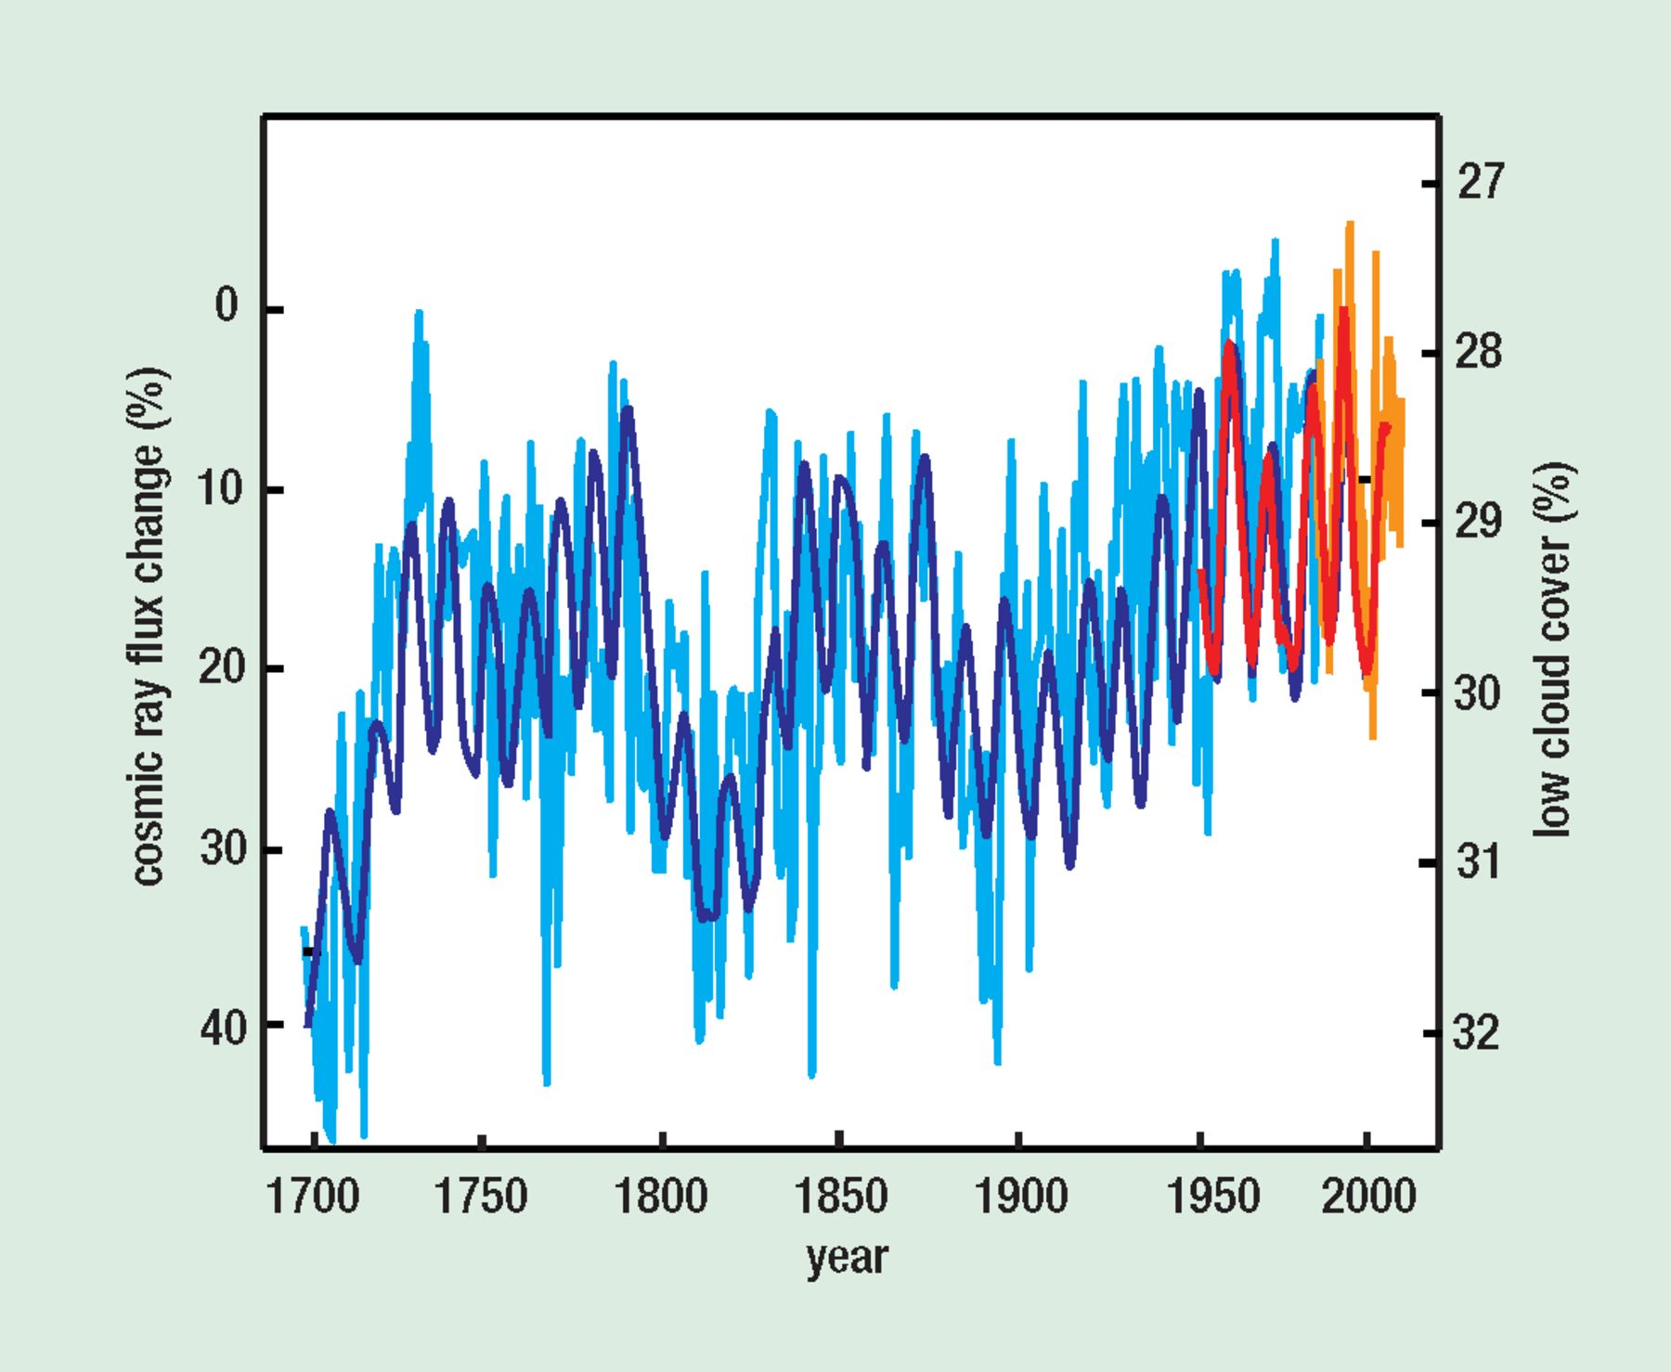
5: Changes in the flux of galactic cosmic rays since 1700 are here derived from two independent proxies, ...
Notes:
5: Changes in the flux of galactic cosmic rays since 1700 are here derived from two independent proxies, 10 Be (light blue) and open solar coronal flux (blue) (Solanki and Fligge 1999). Low cloud amount (orange) from figure 3, is scaled and normalized to observational cosmic-ray data from Climax (red) for the period 1953 to 2005 (3 GeV cut-off). Note that both scales are inverted to correspond with rising temperatures. The long-term change in the average flux is as large as the temporary variation within one solar cycle. The change in radiative forcing by a 3% change in low cloud amount over this period can be estimated to ~2 W m-2.
Unless provided in the caption above, the following copyright applies to the content of this slide:

Slide 6
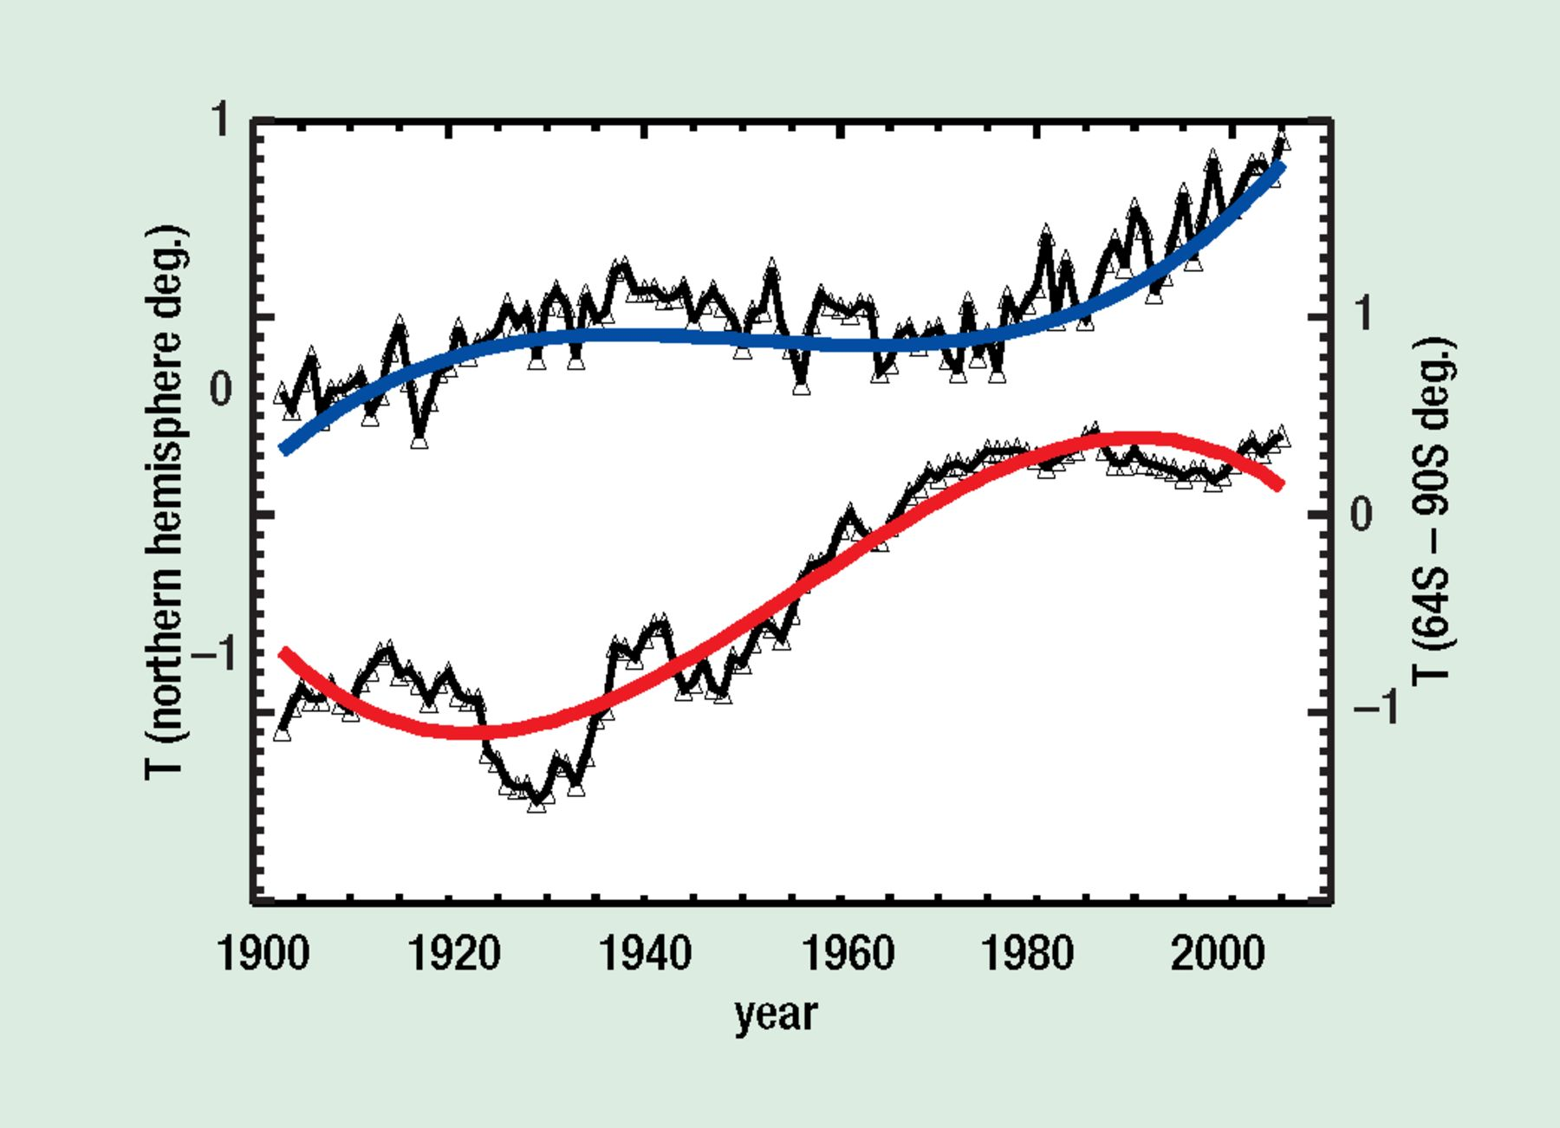
6: The Antarctic climate anomaly during the past 100 years is apparent in this comparison of the annual surface ...
Notes:
6: The Antarctic climate anomaly during the past 100 years is apparent in this comparison of the annual surface temperature anomalies for the northern hemisphere and Antarctica (64°S–90°S), from the NASA-GISS compilations. The Antarctic data have been averaged over 12 years to minimize the temperature fluctuations. The blue and red lines are fourth-order polynomial fits to the data. The curves are offset by 1 K for clarity, otherwise they would cross and re-cross three times. (Svensmark 2007a)
Unless provided in the caption above, the following copyright applies to the content of this slide:

Slide 7
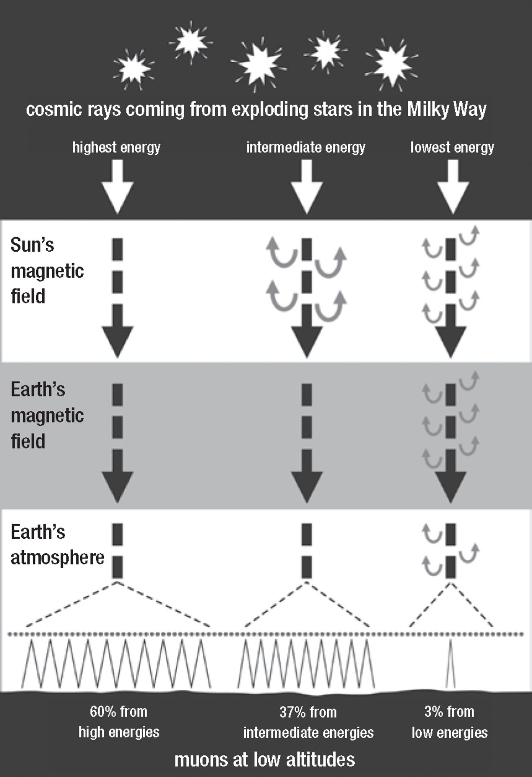
7: The most important cosmic-ray particles that assist in cloud-making in the lower atmosphere (<2 km), the ...
Notes:
7: The most important cosmic-ray particles that assist in cloud-making in the lower atmosphere (<2 km), the muons, originate mainly from particles that arrive from the stars with very high energy. The magnetic defences of the Sun and the Earth have little effect on them. The Sun's magnetic field influences the supply of a large minority of muons, but few are obedient to changes in the Earth's magnetic field (adapted from Svensmark and Calder 2007). Ionization of the air by cosmic rays below 2 km altitude is due mainly to penetrating showers from high-energy primary cosmic rays, according to calculations using the Karlsruhe CORSIKA program (Svensmark and Svensmark 2007). The boxes are only intended to illustrate the energy range that the Earth's magnetic field can modulate. For example, at polar regions there is only small influence and if the geomagnetic field disappears, the expected increase in low-altitude ionization is only 3%. Solar activity influences the primaries responsible for about 37% of the ionization. The entire range of primary energies is subject to large changes from the galactic environment of the solar system, including local supernovae, spiral-arm passages, and variations in the star-formation rate.
Unless provided in the caption above, the following copyright applies to the content of this slide:

Slide 8
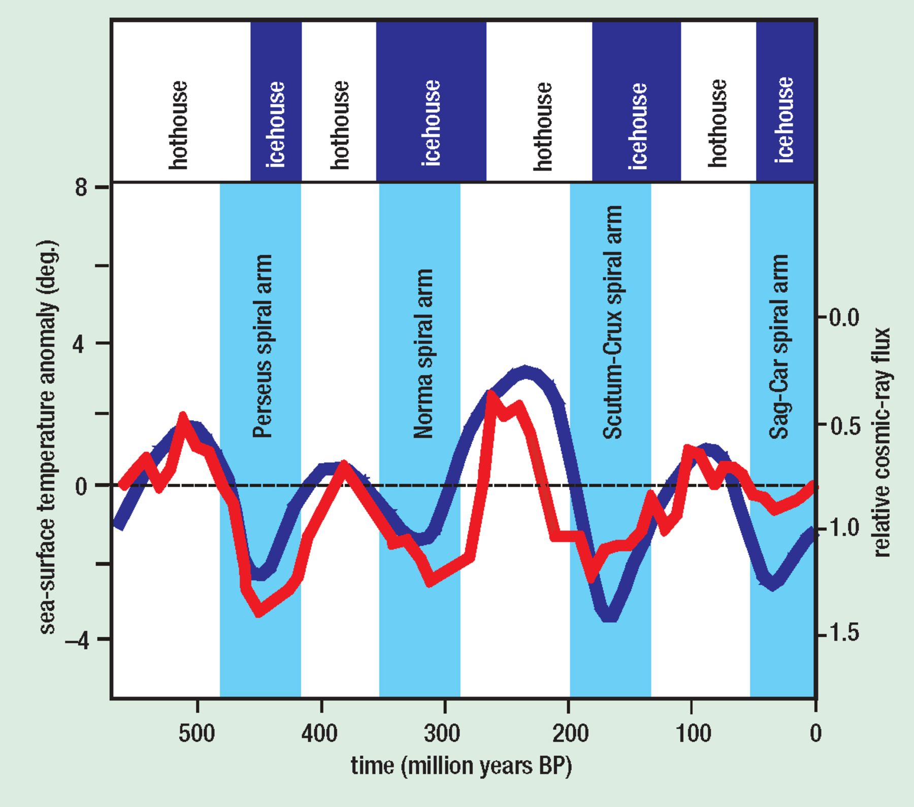
8: Four switches from warm “hothouse” to cold “icehouse” conditions during the Phanerozoic are shown in ...
Notes:
8: Four switches from warm “hothouse” to cold “icehouse” conditions during the Phanerozoic are shown in variations of several degrees K in tropical sea-surface temperatures (red curve). They correspond with four encounters with spiral arms of the Milky Way and the resulting increases in the cosmic-ray flux (blue curve, scale inverted). (After Shaviv and Veizer 2003)
Unless provided in the caption above, the following copyright applies to the content of this slide:

Slide 9
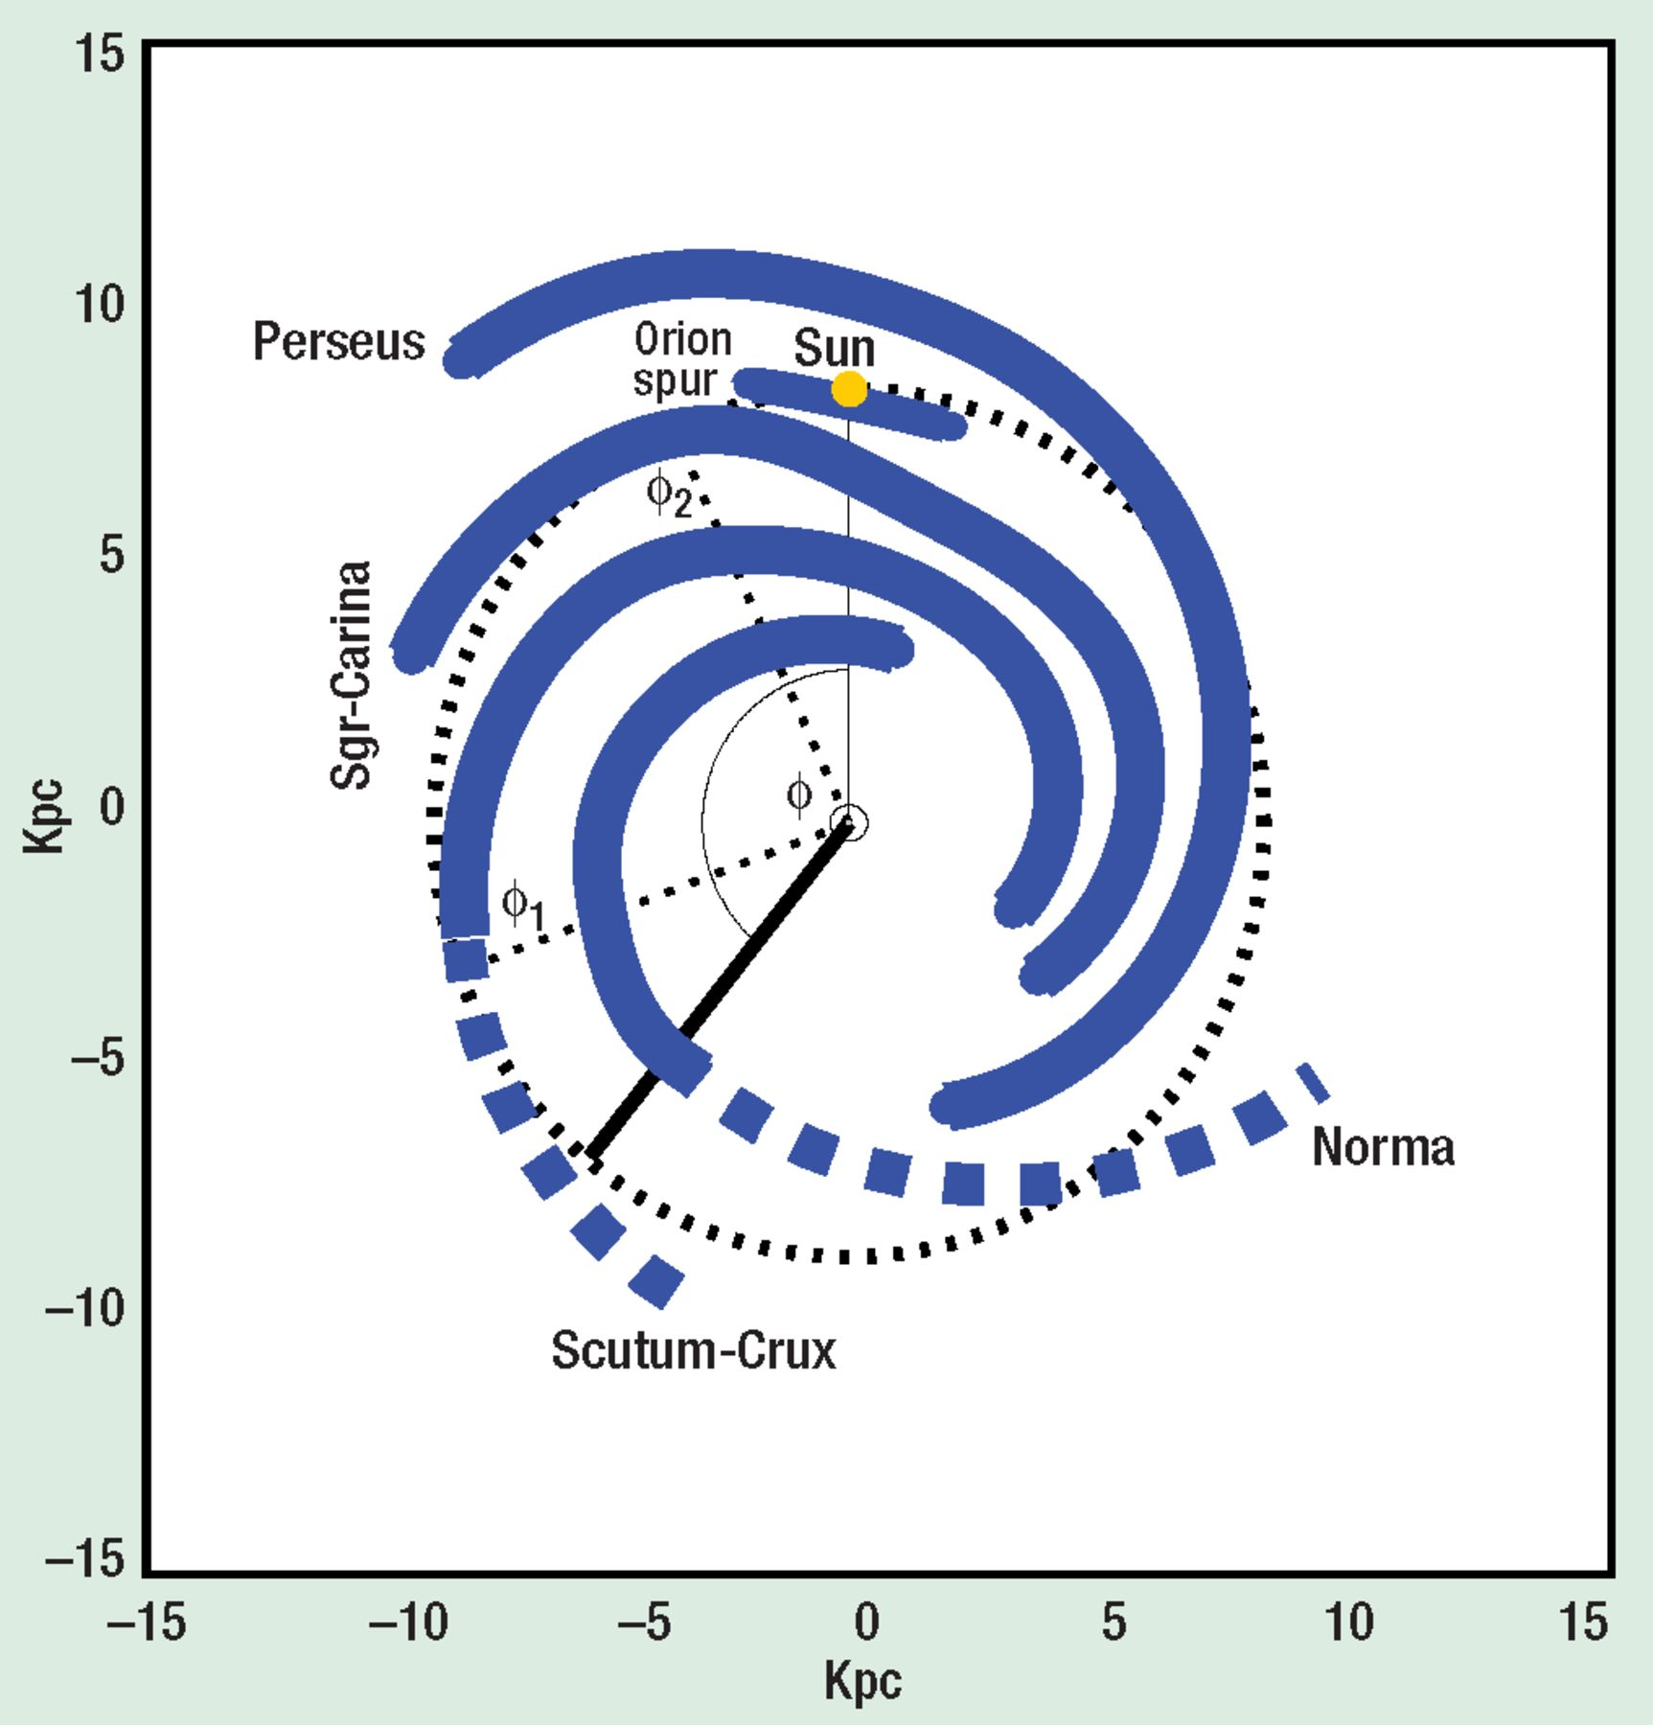
9: The Sun's motion relative to the galaxy's spiral arms over the past 200 million years is defined by changes ...
Notes:
9: The Sun's motion relative to the galaxy's spiral arms over the past 200 million years is defined by changes in the angle ⌽. The most recent spiral-arm crossings ⌽1 and ⌽2 were at ~100° and ~25°. Climatic data show rhythmic cooling of the Earth whenever the Sun crossed the galactic midplane, where cosmic rays are locally most intense. From these geophysical data, the astrophysical data shown in table 1 can be inferred. (Svensmark 2006a)
Unless provided in the caption above, the following copyright applies to the content of this slide:

Slide 10
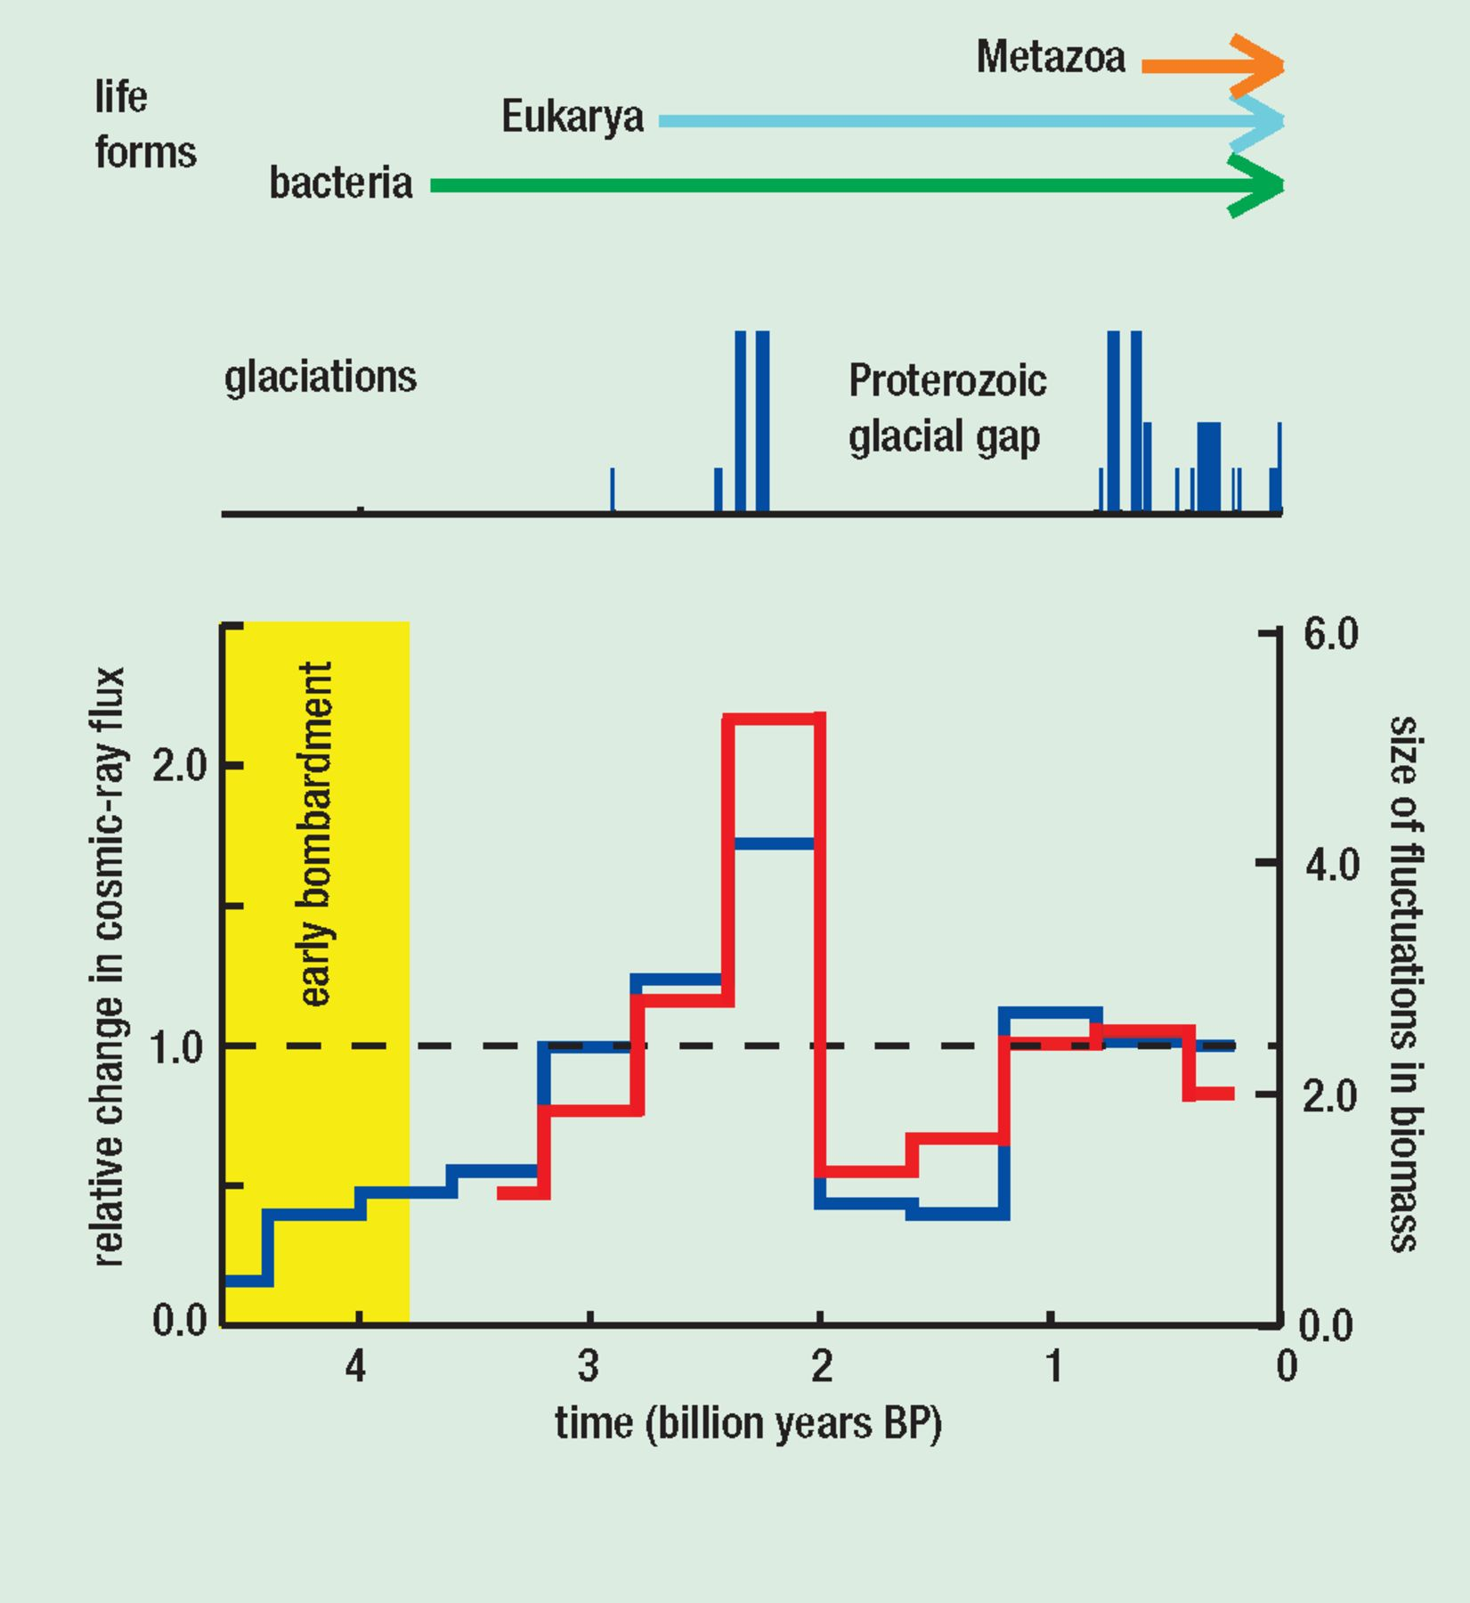
10: When life began about 3.8 billion years ago, the cosmic-ray flux (blue curve) was very low, because of the ...
Notes:
10: When life began about 3.8 billion years ago, the cosmic-ray flux (blue curve) was very low, because of the vigour of the solar wind. Complex life forms (single-cell eukarya and multi-cell metazoa) rose to success during global glaciations, which coincided with high cosmic rays linked to high star-formation rates. The red curve shows the size of variations in the productivity of the biosphere, which was most erratic when the cosmic-ray flux was greatest. (Svensmark 2006b and references therein)
Unless provided in the caption above, the following copyright applies to the content of this slide:

