Slide 1
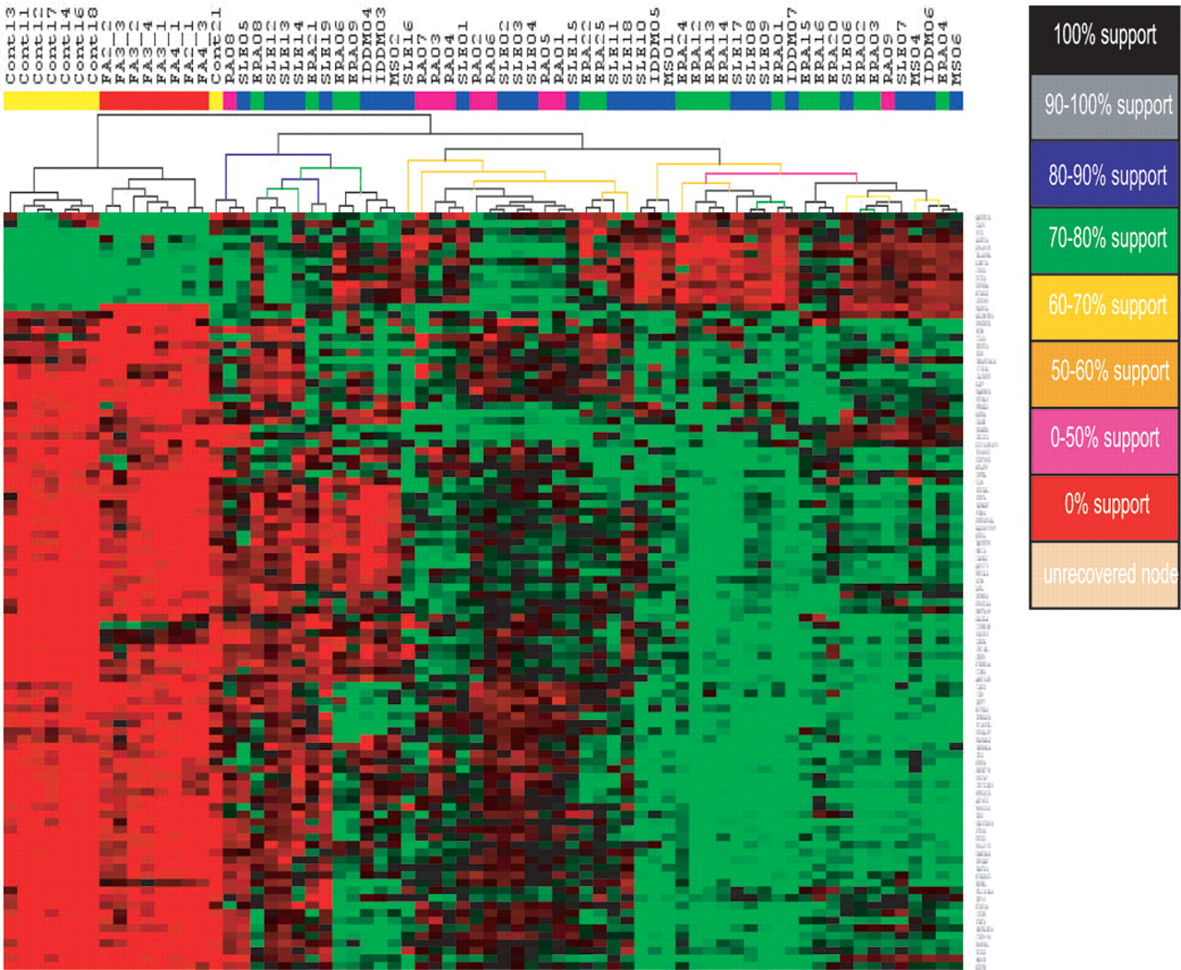
Figure 1. HCL analysis of expression data, using the SAM-identified 100 genes with ST validation. Jackknife ...
Notes:
Figure 1. HCL analysis of expression data, using the SAM-identified 100 genes with ST validation. Jackknife re-sampling was used (1000 times) to establish the support levels for the separate nodes or branches. Color codes correspond to a given level of support for a given node.
Unless provided in the caption above, the following copyright applies to the content of this slide: © The Author 2005. Published by Oxford University Press. All rights reserved. The online version of this article has been published under an open access model. Users are entitled to use, reproduce, disseminate, or display the open access version of this article for non-commercial purposes provided that: the original authorship is properly and fully attributed; the Journal and Oxford University Press are attributed as the original place of publication with the correct citation details given; if an article is subsequently reproduced or disseminated not in its entirety but only in part or as a derivative work this must be clearly indicated. For commercial re-use, please contact: journals.permissions@oxfordjournals.org

Slide 2
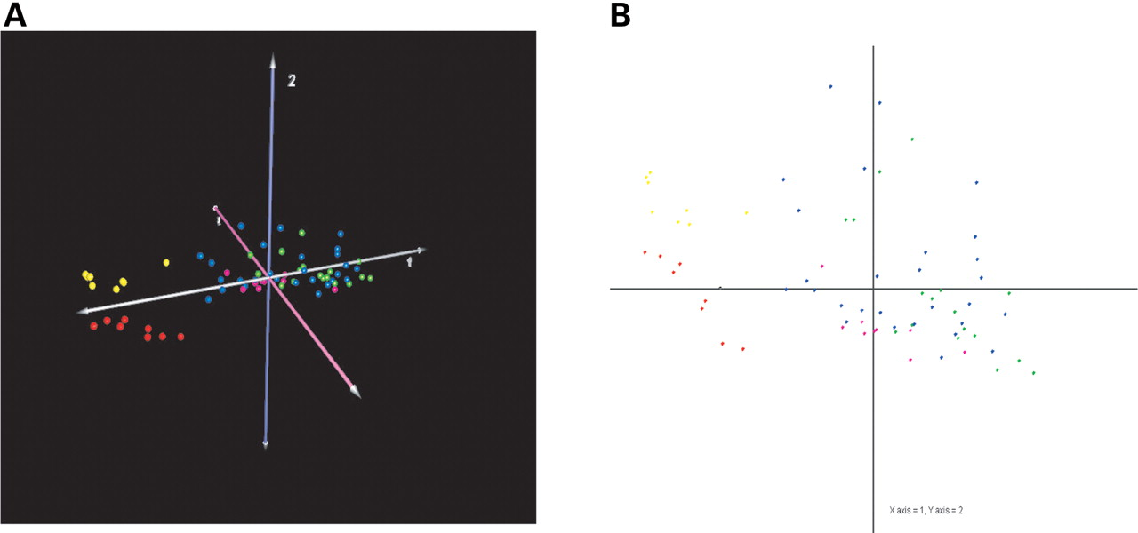
Figure 2. PCA analysis of distribution of samples according to expression levels of SAM-identified 100 genes. ...
Notes:
Figure 2. PCA analysis of distribution of samples according to expression levels of SAM-identified 100 genes. (A) Projection of samples in three-dimensional space: yellow spheres represent control individuals, red spheres represent unaffected family members and other color spheres represent individuals with autoimmune disease. (B) Two-dimensional projection of samples onto an X–Y plane according to expression levels of SAM-identified 100 genes. Yellow squares represent control individuals, red squares represent unaffected family members and other color squares represent individuals with different autoimmune diseases.
Unless provided in the caption above, the following copyright applies to the content of this slide: © The Author 2005. Published by Oxford University Press. All rights reserved. The online version of this article has been published under an open access model. Users are entitled to use, reproduce, disseminate, or display the open access version of this article for non-commercial purposes provided that: the original authorship is properly and fully attributed; the Journal and Oxford University Press are attributed as the original place of publication with the correct citation details given; if an article is subsequently reproduced or disseminated not in its entirety but only in part or as a derivative work this must be clearly indicated. For commercial re-use, please contact: journals.permissions@oxfordjournals.org

Slide 3
Figure 3. Gene distance matrix. The similarity among the three groups was measured by calculating the ...
Notes:
Figure 3. Gene distance matrix. The similarity among the three groups was measured by calculating the distance metric between the samples from each of two different groups (unaffected family members versus controls, unaffected family members versus individuals with autoimmune disease and controls versus individuals with autoimmune disease). Each square element within the matrix is rendered a color that represents the distance or similarity between the two samples associated with the element.
Unless provided in the caption above, the following copyright applies to the content of this slide: © The Author 2005. Published by Oxford University Press. All rights reserved. The online version of this article has been published under an open access model. Users are entitled to use, reproduce, disseminate, or display the open access version of this article for non-commercial purposes provided that: the original authorship is properly and fully attributed; the Journal and Oxford University Press are attributed as the original place of publication with the correct citation details given; if an article is subsequently reproduced or disseminated not in its entirety but only in part or as a derivative work this must be clearly indicated. For commercial re-use, please contact: journals.permissions@oxfordjournals.org

Slide 4
Figure 4. Quantitative differences in gene transcript levels among the three groups. (A) Average expression ...
Notes:
Figure 4. Quantitative differences in gene transcript levels among the three groups. (A) Average expression levels (mean and standard error) of representative ‘autoimmune signature’ genes within SAM-identified 100 genes among three groups are shown (Cont versus Auto and FA versus Auto: P<0.001, Student's t-test). (B) Average expression levels (mean and standard error) of representative ‘non-autoimmune signature’ genes in SAM-identified 100 genes among three groups are shown (Cont versus Auto and FA versus Auto: P<0.001, Student's t-test).
Unless provided in the caption above, the following copyright applies to the content of this slide: © The Author 2005. Published by Oxford University Press. All rights reserved. The online version of this article has been published under an open access model. Users are entitled to use, reproduce, disseminate, or display the open access version of this article for non-commercial purposes provided that: the original authorship is properly and fully attributed; the Journal and Oxford University Press are attributed as the original place of publication with the correct citation details given; if an article is subsequently reproduced or disseminated not in its entirety but only in part or as a derivative work this must be clearly indicated. For commercial re-use, please contact: journals.permissions@oxfordjournals.org

Slide 5
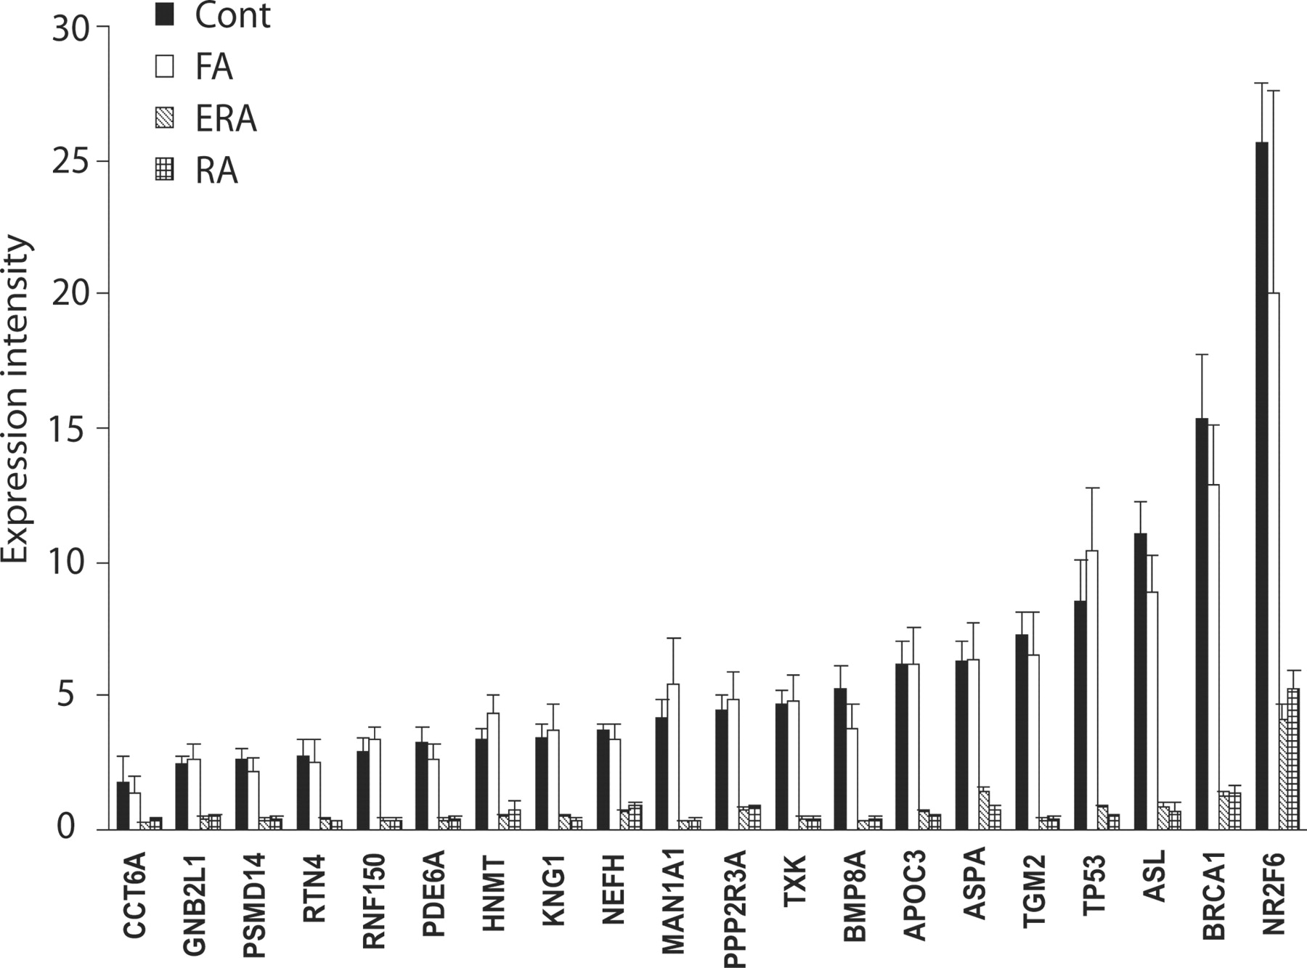
Figure 5. Comparison of gene expression profiles between ERA and established RA samples. Expression levels ...
Notes:
Figure 5. Comparison of gene expression profiles between ERA and established RA samples. Expression levels (mean and standard error) of representative SAM-identified genes were compared in individuals with ERA, individuals with established RA, unaffected family members and controls.
Unless provided in the caption above, the following copyright applies to the content of this slide: © The Author 2005. Published by Oxford University Press. All rights reserved. The online version of this article has been published under an open access model. Users are entitled to use, reproduce, disseminate, or display the open access version of this article for non-commercial purposes provided that: the original authorship is properly and fully attributed; the Journal and Oxford University Press are attributed as the original place of publication with the correct citation details given; if an article is subsequently reproduced or disseminated not in its entirety but only in part or as a derivative work this must be clearly indicated. For commercial re-use, please contact: journals.permissions@oxfordjournals.org

Slide 6
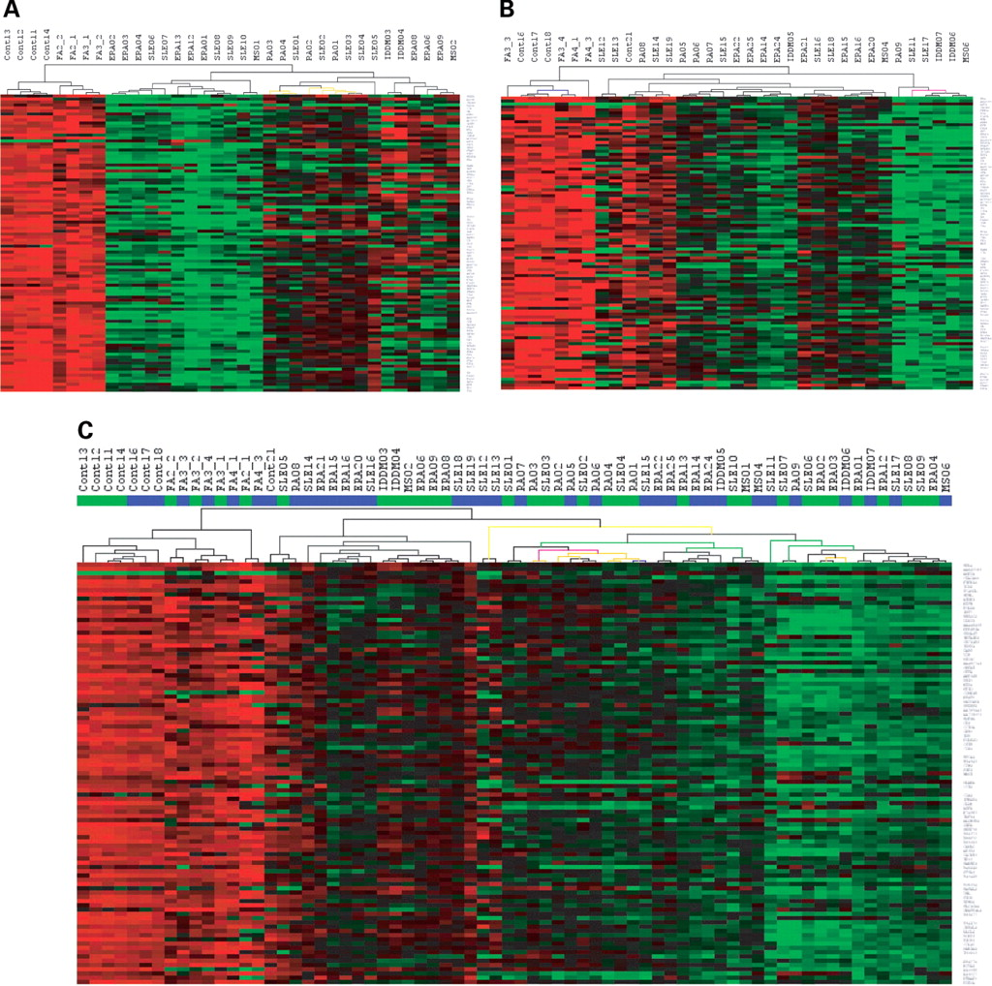
Figure 6. Validation analysis. (A) HCL with ST validation of SAM-identified 99 genes from training set. (B) ...
Notes:
Figure 6. Validation analysis. (A) HCL with ST validation of SAM-identified 99 genes from training set. (B) HCL with ST validation of SAM-identified 99 genes in the test set. (C) HCL with ST validation of SAM-identified 99 genes in both training and test sets. The green bar indicates samples from the training set and the blue bar indicates samples from the test set. Jackknife re-sampling (1000 times) was used to establish support levels for the separate nodes or branches. Color codes correspond to a given level of support for a given node as in Figure 1.
Unless provided in the caption above, the following copyright applies to the content of this slide: © The Author 2005. Published by Oxford University Press. All rights reserved. The online version of this article has been published under an open access model. Users are entitled to use, reproduce, disseminate, or display the open access version of this article for non-commercial purposes provided that: the original authorship is properly and fully attributed; the Journal and Oxford University Press are attributed as the original place of publication with the correct citation details given; if an article is subsequently reproduced or disseminated not in its entirety but only in part or as a derivative work this must be clearly indicated. For commercial re-use, please contact: journals.permissions@oxfordjournals.org

