Slide 1
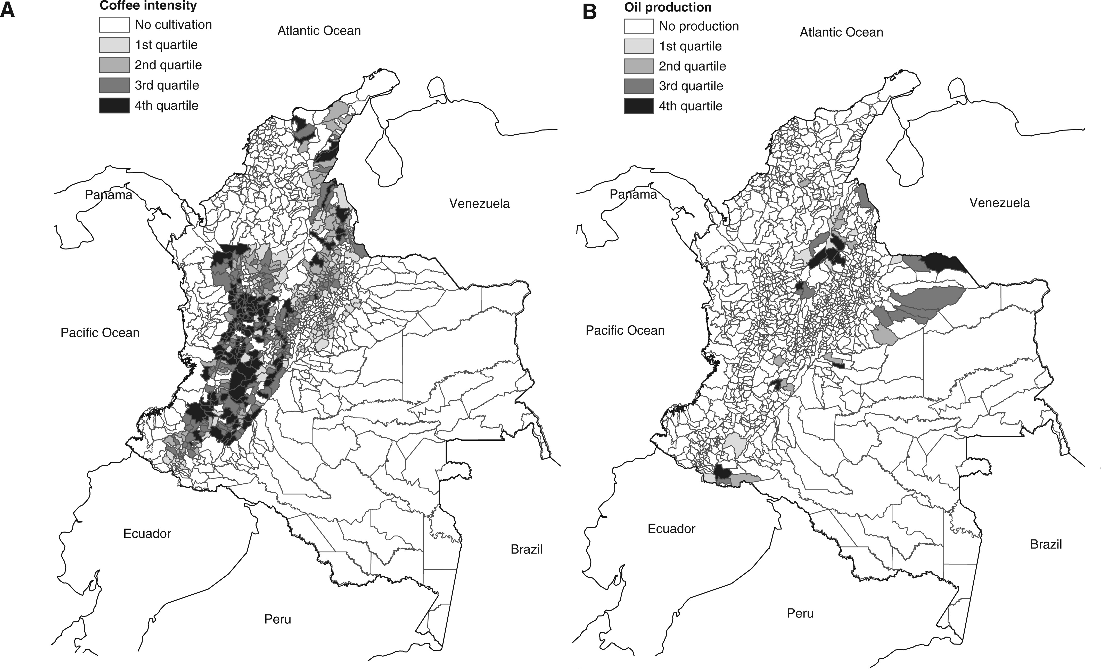
Figure 1 Coffee intensity and oil production in Colombia. (A) Coffee intensity; (B) Oil production Notes: This figure ...
Notes:
Figure 1 Coffee intensity and oil production in Colombia. (A) Coffee intensity; (B) Oil production Notes: This figure shows coffee intensity and oil production in Colombian municipalities. Coffee intensity is measured as the land used for cultivating coffee (in thousands of hectares) in 1997. Oil production is measured in hundreds of thousands of barrels per day in 1988. Sources: Shape file from IGAC; coffee data from NFCG; oil data from the Ministry of Mines and Energy.
Unless provided in the caption above, the following copyright applies to the content of this slide: © The Author 2013. Published by Oxford University Press on behalf of The Review of Economic Studies Limited.

Slide 2
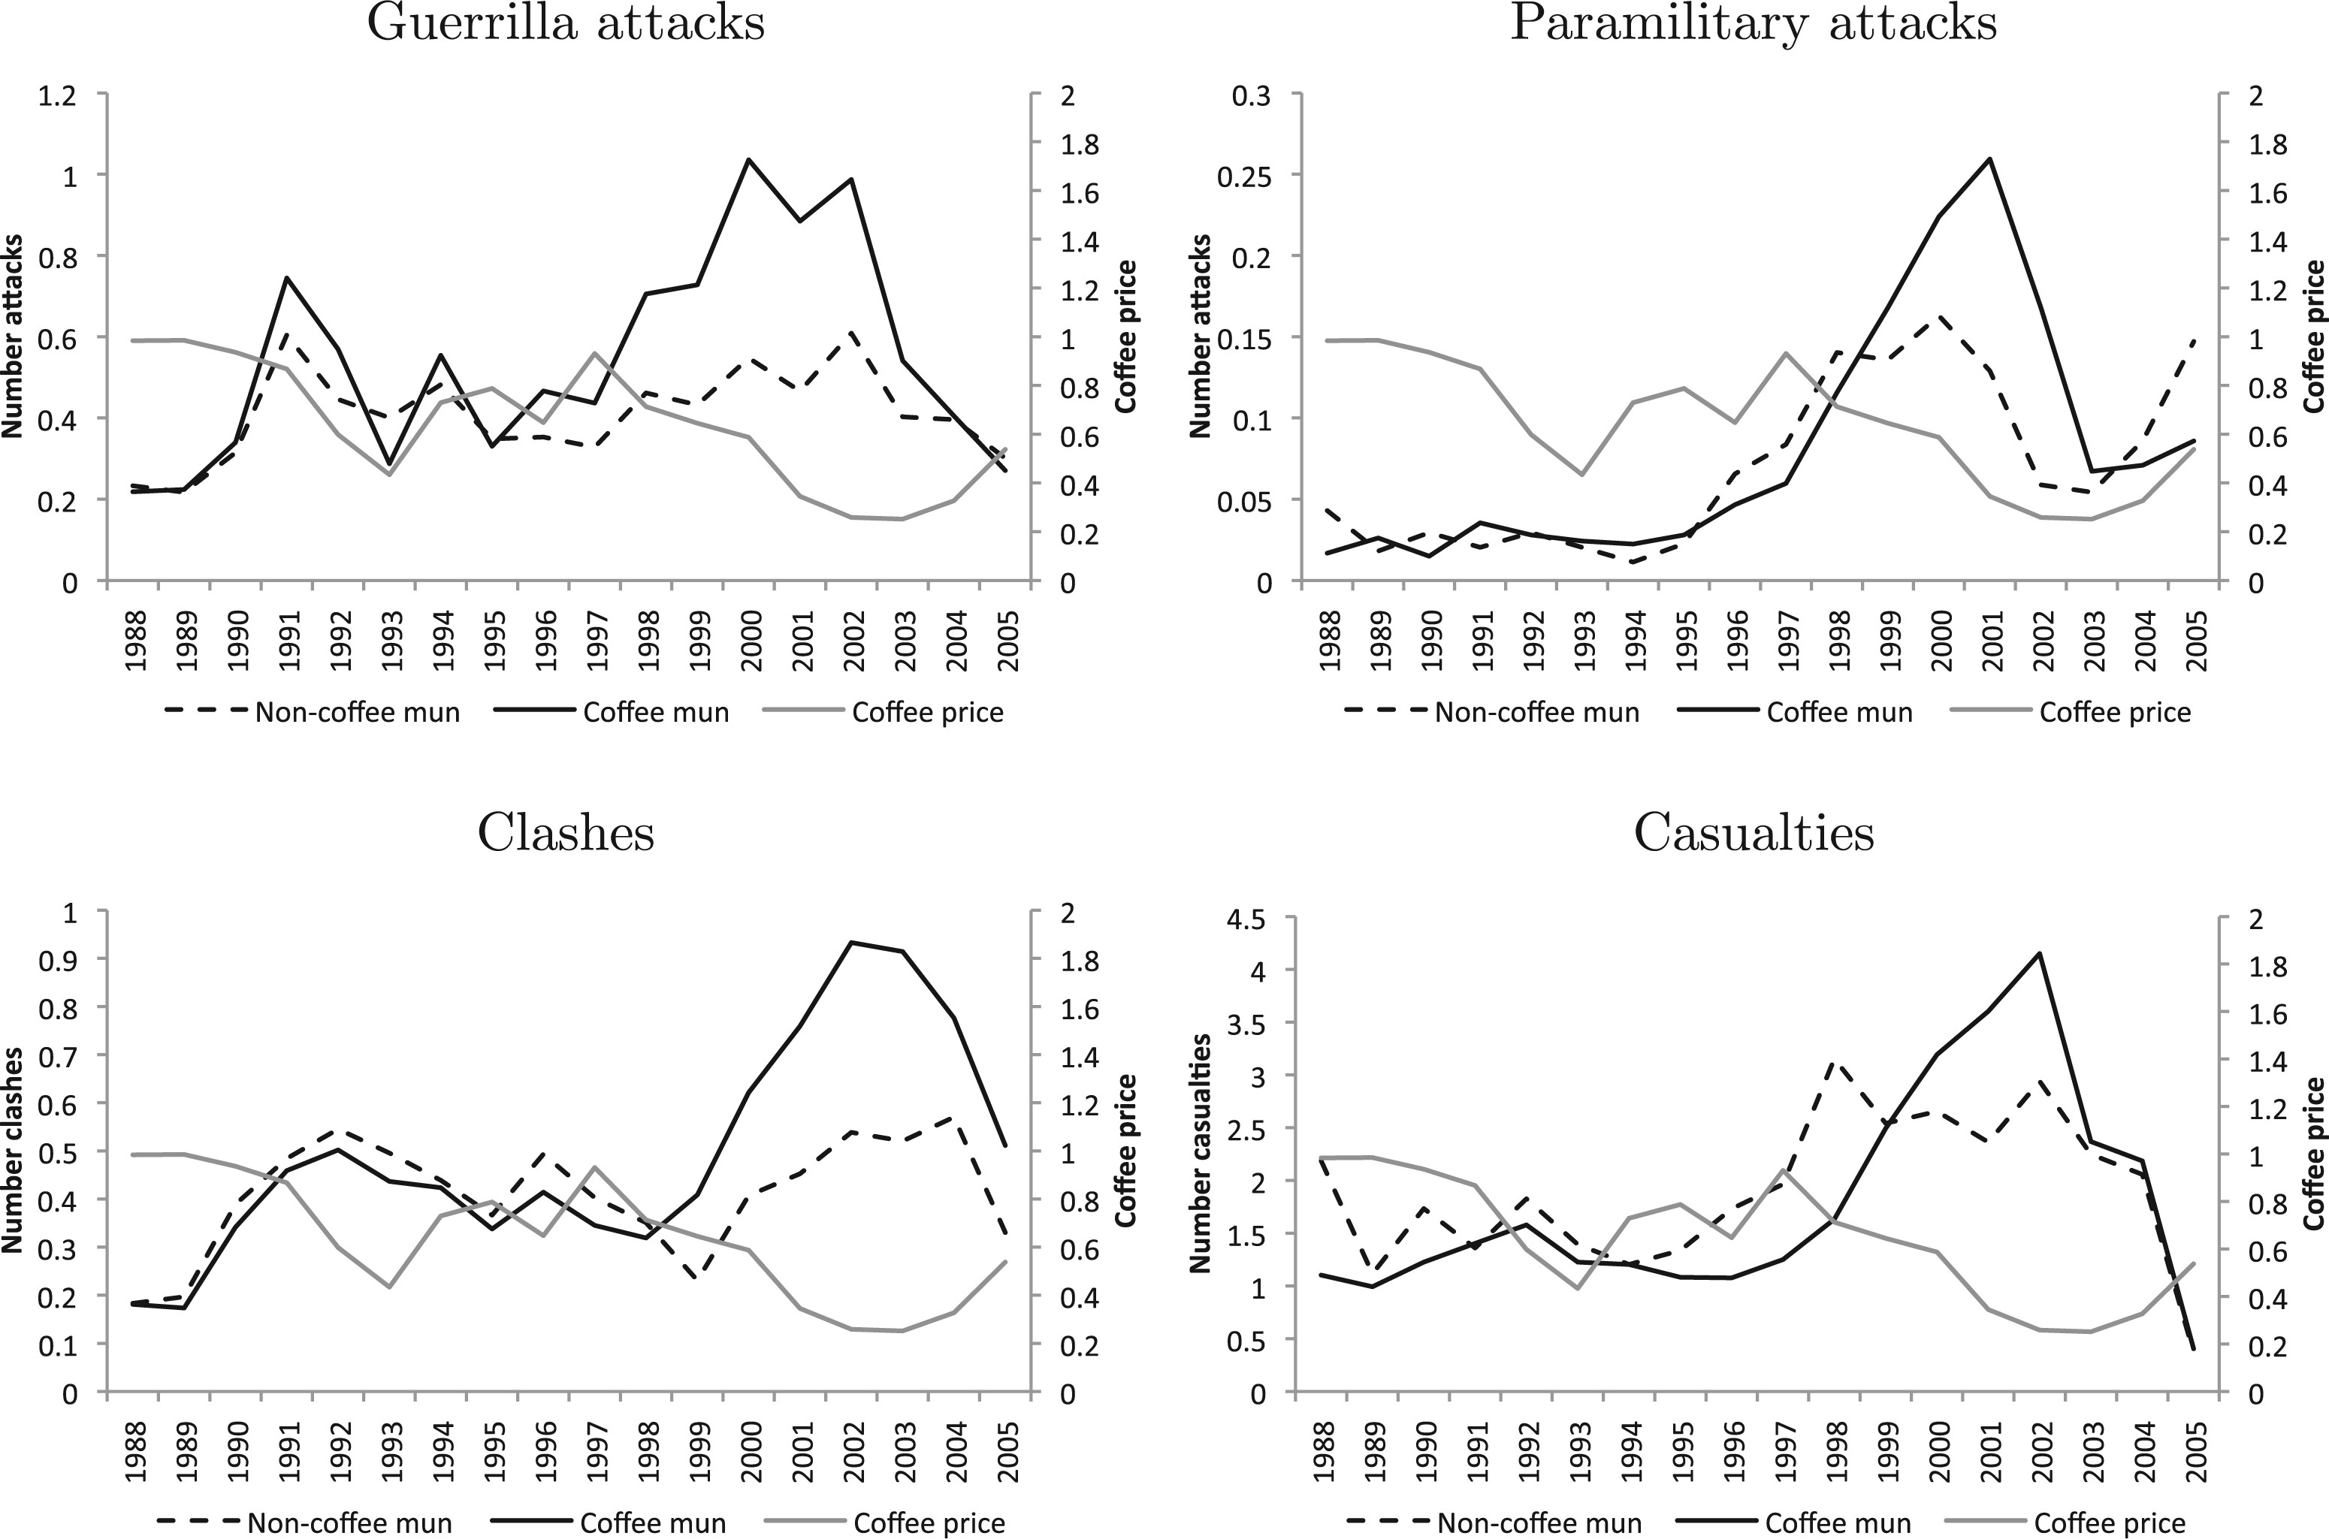
Figure 4 The coffee price and mean violence in coffee and non-coffee municipalities Notes: This figure shows the (log) ...
Notes:
Figure 4 The coffee price and mean violence in coffee and non-coffee municipalities Notes: This figure shows the (log) real internal price of coffee in Colombia, as well as mean violence in municipalities growing coffee in 1997 and mean violence in the non-coffee municipalities.
Unless provided in the caption above, the following copyright applies to the content of this slide: © The Author 2013. Published by Oxford University Press on behalf of The Review of Economic Studies Limited.

Slide 3
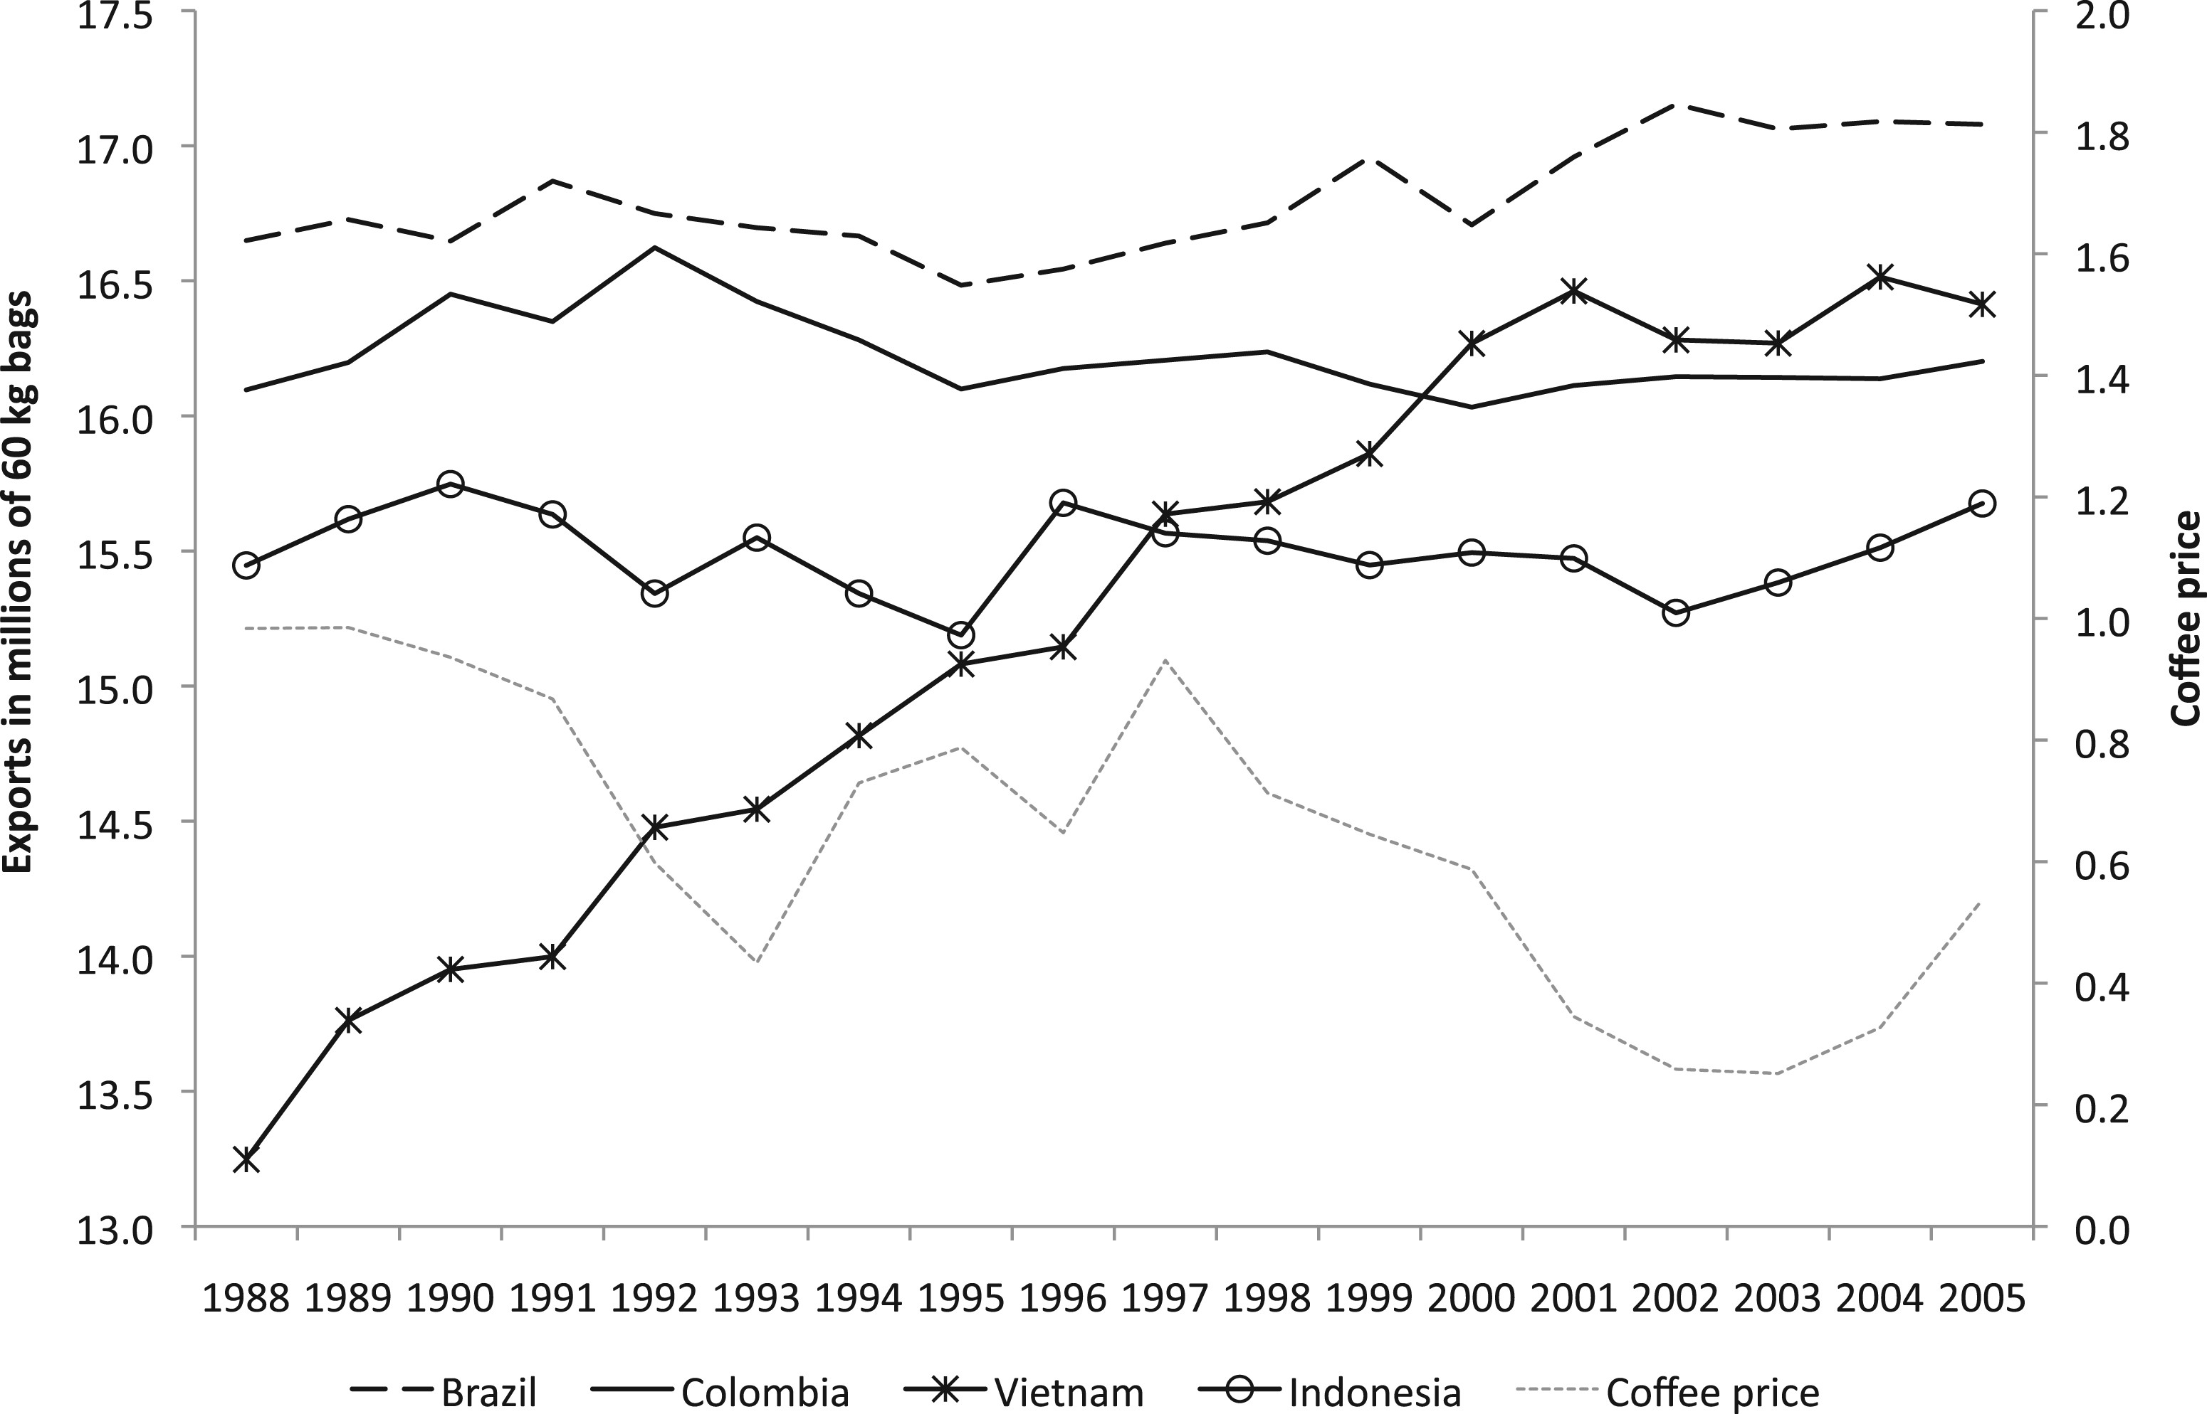
Figure 2 The coffee price and exports of main producers Notes: This figure shows coffee exports (log of millions of 60 ...
Notes:
Figure 2 The coffee price and exports of main producers Notes: This figure shows coffee exports (log of millions of 60 kg bags) of the four largest coffee exporters, and the (log) real internal price of coffee in Colombia. Sources: Coffee export data from the International Coffee Organization and coffee price data from the NFCG.
Unless provided in the caption above, the following copyright applies to the content of this slide: © The Author 2013. Published by Oxford University Press on behalf of The Review of Economic Studies Limited.

Slide 4
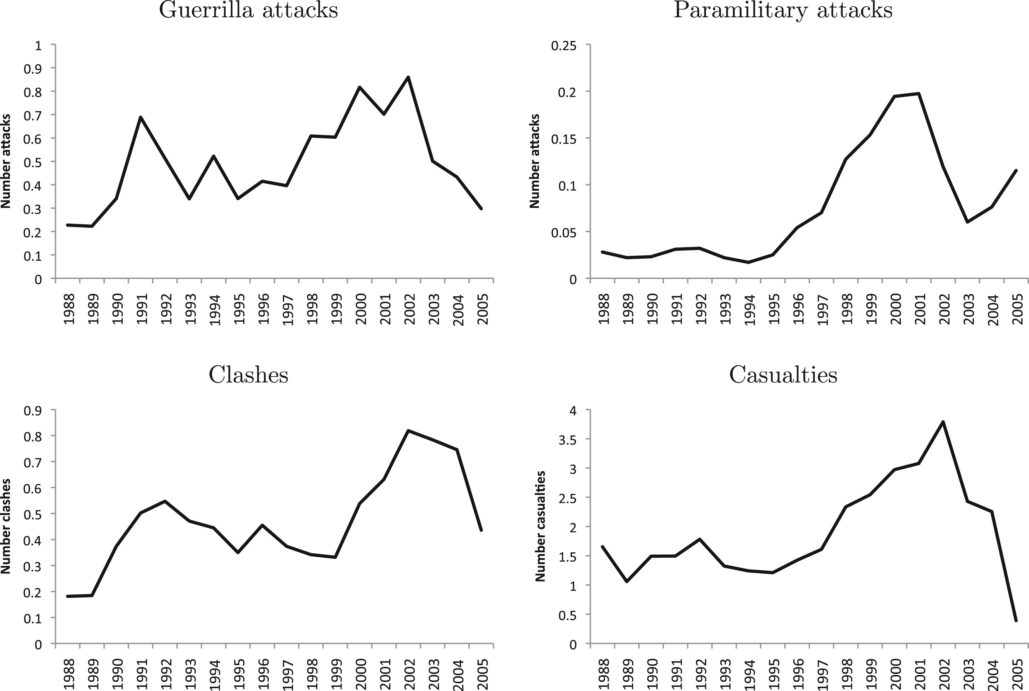
Figure 3 Mean violence in Colombian municipalities, 1988–2005 Notes: This figure shows mean violence levels in the ...
Notes:
Figure 3 Mean violence in Colombian municipalities, 1988–2005 Notes: This figure shows mean violence levels in the sample municipalities.
Unless provided in the caption above, the following copyright applies to the content of this slide: © The Author 2013. Published by Oxford University Press on behalf of The Review of Economic Studies Limited.

Slide 5
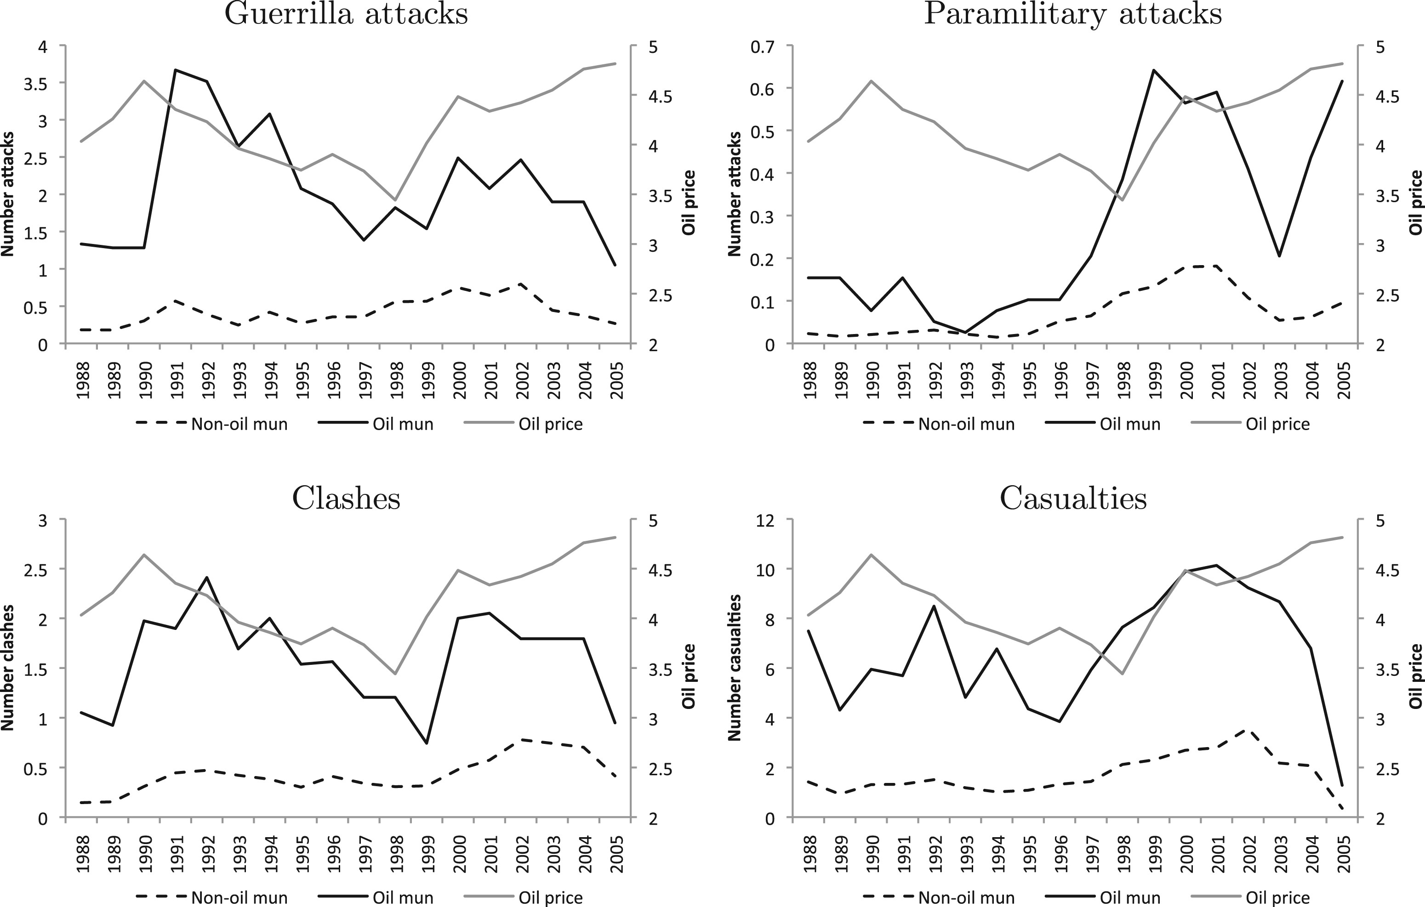
Figure 5 The oil price and mean violence in oil and non-oil municipalities Notes: This figure shows the (log) real ...
Notes:
Figure 5 The oil price and mean violence in oil and non-oil municipalities Notes: This figure shows the (log) real international price of oil, as well as mean violence in municipalities producing oil in 1988 and mean violence in the non-oil producing municipalities.
Unless provided in the caption above, the following copyright applies to the content of this slide: © The Author 2013. Published by Oxford University Press on behalf of The Review of Economic Studies Limited.

