Slide 1
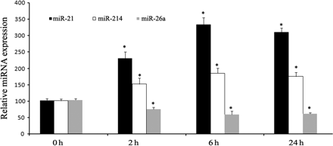
Figure 1 Verification of IP-regulated miRNAs in rat hearts. The expression of miR-21, miR-214, and miR-26a in ...
Notes:
Figure 1 Verification of IP-regulated miRNAs in rat hearts. The expression of miR-21, miR-214, and miR-26a in sham-opened rat hearts (0 h), and in rat hearts at 2, 6, and 24 h after IP was determined by qRT–PCR. Note n = 6; *P < 0.05 compared with the 0 h group.
Unless provided in the caption above, the following copyright applies to the content of this slide: Published on behalf of the European Society of Cardiology. All rights reserved. © The Author 2010. For permissions please email: journals.permissions@oxfordjournals.org.

Slide 2
Figure 2 Inhibition of IP-upregulated miR-21 via antagomiR-21. AntagomiR-21 (80 mg/kg) or vehicle control was ...
Notes:
Figure 2 Inhibition of IP-upregulated miR-21 via antagomiR-21. AntagomiR-21 (80 mg/kg) or vehicle control was delivered into the rat hearts at 24 h before IP using the local delivery method described in Methods section. miR-21 expression was determined at 6 h after IP. (A) IP-induced upregulation of cardiac miR-21 was inhibited by antagomiR-21 as determined by qRT–PCR. (B) The inhibitory effect of antagomiR-21 on miR-21 expression was verified by Northern blot analysis. Note n = 6; *P < 0.05 compared with the Vehicle + IP group.
Unless provided in the caption above, the following copyright applies to the content of this slide: Published on behalf of the European Society of Cardiology. All rights reserved. © The Author 2010. For permissions please email: journals.permissions@oxfordjournals.org.

Slide 3
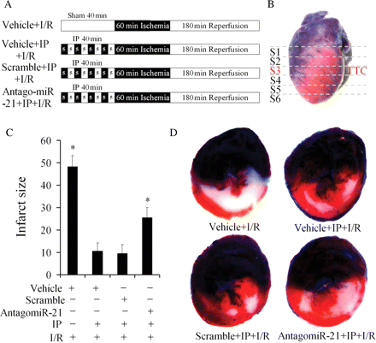
Figure 3 The role of miR-21 in IP-mediated protective effect on myocardial infarct size induced by I/R. (A) Schematic ...
Notes:
Figure 3 The role of miR-21 in IP-mediated protective effect on myocardial infarct size induced by I/R. (A) Schematic diagram showing the four groups of rats with different treatments. (B) Schematic diagram showing the six-heart slices for histology analysis. (C) The effects of IP and miR-21 inhibition on myocardial infarct size. (D) Representative TTC and Evans blue stained heart slices from rats treated with vehicle + I/R, vehicle + IP + I/R, scramble + IP + I/P, and antagomiR-21 + IP + I/P. Note: blue colour is Evans blue; red colour is TTC staining showing the uninfarcted area; write colour is infarcted area. n = 9, *P < 0.05 compared with the group treated with vehicle + IP + I/R in (C).
Unless provided in the caption above, the following copyright applies to the content of this slide: Published on behalf of the European Society of Cardiology. All rights reserved. © The Author 2010. For permissions please email: journals.permissions@oxfordjournals.org.

Slide 4
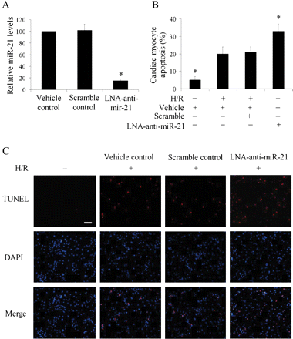
Figure 4 The effect of miR-21 inhibition on H/R induced cardiac cell apoptosis in vitro. Cultured cardiac cell injury ...
Notes:
Figure 4 The effect of miR-21 inhibition on H/R induced cardiac cell apoptosis in vitro. Cultured cardiac cell injury was induced by hypoxia for 4 h in a serum- and glucose-free medium followed by reoxygenation for 3 h in normal culture medium. Cell apoptosis was determined by TUNEL staining. (A) miR-21 inhibitor, LNA-anti-miR-21 (30 nM) decreased miR-21 expression in cultured cardiac cells. Note: n = 6, *P < 0.05 compared with the vehicle control. (B) H/R resulted in an increase in apoptosis. Cardiac myocyte apoptosis was exacerbated after treatment with LNA-anti-miR-21. Note: n = 6, *P < 0.05 compared with H/R treated with the vehicle. (C) Representative TUNEL-stained photomicrographs from cells without I/R, and cardiac myocytes with I/R treated with vehicle, control oligo (scramble), or LNA-anti-miR-21. Note: red colour is TUNEL staining representing apoptotic cell; blue colour is the cell nucleus stained by 4′,6-diamidino-2-phenylindole. Scale bar in (C) is 100 μm.
Unless provided in the caption above, the following copyright applies to the content of this slide: Published on behalf of the European Society of Cardiology. All rights reserved. © The Author 2010. For permissions please email: journals.permissions@oxfordjournals.org.

Slide 5
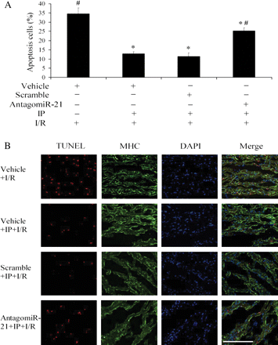
Figure 5 The effect of miR-21 inhibition on the cardiac cell apoptosis in rat hearts after I/R. (A) Quantitative ...
Notes:
Figure 5 The effect of miR-21 inhibition on the cardiac cell apoptosis in rat hearts after I/R. (A) Quantitative analysis of the apoptotic cells in heart sections. Note: n = 6, *P < 0.05 compared with I/R treated with vehicle (Vehicle + I/R); #P < 0.05 compared with I/R treated with IP (vehicle + IP + I/R). (B) Representative TUNEL- and myosin heavy chain (MHC)-stained photomicrographs OF cardiac myocytes in heart sections from rats treated with vehicle + I/R, vehicle + IP + I/R, scramble + IP + I/P, and antagomiR-21 + IP + I/P. Note: red colour is TUNEL staining representing apoptotic cells; green colour is the MHC staining representing cardiac myocytes; blue colour is the cell nucleus stained by 4′,6-diamidino-Z-phenylindole. Scale bar in (C) is 500 μm.
Unless provided in the caption above, the following copyright applies to the content of this slide: Published on behalf of the European Society of Cardiology. All rights reserved. © The Author 2010. For permissions please email: journals.permissions@oxfordjournals.org.

Slide 6
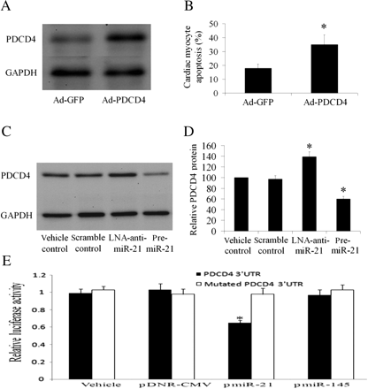
Figure 6 PDCD4 is an miR-21 target gene that is related to miR-21-mediated anti-apoptotic effect on cardiac cells. (A) ...
Notes:
Figure 6 PDCD4 is an miR-21 target gene that is related to miR-21-mediated anti-apoptotic effect on cardiac cells. (A) Overexpression of PDCD4 by Ad-PDCD4 (30 MOI) in cultured cardiac myocytes. (B) Ad-PDCD4 (30 MOI) increased cardiac myocyte apoptosis induced by H/R as determined by TUNEL staining. Note: n = 5, *P < 0.05 compared with the Ad-GFP control. (C) Modulation of PDCD4 expression in cardiac myocytes by LNA-anti-miR-21 (30 nM) and pre-miR-21 (30 nM). (D) Quantitative analysis of PDCD4 protein. Note: n = 6, *P < 0.05 compared with the vehicle control. (E) miR-21 is able to bind to PDCD4 and inhibit PDCD4 expression in HEK 293 cells. A construct (1 µg/well) in which a fragment of the 3′-UTR of PDCD4 mRNA with the putative miR-21 binding sequence was cloned into a firefly luciferase reporter construct and transfected into HEK 293 cells with either vehicle (vehicle), an empty plasmid (pDNR-CMV, 30 nM), a plasmid expressing miR-21 (pmiR-21, 30 nM), or a control plasmid expressing an unrelated miRNA, miR-145 (pmiR-145, 30 nM). The construct (1 µg/well) with mutated fragment of the 3′-UTR of PDCD4 mRNA without the putative miR-21 binding sequence was used as the mutated control. pmiR-21, but not pDNR-CMV or pmiR-145, inhibited luciferase activity. In the mutated control group, the inhibitory effect of pmiR-21 disappeared. Note; n = 5; *P < 0.05 compared with vehicle control.
Unless provided in the caption above, the following copyright applies to the content of this slide: Published on behalf of the European Society of Cardiology. All rights reserved. © The Author 2010. For permissions please email: journals.permissions@oxfordjournals.org.

