Slide 1
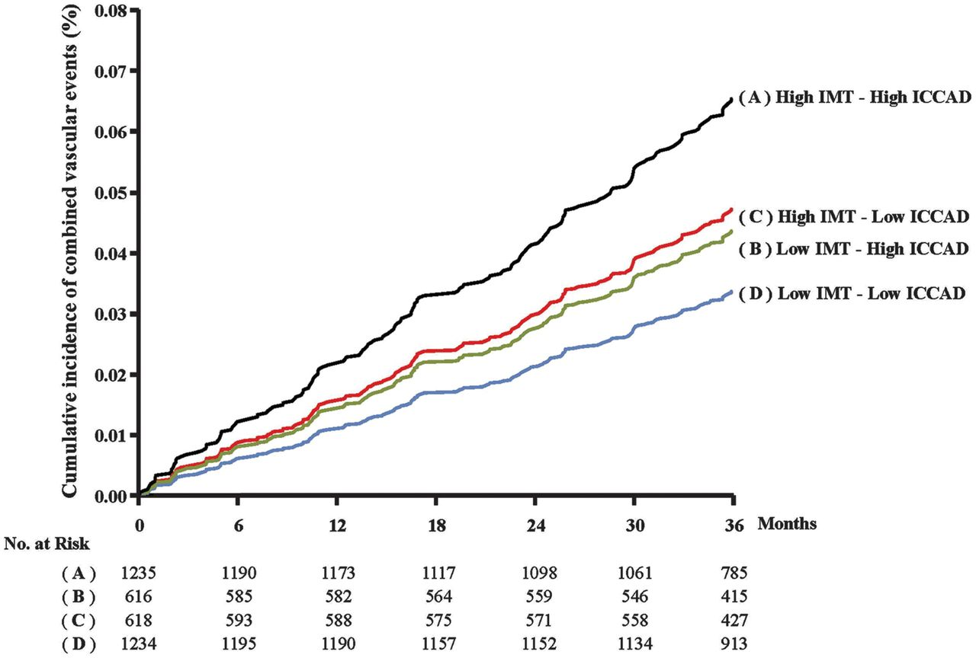
Figure 1 Framingham risk score-adjusted Kaplan–Meier incidence curves. The study population was stratified according ...
Notes:
Figure 1 Framingham risk score-adjusted Kaplan–Meier incidence curves. The study population was stratified according to intima media thickness (measured as average of maximal intima media thickness measured in eight segments including common carotid, bifurcation, and internal in left and right carotid arteries) and inter-adventitia common carotid artery diameter values above or below their respective medians (1.34 and 7.74 mm, respectively). Curves were computed for the mean value of FRS (22.6%). Reproduced with permission from Baldassarre et al.10
Unless provided in the caption above, the following copyright applies to the content of this slide: Published on behalf of the European Society of Cardiology. All rights reserved. © The Author 2013. For permissions please email: journals.permissions@oup.com

Slide 2
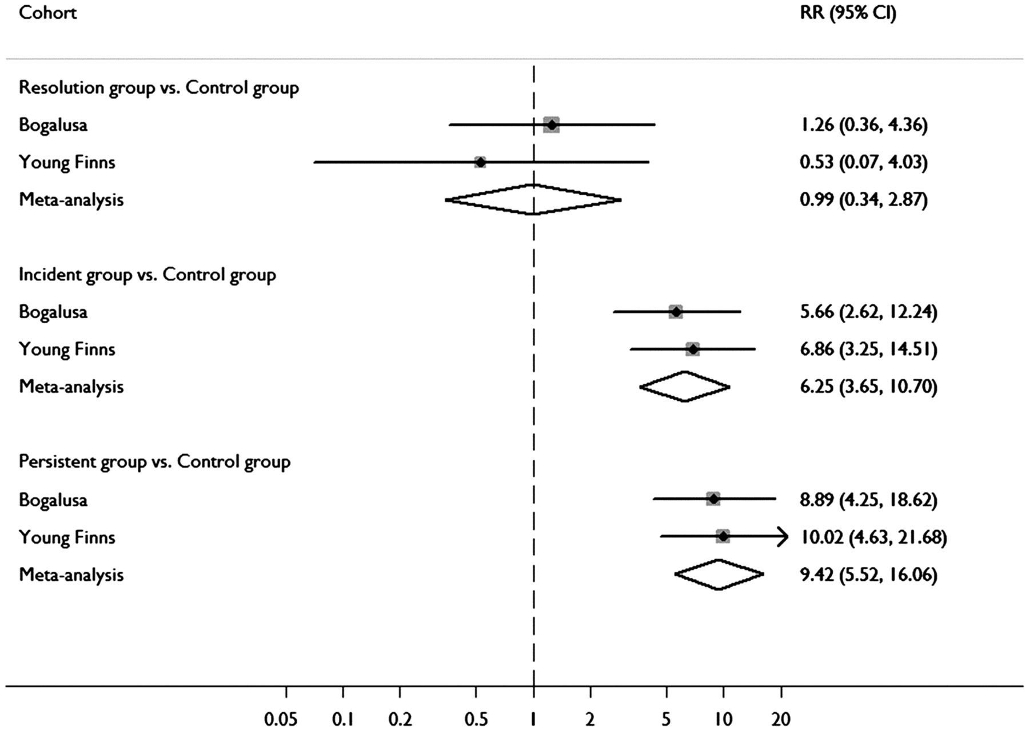
Figure 2 Impact of metabolic syndrome on carotid intima media thickness by the length of exposure. Metabolic syndrome ...
Notes:
Figure 2 Impact of metabolic syndrome on carotid intima media thickness by the length of exposure. Metabolic syndrome in youth but not in adulthood is associated with normalization of carotid intima media thickness compared with increased carotid intima media thickness noted in participants with persistent metabolic syndrome (youth to adulthood) or those with metabolic syndrome when emerged in adulthood. The size of each box is directly proportional to the weight of the cohort in the meta-analysis. The diamonds represent the relative risks estimated from the meta-analysis, with the lateral points indicating the 95% confidence intervals. The P-values for heterogeneity were 0.97 for the comparison of Group II with Group I, 0.89 for the comparison of Group III with Group I, and 0.15 for the comparison of Group IV with Group I, suggesting that there was no dissimilarity between cohorts. Reproduced with permission from Magnussen et al. J Am Coll Cardiol. 2012;60(17):1631-9.16
Unless provided in the caption above, the following copyright applies to the content of this slide: Published on behalf of the European Society of Cardiology. All rights reserved. © The Author 2013. For permissions please email: journals.permissions@oup.com

