Slide 1
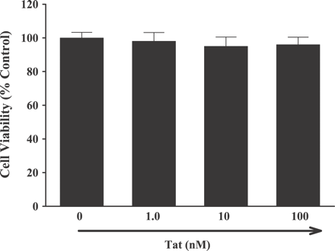
Fig. 1 HIV Tat protein does not affect viability of human vascular endothelial cells. HUVEC were either untreated or ...
Notes:
Fig. 1 HIV Tat protein does not affect viability of human vascular endothelial cells. HUVEC were either untreated or treated with the indicated concentrations of Tat for 24 h, and cell viability was measured by the MTT conversion assay. Data are means±S.D. of six determinations.
Unless provided in the caption above, the following copyright applies to the content of this slide: Copyright © 2004, European Society of Cardiology

Slide 2
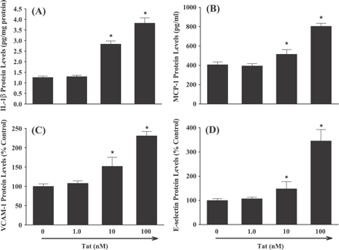
Fig. 3 HIV Tat protein upregulates the protein expression of inflammatory mediators in human vascular endothelial ...
Notes:
Fig. 3 HIV Tat protein upregulates the protein expression of inflammatory mediators in human vascular endothelial cells. HUVEC were either untreated or treated with the indicated concentrations of Tat for 16 h (IL-1β and MCP-1), 12 h (VCAM-1), or 6 h (E-selectin). The protein levels of IL-1β (A), MCP-1 (B), VCAM-1 (C), and E-selectin (D) were measured by ELISA, respectively, as described in Methods. Data are means±S.D. of four determinations. *Statistically significant compared with the control group (P<0.05).
Unless provided in the caption above, the following copyright applies to the content of this slide: Copyright © 2004, European Society of Cardiology

Slide 3
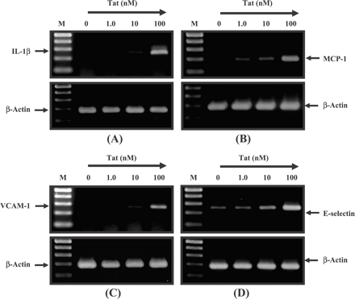
Fig. 2 HIV Tat protein upregulates the mRNA expression of inflammatory mediators in human vascular endothelial ...
Notes:
Fig. 2 HIV Tat protein upregulates the mRNA expression of inflammatory mediators in human vascular endothelial cells. HUVEC were either untreated or treated with the indicated concentrations of Tat for 4 h. The mRNA levels of IL-1β (A), MCP-1 (B), VCAM-1 (C), and E-selectin (D) were measured by semiquantitative reverse transcriptase-polymerase chain reaction (RT-PCR), respectively. β-Actin (a housekeeping gene) was used to indicate that the same amount of RNA was used per sample. The amplified PCR products were analyzed by 2% agarose gel electrophoresis and visualized by using phosphorimaging technology. M, molecular weight markers (100-bp DNA ladder).
Unless provided in the caption above, the following copyright applies to the content of this slide: Copyright © 2004, European Society of Cardiology

Slide 4
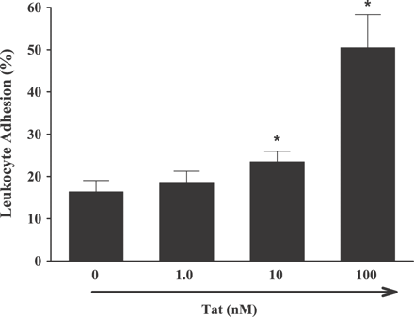
Fig. 4 HIV Tat protein upregulates the adhesion of leukocytes to human vascular endothelial cell monolayers. HUVEC ...
Notes:
Fig. 4 HIV Tat protein upregulates the adhesion of leukocytes to human vascular endothelial cell monolayers. HUVEC were either untreated or treated with the indicated concentrations of Tat for 8 h. To perform the adhesion assay, the calcein AM-labeled human monocytic leukemia cells (THP-1) were incubated with endothelial cell monolayers for 20 min at 37 °C. The adherence of calcein AM-labeled THP-1 cells was measured by fluorescent microplate reader using excitation of 490 nm and emission of 517 nm. Data are means±S.D. of four determinations. *Statistically significant compared with the control group (P<0.05).
Unless provided in the caption above, the following copyright applies to the content of this slide: Copyright © 2004, European Society of Cardiology

Slide 5
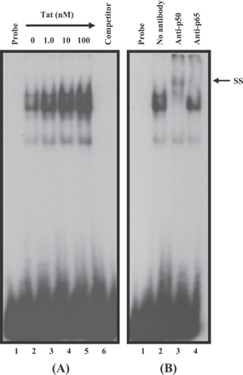
Fig. 5 HIV Tat protein enhances the NF-κB DNA-binding activity in human vascular endothelial cells. HUVEC were ...
Notes:
Fig. 5 HIV Tat protein enhances the NF-κB DNA-binding activity in human vascular endothelial cells. HUVEC were either untreated or treated with the indicated concentrations of Tat for 2 h. Nuclear extracts were prepared and analyzed by electrophoretic mobility shift assay (EMSA). Competition study was performed by the addition of excess unlabeled NF-κB DNA-binding consensus sequence using nuclear extracts from cells treated with 100 nM Tat (A). Supershift analysis of NF-κB DNA-binding activity. Nuclear extracts were prepared from cells treated with 100 nM Tat for 2 h and incubated with anti-p50 antibody or anti-p65 antibody, respectively, for 25 min before the addition of 32P-labeled probe. SS, supershift (B).
Unless provided in the caption above, the following copyright applies to the content of this slide: Copyright © 2004, European Society of Cardiology

Slide 6
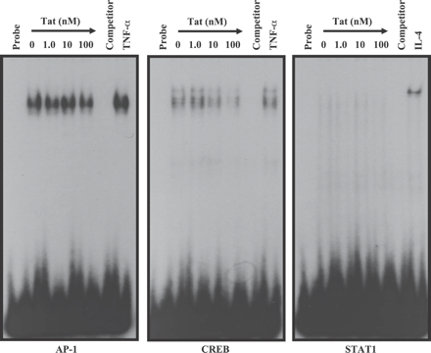
Fig. 6 Exposure to HIV Tat protein does not activate AP-1, CREB or STAT1 in human vascular endothelial cells. ...
Notes:
Fig. 6 Exposure to HIV Tat protein does not activate AP-1, CREB or STAT1 in human vascular endothelial cells. Treatments and analyses were performed as described in Fig. 5. TNF-α and IL-4 were used as positive controls to illustrate the specificity of analysis and treatment-dependent activation of individual transcription factors.
Unless provided in the caption above, the following copyright applies to the content of this slide: Copyright © 2004, European Society of Cardiology

Slide 7
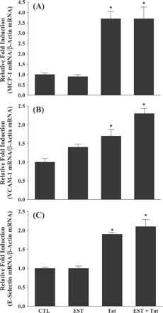
Fig. 8 17β-Estradiol does not affect HIV Tat protein-induced mRNA expression of MCP-1, VCAM-1, and E-selectin in ...
Notes:
Fig. 8 17β-Estradiol does not affect HIV Tat protein-induced mRNA expression of MCP-1, VCAM-1, and E-selectin in human vascular endothelial cells. Treatments and analyses were performed as described in Fig. 7. Data are means±S.E.M. of four determinations. *Statistically significant compared with the control group (P<0.05). CTL, control; EST, 17β-estradiol; Tat, HIV Tat protein.
Unless provided in the caption above, the following copyright applies to the content of this slide: Copyright © 2004, European Society of Cardiology

Slide 8
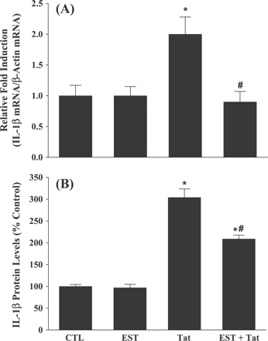
Fig. 7 17β-Estradiol inhibits the mRNA and protein expression of IL-1β in human vascular endothelial cells treated ...
Notes:
Fig. 7 17β-Estradiol inhibits the mRNA and protein expression of IL-1β in human vascular endothelial cells treated with HIV Tat protein. HUVEC were pretreated with 2 nM 17β-estradiol for 24 h and then exposed to 100 nM Tat for 4 h (mRNA expression) (A) and 16 h (protein expression) (B), respectively. The mRNA levels of IL-1β were determined by real-time RT-PCR as described in Methods. Data are means±S.E.M. of four determinations. The protein levels of IL-1β were measured by ELISA as described in Methods. Data are means±S.D. of four determinations. *Statistically significant compared with the control group (P<0.05). #Values in the groups treated with Tat plus estradiol are significantly different from the Tat-treated group (P<0.05). CTL, control; EST, 17β-estradiol; Tat, HIV Tat protein.
Unless provided in the caption above, the following copyright applies to the content of this slide: Copyright © 2004, European Society of Cardiology

Slide 9
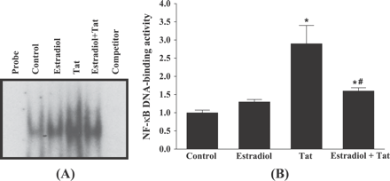
Fig. 9 17β-Estradiol attenuates NF-κB DNA-binding activity in human vascular endothelial cells treated with HIV Tat ...
Notes:
Fig. 9 17β-Estradiol attenuates NF-κB DNA-binding activity in human vascular endothelial cells treated with HIV Tat protein. HUVEC were pretreated with 2 nM 17β-estradiol for 24 h and then exposed to 100 nM Tat for 2 h. Nuclear extracts were prepared and analyzed by EMSA. (A) Representative autoradiogram of EMSA. (B) Densitometric quantification of the effects of 17β-estradiol pretreatment on NF-κB DNA-binding activity in Tat-treated HUVEC. Experiments were repeated four times, and the intensities of the NF-κB-specific bands were measured and statistically analyzed. The results are expressed as fold increase over control values. Data are means±S.E.M. of four determinations. *Statistically significant compared with the control group (P<0.05). #Values in the groups treated with Tat plus estradiol are significantly different from the Tat-treated group (P<0.05).
Unless provided in the caption above, the following copyright applies to the content of this slide: Copyright © 2004, European Society of Cardiology

