Slide 1
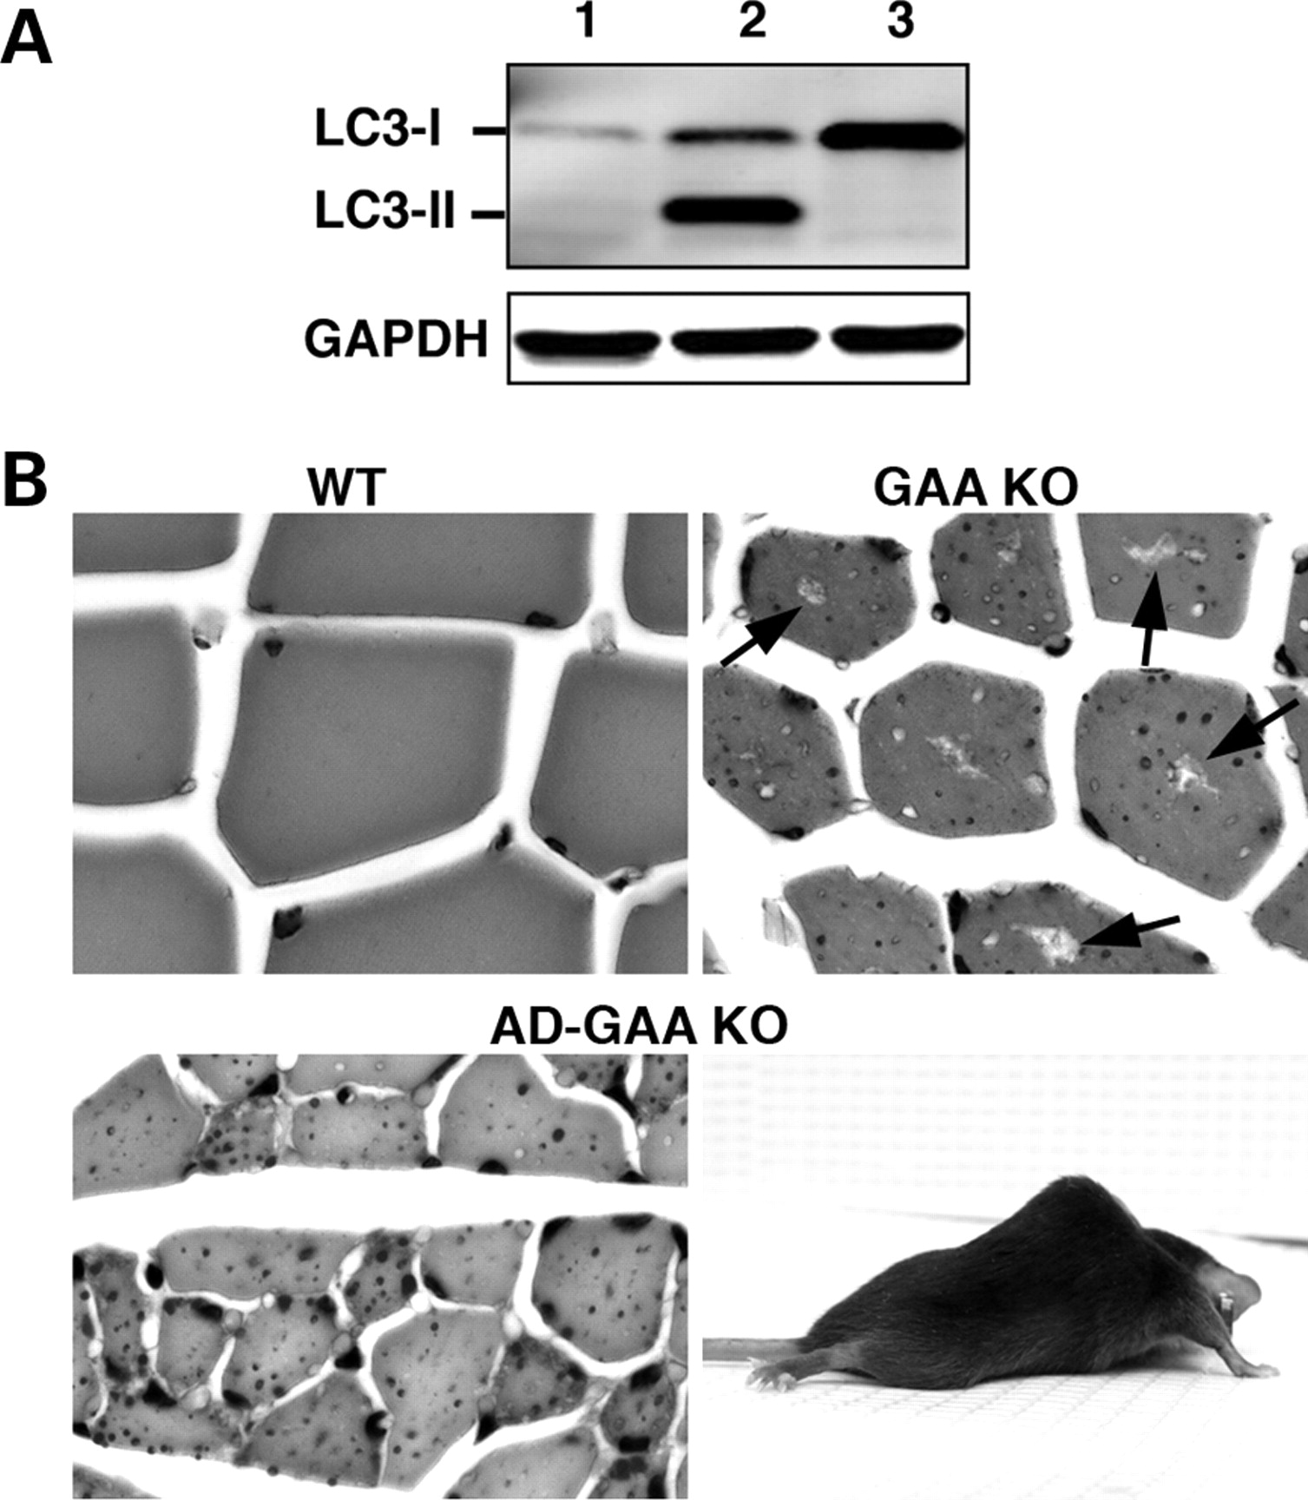
Figure 1. Generation and characterization of muscle-specific AD-GAA KO mice. (A) Western blotting of protein lysates ...
Notes:
Figure 1. Generation and characterization of muscle-specific AD-GAA KO mice. (A) Western blotting of protein lysates from gastrocnemius muscle of 3-month-old mice with LC3 antibody. Lane 1: WT; Lane 2: GAA KO; Lane 3: AD-GAA KO. The absence of LC3-II in AD-GAA KO indicates an efficient suppression of autophagy (dozens of mice were analyzed for the suppression of autophagy). (B) PAS-stained sections of gastrocnemius muscle from 5-month-old WT, GAA KO and AD-GAA KO; PAS-positive material (small dots) is seen in both GAA KO and AD-GAA KO. Centrally located ‘holes’ found in the GAA KO, but not in the AD-GAA KO fibers represent areas of autophagic buildup (arrows). Magnification: 335×. A 4.5-month-old AD-GAA KO mouse shows profound muscle wasting.
Unless provided in the caption above, the following copyright applies to the content of this slide: Published by Oxford University Press 2008

Slide 2
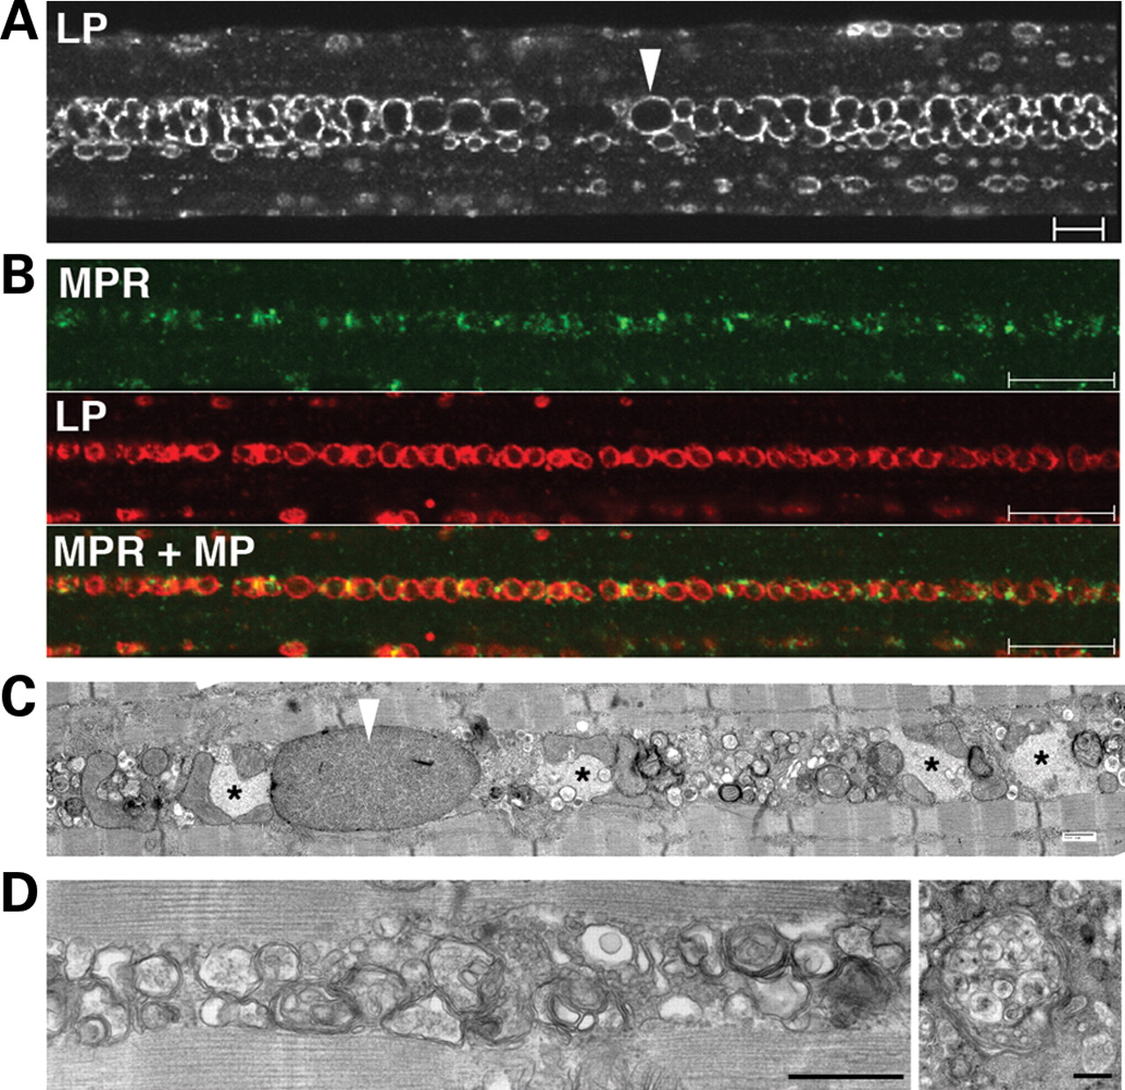
Figure 2. Buildup of late endocytic vesicles in fast (psoas) fibers from AD-GAA KO. (A) Single fiber stained for LAMP-1 ...
Notes:
Figure 2. Buildup of late endocytic vesicles in fast (psoas) fibers from AD-GAA KO. (A) Single fiber stained for LAMP-1 (LP). Arrowhead points to an enlarged lysosome. Bar: 10 µm. (B) Single fiber stained for CI-MPR (MPR) and LAMP-1. Bar: 10 µm. (C and D) Electron microscopy shows intermyofibrillar accumulations of enlarged glycogen-filled lysosomes (arrowhead), clusters of vesicles and inclusions (*). These inclusions likely represent polyubiquitinated protein aggregates (see text and Fig. 4). Some vesicles have the typical morphology of multi-vesicular bodies (right panel in D). Bars: 500 nm.
Unless provided in the caption above, the following copyright applies to the content of this slide: Published by Oxford University Press 2008

Slide 3
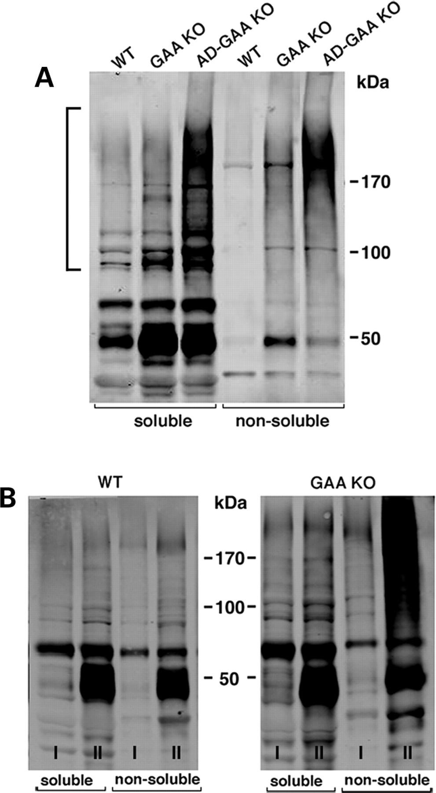
Figure 3. Accumulation of Ub-proteins in fast (gastrocnemius) muscle of GAA KO and AD-GAA KO. Muscle lysates, prepared ...
Notes:
Figure 3. Accumulation of Ub-proteins in fast (gastrocnemius) muscle of GAA KO and AD-GAA KO. Muscle lysates, prepared as detergent (Triton X-100)-soluble and -non-soluble fractions, were analyzed by immunoblotting with anti-ubiquitin (FK2) antibody. (A) Muscle samples were taken from ∼4-month-old WT, GAA KO and AD-GAA KO mice. High molecular mass Ub-proteins are marked by a bracket. Data shown are representative of at least four independent experiments. (B) Age-dependent accumulation of soluble and non-soluble Ub-proteins in muscle from young (6-week-old; I) and old (10-month-old; II) GAA KO. For each time point and each genotype, three mice were used.
Unless provided in the caption above, the following copyright applies to the content of this slide: Published by Oxford University Press 2008

Slide 4
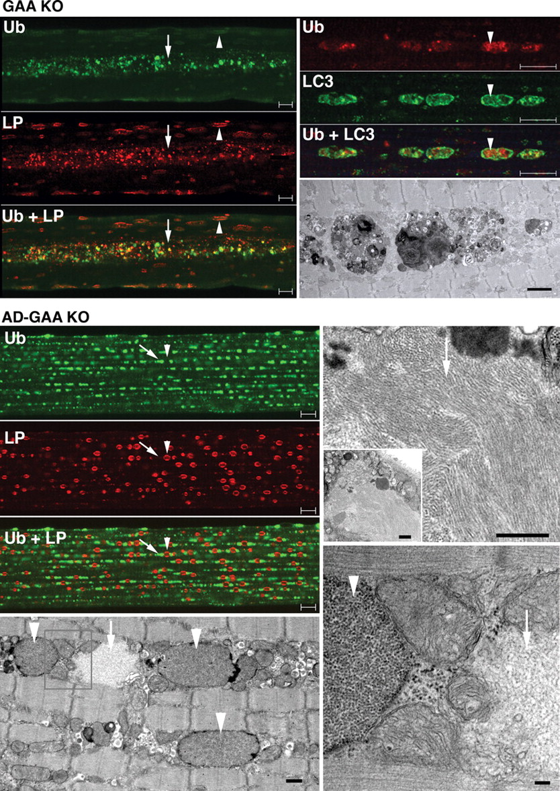
Figure 4. Distribution of Ub-proteins in fast (psoas) muscle of GAA KO and AD-GAA KO. Left top panel: GAA KO; single ...
Notes:
Figure 4. Distribution of Ub-proteins in fast (psoas) muscle of GAA KO and AD-GAA KO. Left top panel: GAA KO; single fiber stained for ubiquitin (Ub) and LAMP-1 (LP) showing the confinement of Ub-positive structures to the area of autophagic buildup (arrow); in contrast, LAMP-1 staining is present throughout the fiber—in the autophagic area and on the enlarged lysosomes (arrowhead). Bar: 10 µm. Right panel: single fiber stained for Ub and LC3 showing the presence of Ub-positive structures within LC3-positive autophagosomes. Bar: 10 µm. The EM panel shows autophagic buildup. Bar: 2 µm. Left panel: AD-GAA KO; single fiber stained for Ub and LAMP-1 showing Ub-positive structures (arrow) dispersed in a linear array throughout the fiber in a repeating pattern of inclusions flanking lysosomes (arrowhead). Bar: 10 µm. EM (left bottom panel) shows glycogen-filled lysosomes (arrowheads) and an electron-light, irregularly shaped structure (arrow), which likely represents a Ub-positive inclusion. Bar: 500 nm. At higher magnification (right EM panels) the filamentous inclusions (arrows) appear very different from the membrane-bound lysosomal glycogen (arrowhead). Bars: 500 nm (top); 100 nm (bottom).
Unless provided in the caption above, the following copyright applies to the content of this slide: Published by Oxford University Press 2008

Slide 5
Figure 5. Distribution of P62/SQSTM1 protein in fast (psoas) muscle of GAA KO and AD-GAA KO. Single fibers stained for ...
Notes:
Figure 5. Distribution of P62/SQSTM1 protein in fast (psoas) muscle of GAA KO and AD-GAA KO. Single fibers stained for P62 and for LAMP-1 (LP). P62 protein accumulates in the area of autophagic buildup in muscle from GAA KO. In AD-GAA KO P62-positive structures are dispersed throughout the fiber [this pattern was observed in profoundly atrophic fibers (∼50% of the total); the remaining fibers showed no staining for P62]. The recording parameters were optimized for each genotype. The WT P62 image was recorded at a higher gain than the other two images to ensure the absence of cytoplasmic staining. Bar: 10 µm.
Unless provided in the caption above, the following copyright applies to the content of this slide: Published by Oxford University Press 2008

Slide 6
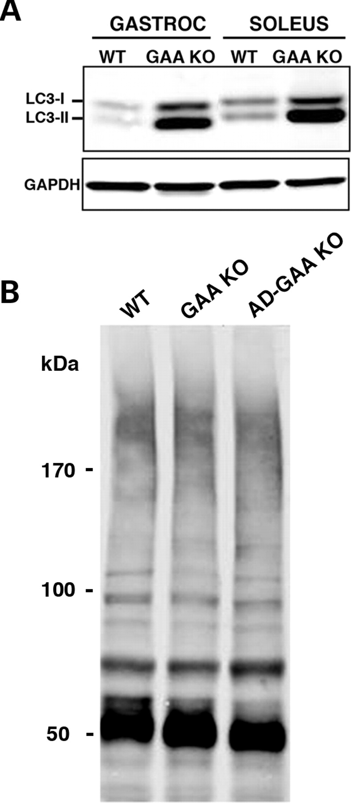
Figure 6. (A) Basal level of autophagy in gastrocnemius and soleus muscles from WT and GAA KO. Western blotting of ...
Notes:
Figure 6. (A) Basal level of autophagy in gastrocnemius and soleus muscles from WT and GAA KO. Western blotting of protein lysates with LC3 antibody shows a dramatic increase in the levels of both LC3-I and LC3-II in GAA KO. At least five WT and five GAA KO animals were used for these experiments. (B) Western blotting of protein lysates from soleus (slow) muscle with FK2 antibody. No difference in the levels of Ub-proteins is observed among the three genotypes in 4-month-old mice. Data shown are representative of at least three independent experiments.
Unless provided in the caption above, the following copyright applies to the content of this slide: Published by Oxford University Press 2008

Slide 7
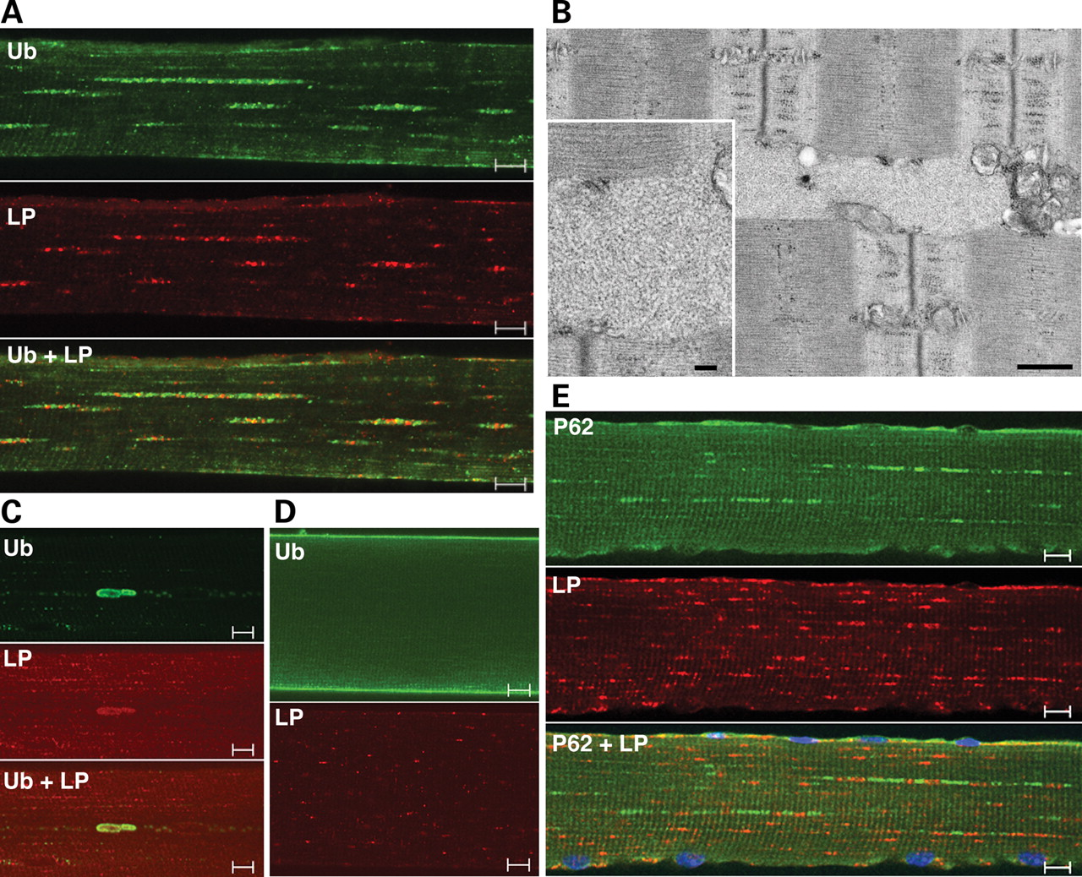
Figure 7. Accumulation of Ub-proteins and P62 in AD-WT gastrocnemius muscle. Single fibers stained for Ub and LAMP-1 ...
Notes:
Figure 7. Accumulation of Ub-proteins and P62 in AD-WT gastrocnemius muscle. Single fibers stained for Ub and LAMP-1 (LP) show a typical Ub pattern (A) and a rare pattern of large deposits (C) of ubiquitin-positive material. The overall level of Ub-positive staining is much lower than in the AD-GAA KO shown in Figure 4. The WT Ub image (D) was recorded at a higher gain than the AD-WT images (A and C) to ensure the absence of cytoplasmic staining. (B) EM shows a filamentous inclusion, which resembles those shown in Figure 4. Bars: 500 nm; 100 nm (inset). (E) Single fiber stained for P62 and LAMP-1 showing the similarity between P62 and Ub staining patterns. Bars: 10 µm.
Unless provided in the caption above, the following copyright applies to the content of this slide: Published by Oxford University Press 2008

Slide 8
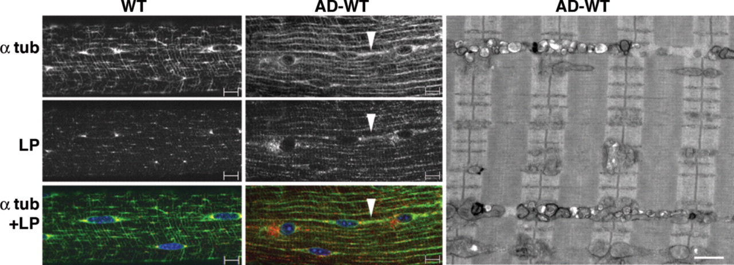
Figure 8. Altered distribution of microtubules and lysosomes in AD-WT muscle. Single fibers from fast WT and AD-WT ...
Notes:
Figure 8. Altered distribution of microtubules and lysosomes in AD-WT muscle. Single fibers from fast WT and AD-WT (gastrocnemius) muscle stained for alpha-tubulin (α tub) and LAMP-1 (LP) showing the realignment of microtubules and lysosomes in AD-WT. Arrowhead points to a string of microtubules and lysosomes. Bar: 10 µm. EM of fast (psoas) muscle from AD-WT shows vesicular structures in the intermyofibrillar space. The vesicles likely represent lysosomes. Bar: 1 µm.
Unless provided in the caption above, the following copyright applies to the content of this slide: Published by Oxford University Press 2008

