Slide 1
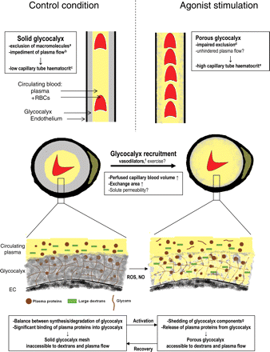
Figure 1 Cartoons illustrating the concept of agonist-stimulated glycocalyx modulation as means of increasing ...
Notes:
Figure 1 Cartoons illustrating the concept of agonist-stimulated glycocalyx modulation as means of increasing functionally perfused blood volume in the capillaries. Top and middle panels: longitudinal (top) and cross (middle) sections of two capillaries depicting proposed relations between glycocalyx exclusion of flowing RBCs/plasma (yellow) and capillary tube haematocrit/vascular volume available for perfusion, in control conditions (left), and during agonist stimulation (right). Under control conditions, a solid glycocalyx (grey), which excludes circulating blood and macromolecules (a: refs 10,23,24,33,60; b: refs 47,48) lines the endothelium (black), causing capillary tube haematocrit to be low (represented by the low number of RBCs in the left section; c: refs 16,17,19,23,26,33). During stimulation with vasoactive substances, the glycocalyx becomes accessible for large dextrans with a very limited effect on RBC accessibility (d: refs 33,60), and capillary tube haematocrit increases (e: refs 19,33). These data suggest that these agonists can ‘recruit’ capillary volume for perfusion by increasing accessibility of the glycocalyx for flowing plasma, but μ-PIV measurements are needed for definite proof. Vasodilators such as adenosine, bradykinin, and SNP (f: refs 33,60) have been indicated to induce recruitment of blood-excluding glycocalyx volume in capillaries. We propose that the induced increase in capillary surface area may enable solute exchange in the capillaries to be matched to an increase in solute delivery by blood flow due to relaxation of resistance vessels during vasodilator administration and perhaps exercise as well. The insets at the bottom give a simplified illustration of the proposed constitution of the glycocalyx under control conditions and during agonist stimulation. The scaffold of the glycocalyx is formed by a mesh of anionic polysaccharide structures (proteoglycans, glycosaminoglycans, and glycoproteins) produced by the EC. In addition, association of the glycans with plasma proteins from the circulating blood permits the glycocalyx to hinder accessibility of flowing plasma and large dextrans. Agonists may increase shedding of glycosaminoglycan components (g: refs 30,82) and of plasma proteins, possibly via nitric oxide (NO) and reactive oxygen species (ROS), resulting in an increased permeation of large dextrans and presumably allowing axial plasma flow through a larger cross-section of the vessel.
Unless provided in the caption above, the following copyright applies to the content of this slide: Published on behalf of the European Society of Cardiology. All rights reserved. © The Author 2010. For permissions please email: journals.permissions@oxfordjournals.org.

Slide 2
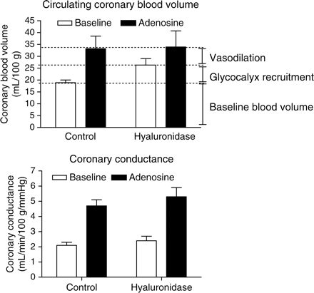
Figure 2 Data (mean ± SEM) adapted from Brands et al.³⁰ in anaesthetized goats, illustrating the ...
Notes:
Figure 2 Data (mean ± SEM) adapted from Brands et al.30 in anaesthetized goats, illustrating the contribution of glycocalyx recruitment to the increase in circulating coronary blood volume (top panel) and coronary conductance (bottom panel) during intracoronary adenosine infusion. Circulating coronary blood volume was measured using the tracer-dilution technique with fluorescently labelled 2000 kDa dextrans as a circulating plasma tracer and labelled RBCs as an RBC tracer.30 Coronary conductance was defined as the ratio of coronary arterial inflow and perfusion pressure. For more methodological details, the reader is referred to the original study by Brands et al.30 Under control conditions, circulating coronary blood volume nearly doubled during adenosine infusion. After intracoronary hyaluronidase infusion, blood volume increased during baseline and was not changed during adenosine, resulting in a reduction in the adenosine-induced increase in circulating blood volume. Glycocalyx degradation did not affect coronary conductance at baseline nor during adenosine. Since it appeared that coronary conductance was increased primarily by resistance vessel relaxation (no effect of glycocalyx degradation) but that the circulating coronary blood volume increase depended on both dilation of the resistance vessels and recruitment of glycocalyx volume (increase in baseline volume without a change in adenosine-stimulated volume), the disparity between the coronary blood volume vs. flow response allows an estimation of the contribution of capillary glycocalyx volume recruitment to the total increase in circulating coronary blood volume during adenosine to be made. This is shown in the top panel: both recruitment of glycocalyx volume and vasodilation of resistance vessels appear to contribute for about 50% to the increase in circulating coronary blood volume by adenosine.
Unless provided in the caption above, the following copyright applies to the content of this slide: Published on behalf of the European Society of Cardiology. All rights reserved. © The Author 2010. For permissions please email: journals.permissions@oxfordjournals.org.

Slide 3
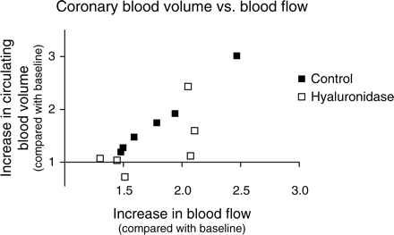
Figure 3 Adenosine-induced increases in circulating coronary blood volume (Y-axis) vs. coronary blood flow (X-axis) in ...
Notes:
Figure 3 Adenosine-induced increases in circulating coronary blood volume (Y-axis) vs. coronary blood flow (X-axis) in anaesthetized goat hearts during control conditions (closed symbols) and after intracoronary administration of hyaluronidase (open symbols). Each data point represents an individual experiment in the study of Brands et al.,30 of which average data are shown in Figure 2. Blood volumes and flows are normalized to their corresponding baseline values. In control hearts, the increase in blood flow corresponds with an increase in blood volume (R2 = 0.99). After hyaluronidase treatment of the glycocalyx, this match between flow and volume seems virtually absent.
Unless provided in the caption above, the following copyright applies to the content of this slide: Published on behalf of the European Society of Cardiology. All rights reserved. © The Author 2010. For permissions please email: journals.permissions@oxfordjournals.org.

