Slide 1
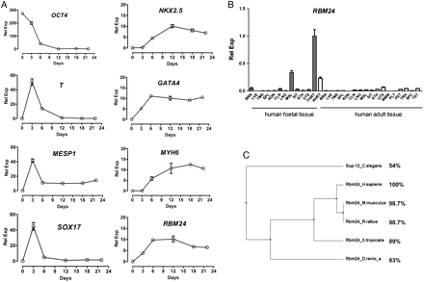
Figure 1 During hESC cardiomyogenic differentiation, expression of RBM24 correlates with that of cardiac markers. (A) ...
Notes:
Figure 1 During hESC cardiomyogenic differentiation, expression of RBM24 correlates with that of cardiac markers. (A) Temporal expression analysis of RBM24 and developmental markers following hESC cardiomyogenic differentiation by qRT–PCR. Samples for RNA extraction were collected after the formation of embryoid bodies overnight (day 0) and on days 3, 6, 12, 18, and 22. Note that the expression level of RBM24 is elevated at day 6 and sustained over the time course similar to cardiac markers. The level of gene expression is normalized to GAPDH. (B) qRT–PCR analysis of RBM24 expression in foetal and adult human tissues. The level of gene expression is normalized to GAPDH and presented relative to the foetal heart. Error bars = SEM, n= 3. (C) Multiple sequence alignment analysed by Cluster W and visualized by Jalview. BRN, brain; LVE, liver; TMS, thymus; SPL, spleen; KDN, kidney; CLN, colon; LNG, lung; MSL, skeletal muscle; SIT, small intestine; STH, stomach; UTS, uterus; FHRT, foetal heart; AHRT, adult heart; BMW, bone marrow; PLT, placenta; PST, prostate; TRH, trachea; SPC, spinal cord; TST, testis.
Unless provided in the caption above, the following copyright applies to the content of this slide: Published on behalf of the European Society of Cardiology. All rights reserved. © The Author 2012. For permissions please email: journals.permissions@oup.com

Slide 2
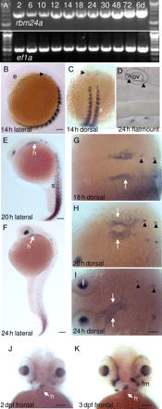
Figure 2 rbm24a expression in the zebrafish embryonic heart precursors precedes heart contraction. (A) rbm24a ...
Notes:
Figure 2 rbm24a expression in the zebrafish embryonic heart precursors precedes heart contraction. (A) rbm24a transcripts by RT–PCR in 2, 6, 10, 12, 14, 18, 24, 30, 48, 72 hpf, and 6 dpf embryos. As a loading control, elongation factor 1 alpha (ef1a) was used. (B, E, and F) Dynamic expression of rbm24a in the heart (white arrows) and somites at 14, 20, and 24 hpf (lateral view); (G–I) Dorsal view shows rbm24a+ myocardial progenitors migrating towards the midline (white arrows). Black arrowheads in (B–D) and (G–I) point to primordia of anterior and posterior crista (otic vesicle). (J and K) 2 dpf (J) and 3 dpf (K); white arrows in (J) and (K)—the heart. Scale bar = 50 µm. e, eye; fm, facial muscle; h, heart; l, lens; ov, otic vesicle; s, somite.
Unless provided in the caption above, the following copyright applies to the content of this slide: Published on behalf of the European Society of Cardiology. All rights reserved. © The Author 2012. For permissions please email: journals.permissions@oup.com

Slide 3
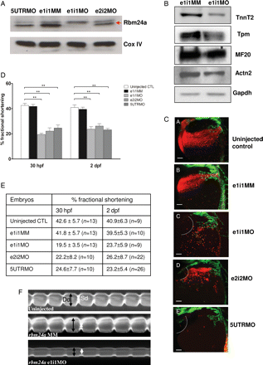
Figure 3 rbm24a morphants exhibit defects in blood circulation and compromised cardiac contractility. (A) Immunoblot ...
Notes:
Figure 3 rbm24a morphants exhibit defects in blood circulation and compromised cardiac contractility. (A) Immunoblot showing the reduction in Rbm24a in 2 dpf zebrafish morphants (e1i1MO, e2i2MO, and 5UTRMO) when compared with e1i1MM mismatch morphants. Red arrow, Rbm24a. COX-IV is a loading control. (B) Knockdown of Rbm24 reduces expression of sarcomeric proteins in Rbm24a morphants. Western blot was done using antibodies against Tnnt2, Tpm (tropomyosin), MF20 (meromyosin), Actn2 (α-actinin), and Gapdh (loading control). (C) Fluorescent images of control and rbm24a morphants in the background of Tg(fli1a:GFP):Tg(gata1:dsRed) double transgenic at 36 hpf. At 36 hpf, the rbm24a e1i1, e2i2, and 5UTR morphants developed the concave yolk depression (dotted line) unlike controls. The blood circulation in the control (streams of dsRed-labelled erythrocytes) was absent in the three rbm24a morphants. Scale bar = 100 µm. (D and E) FS analysis at 30 hpf and 2 dpf. Significant decrease in %FS is observed in rbm24a morphants (e1i1MO, e2i2MO, and 5UTRMO; **P < 0.05) as shown in graph (D) and values tabulated in a table (E). n, the number of embryos analysed. (F) Representative M-mode analysis of a 30 hpf uninjected control embryo, mismatched morphant, and rbm24a morphant. Black arrows, end-diastolic diameter (Dd); white rhomboids, end-systolic diameter (Sd).
Unless provided in the caption above, the following copyright applies to the content of this slide: Published on behalf of the European Society of Cardiology. All rights reserved. © The Author 2012. For permissions please email: journals.permissions@oup.com

Slide 4
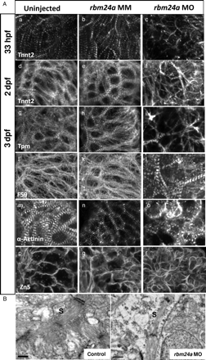
Figure 4 Rbm24a is required for sarcomere assembly. (A) When compared with the organized striation in the control ...
Notes:
Figure 4 Rbm24a is required for sarcomere assembly. (A) When compared with the organized striation in the control embryonic hearts (a, b, d, e, g, h, j, k, m, and n), cardiac sarcomere assembly is less distinct in the rbm24a morphants (c, f, i, l, and o) as revealed by reduced striation shown by immunohistochemistry with specific antibodies recognizing sarcomeric proteins Tnnt2 (a–f), Tpm (f–i), Myosin (labelled by anti-F59, j–l), and α-Actinin (m–o). In morphants, the cardiomyocytes are small (r) unlike those in controls (p and q) as seen by organization of the cell membrane revealed by Zn5 antibody staining. (B) Myocardial ultrastructure is disrupted in the Rbm24a morphants. Longitudinal sections of zebrafish heart at 2 dpf in control (left) and rbm24a morphant (right) are shown by TEM. S, sarcomere. Scale bar = 0.5 μm.
Unless provided in the caption above, the following copyright applies to the content of this slide: Published on behalf of the European Society of Cardiology. All rights reserved. © The Author 2012. For permissions please email: journals.permissions@oup.com

Slide 5
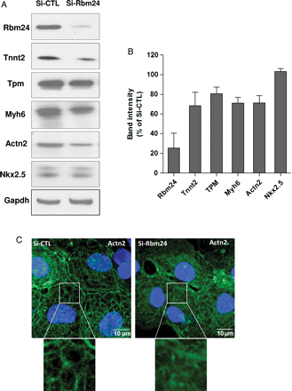
Figure 5 Effect of Rbm24 knockdown on cardiac protein expression and cytoskeleton in HL-1 cells. (A) Knockdown of ...
Notes:
Figure 5 Effect of Rbm24 knockdown on cardiac protein expression and cytoskeleton in HL-1 cells. (A) Knockdown of Rbm24 reduces expression of sarcomeric proteins. HL-1 cells transfected with siRNA-control (Si-CTL) or siRNA-Rbm24 (Si-Rbm24) oligonucleotides 72 h after transfection. Western blot was done using antibodies against Rbm24, Tnnt2, Tpm (tropomyosin), Myh6, Actn2 (α-actinin), Nkx2.5, and Gapdh (loading control). (B) Band intensities were normalized to Gapdh and presented as a percentage of siRNA-control cells; data represent means ± SD, n= 3–5. (C) Immunofluorescence imaging of cytoskeleton in HL-1 cells transfected with siRNA-control or siRNA-Rbm24 oligonucleotides using anti-Actn2 antibody (green). Nuclei were stained with Hoechst 33342. The contractility of cells is reduced by Rbm24 knockdown (see Supplementary material online, Videos S5 and S6).
Unless provided in the caption above, the following copyright applies to the content of this slide: Published on behalf of the European Society of Cardiology. All rights reserved. © The Author 2012. For permissions please email: journals.permissions@oup.com

Slide 6
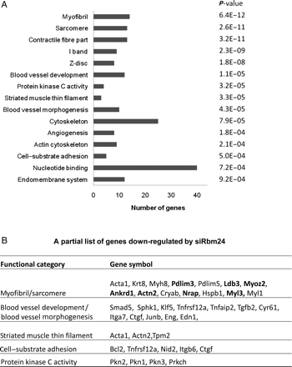
Figure 6 Microarray analysis. (A) Functional classification of the genes down-regulated after Rbm24 knockdown in HL-1 ...
Notes:
Figure 6 Microarray analysis. (A) Functional classification of the genes down-regulated after Rbm24 knockdown in HL-1 cardiomyoctes, the bar chart showing significantly (P < 0.001) overrepresented GO categories. (B) A representative list of genes in the functional categories. For a complete list of genes and GO categories, see Supplementary material online, Tables S2 and S4.
Unless provided in the caption above, the following copyright applies to the content of this slide: Published on behalf of the European Society of Cardiology. All rights reserved. © The Author 2012. For permissions please email: journals.permissions@oup.com

