Slide 1
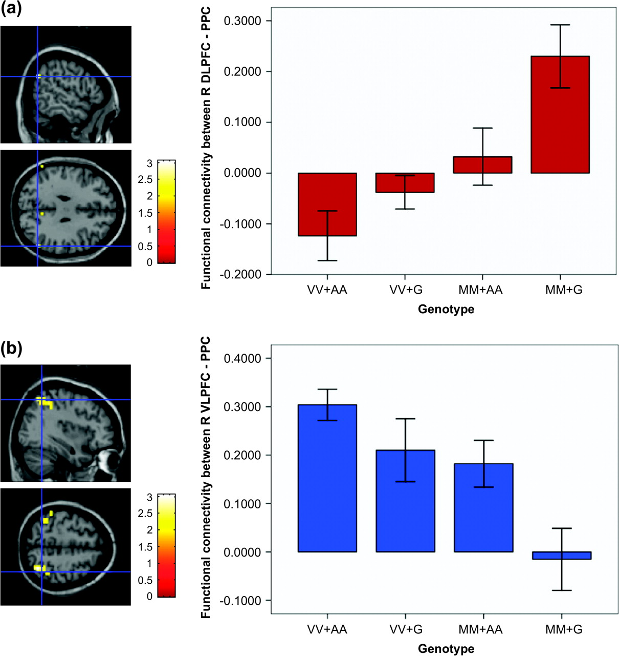
Figure 3. (a) Regions in the bilateral posterior parietal cortex (PPC) where functional connectivity with the ...
Notes:
Figure 3. (a) Regions in the bilateral posterior parietal cortex (PPC) where functional connectivity with the dorsolateral prefrontal cortex (DLPFC) occurred in the conjunction contrast of COMT Met-homozygote > Val homozygote and GRM3 G-carrier > A-homozygote (P Met homozygote and GRM3 A-homozygote > G-carriers (P < 0.001 uncorrected). There was a reciprocal relationship whereby decreased DLPFC–PPC functional connectivity with relatively deleterious COMT Val (Egan, Goldberg, Kolachana, et al. 2001) and GRM A alleles (Egan et al. 2004) was associated with increased VLPFC–PPC functional connectivity and vice versa. (Adapted from Tan et al. 2007)
Unless provided in the caption above, the following copyright applies to the content of this slide: Published by Oxford University Press 2007.

Slide 2
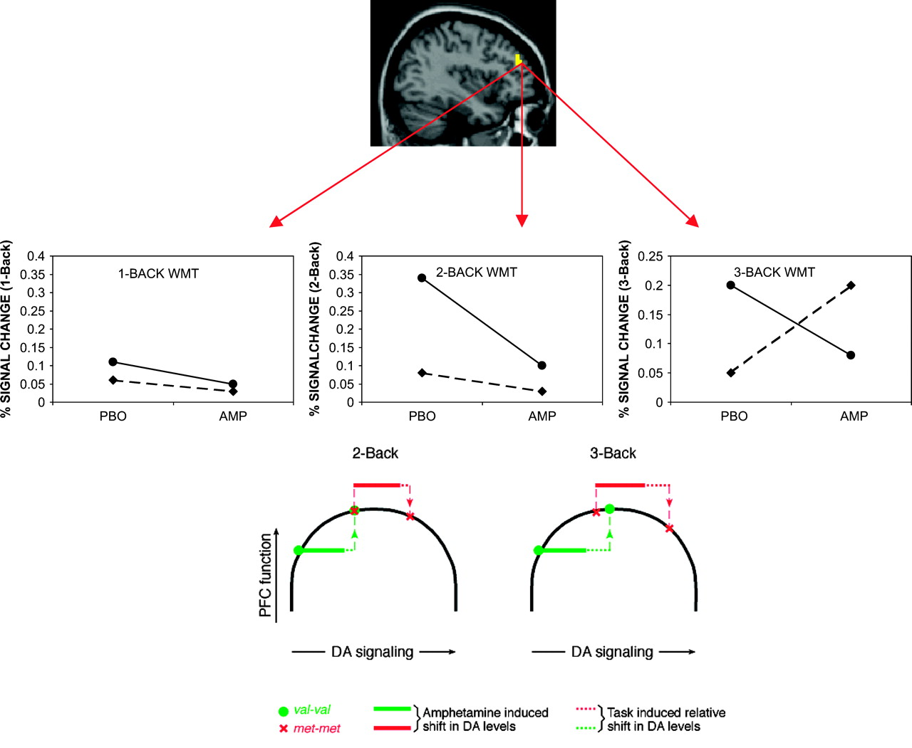
Figure 2. fMRI activation signal was extracted from the dorsal prefrontal cortex (top panel) in the presence of ...
Notes:
Figure 2. fMRI activation signal was extracted from the dorsal prefrontal cortex (top panel) in the presence of amphetamine (AMP) or placebo (PBO) administration at differing working memory task (WMT) loads as a function of COMT genotype (middle panel). In COMT Val-homozygote individuals (who have relatively lower cortical DA; solid lines, middle panel), AMP improved prefrontal cortical efficiency (lower activation). In contrast, individuals homozygous for the met allele (who have relatively greater cortical DA; dashed lines, middle panel), AMP had deleterious effects on PFC efficiency (greater activation) at 3-back WMT load (rightmost graph in middle panel). These results suggest that individuals homozygous for the COMT-val allele have PFC functional efficiency on the up slope of the normal range, whereby AMP could increase DA signaling to more optimal levels nearer the peak (bottom panel). On the other hand, individuals homozygous for the COMT-met allele appear already near peak PFC functional efficiency, and so increased DA signaling from AMP shifted PFC function onto the down slope of the inverted-U efficiency curve (bottom panel; adapted from Mattay et al. 2003).
Unless provided in the caption above, the following copyright applies to the content of this slide: Published by Oxford University Press 2007.

Slide 3
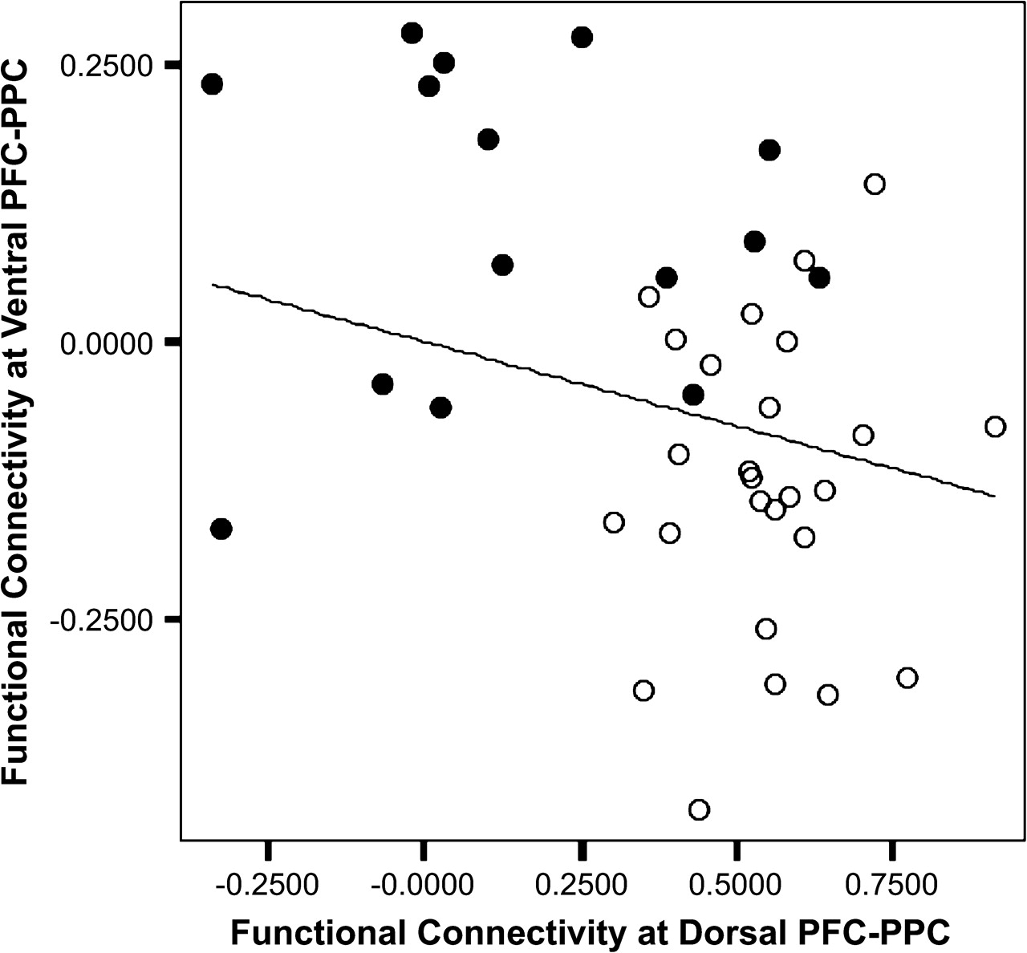
Figure 1. Functional connectivity of the ventral prefrontal cortex (PFC)—posterior parietal cortex (PPC) plotted ...
Notes:
Figure 1. Functional connectivity of the ventral prefrontal cortex (PFC)—posterior parietal cortex (PPC) plotted against that of the dorsal PFC–PPC for all subjects. Functional connectivity of the left ventral PFC and right dorsal PFC regions of interest with the respective PPC regions had an inverse relationship (P < 0.01). Lower connectivity at the dorsal PFC–PPC predicted higher compensatory connectivity at the ventral PFC–PPC. Patients are represented by filled circles (n = 15) and normal controls by open circles (n = 26). (Adapted from Tan et al. 2006.)
Unless provided in the caption above, the following copyright applies to the content of this slide: Published by Oxford University Press 2007.

