Slide 1
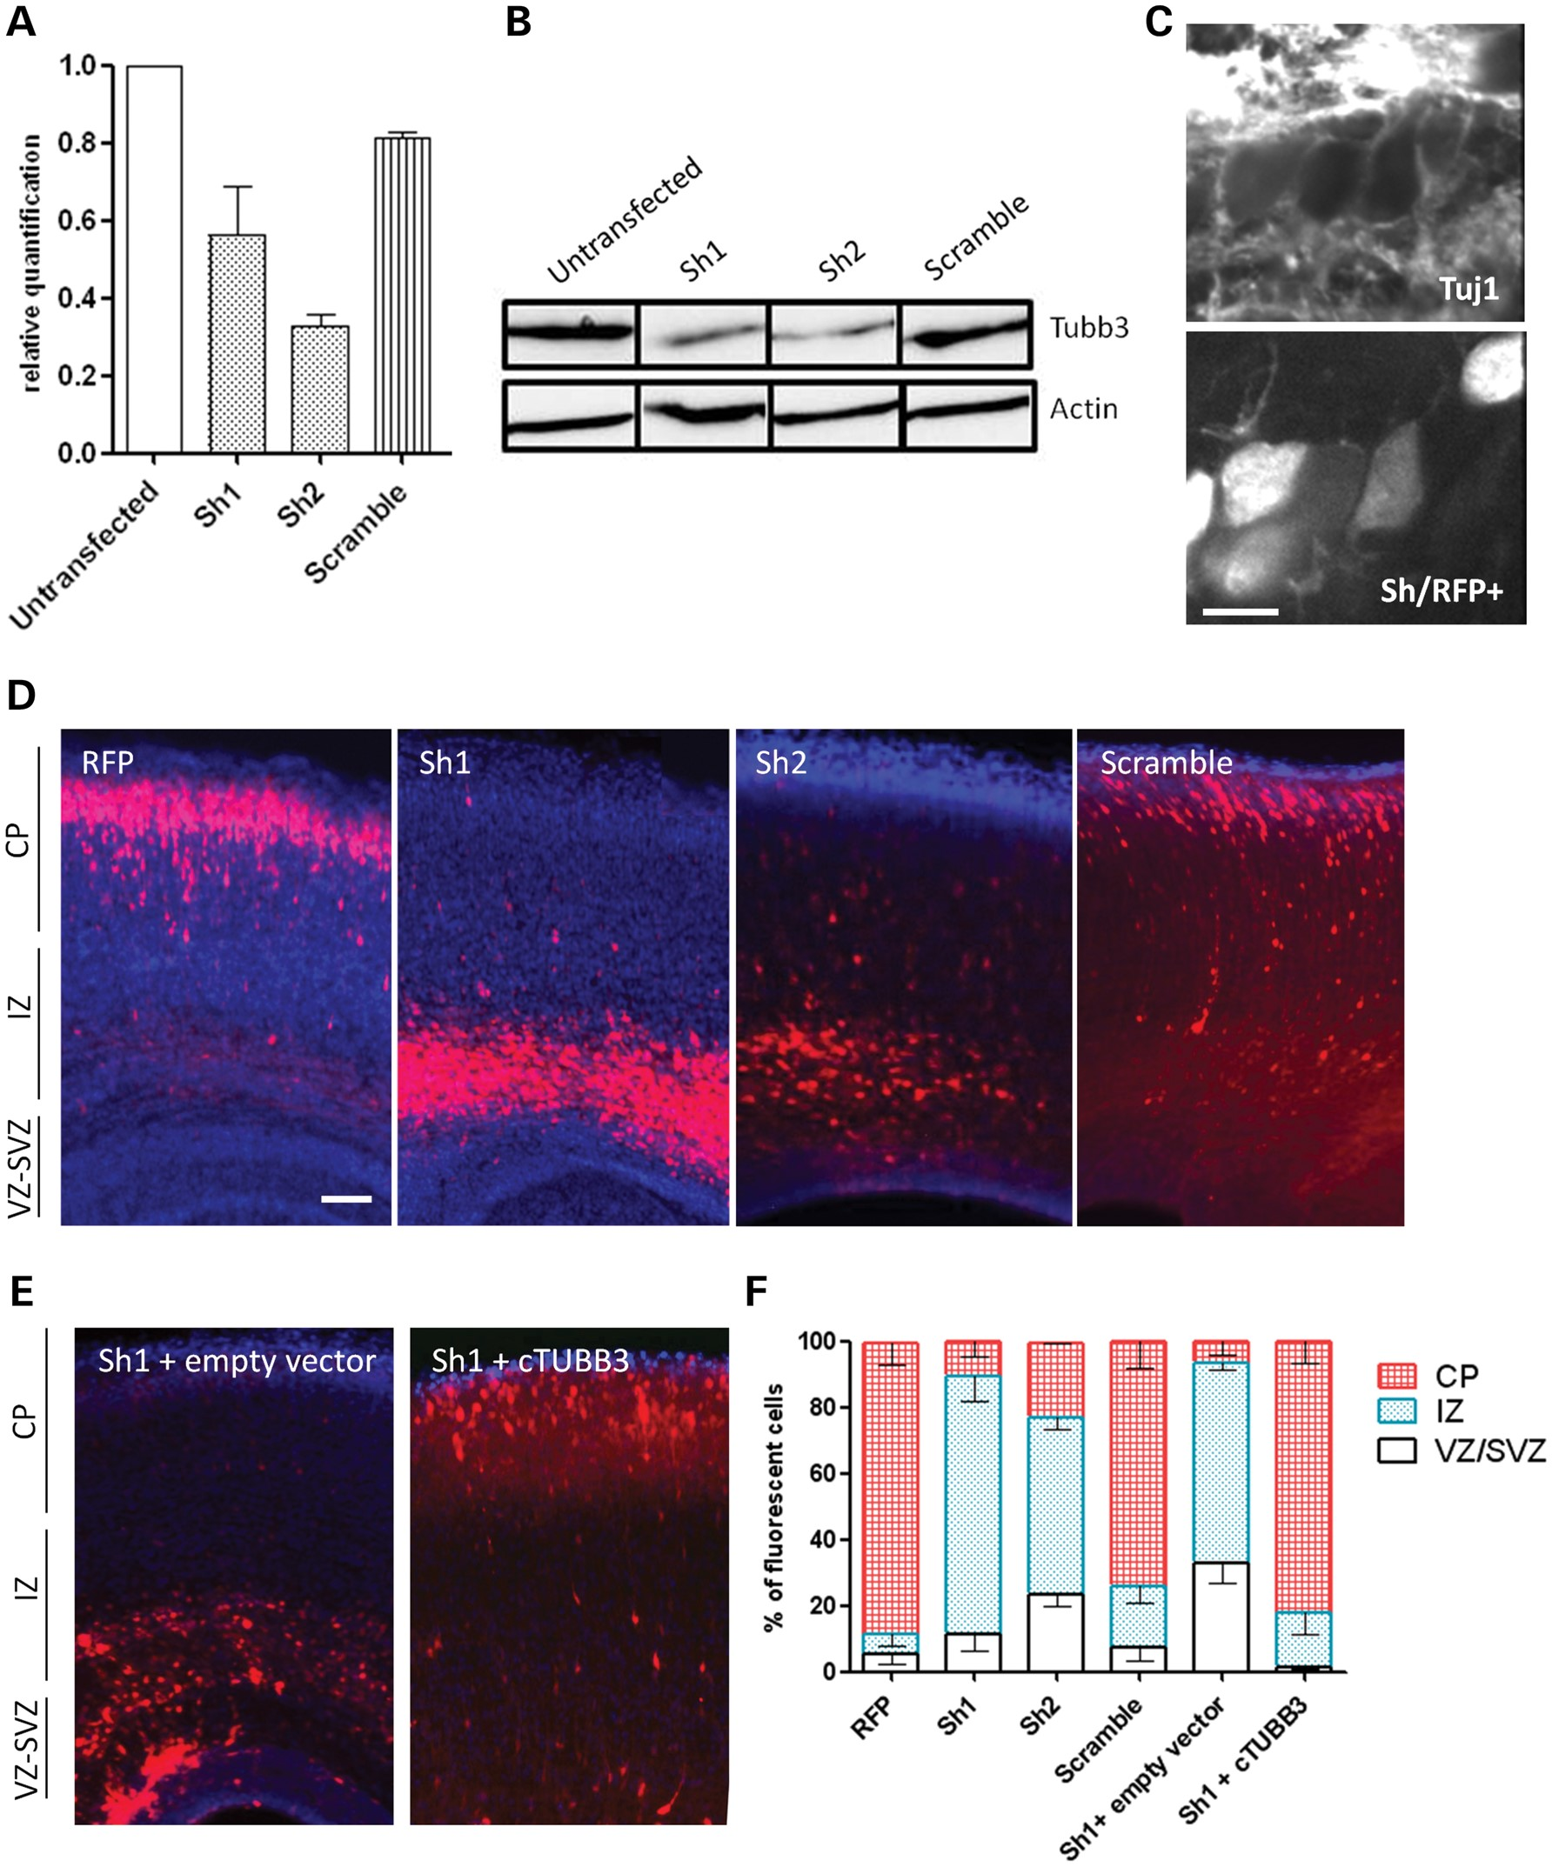
Figure 1. Effect of the knockdown of Tubb3 by shRNA. (A–C) Validations of efficiency of two sh-RNAs constructs ...
Notes:
Figure 1. Effect of the knockdown of Tubb3 by shRNA. (A–C) Validations of efficiency of two sh-RNAs constructs targeting Tubb3. Expression of these two shRNAs in P19 cells led to a decrease of the RNA transcript (sh1:−44%; sh2: −67%) (A) that was confirmed at the protein level by western blotting (B). We checked the efficiency of the shRNAs in vivo by immunelabeling the Tubb3 protein in brain sections using the Tuj1 antibody and confirmed the large reduction of Tubb3 expression in electroporated cells, scale bar 5 µm (C). (D, E) Examination of E18.5 coronal sections of mouse brain, electroporated at E14.5 with RFP alone, or sh1, sh2 and scrambled RNAs together with the RFP plasmid (D), or the sh1 together with an empty vector or the TUBB3 rescue construct (E). (F) Fluorescent neurons positioning was quantified in three different regions: VZ/SVZ, IZ and CP. Control cells reached the CP (RFP embryos n = 4, VZ: 5.6 ± 3.4%, IZ: 6 ± 3.3%, CP: 88.4 ± 6.7%; scramble n = 6, VZ: 8.86 ± 3.6%, IZ: 18.8 ± 5.1%, CP: 74.1 ± 8.3%), whereas shRNAs expressing cells were found in a large majority in the IZ (Sh1, n = 4, VZ: 11.5 ± 5.2%, IZ: 78.2 ± 7.8%, CP: 10.5 ± 4.5%; Sh2, n = 4, VZ: 23.3 ± 3.5%, IZ: 53.7 ± 3.5%, CP: 22.3 ± 0.2%) (sh1 versus scramble Mann–Whitney test P-value: VZ: 0.35; IZ**; CP**; sh2 versus scramble: VZ*; IZ***; CP***) (E). cTUBB3 overexpression leads to the rescue of the shRNA migration phenotype, electroporated neurons were found mainly present in the CP (n = 5, VZ: 1.4 ± 0.7%, IZ: 16.3 ± 6.3%, CP: 82.3 ± 6.8%) (sh versus sh+cTUBB3 P-value: VZ: 0.06; IZ*; CP*), scale bar 100 µm (D–E).
Unless provided in the caption above, the following copyright applies to the content of this slide: © The Author 2013. Published by Oxford University Press. All rights reserved. For Permissions, please email: journals.permissions@oup.com

Slide 2
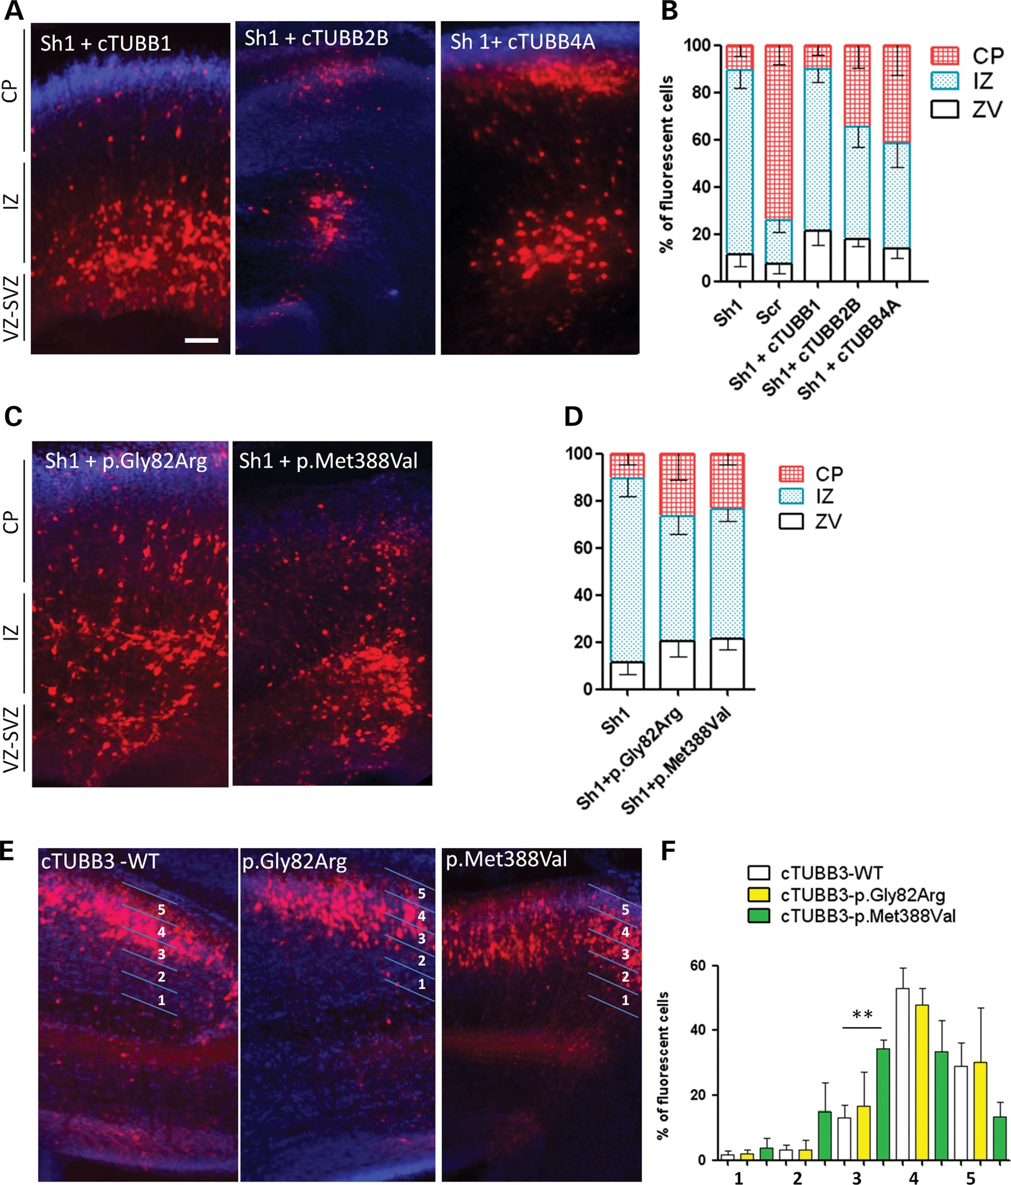
Figure 2. Rescue experiments using TUBB1, TUBB2B and TUBB4A and overexpression of TUBB3 mutants. Examination of E18.5 ...
Notes:
Figure 2. Rescue experiments using TUBB1, TUBB2B and TUBB4A and overexpression of TUBB3 mutants. Examination of E18.5 coronal sections of mouse brains electroporated at day E14.5. (A, B) Electroporation of Tubb3 shRNA in combination with the coding sequences of TUBB1, TUBB2B and TUBB4A (A). Fluorescent neuron positioning was quantified in three different regions: VZ/SVZ, IZ and CP (B). The sh1+TUBB1 condition showed a majority of cells in the IZ (embryos n = 5, VZ: 21.5 ± 6%, IZ: 68.2 ± 5.2%, CP: 10.3 ± 4.1%) (sh1 versus sh1+cTUBB1 P-value: VZ: 0.29; IZ: 0.41; CP: 0.73), the sh1+TUBB2B and sh1+TUBB4A conditions displayed two relatively equal populations in the IZ and CP (TUBB2B n = 8, VZ: 18 ± 3.1%, IZ: 47.1 ± 8.4%, CP: 34.9 ± 9.6%; TUBB4A n = 9, VZ: 13.8 ± 3.7%, IZ: 44.5 ± 9.7%, CP: 41.7 ± 12.5%) hence showing partial rescue (sh1 versus sh1+cTUBB2B P-value: VZ: 0.24; IZ*; CP: 0.07; sh1 versus sh1+cTUBB4A P-value: VZ: 0.60; IZ: 0.09; CP: 0.26). (C, D) Two MCD-related mutations (p.Gly82Arg and p.Met388Val) were co-electroporated with the sh construct, in both conditions, a majority of cells were found in the IZ (p.Gly82Arg n = 6, IZ: 53.2 ± 7.5%; p.Met388Val n = 12, IZ: 55 ± 5.1%) showing therefore partial rescue. (E, F) Overexpression of TUBB3 WT or p.Gly82Arg and p.Met388Val mutants alone (E). In the three conditions, electroporated neurons migrated to the CP. The CP was divided in five strata (1 = IZ-CP boundary, 5 = marginal zone) and showed a similar pattern for both WT (n = 4) and p.Gly82Arg (n = 3) conditions and a shift of the position of the neurons overexpressing the p.Met388Val (n = 4) mutation to lower layers (F). Error bar represents SEM, Mann–Whitney test, **P < 0.01. Scale bar 100 µm.
Unless provided in the caption above, the following copyright applies to the content of this slide: © The Author 2013. Published by Oxford University Press. All rights reserved. For Permissions, please email: journals.permissions@oup.com

Slide 3
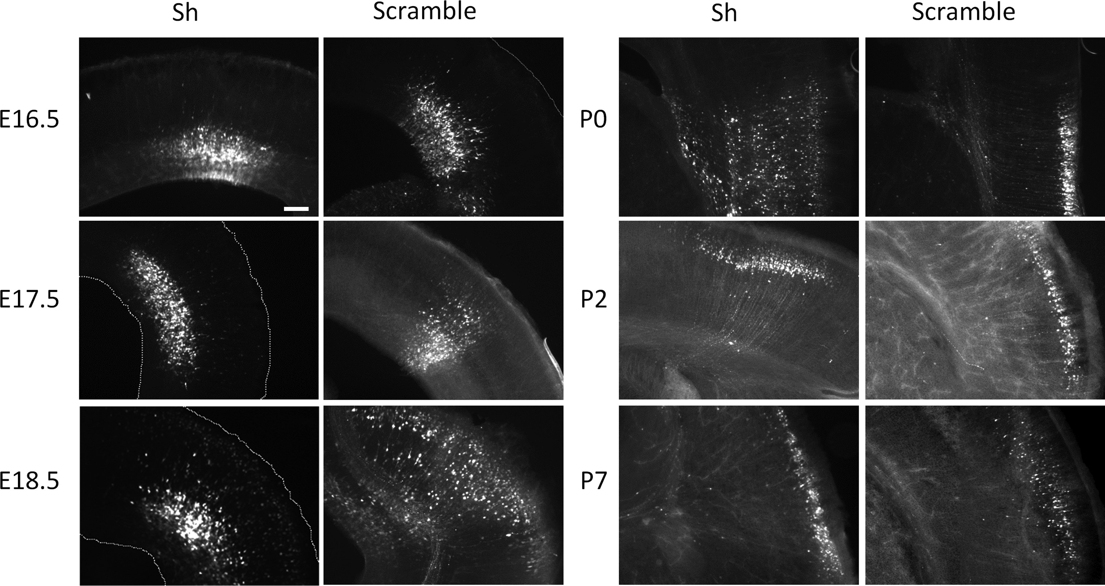
Figure 3. Effects of the Tubb3 shRNA at pre- and post-natal stages on the radial migration. Mouse brains were ...
Notes:
Figure 3. Effects of the Tubb3 shRNA at pre- and post-natal stages on the radial migration. Mouse brains were electroporated at E14.5 with the shRNA against-Tubb3 or control constructs and embryos or pups harvested at E16.5, E17.5, E18.5, P0, P2 and P7. At day E16.5, sh (embryos n = 6) and control (n = 3) cells were similarly present in the SVZ/lower IZ. While control electroporated cells started to reach the CP from E17.5 stage (n = 13), sh cells were still blocked in the SVZ/IZ (n = 7). A majority of control cells reached the CP at E18.5 (n = 4), whereas sh electroporated cells remained mostly in the SVZ/IZ (n = 4). Later, a significant proportion entered the CP at P0 (sh n = 4, scramble n = 6) and finally formed a compact layer in the upper CP at P2 (sh n = 4, scramble n = 3) and P7 (sh n = 5, scramble n = 4). Scale bar 100 µm.
Unless provided in the caption above, the following copyright applies to the content of this slide: © The Author 2013. Published by Oxford University Press. All rights reserved. For Permissions, please email: journals.permissions@oup.com

Slide 4
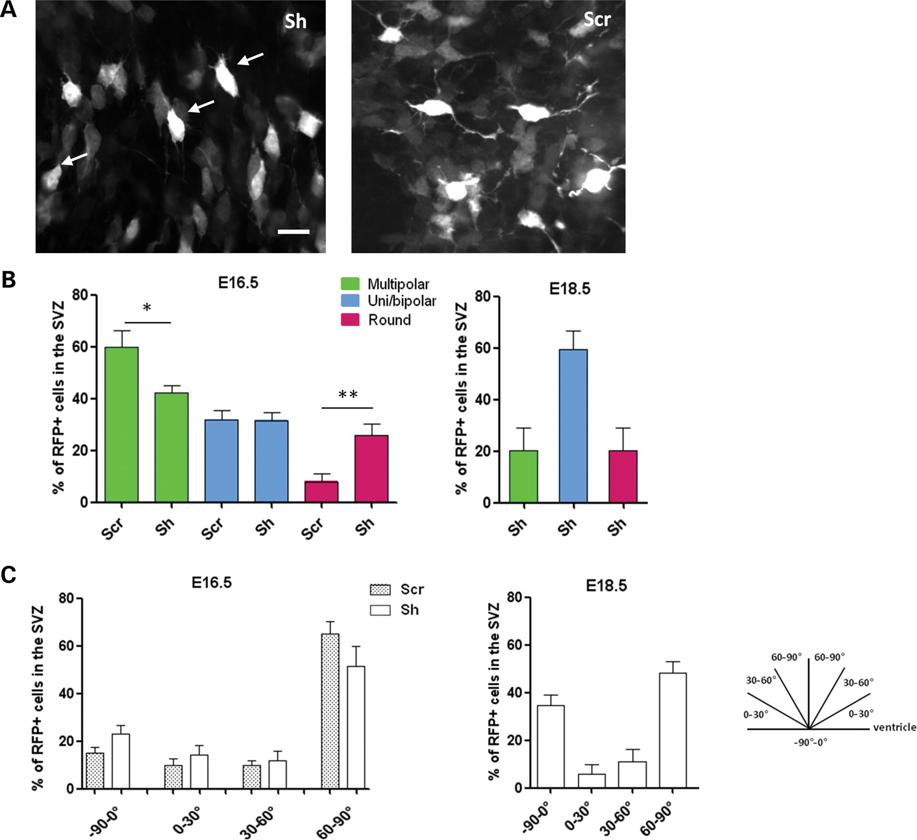
Figure 4. Characterization of cells blocked in the SVZ and lower IZ after Tubb3 inactivation. (A, B) Morphology of ...
Notes:
Figure 4. Characterization of cells blocked in the SVZ and lower IZ after Tubb3 inactivation. (A, B) Morphology of cells in the SVZ/lower IZ of E16.5 mouse brains electroporated 2 days earlier with sh anti-Tubb3 or control shRNA. These inactivated cells displayed a decrease of the multipolar morphology with multiple visible processes (scr: 60 ± 5.5%, sh: 42.4 ± 2.5%) and an increase of round-shaped cells with very short processes (white arrows) compared with the control (scr: 8.1 ± 2.6%, sh: 26 ± 3.8%) with an equal amount of uni/bipolar cells (scr: 31.9 ± 3.6%, sh: 31.6 ± 3.1%) (n: scr = 305, sh = 156). Scale bar 10 µm. Two days later, at day E18.5, 20.4 ± 8.6% of blocked cells in the sh condition were multipolar and 20.3 ± 9% remained round with short processes, whereas 59.3 ± 7.3% were uni- or bipolar (n = 87). (C) Orientation study of bipolar cells in the VZ. shRNA and scramble conditions showed a similar repartition at E16.5 with a majority of cells oriented radially (scr: 65.1 ± 5%, sh: 51.4 ± 8.4%) and ∼20% of them migrating toward the ventricle (scr: 15.2 ± 4.9%, sh: 22.9 ± 3.6%) (n: scr = 262, sh = 206). At E18.5, while control cells have already reached the CP, Sh electroporated cells elongating a main process were for half of them radially oriented (48.3 ± 4.8%), 5.8% of them elongated a process tangentially and 35 ± 4.5% migrated toward the ventricle (n: sh = 40). Error bar represents SEM, χ2-test, *P < 0.05, **P < 0.01.
Unless provided in the caption above, the following copyright applies to the content of this slide: © The Author 2013. Published by Oxford University Press. All rights reserved. For Permissions, please email: journals.permissions@oup.com

Slide 5
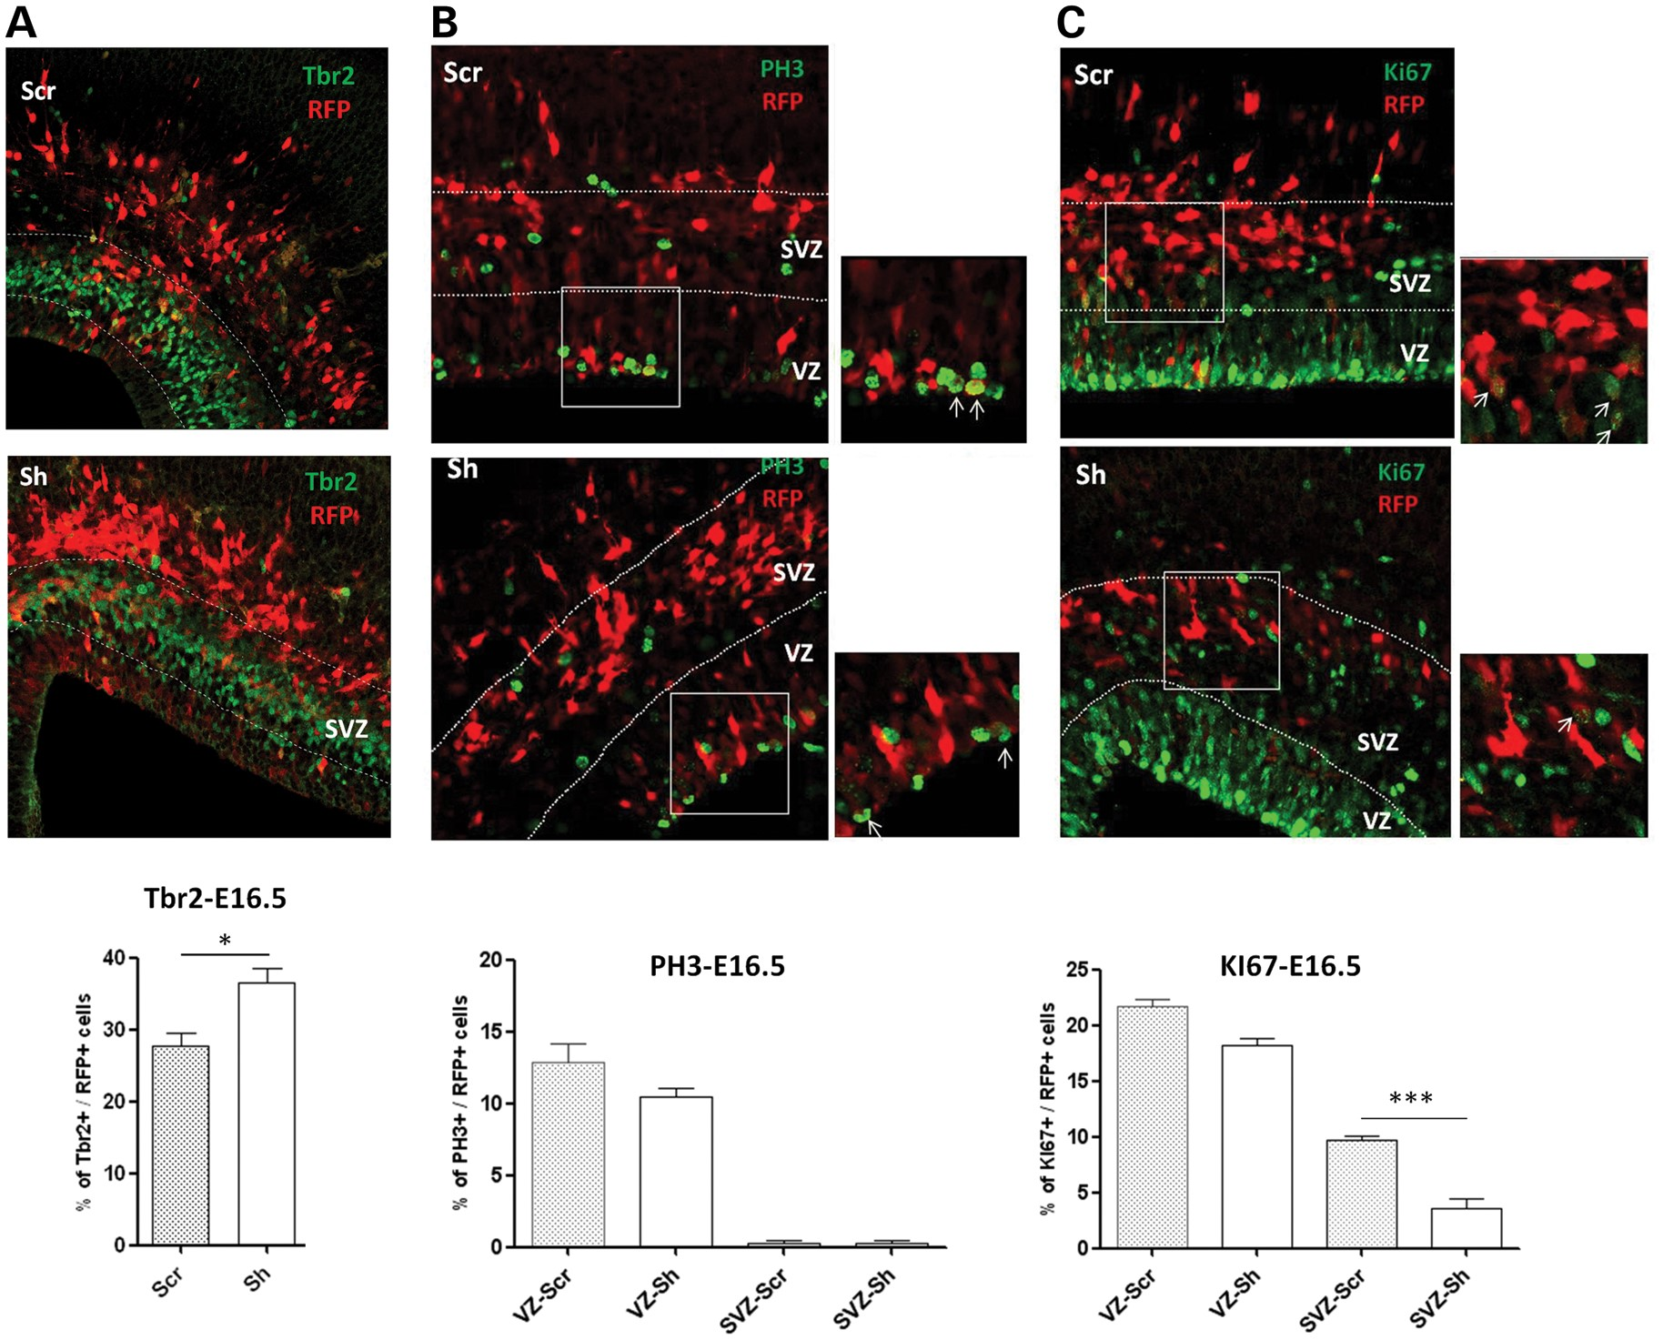
Figure 5. Consequences of Tubb3 inactivation on IPs. (A) Quantification of Tbr2+/RFP+ cells in the SVZ of brains ...
Notes:
Figure 5. Consequences of Tubb3 inactivation on IPs. (A) Quantification of Tbr2+/RFP+ cells in the SVZ of brains electroporated at E14.5 and examined at E16.5 after immunolabeling showed an increased number of Tbr2+ cells electroporated with the sh compared with the control (n: scr = 1813, sh = 688). (B, C) Immunolabelings with antibodies against PH3 (B) and KI67 (C) of scramble and shRNA electroporated brain sections and quantification of RFP+/PH3+ and RFP+/KI67+ in the VZ (nPH3: scr = 280, sh = 261; nKI67: scr = 343, sh = 366) and the SVZ (nPH3: scr = 561, sh = 565; nKI67: scr = 816, sh = 897). Error bar represents SEM, χ2-test, *P < 0.05, ***P < 0.001. Scale bar 25 µm.
Unless provided in the caption above, the following copyright applies to the content of this slide: © The Author 2013. Published by Oxford University Press. All rights reserved. For Permissions, please email: journals.permissions@oup.com

Slide 6
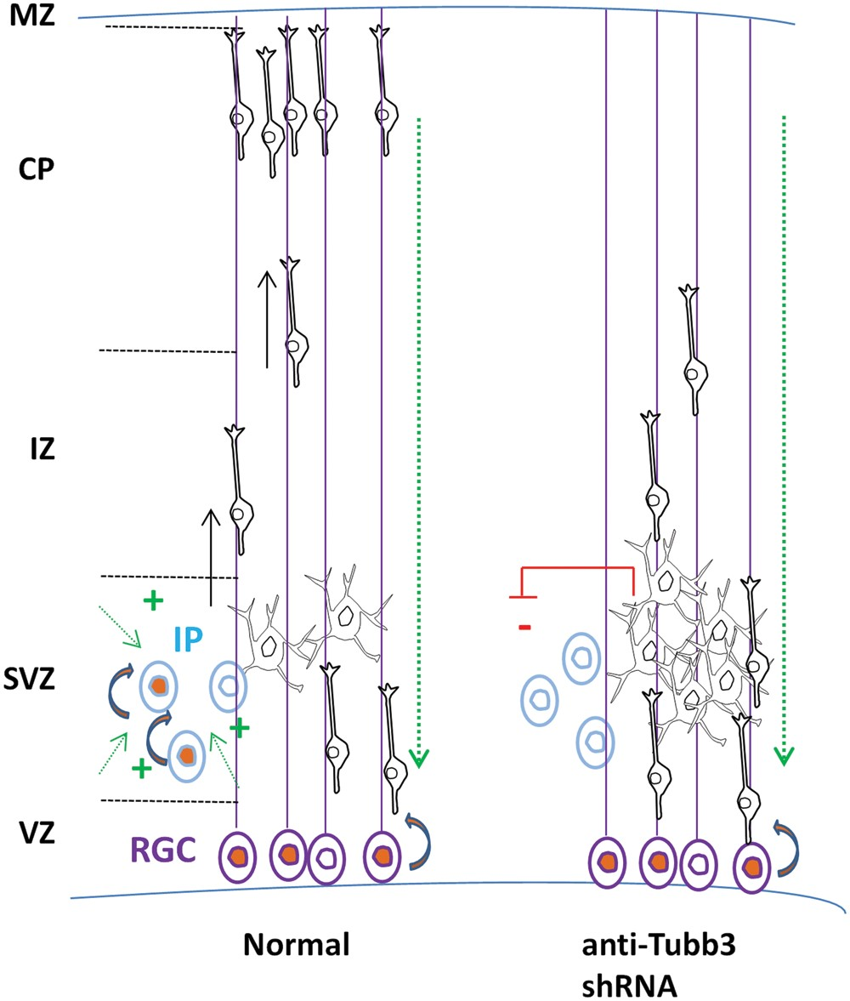
Figure 6. Schematic representation illustrating the hypothesis, proposed in the discussion, of cross talk between ...
Notes:
Figure 6. Schematic representation illustrating the hypothesis, proposed in the discussion, of cross talk between progenitors proliferation and neuronal positioning.
Unless provided in the caption above, the following copyright applies to the content of this slide: © The Author 2013. Published by Oxford University Press. All rights reserved. For Permissions, please email: journals.permissions@oup.com

