Slide 1
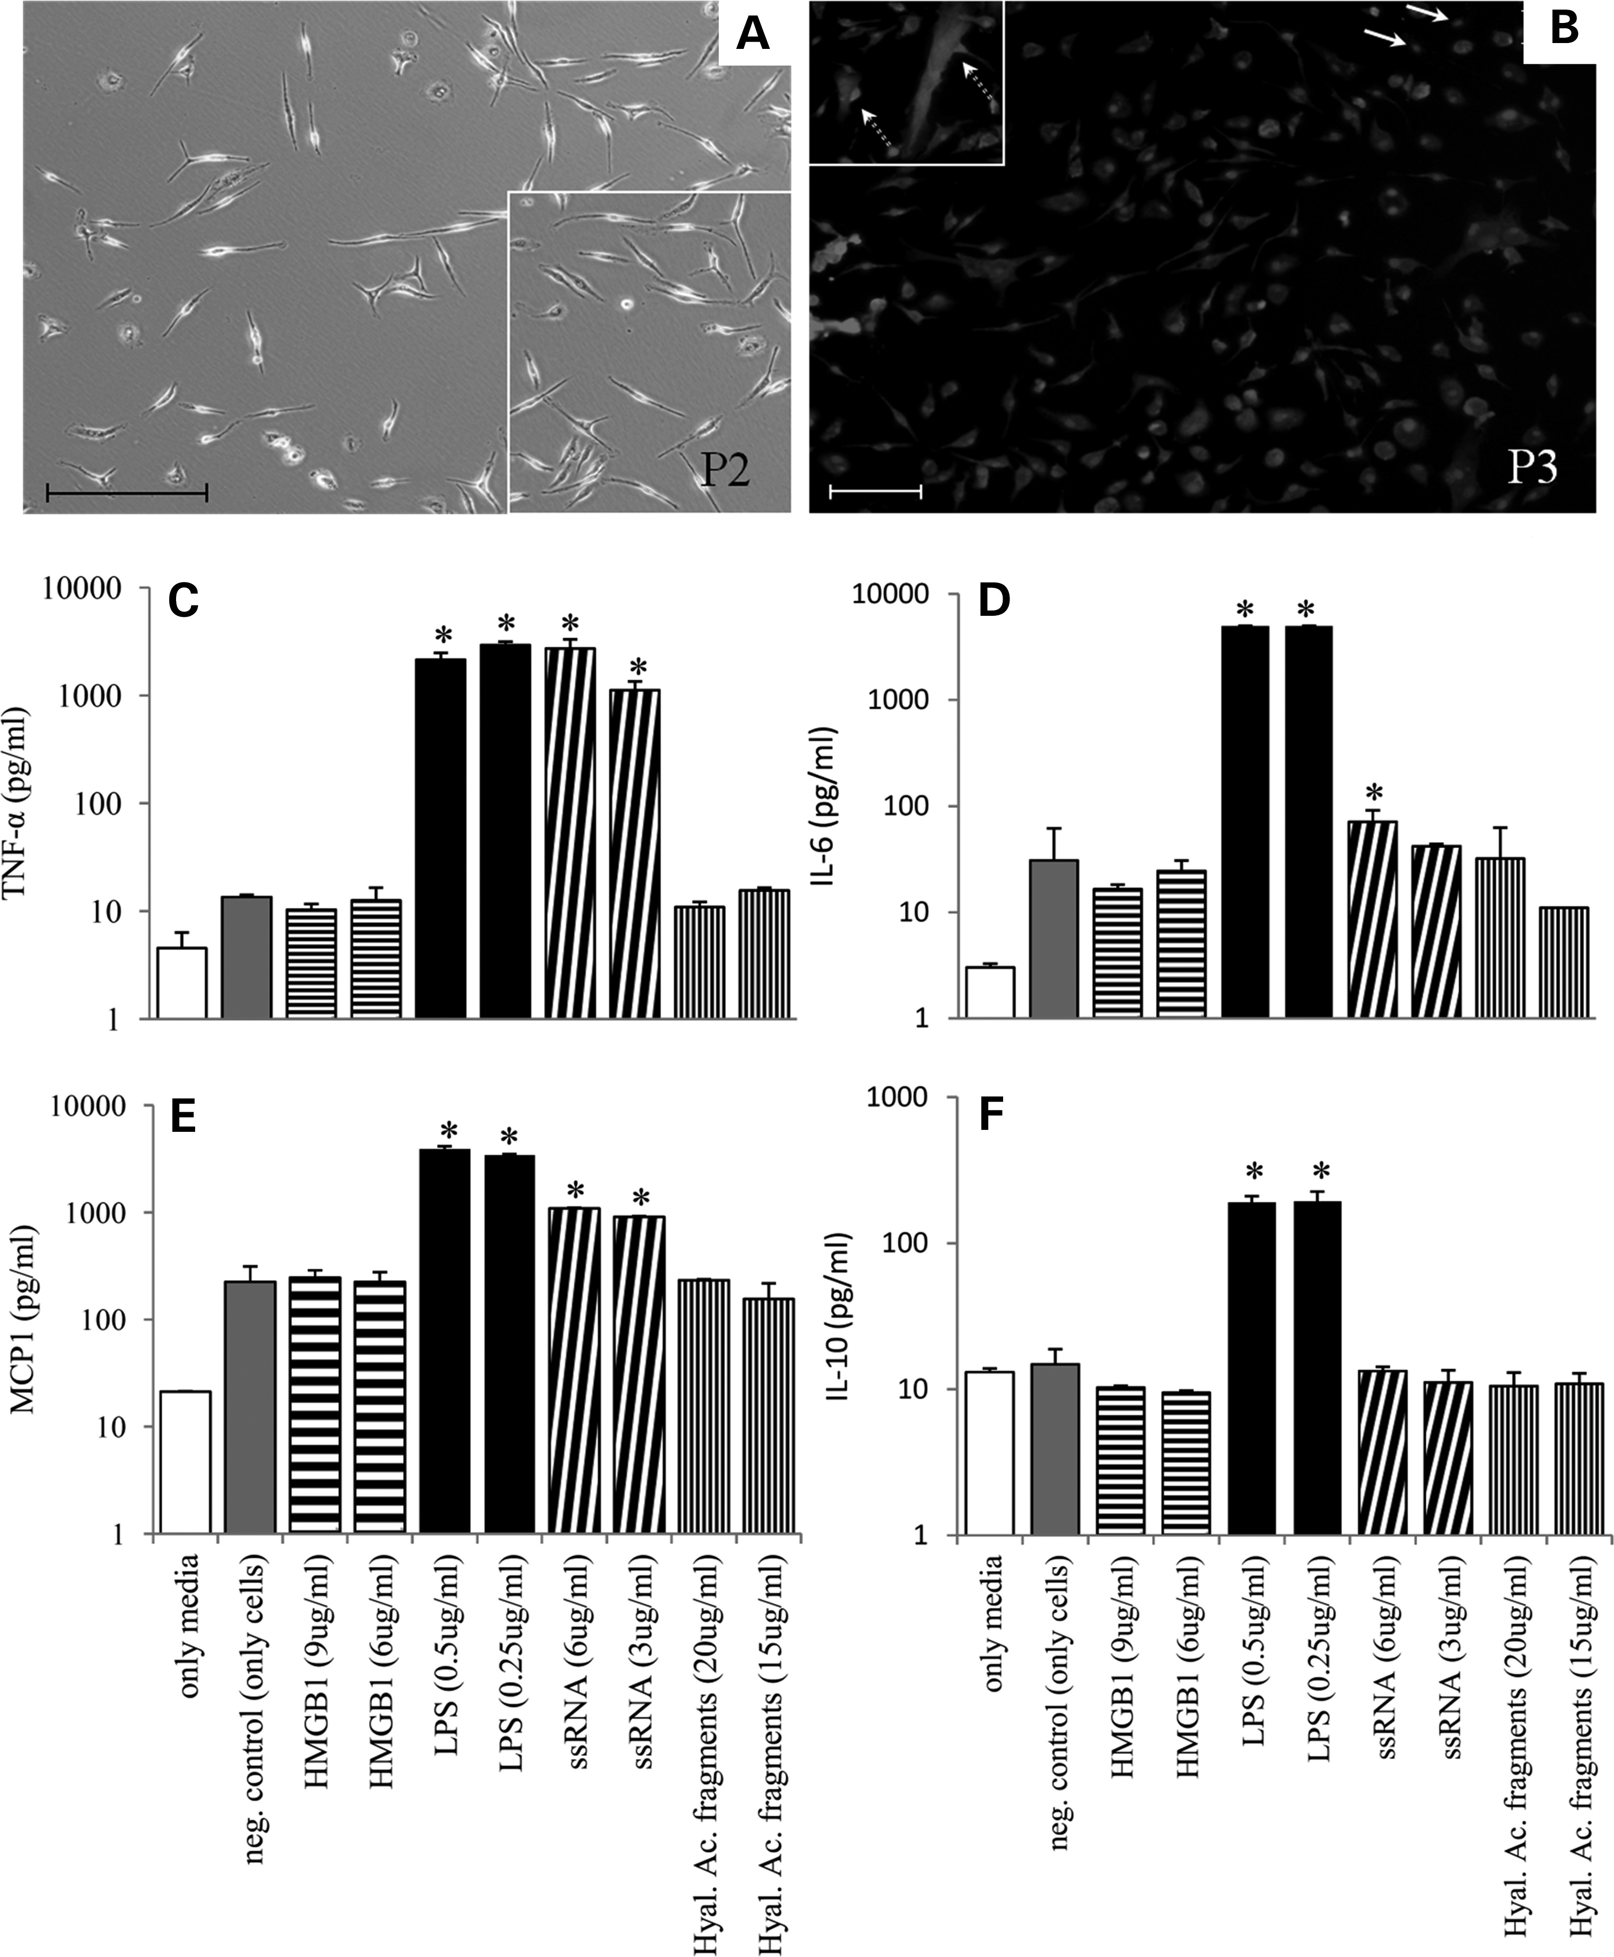
Figure 1. Myoblast cultures and stimulation by TLR agonists: myoblast cultures were obtained from diaphragm fragments ...
Notes:
Figure 1. Myoblast cultures and stimulation by TLR agonists: myoblast cultures were obtained from diaphragm fragments from 2-month-old mdx mice, here shown in the second passage (P2) (A), with at least 95% enrichment of desmin-positive muscle-committed cells in P3 (B). At this stage, the cells were exposed for 18 h to the indicated concentrations of HMGB1, lipopolysaccharide (LPS), ssRNA or hyaluronic acid fragments as TLR ligands. The levels of TNF-α (C), IL-6 (D), monocyte chemoattractant protein -1 (MCP1) (E) and IL-10 (F) were then evaluated by flow cytometry in culture supernatants using a commercial kit (CBA flex). Nuclear labeling was done using DAPI. *P ≤ 0.05 when compared with the negative control (cells only, with no agonist). Arrows indicate desmin-negative cells, and dashed arrows indicate myoblasts fusing. Bar = 50 µm. Three independent experiments were done, and a representative result is shown.
Unless provided in the caption above, the following copyright applies to the content of this slide: © The Author 2013. Published by Oxford University Press. All rights reserved. For Permissions, please email: journals.permissions@oup.com

Slide 2
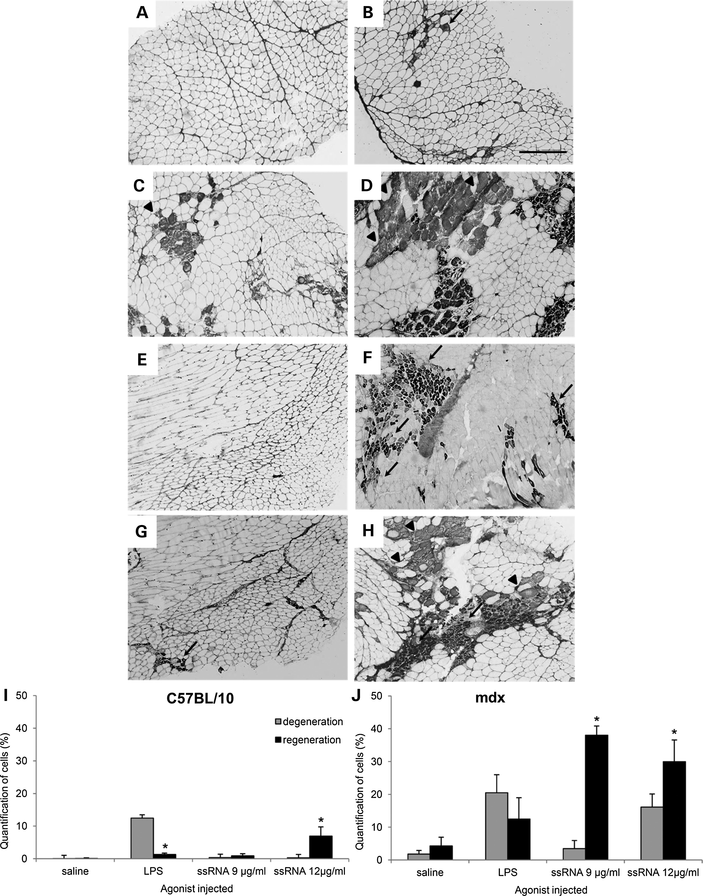
Figure 2. Muscle cell regeneration after in vivo intramuscular injection of TLR ligands: All C57BL/10 (left panels) and ...
Notes:
Figure 2. Muscle cell regeneration after in vivo intramuscular injection of TLR ligands: All C57BL/10 (left panels) and mdx (right panels) mice received injections of saline three times in the left quadriceps (four injections of 10 μl per muscle each time) at intervals of 3 days (A and B). The contralateral muscle received, in parallel, the same treatment of 2 µg/ml LPS (C and D), 9 µg/ml ssRNA (E and F) and 12 µg/ml ssRNA (G and H). Three days after the last injection, the mice were sacrificed, and all samples were collected and immunostained with anti-eMHC. Arrows indicate positive cells, and arrowheads indicate degenerating myofibers. Quantitation of regeneration and degeneration in mdx mice treated with TLR agonists was based on the labeling of anti-eMHC in C57BL/10 (I) or mdx (J) mice. We quantified the number of darkly positive cells (regeneration) and all cells per microscopic field in tissue slices and expressed the data as the percentage of positive cells. Lightly positive cells with blurred labeling and no distinguishable intracellular structures or sarcolemma were considered degenerating muscle fibers. Each group consisted of five mice, and the results shown are representative of two independent experiments (Bar = 200 μm). The quantitative analysis was done in at least 60 microscopic fields from three mice per group. *P ≤ 0.05 compared with the saline group in each mouse strain.
Unless provided in the caption above, the following copyright applies to the content of this slide: © The Author 2013. Published by Oxford University Press. All rights reserved. For Permissions, please email: journals.permissions@oup.com

Slide 3
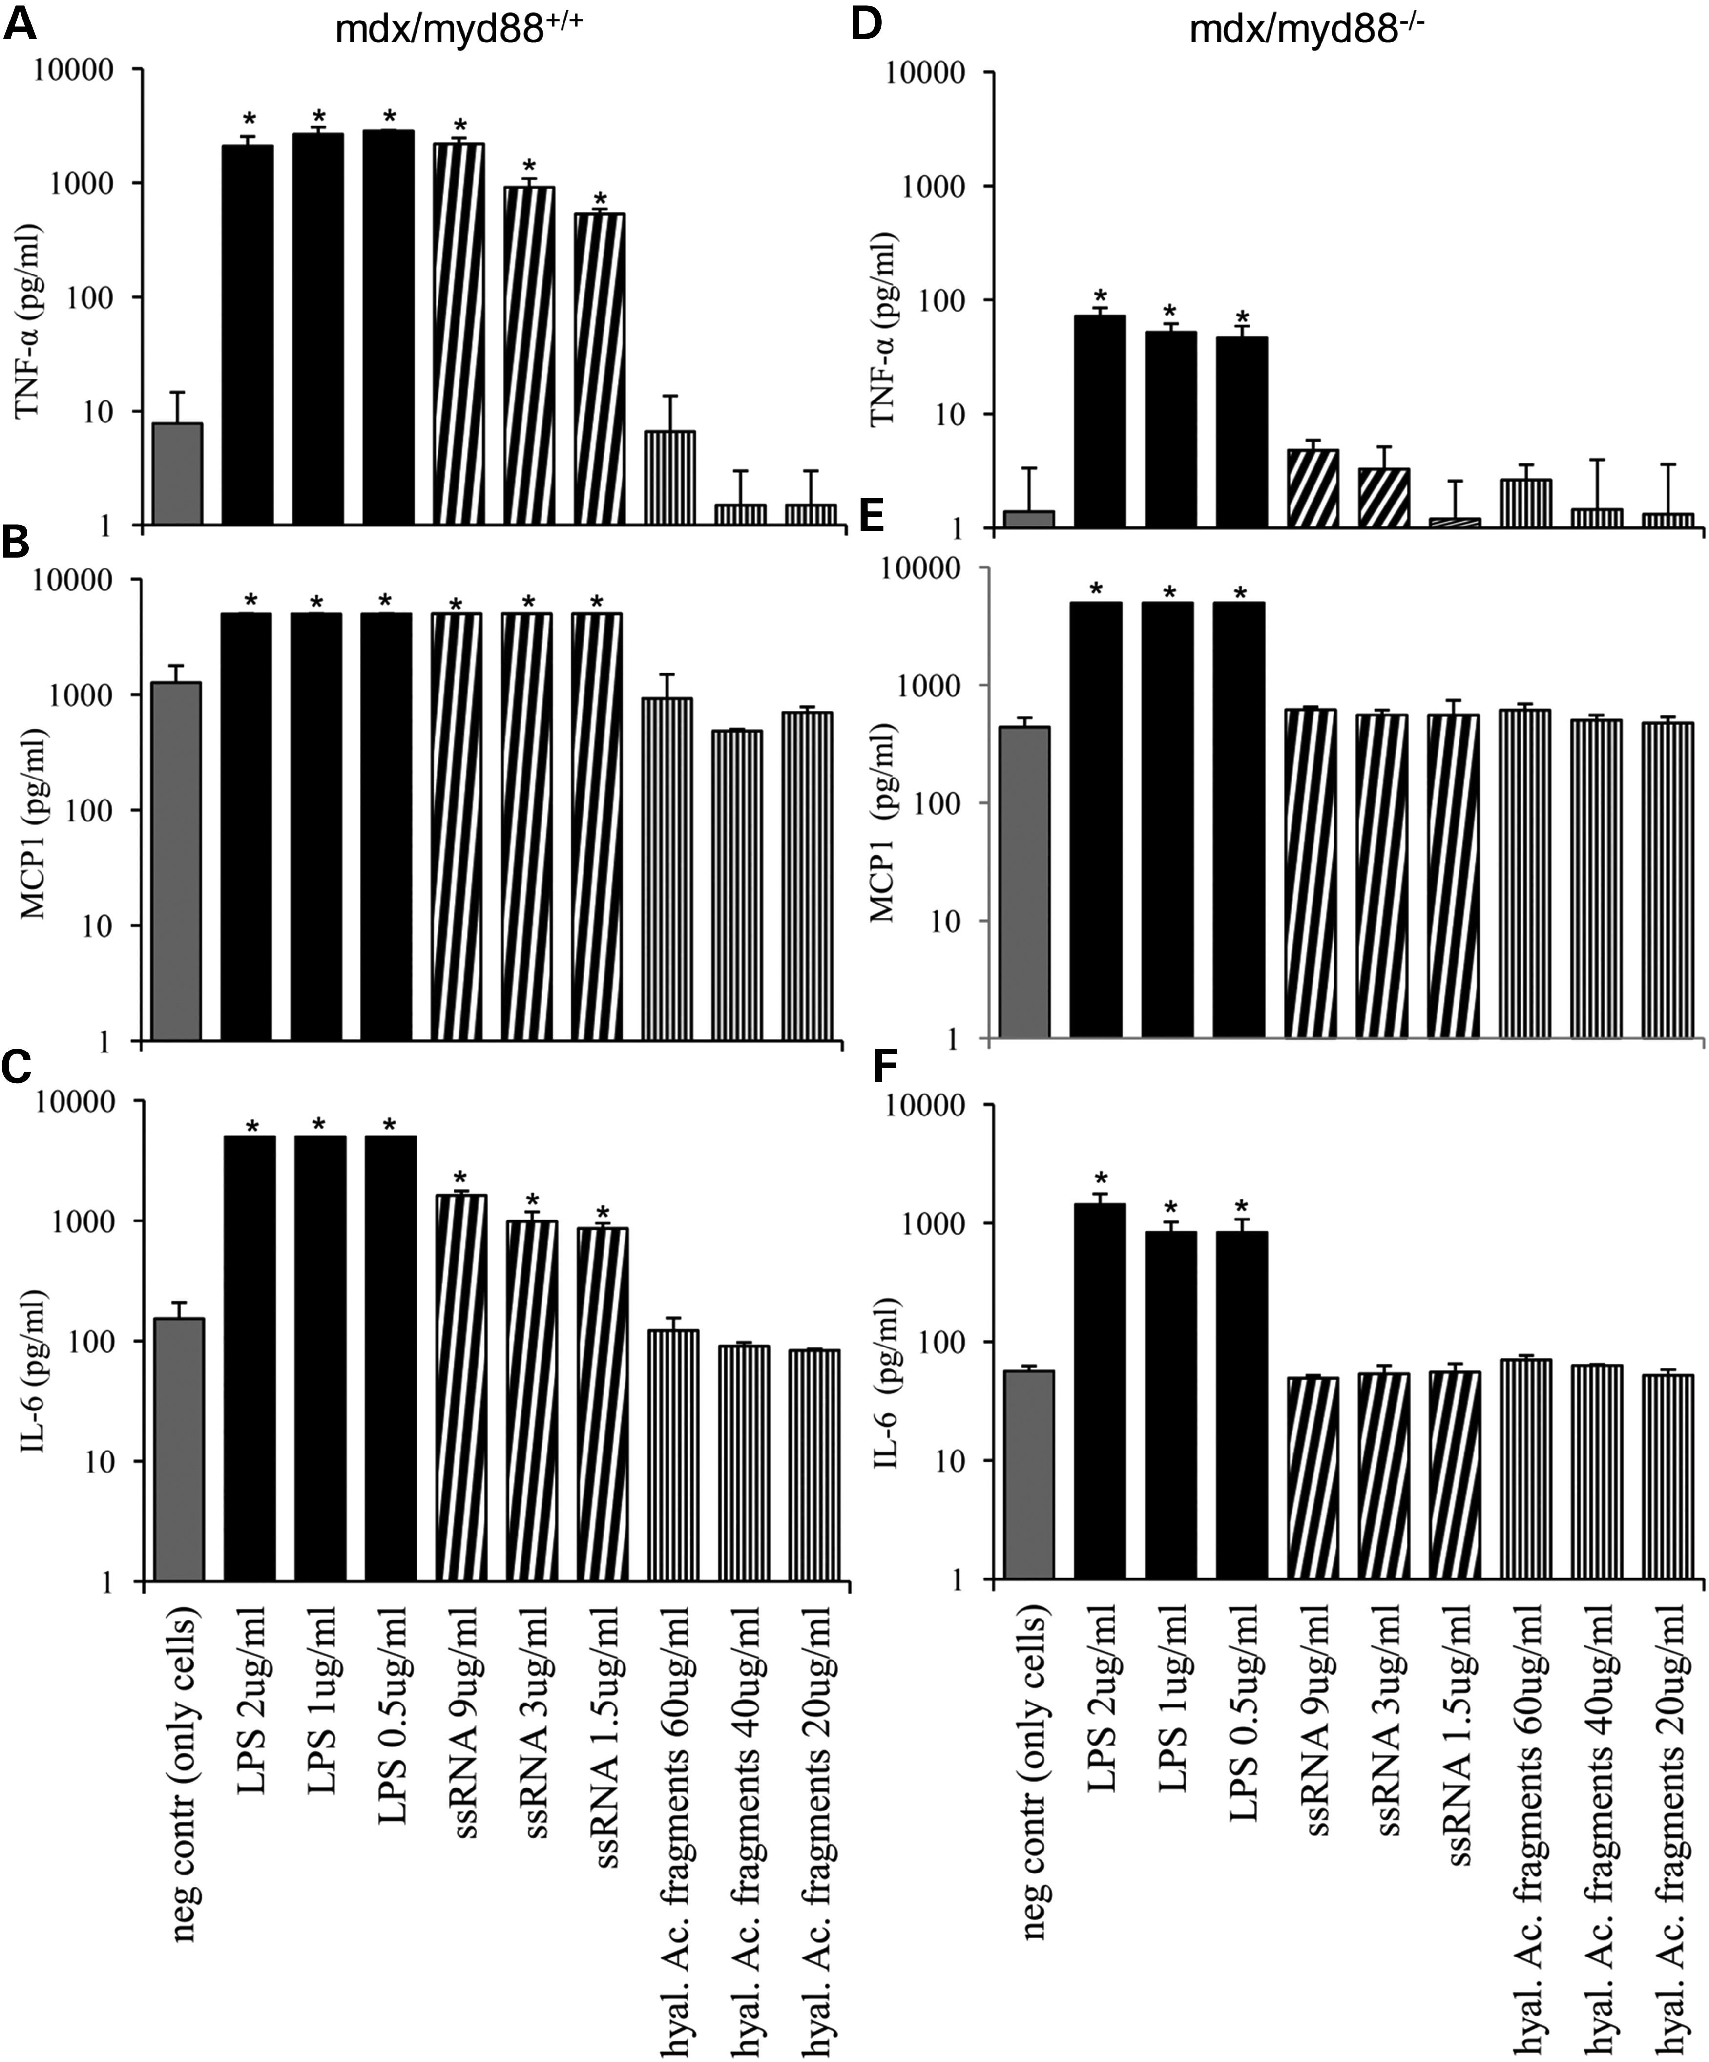
Figure 3. Myd88-dependent cytokine secretion by muscle cells: diaphragm muscles from mdx/myd88^{+/+} (left ...
Notes:
Figure 3. Myd88-dependent cytokine secretion by muscle cells: diaphragm muscles from mdx/myd88+/+ (left panels) and mdx/myd88−/− (right panels) mice were plated and maintained in culture for 24 h. All supernatants were removed for incubation with agonist at the indicated concentrations. After 18 h of incubation, we measured the concentration of TNF-α (A and D), MCP1 (B and E) and IL-6 (C and F) using a CBA flex kit for flow cytometry. Data are expressed as picograms/mililiter, with a maximal detection level of 5000 pg/ml (due to the standard curve limit). *P ≤ 0.05 when compared with the negative controls (only cells).
Unless provided in the caption above, the following copyright applies to the content of this slide: © The Author 2013. Published by Oxford University Press. All rights reserved. For Permissions, please email: journals.permissions@oup.com

Slide 4
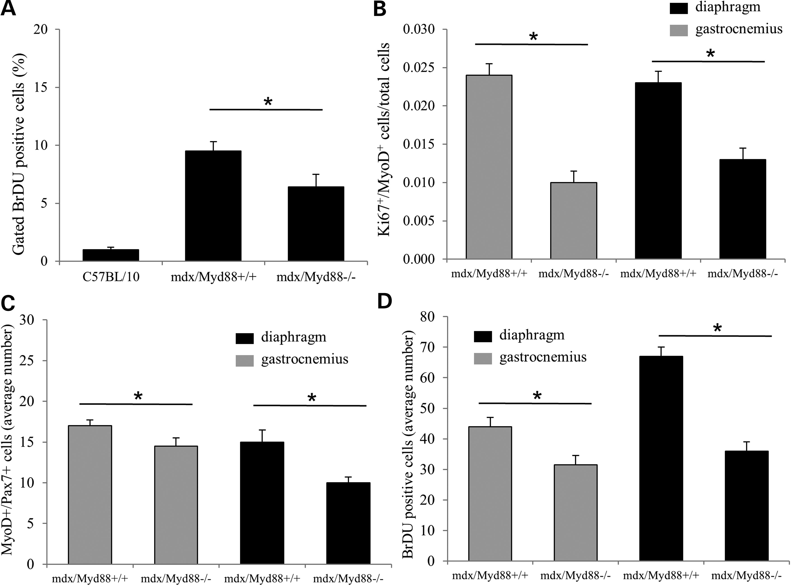
Figure 4. Proliferation of muscle cells from mdx/myd88^{−/−} mice: all mice were treated with BrdU administered ...
Notes:
Figure 4. Proliferation of muscle cells from mdx/myd88−/− mice: all mice were treated with BrdU administered in the drinking water, and the gastrocnemius muscles from the indicated mouse lineages were dissociated using collagenase and analyzed by flow cytometry (A). To analyze the proliferation of muscle subpopulations, we labeled diaphragm and gastrocnemius slices with anti-Ki67 and anti-MyoD (double-positive cells considered proliferating myoblasts) (B) and with anti-Pax7 and anti-MyoD (double-positive cells considered satellite cells in self-renewal cycle) (C). The average number of BrdU-positive cells in diaphragm and gastrocnemius of each strain measured were shown (D). BrdU-positive and immunophenotyped cells in the diaphragm and gastrocnemius were individually counted in six sections in three mice per group. *P < 0.05 when compared between mdx/myd88+/+ and mdx/myd88−/− mice.
Unless provided in the caption above, the following copyright applies to the content of this slide: © The Author 2013. Published by Oxford University Press. All rights reserved. For Permissions, please email: journals.permissions@oup.com

Slide 5
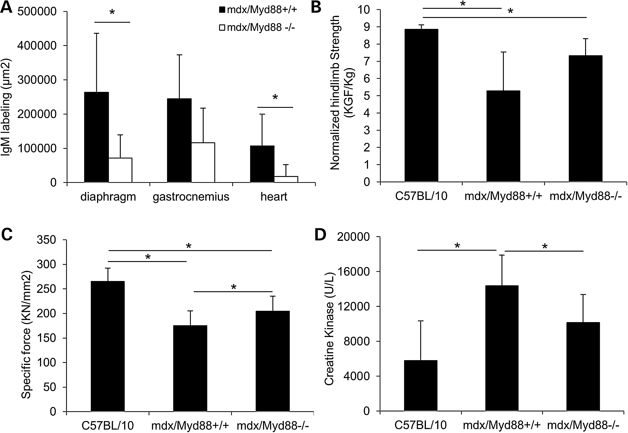
Figure 5. Dystrophinopathy in mdx/myd88^{−/−} mice: (A) degenerating cells evaluated by IgM labeling, measuring ...
Notes:
Figure 5. Dystrophinopathy in mdx/myd88−/− mice: (A) degenerating cells evaluated by IgM labeling, measuring the stained area in relation to the whole area of the tissue in the diaphragm, gastrocnemius and heart. (B) Hind limb grip strength normalized to bodyweight was shown. (C and D) Specific force of the EDL muscle (C) and serum CK levels (used as a marker of skeletal muscle damage) (D) were shown. Data are presented as mean ± SD for five mice per group (*P < 0.05 by Students t-test).
Unless provided in the caption above, the following copyright applies to the content of this slide: © The Author 2013. Published by Oxford University Press. All rights reserved. For Permissions, please email: journals.permissions@oup.com

Slide 6
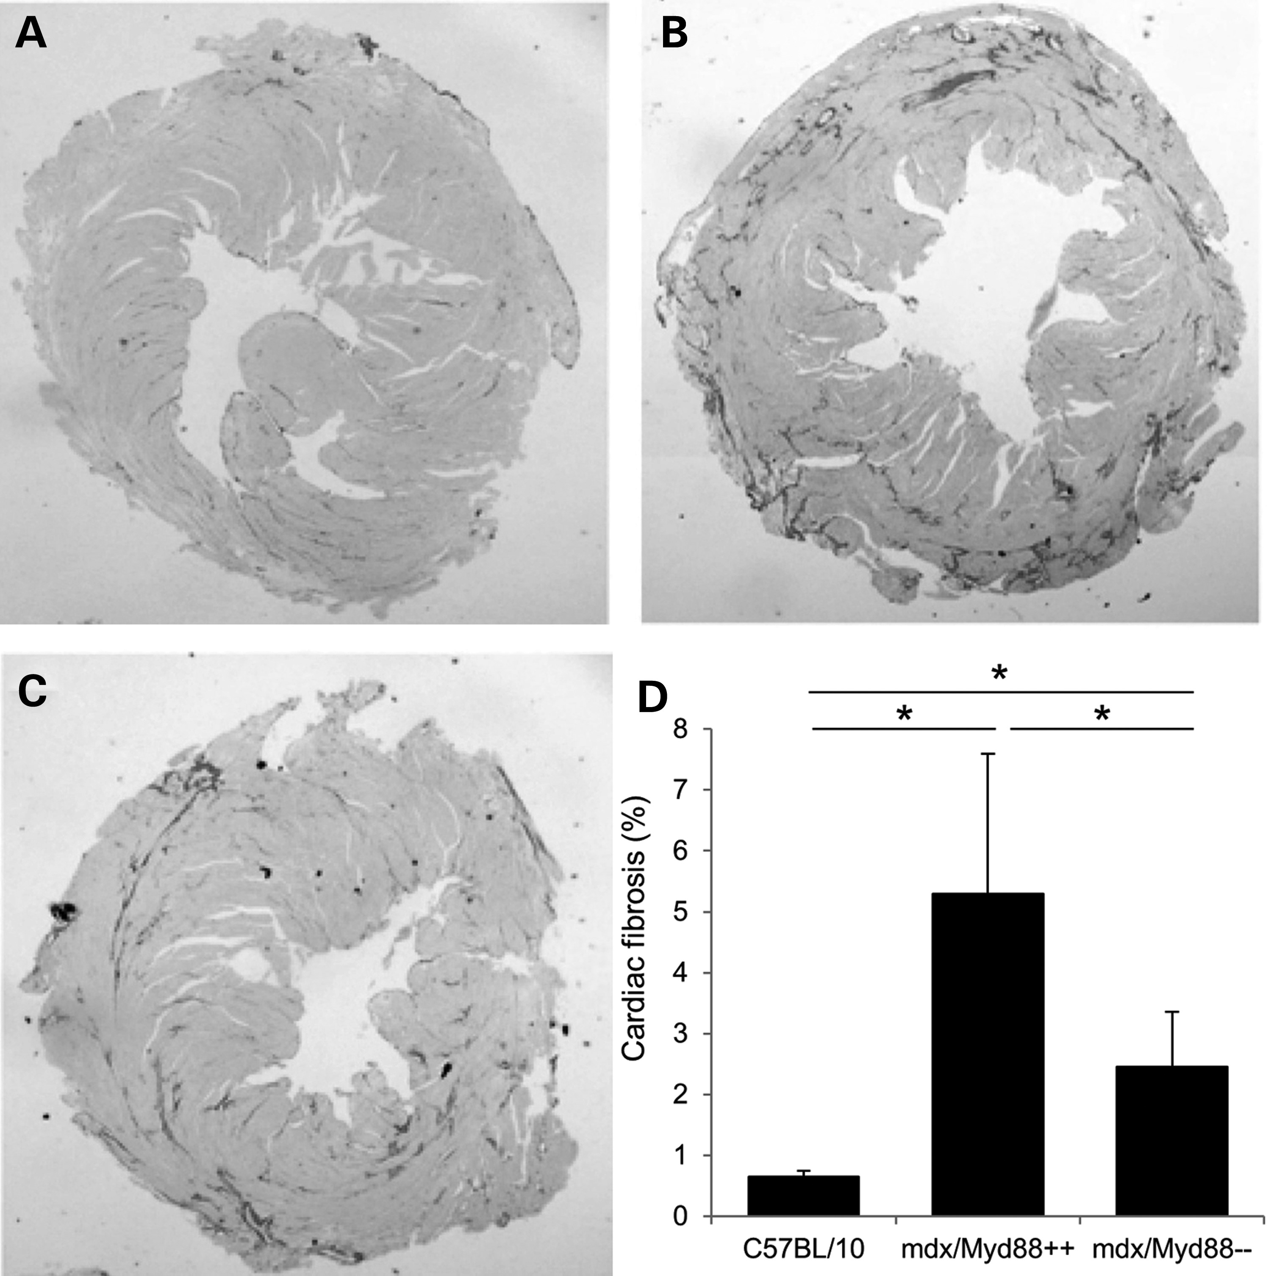
Figure 6. Cardiac fibrosis: cardiac tissue sections were collected from 10- to 12-month-old C57BL10 controls (A), ...
Notes:
Figure 6. Cardiac fibrosis: cardiac tissue sections were collected from 10- to 12-month-old C57BL10 controls (A), mdx/myd88+/+ mice (B) or mdx/myd88−/− mice (C). The slices were paraffin-embedded, cut and stained with picrosirius red. (D) Quantitation of fibrosis was done by measuring the positive areas stained with picrosirius red in relation to the whole area of the slice, and the results were expressed as percent collagen deposition. The mdx/myd88−/− mice showed significantly (*P < 0.05) decreased fibrosis when compared with mdx/myd88+/+ mice (D).
Unless provided in the caption above, the following copyright applies to the content of this slide: © The Author 2013. Published by Oxford University Press. All rights reserved. For Permissions, please email: journals.permissions@oup.com

Slide 7
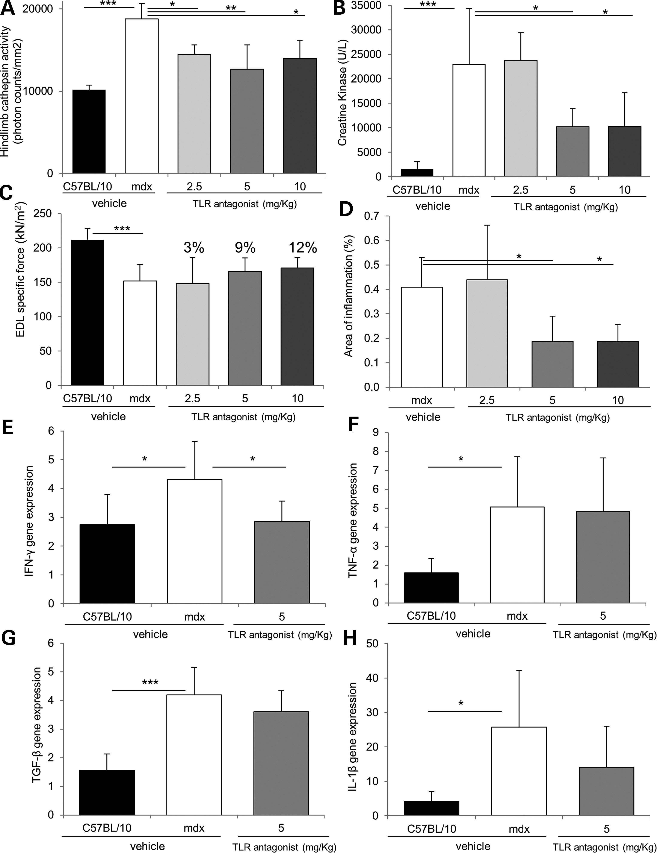
Figure 7. In vivo treatment using TLR antagonist ameliorated dystrophic phenotype: C57BL/10 and mdx mice (5 weeks old) ...
Notes:
Figure 7. In vivo treatment using TLR antagonist ameliorated dystrophic phenotype: C57BL/10 and mdx mice (5 weeks old) were treated with PBS or TLR7/8/9 antagonist for 4 weeks (dissolved in PBS for intraperitoneal injection at 2.5, 5 or 10 mg/kg) twice a week. (A) Optical imaging for cathepsin activity was performed at high resolution (1.0 mm) in the hindlimb muscles of C57BL/10 and mdx vehicle-treated mice and TLR antagonist-treated mdx mice. (B) Serum creatine kinase activity was evaluated according to manufacturer’s instructions. (C) Specific force (kN/m2) produced by EDL muscle was shown. (D) Area of inflammation (%) in vehicle and TLR antagonist-treated mdx mice as monitored by H&E staining. (E–H) Expression of various inflammatory cytokine transcripts in control and mdx groups (vehicle and 5 mg/kg TLR antagonist) as monitored by qPCR (*P < 0.05, **P < 0.01 and ***P < 0.001).
Unless provided in the caption above, the following copyright applies to the content of this slide: © The Author 2013. Published by Oxford University Press. All rights reserved. For Permissions, please email: journals.permissions@oup.com

