Slide 1
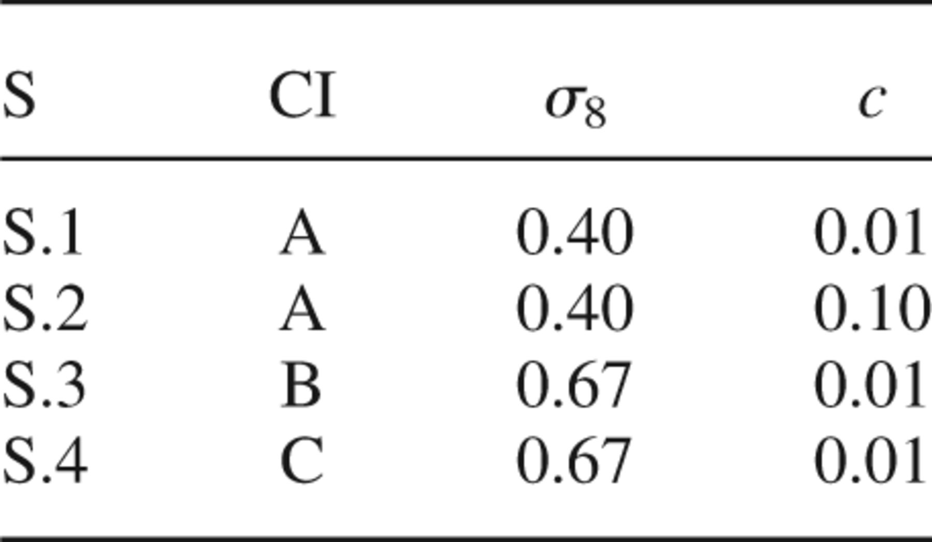
1 Numerical simulations.
Notes:
1 Numerical simulations.
Unless provided in the caption above, the following copyright applies to the content of this slide: © 2002 RAS

Slide 2
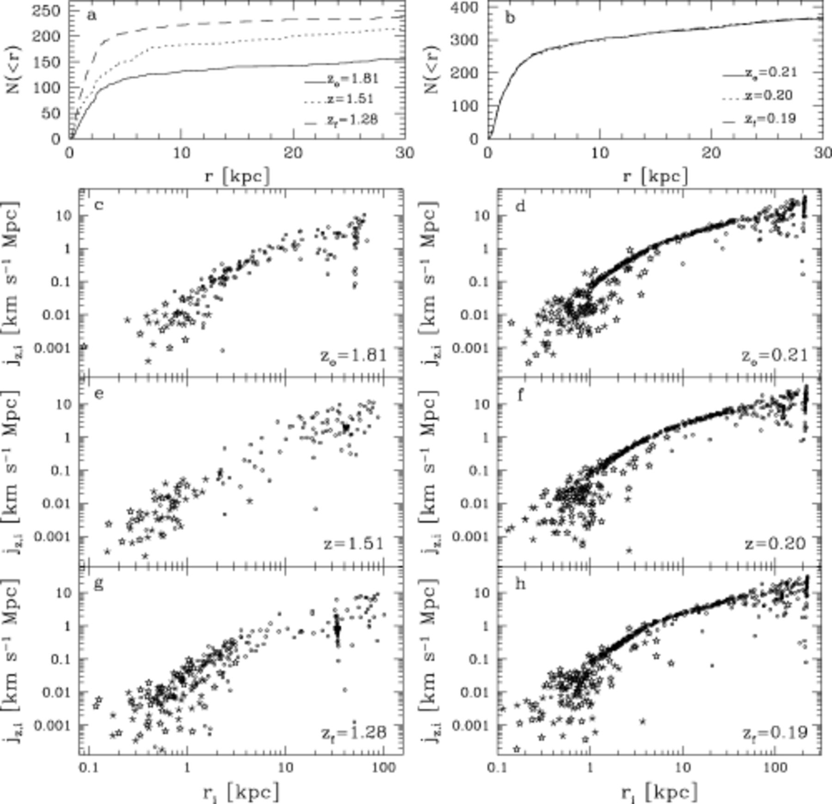
2 Number of baryonic particles within radial distance r for GLO 2 (a) in S.4 and GLO 5 (b) in S.1 between ...
Notes:
2 Number of baryonic particles within radial distance r for GLO 2 (a) in S.4 and GLO 5 (b) in S.1 between zo and zf. Specific angular momentum component jz,i along the direction of the total angular momentum of the progenitor for each baryonic particle within ≈100 kpc of GLO 2 (c,e,g) and GLO 5 (d,f,h) versus their positions ri from zo to zf. Circles: gas particles, stars: star particles, asterisks: counter-rotating stars.
Unless provided in the caption above, the following copyright applies to the content of this slide: © 2002 RAS

Slide 3
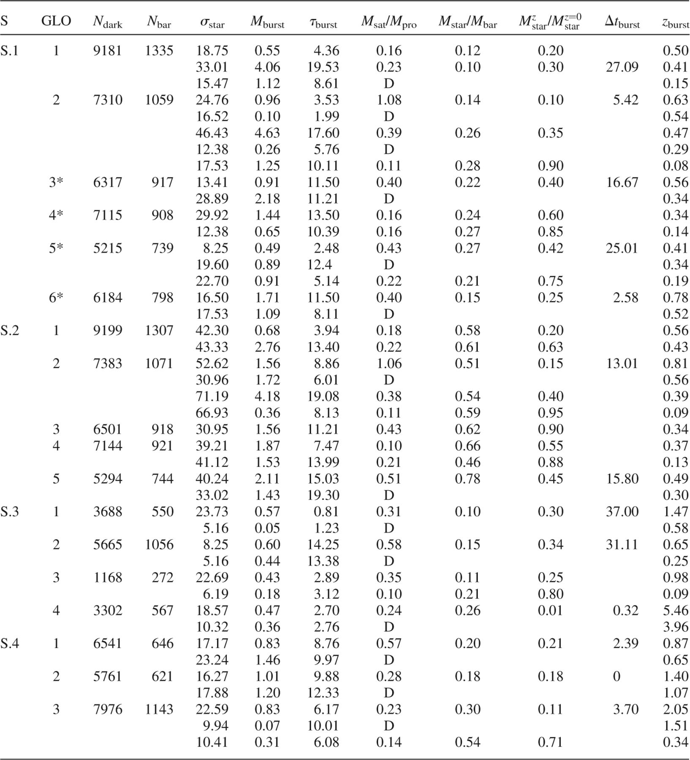
2 Main characteristics of starbursts.
Notes:
2 Main characteristics of starbursts.
Unless provided in the caption above, the following copyright applies to the content of this slide: © 2002 RAS

Slide 4
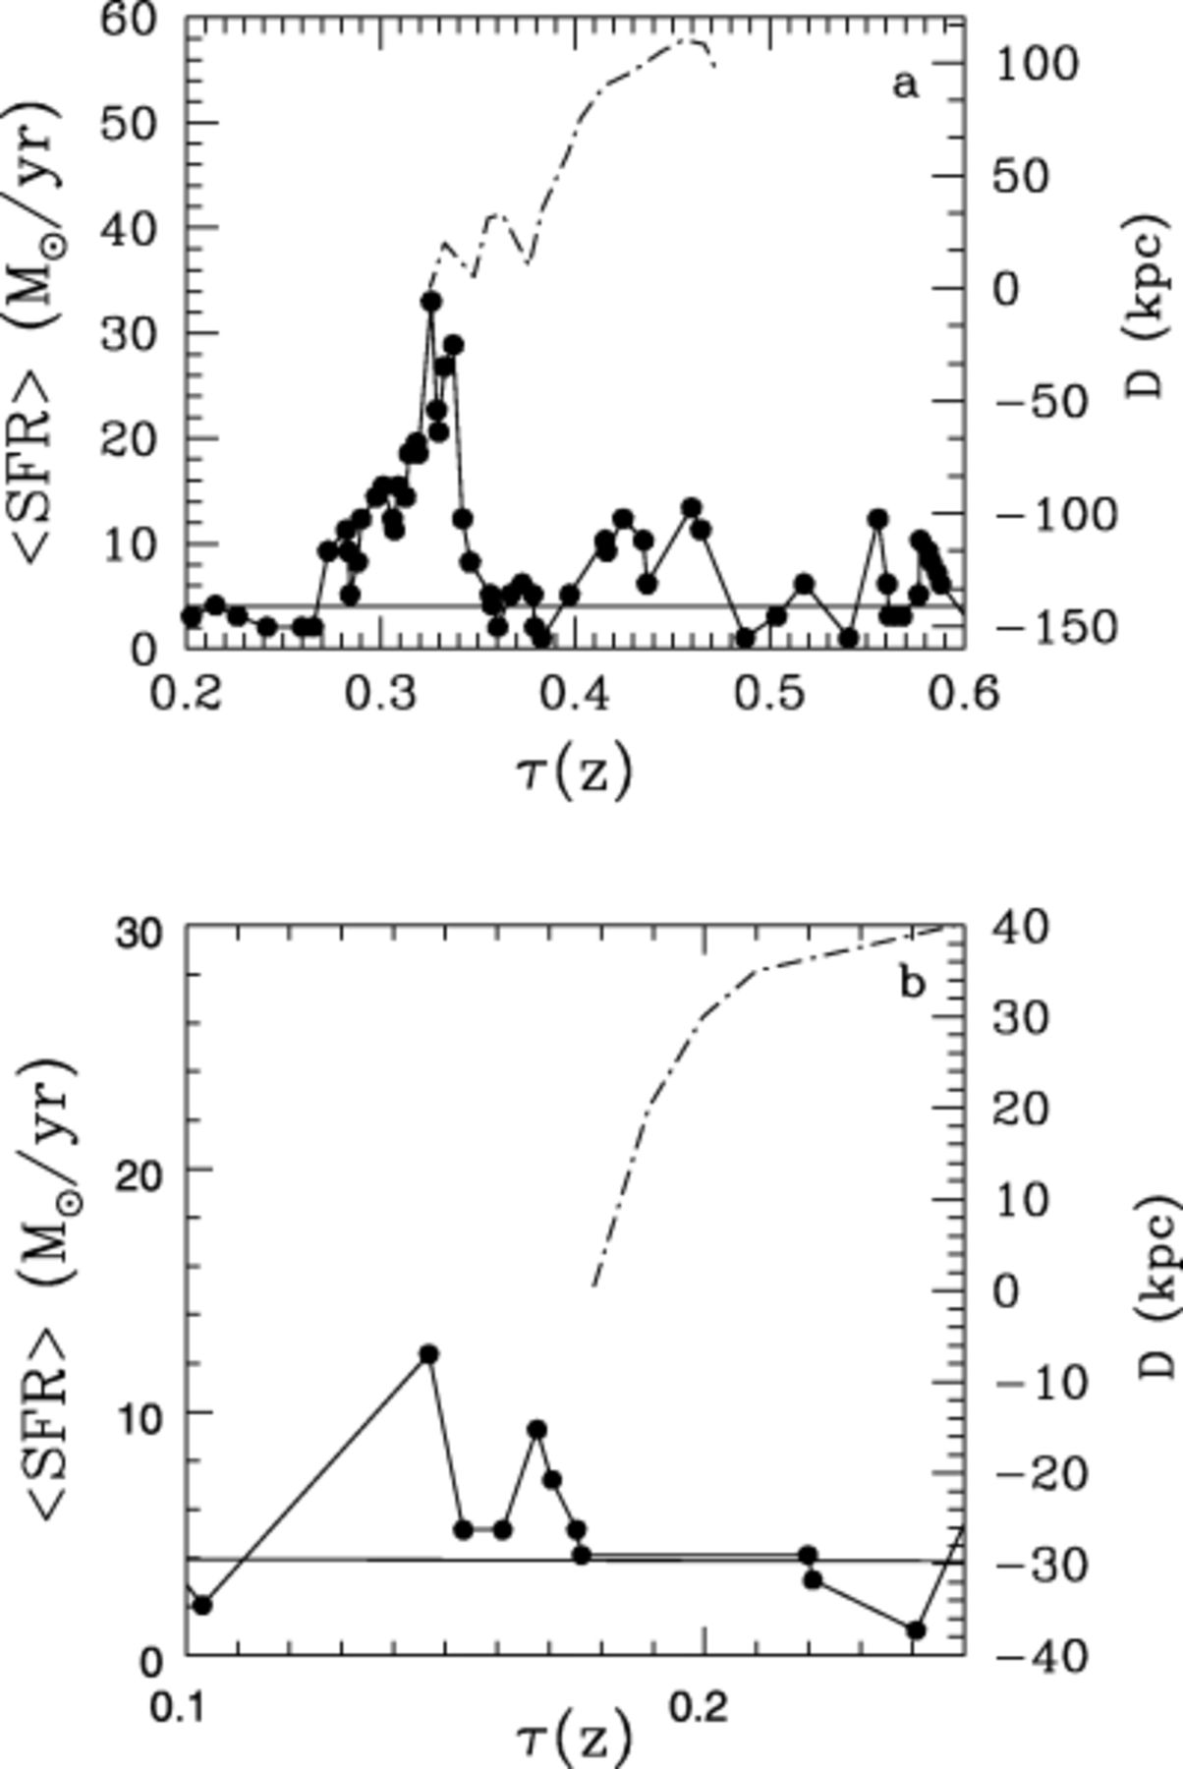
1 Star formation rate for a typical galaxy-like object experiencing (a) a double starburst and (b) a single one ...
Notes:
1 Star formation rate for a typical galaxy-like object experiencing (a) a double starburst and (b) a single one in simulation S.1 as a function of look-back time. The spatial separation between the mass centres of the progenitor and satellite clumps are plotted (dashed lines). The solid lines represent the quiescent star formation component.
Unless provided in the caption above, the following copyright applies to the content of this slide: © 2002 RAS

Slide 5
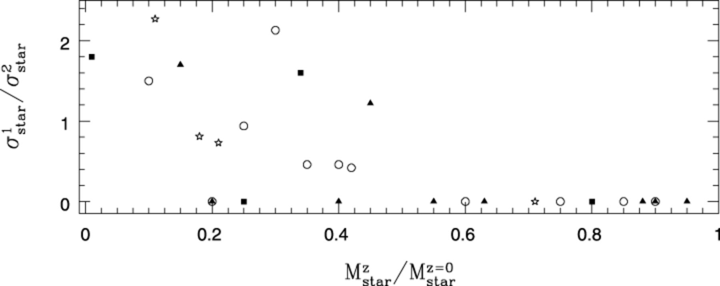
3 Ratio between the strengths of the starbursts and the fraction of stars already formed in the progenitor at ...
Notes:
3 Ratio between the strengths of the starbursts and the fraction of stars already formed in the progenitor at the z of the merger. Single bursts have been assigned . GLO 1 in S.3 has not been included for the sake of clarity . GLOs in S.1: open circles, S.2: filled triangles S.3: filled squares and S.4: open stars.
Unless provided in the caption above, the following copyright applies to the content of this slide: © 2002 RAS

Slide 6
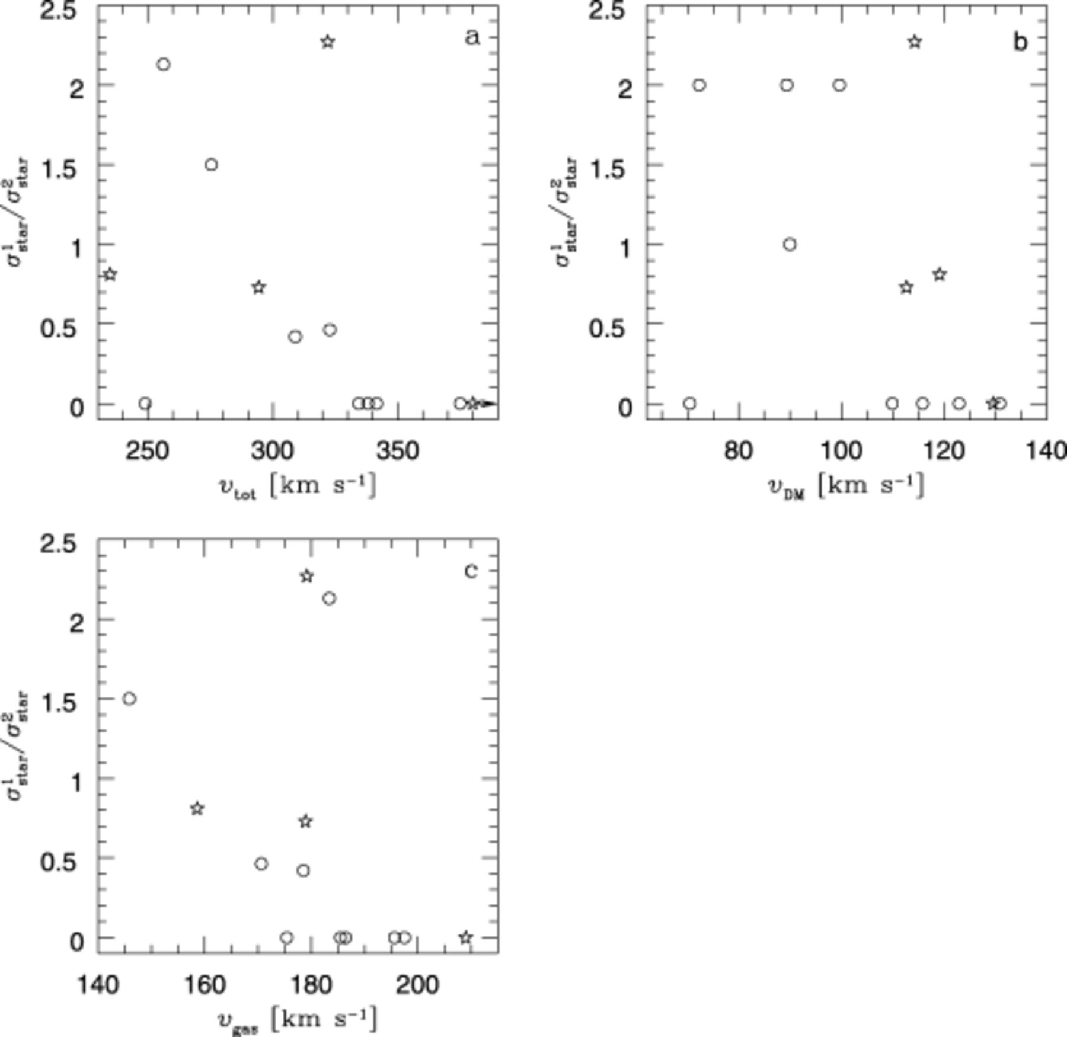
4 Ratio between the strengths of the starbursts versus the circular velocity at 2 kpc of (a) the total mass ...
Notes:
4 Ratio between the strengths of the starbursts versus the circular velocity at 2 kpc of (a) the total mass distribution (υtot), (b) the dark matter (υDM) and (c) the gas (υgas) for all bursts in S.1 (open circles) and S.4 (open stars).
Unless provided in the caption above, the following copyright applies to the content of this slide: © 2002 RAS

Slide 7
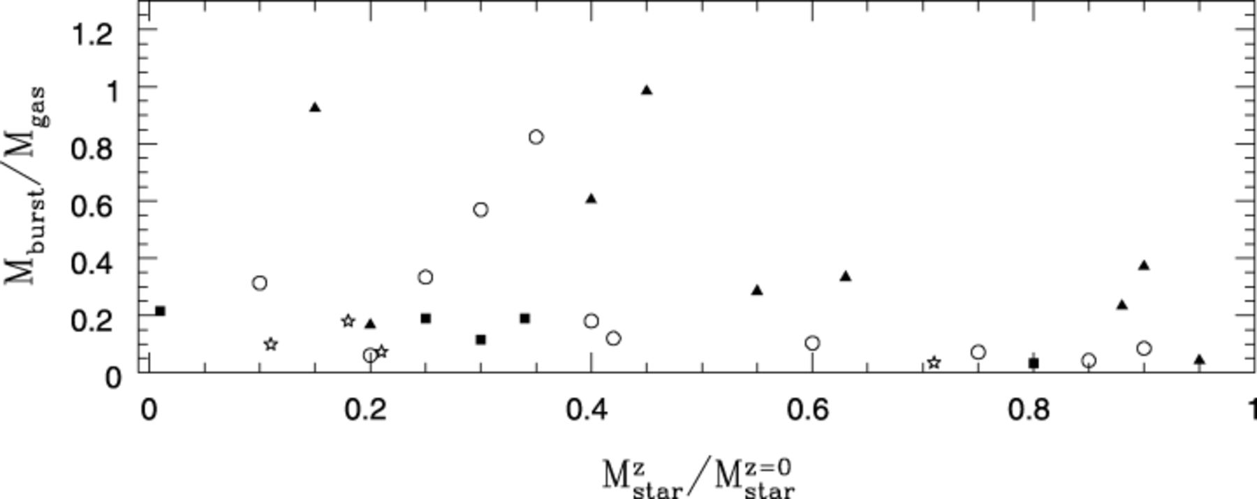
5 The fraction of gas consumed into stars during starbursts, M_{burst}/M_{gas}, as a function ...
Notes:
5 The fraction of gas consumed into stars during starbursts, Mburst/Mgas, as a function of the fraction of stars already in place in the progenitor at the z of the merger . Single bursts and primary components of double ones have been included. We find that, in a given simulation, higher burst efficiencies tend to occur in GLOs that lack an important stellar mass concentration (see Fig. 3 for feature code).
Unless provided in the caption above, the following copyright applies to the content of this slide: © 2002 RAS

Slide 8
3 Mean starburst efficiencies.
Notes:
3 Mean starburst efficiencies.
Unless provided in the caption above, the following copyright applies to the content of this slide: © 2002 RAS

Slide 9
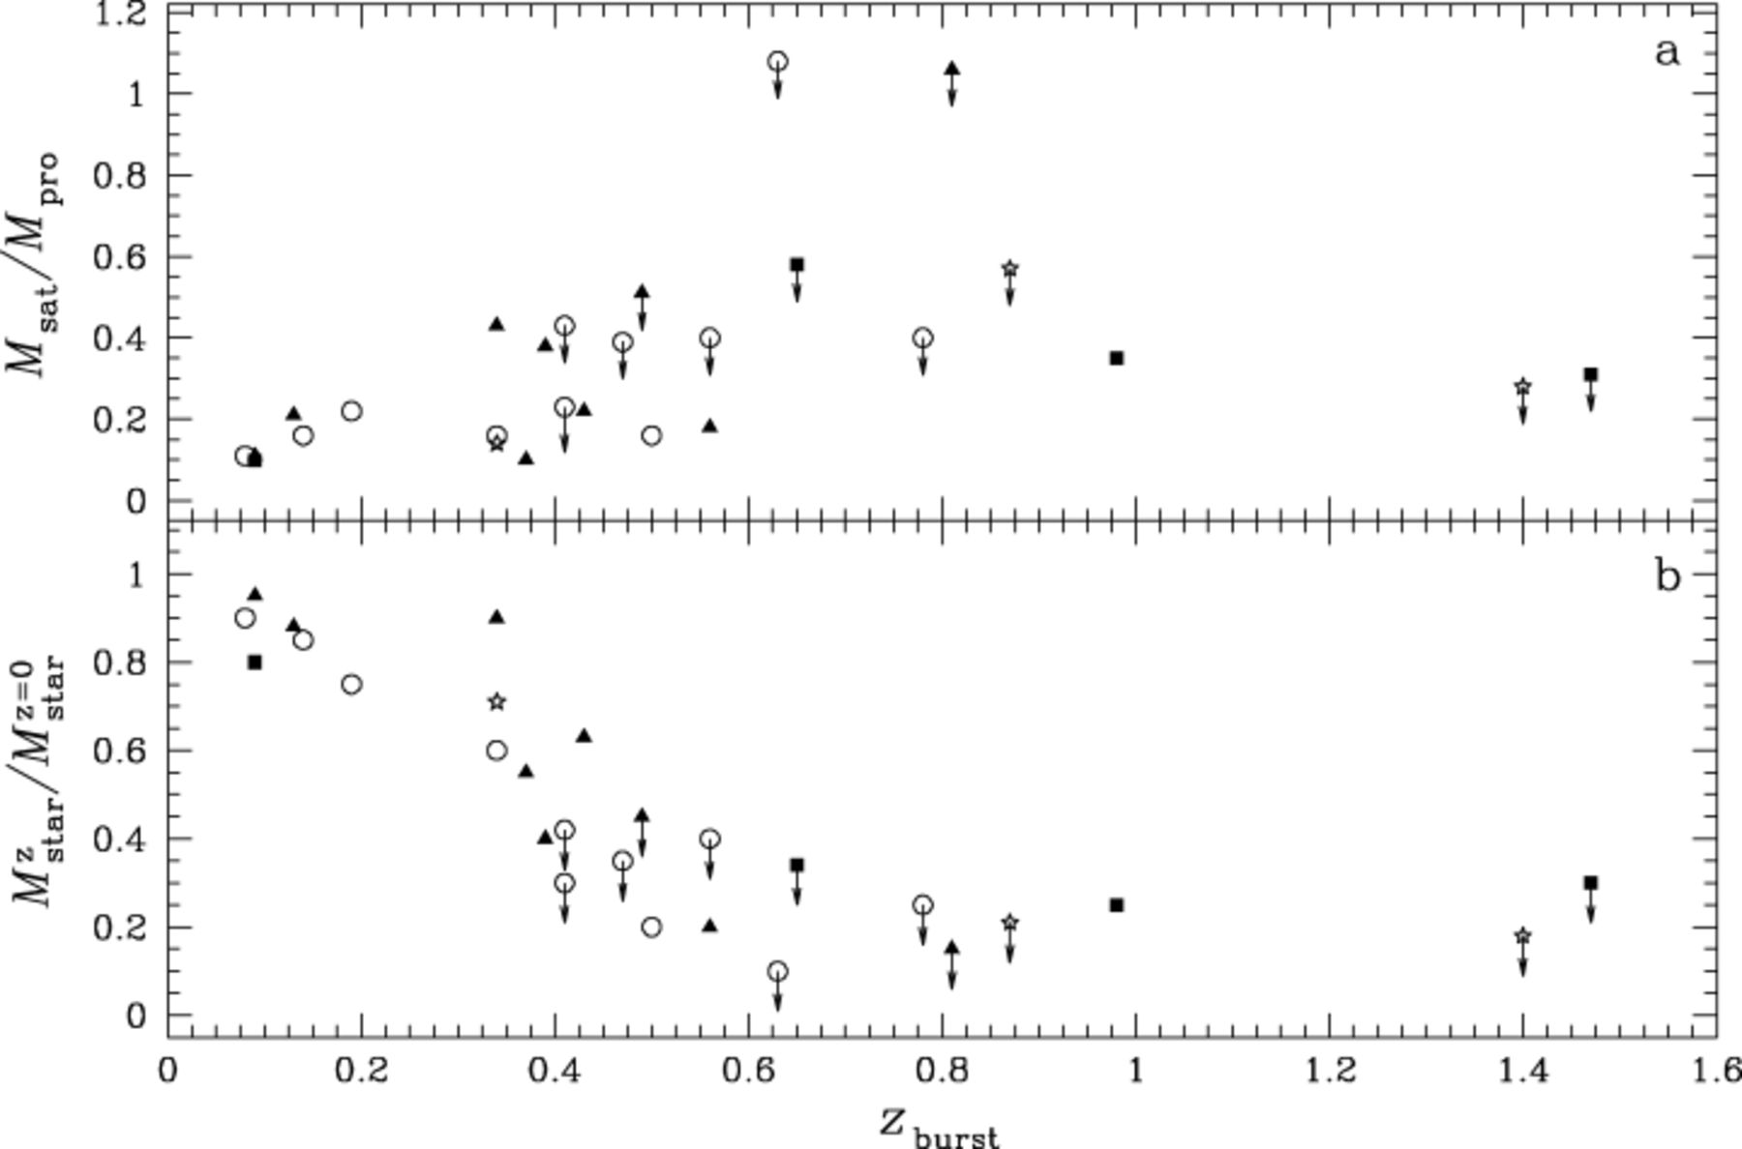
6 (a) M_{sat}/M_{pro} and (b) as a function of the z_{burst} for single SBs and ...
Notes:
6 (a) Msat/Mpro and (b) as a function of the zburst for single SBs and primary components of double ones (symbols with arrows). See Fig. 3 for feature description.
Unless provided in the caption above, the following copyright applies to the content of this slide: © 2002 RAS

