Slide 1
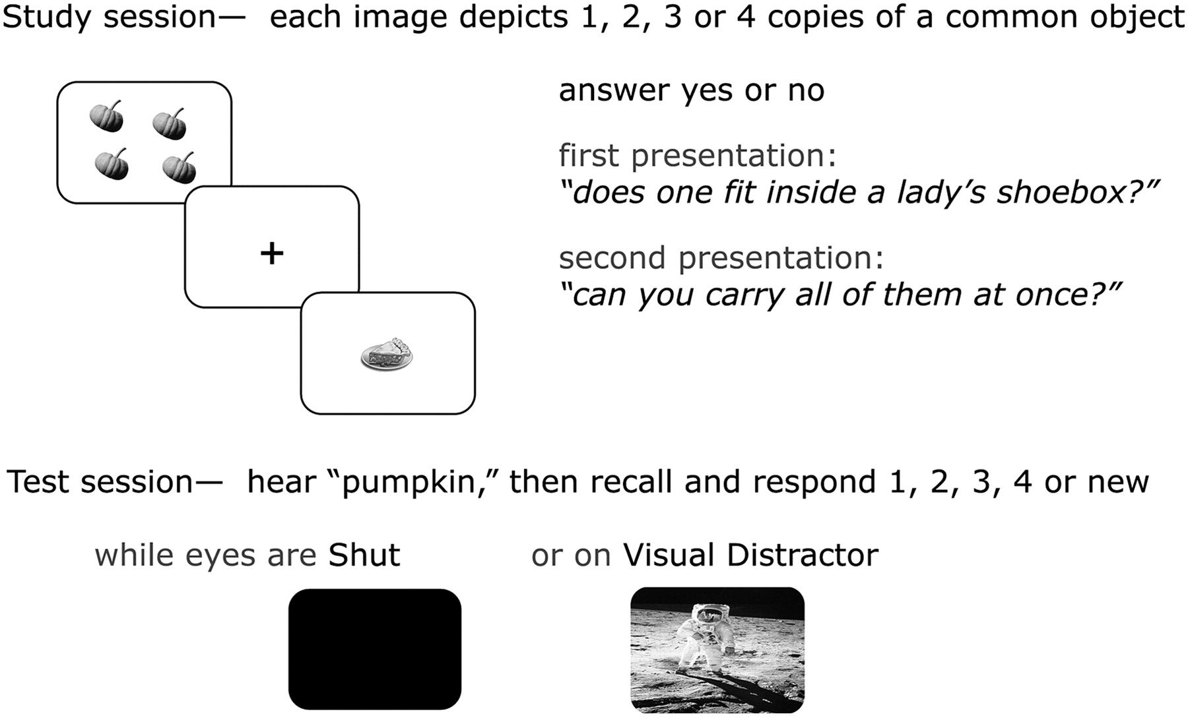
Figure 1. Experimental paradigm. A schematic of the procedure shows the study session, when participants answered 2 ...
Notes:
Figure 1. Experimental paradigm. A schematic of the procedure shows the study session, when participants answered 2 incidental questions about each of 168 images (3 s per presentation), and the test session when auditory cues described 168 targets and 72 lures in singular form (2.5 s per presentation). In each block of the test session, after 10 min of rTMS treatment, auditory cues probed participants' recall while they wore earphones during trials presented in either the eyes shut (SHUT) or visual distractor (VD) conditions.
Unless provided in the caption above, the following copyright applies to the content of this slide: © The Author 2011. Published by Oxford University Press. All rights reserved. For permissions, please e-mail: journals.permissions@oup.com

Slide 2
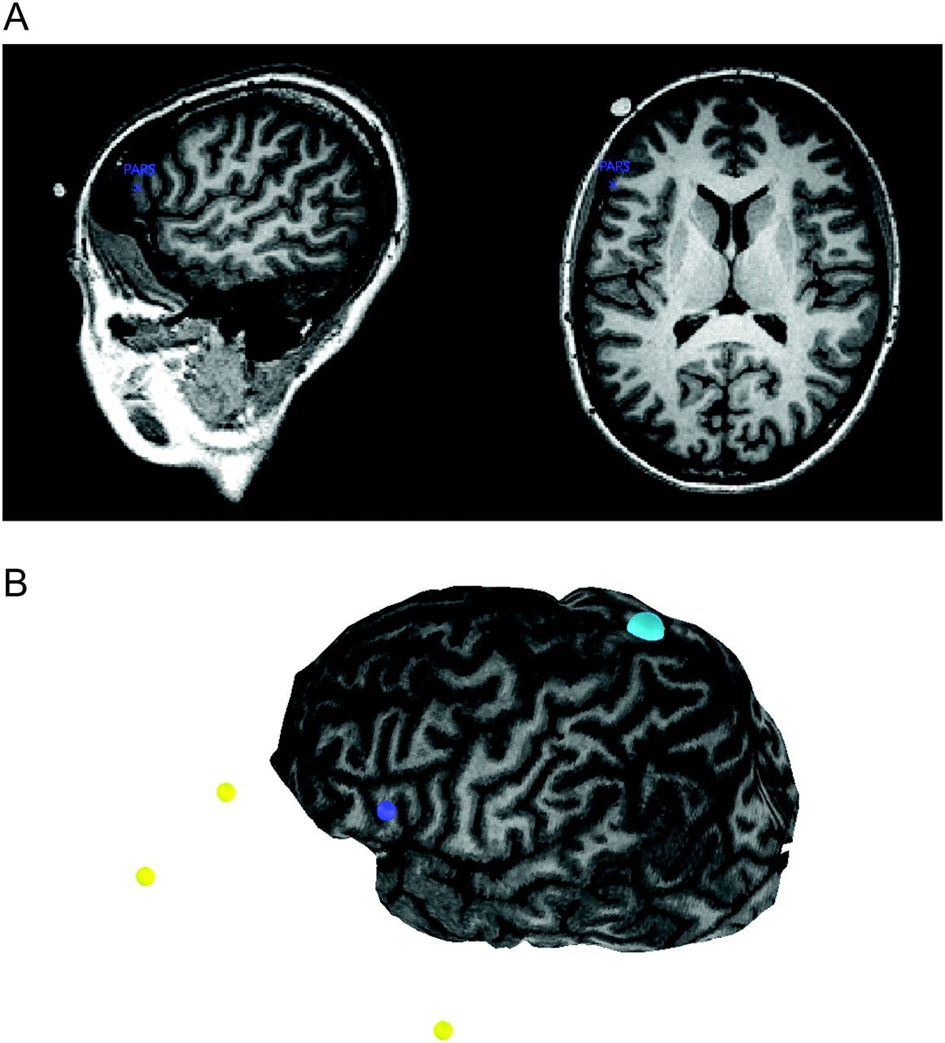
Figure 2. Rendering of ROIs for rTMS treatment. For each participant, the targeted ROIs for rTMS treatment were aligned ...
Notes:
Figure 2. Rendering of ROIs for rTMS treatment. For each participant, the targeted ROIs for rTMS treatment were aligned onto their anatomical MRI in native space and rendered onto a virtual 3D cortical surface using Brainsight TMS software. (A) The functional ROI for the left mVLPFC from the group results in Wais, Rubens, et al. (2010) was inverse-warped to each participant's anatomical MRI (i.e., blue x at the peak voxel, “PARS”). (B) A 3D cortical rendering was coregistered with the participant's head position before rTMS treatment using reference points at the tip and bridge of the nose and the left and right preauricular spaces (yellow spheres). Targets on the virtual cortex were rendered for the left mVLPFC (blue sphere) and the Vertex (cyan sphere), which were aligned under the rTMS coil by the experimenter using Brainsight TMS software.
Unless provided in the caption above, the following copyright applies to the content of this slide: © The Author 2011. Published by Oxford University Press. All rights reserved. For permissions, please e-mail: journals.permissions@oup.com

Slide 3
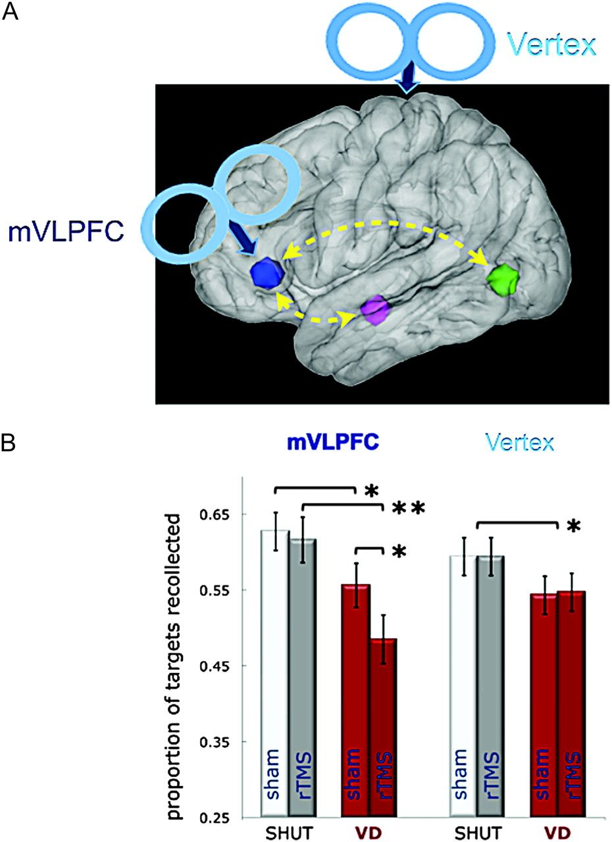
Figure 3. Role of the left mVLPFC in retrieval of Correct responses during visual distraction. A schematic illustration ...
Notes:
Figure 3. Role of the left mVLPFC in retrieval of Correct responses during visual distraction. A schematic illustration (A) shows the rTMS targets located on a sagittal rendering of the MNI template brain, including the mVLPFC ROI (blue) functionally connected in a recollection network with the left hippocampus (magenta) and lateral occipital cortex (green), as represented in Wais, Rubens, et al. (2010). (B) Objective recollection performance is shown in each experiment by condition (SHUT, VD) after sham or actual rTMS treatment. Recollection of episodic details was disrupted by visual distraction, and there was an interaction of actual rTMS on recollection during visual distraction after mVLPFC treatment but not after Vertex rTMS treatment. Error bars represent the standard error of the mean; ** indicates a difference between means, P < 0.005; and * indicates a difference between means, P < 0.05.
Unless provided in the caption above, the following copyright applies to the content of this slide: © The Author 2011. Published by Oxford University Press. All rights reserved. For permissions, please e-mail: journals.permissions@oup.com

Slide 4
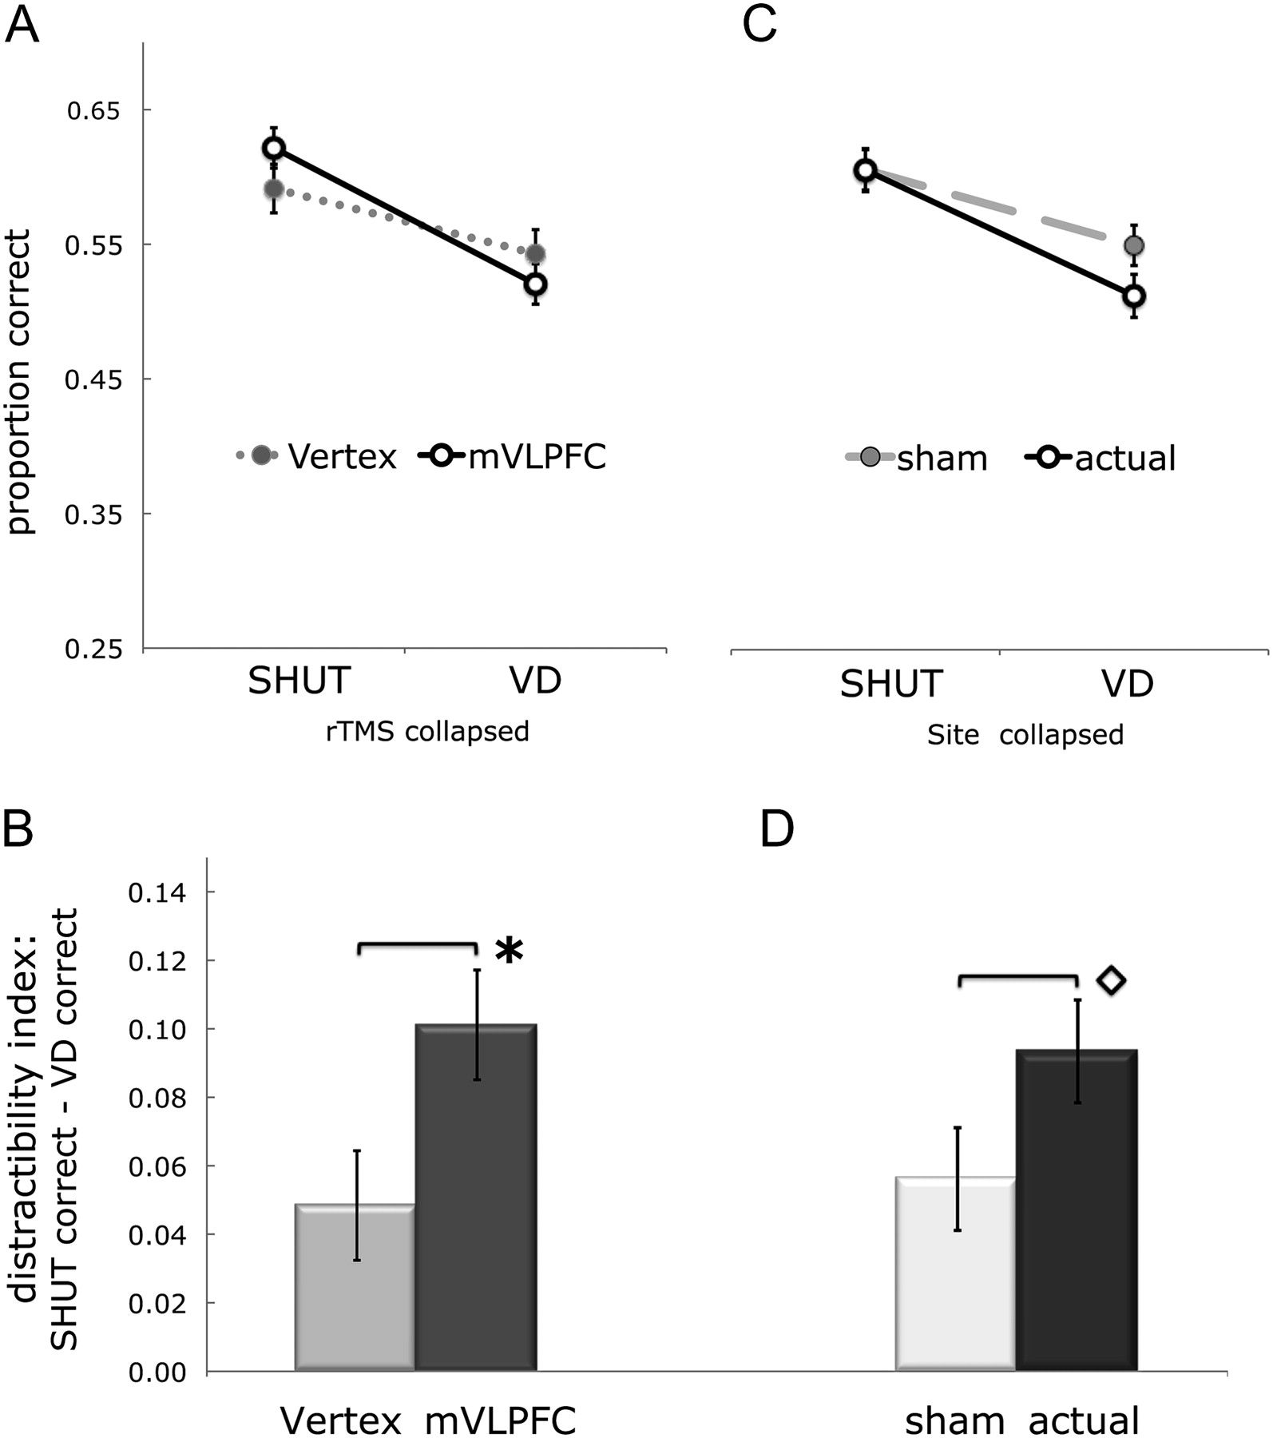
Figure 4. Comparison of the effects of Site and rTMS on episodic retrieval. Pairwise comparisons collapsed across ...
Notes:
Figure 4. Comparison of the effects of Site and rTMS on episodic retrieval. Pairwise comparisons collapsed across blocks after actual and sham rTMS treatment showed that (A) the difference in Correct responses (i.e., based on recollection) between the SHUT and VD conditions increased in the mVLPFC experiment relative to the Vertex experiment and (B) an index of distractibility (i.e., SHUT Correct − VD Correct) was greater in the mVLPFC experiment. Pairwise comparisons collapsed across the Vertex and left mVLPFC sites suggested that (C) disruption of recollection during VD was exacerbated after actual relative to sham rTMS and (D) an index of distractibility increased after actual relative to sham rTMS. Error bars represent the standard error of the mean difference; * indicates a difference between means, P < 0.023; and ⋄indicates a difference between means, P < 0.058.
Unless provided in the caption above, the following copyright applies to the content of this slide: © The Author 2011. Published by Oxford University Press. All rights reserved. For permissions, please e-mail: journals.permissions@oup.com

Slide 5
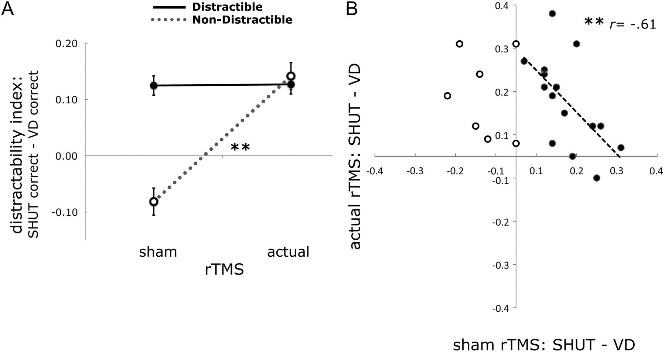
Figure 5. Individual differences in the impact of visual distraction on episodic retrieval. The separation of ...
Notes:
Figure 5. Individual differences in the impact of visual distraction on episodic retrieval. The separation of participants into subgroups based on a distractibility index (i.e., disruption to recollection measured by SHUT Correct − VD Correct) is shown with the effect of mVLPFC rTMS treatment. (A) Seven participants were not distracted before treatment (Non-Distractible), yet suffered disruption to recollection from external interference after mVLPFC rTMS. Fifteen participants who were Distractible before treatment did not show increased distractibility after mVLPFC rTMS. (B) A scatter plot shows, for the Distractible participants (solid dots), increased distractibility after mVLPFC rTMS was inversely correlated with their index of disruption before treatment. These results suggest a direct role of left mVLPFC interacting with external interference during recollection. Error bars represent the standard error of the mean difference; ** indicates a difference between means or a correlation between variables, P < 0.005.
Unless provided in the caption above, the following copyright applies to the content of this slide: © The Author 2011. Published by Oxford University Press. All rights reserved. For permissions, please e-mail: journals.permissions@oup.com

