Slide 1
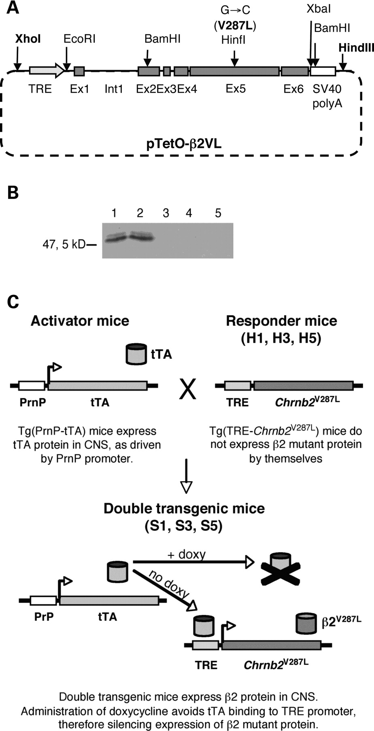
Figure 1. Transgenic constructs. (A) Schematic map of pTetO-β2VL construct. The coding sequence of mouse Chrnb2 gene ...
Notes:
Figure 1. Transgenic constructs. (A) Schematic map of pTetO-β2VL construct. The coding sequence of mouse Chrnb2 gene (exons 1–6), comprising the first intron, was mutagenized to obtain the V287L ADNFLE mutation, thus cloned down-stream the TRE and up-stream the SV40 polyadenylation sequence (SV40 polyA). The V287L missense mutation inserts a new HinfI restriction site that is absent in wild-type Chrnb2 gene. (B) pTetO-β2VL expression test. In the presence of pUHD15.1 plasmid that expresses the activator protein tTA, mutant β2 subunit (52 kD) was correctly expressed (lane 1), while it was not in the absence of tTA (lane 3). By adding doxycycline (1 µg/ml in culture medium for 48 h), which inhibits tTA binding to TRE promoter, expression is completely silenced (lanes 4–5). Co-expression of wild-type α4 subunit did not influence the stability of β2 mutated subunit (lanes 2, 3 and 5). (C) Schematic diagram of tet-off system. Chrnb2V287L transgene was excised from pTetO-β2VL construct with XhoI and HindIII enzymes, and then injected into FVB fertilized eggs generating three lines of transgenic responder mice (H1, H3 and H5 lines) that do not express transgene per se. To achieve activation of TRE promoter by tTA, responder mice were bred with transgenic activator mice, expressing tTA driven by PrnP promoter. S1, S3 and S5 double transgenic lines express mutant β2 subunit in CNS. Administration of doxycycline silences expression of Chrnb2V287L transgene.
Unless provided in the caption above, the following copyright applies to the content of this slide: © The Author 2009. Published by Oxford University Press. All rights reserved. For Permissions, please email: journals.permissions@oxfordjournals.org

Slide 2
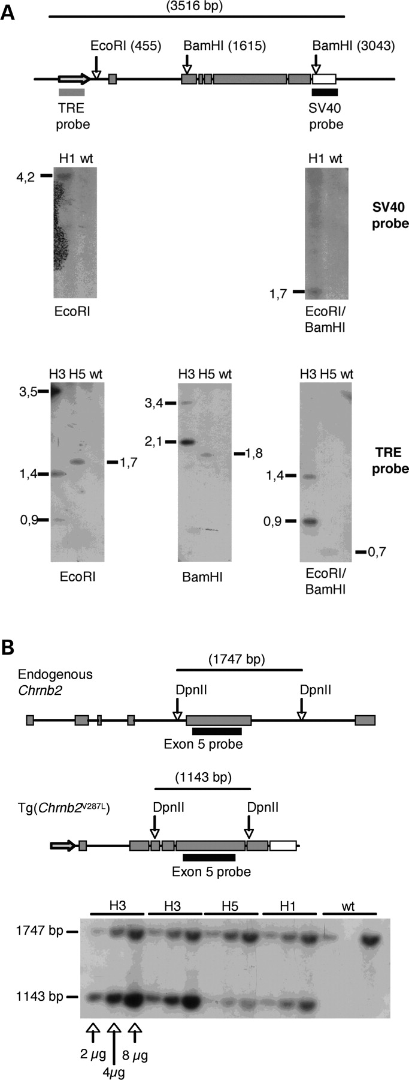
Figure 2. Southern blot analysis. (A) gDNA from H1, H3 and H5 responder mice was digested with EcoRI and/or BamHI ...
Notes:
Figure 2. Southern blot analysis. (A) gDNA from H1, H3 and H5 responder mice was digested with EcoRI and/or BamHI restriction enzymes (restriction sites position is given in brackets). Analysis with SV40 probe is shown for H1 line: a single band was detectable in single and double digestion, demonstrating that transgene is inserted in single copy. Band resulting from BamHI single digestion was not detectable. Analysis with TRE probe is shown for H5 and H3 lines: single and double digestions of H5 gDNA show a single band, demonstrating that transgene is inserted in single copy. H3 gDNA digestion shows a complex pattern of bands: the high intensity bands at 3.5 kb in EcoRI digestion, at 2.1 kb in BamHI digestion and at 0.9 kb in double digestion are the result of digestion and hybridization of tandem insertion of multiple copies. Wild-type (wt) digested gDNA was loaded as negative control of probe specificity. (B) Determination of transgene copy number. gDNA digestion with DpnII enzyme and hybridization with an exon 5 probe allowed direct intra-lane comparison between endogenous gene (band size: 1747 bp) and transgene (band size: 1143 bp). Increasing amounts (2, 4 and 8 µg) of digested gDNA were loaded on agarose gel to mimic 2, 4 and 8 copies of the gene (wild-type 4 µg lane was not loaded). In H3 lanes, bands corresponding to Chrnb2V287L transgene show a doubled intensity compared with endogenous gene's bands, suggesting that in H3 line about four copies of the transgene were inserted.
Unless provided in the caption above, the following copyright applies to the content of this slide: © The Author 2009. Published by Oxford University Press. All rights reserved. For Permissions, please email: journals.permissions@oxfordjournals.org

Slide 3
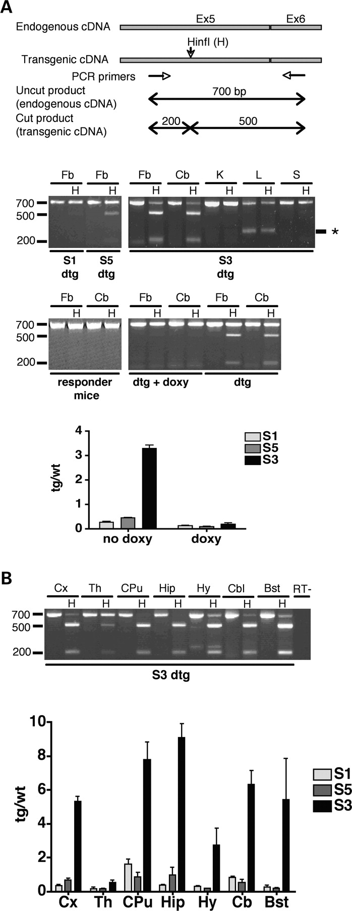
Figure 3. Transgene expression analysis. (A) Endogenous and transgenic Chrnb2 cDNA (700 bp PCR product) was amplified ...
Notes:
Figure 3. Transgene expression analysis. (A) Endogenous and transgenic Chrnb2 cDNA (700 bp PCR product) was amplified with primers on exons 5 and 6. With a subsequent digestion with HinfI enzyme, specific for the transgene, the uncut product derived from endogenous gene amplification (700 bp) could be distinguished on electrophoresis gel from fragments derived from amplified and digested transgenic cDNA (500 and 200 bp). Each sample was loaded on gel as indigested PCR product and HinfI digested (H). S1, S5 and S3 double transgenic mice (dtg) expressed the mutated β2 subunit in neuronal tissues, while in the absence of tTA (responder mice and non neuronal tissues) the transgene was not expressed. Transgene expression was correctly silenced in dtg mice (n = 3 for each line) by administration of doxycycline (+doxy). S3 mice show the highest level of expression. * indicates an aspecific band at ≈250 bp, that appears stochastically. Histogram shows transgene level of expression normalized on endogenous’ in basal conditions and after doxy treatment (mean ± s.d., n = 3). Fb, forebrain; Cb, cerebellum; K, kidney; L, liver; S, spleen. (B) Transgene brain regional expression was assessed in S1, S5 and S3 mice. Gel loaded with S3 samples is shown. Transgene expression follows endogenous gene's expression pattern. S1, S5 and S3 mice express increasing levels of transgene, respectively, as shown in graph (mean ± s.d., n = 3). Cx, cortex; Th, thalamus; CPu, caudate-putamen; Hip, hippocampus; Hy, hypothalamus; Cb, cerebellum; Bst, brainstem.
Unless provided in the caption above, the following copyright applies to the content of this slide: © The Author 2009. Published by Oxford University Press. All rights reserved. For Permissions, please email: journals.permissions@oxfordjournals.org

Slide 4
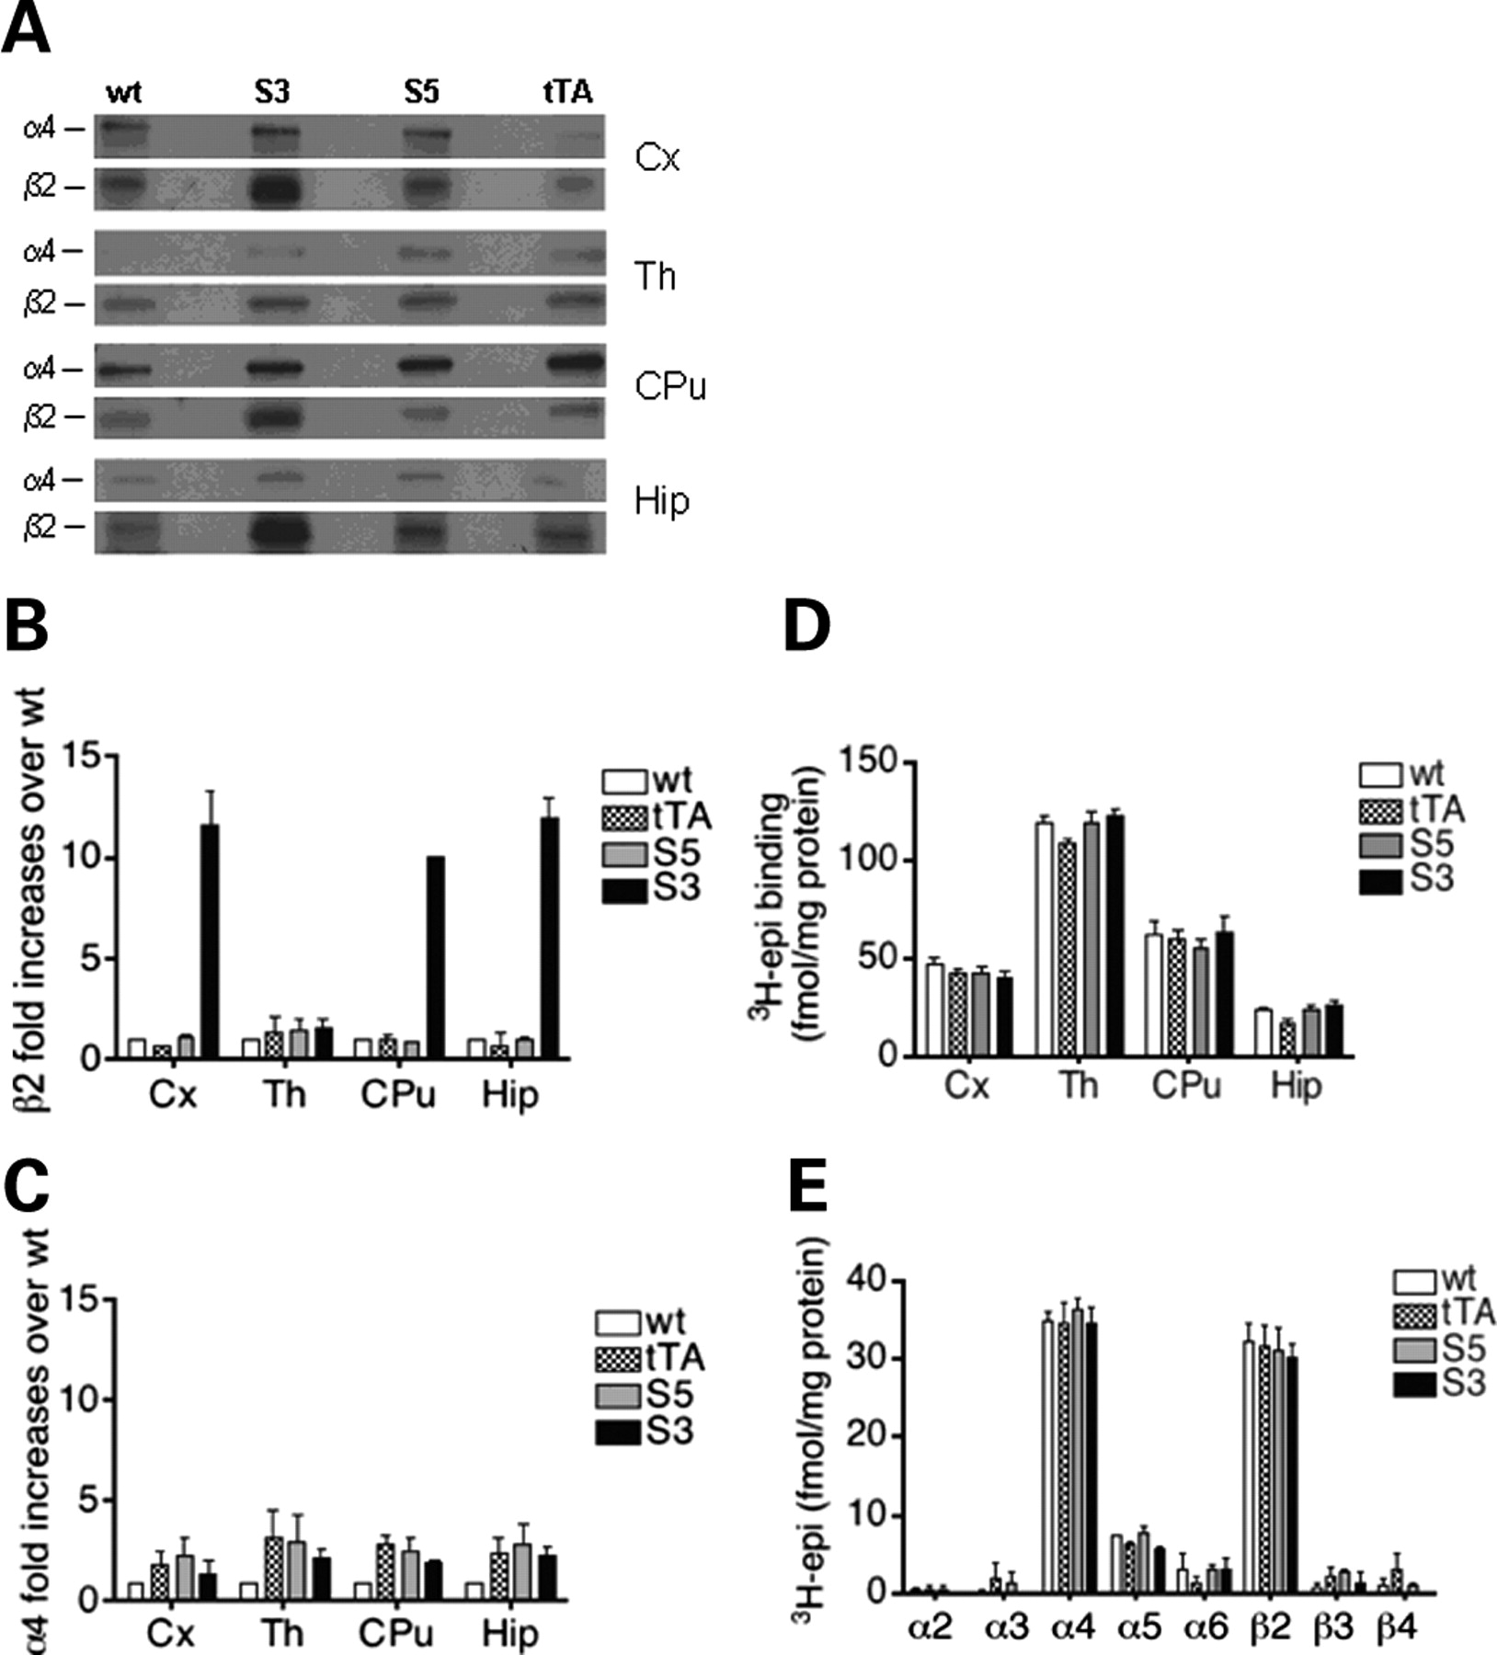
Figure 4. In vivo transgene expression. (A) Western blot analysis of β2 and α4 subunits level in cortex (Cx), thalamus ...
Notes:
Figure 4. In vivo transgene expression. (A) Western blot analysis of β2 and α4 subunits level in cortex (Cx), thalamus (Th), caudate-putamen (CPu) and hippocampus (Hip) for each genotype. Quantification of β2 (B) and α4 (C) subunit protein expression in wild-type, tTA, S3 and S5 lines. (mean values ± s.e.m.). Data are expressed as fold increase of optical density relative to wild-type. Higher expression of β2 subunit was observed in cortex, hippocampus and caudate-putamen of S3 mice, but not in thalamus, as expected on the basis of RT–PCR. No significant increase in α4 subunit level was observed in mutant mice compared to controls. (D) Receptor binding analysis by 3H-epibatidine (3H-epi) to detect β2 containing nAChR subtypes. Values are expressed as fmol of specific labeled 3H-epi binding sites per mg of protein, and are the mean values ± s.e.m. of four experiments performed in triplicate for the different genotypes. No significant differences in the total number of nicotinic receptors were found. (E) 3H-epi-labeled nAChRs were immunoprecipitated from cortical membranes with specific α2, α3, α4, α5, α6, β2, β3, β4 antibodies. Results are expressed as fmol of 3H-epi-labeled receptors per mg of protein, and are the mean values ± s.e.m. of three experiments performed in duplicate for the different genotypes. No significant differences in nAChR subtypes composition were found.
Unless provided in the caption above, the following copyright applies to the content of this slide: © The Author 2009. Published by Oxford University Press. All rights reserved. For Permissions, please email: journals.permissions@oxfordjournals.org

Slide 5
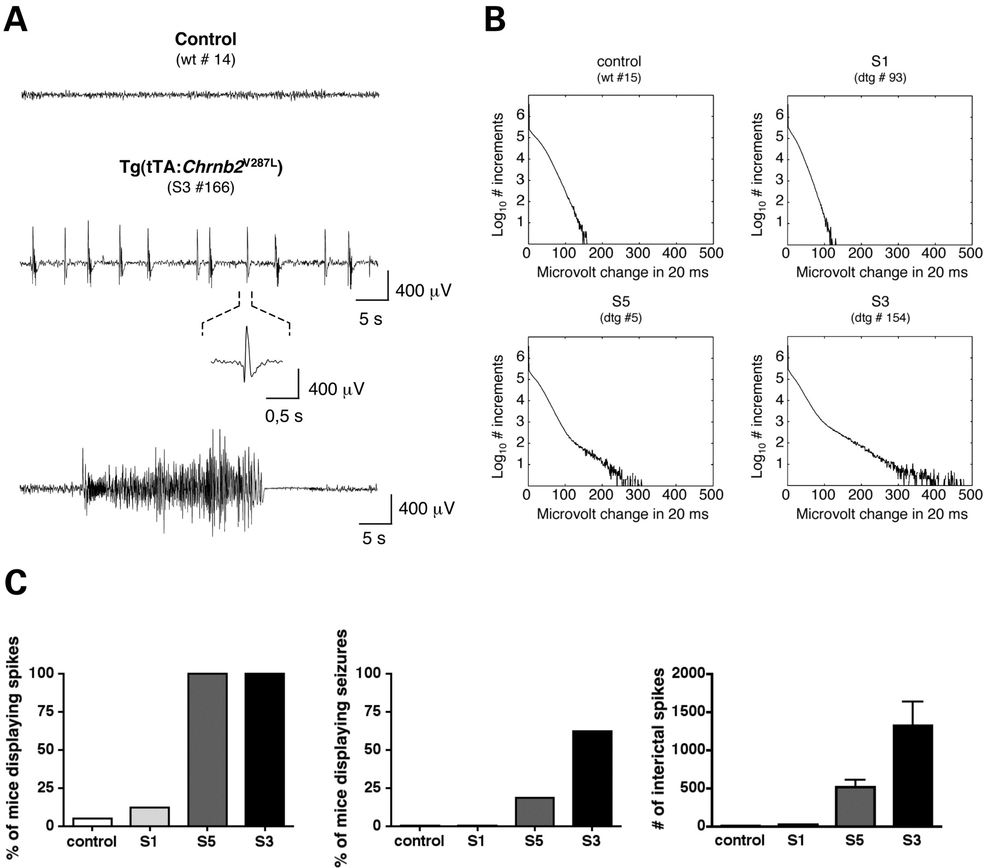
Figure 5. EEG basal recordings. (A) 1 min of EEG traces from control and S3 transgenic mice is shown. Transgenic mice ...
Notes:
Figure 5. EEG basal recordings. (A) 1 min of EEG traces from control and S3 transgenic mice is shown. Transgenic mice of S5 and S3 lines display abnormal EEG with frequent spikes of high amplitude and spontaneous seizures. (B) Increments detected by unsupervised algorithm during every 24 h recording were plotted in histograms of rectified increments amplitude on a log scale (see Materials and Methods). Here are shown representative histograms derived from 24 h recordings of a mouse baseline EEG for each genotype. In control and S1 mice that do not display EEG abnormalities, the histogram falls off logarithmically with amplitude. In S5 and S3 mice frequent interictal spikes and seizures produce an excess of high amplitude fast EEG increments, thus the histogram decays slower; in a log-linear plot it deviates from the exponential distribution. Values outside the exponential distribution expected for normal EEG were identified as spikes. (C) Severity of the phenotype displays apparent gene-dosage dependence. Left histogram shows the percentage of mice displaying interictal spikes; the middle histogram shows the percentage of mice displaying complex seizures; right histogram shows mean ± s.e.m. of the number of interictal spikes counted for each animal in 24 h recordings. S3 mice show the most severe phenotype, displaying frequently seizures during 24 h recording and a higher number of interictal spikes.
Unless provided in the caption above, the following copyright applies to the content of this slide: © The Author 2009. Published by Oxford University Press. All rights reserved. For Permissions, please email: journals.permissions@oxfordjournals.org

Slide 6
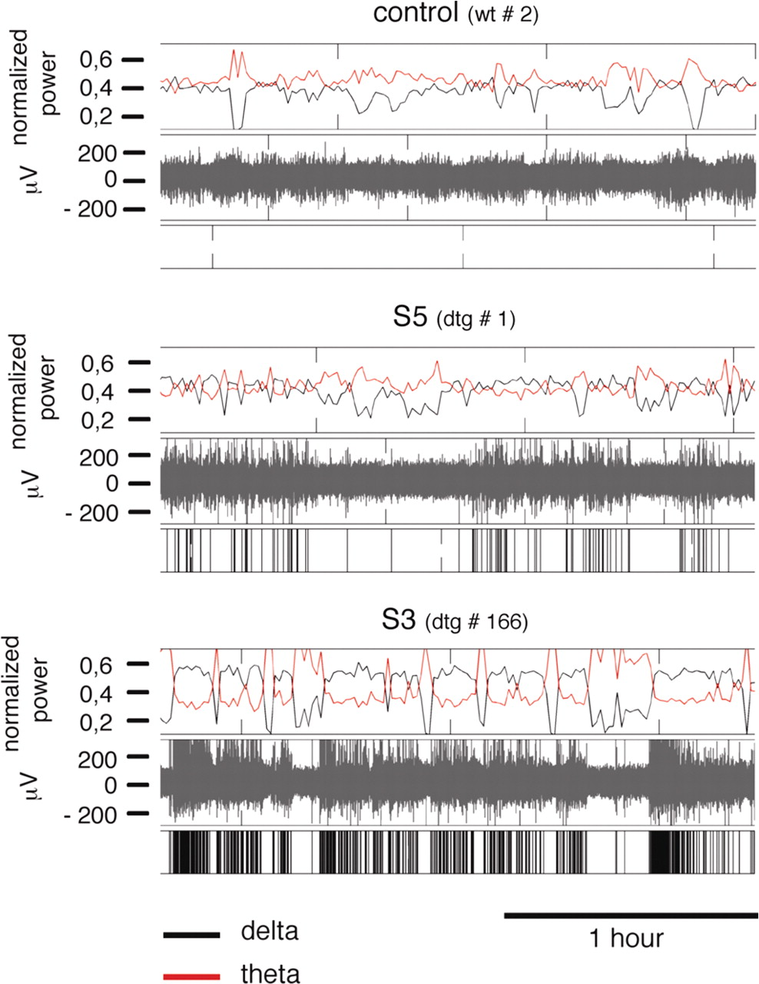
Figure 6. Spectral analysis of EEG recordings. About 2 h of typical EEG recordings from control, S5 and S3 mice are ...
Notes:
Figure 6. Spectral analysis of EEG recordings. About 2 h of typical EEG recordings from control, S5 and S3 mice are shown with relative spectral analysis. The upper box represents the contribution of delta (black line) and theta (red line) waves, as percentage on the total spectrum, sampled every minute; in the middle box is shown the EEG trace; on the bottom, bars represent spikes and seizures detected automatically. While control mice usually show a predominant theta activity during the 24 h of recording, transgenic mice show a higher delta rhythm. The vast majority of epileptic events occur during epochs of increased delta rhythm.
Unless provided in the caption above, the following copyright applies to the content of this slide: © The Author 2009. Published by Oxford University Press. All rights reserved. For Permissions, please email: journals.permissions@oxfordjournals.org

Slide 7
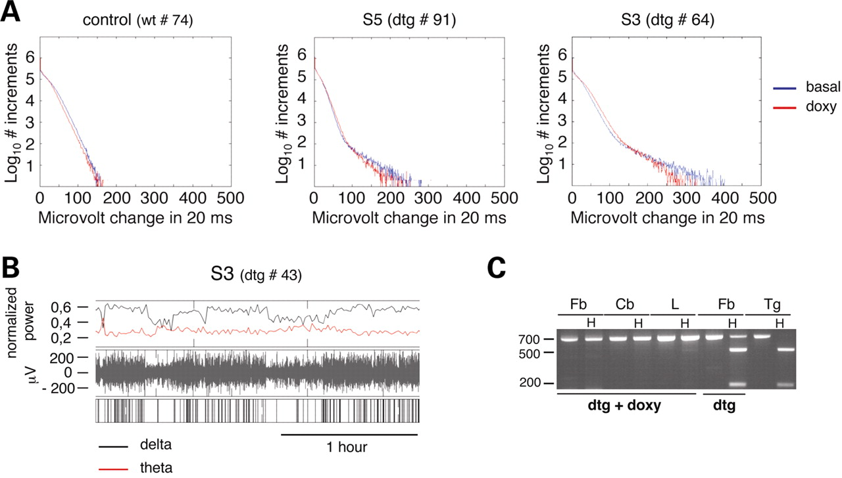
Figure 7. Chrnb2^{V287L} transgene silencing is not sufficient to revert the epileptic phenotype. Complete ...
Notes:
Figure 7. Chrnb2V287L transgene silencing is not sufficient to revert the epileptic phenotype. Complete silencing of transgene expression by doxycycline administration (1 mg/ml in drinking water for 1–3 weeks) in adult S5 (n = 5) and S3 (n = 7) mice was not sufficient to revert the epileptic phenotype. High amplitude spikes and seizures, here shown as histogram deviating from the exponential distribution, were still present in treated adult mice (A). Spectral analysis revealed an increased delta rhythm associated with epileptic events (B). Confirmation of complete silencing by RT–PCR after recordings is shown in (C) (dtg+doxy); RT–PCR on RNA from untreated mice (dtg) was loaded as comparison.
Unless provided in the caption above, the following copyright applies to the content of this slide: © The Author 2009. Published by Oxford University Press. All rights reserved. For Permissions, please email: journals.permissions@oxfordjournals.org

Slide 8
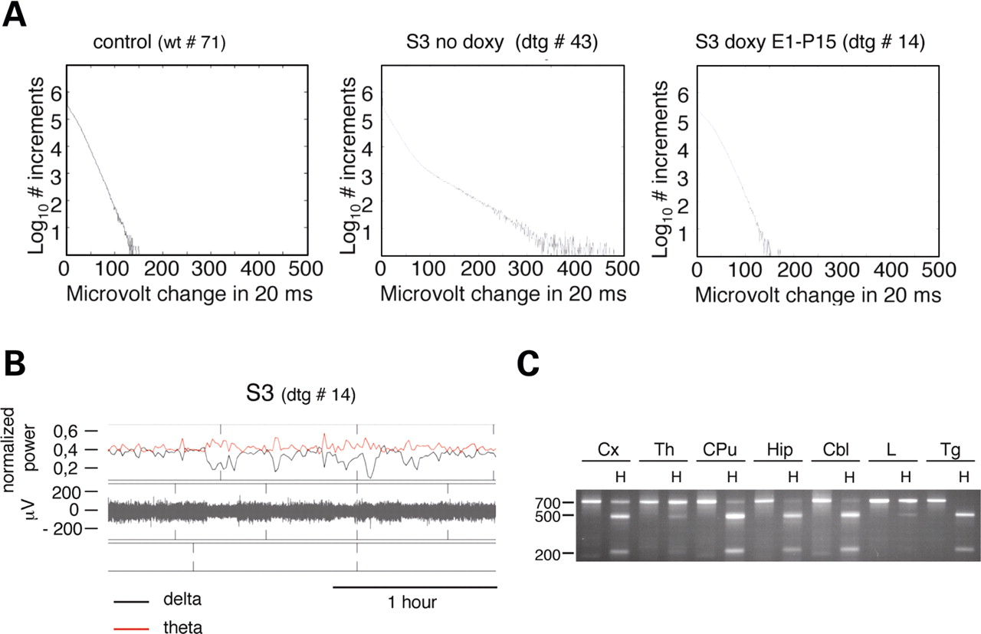
Figure 8. Embryonal Chrnb2^{V287L} transgene silencing inhibits the development of epilepsy. (A) No epileptic ...
Notes:
Figure 8. Embryonal Chrnb2V287L transgene silencing inhibits the development of epilepsy. (A) No epileptic events were detected in 4 months aged mice (n = 4) in which transgene expression was silenced during development (S3 doxy E1–P15). Typical histograms of a control mouse and S3 mouse never treated with doxycycline (S3 no doxy) are shown as comparison. Traces of mice treated with doxycycline during development events were completely comparable to control mice traces, showing also a prevalent theta rhythm (B). Correct switch on of the transgene was verified by RT–PCR after recording (C).
Unless provided in the caption above, the following copyright applies to the content of this slide: © The Author 2009. Published by Oxford University Press. All rights reserved. For Permissions, please email: journals.permissions@oxfordjournals.org

